Slide 1
Coastal Hazards: Hurricanes

Slide 2
Homework Questions
Would you live in an area at risk for hurricanes? If so, where?
What level of risk from hurricanes is acceptable to you? (How would you know if the risk was assessed accurately?)
What should be done by people and communities in hurricane prone areas to prepare for the hazard and prevent catastrophe?

Slide 3
Questions to Consider
What factors influence the impact of hurricanes?
How do coastal hazards vary from place to place? Why?
The five fundamental concepts from Ch. 1

Slide 4
The Coast
Over 50% of the Earth’s people live within 50 miles of a coast!
Typically susceptible to flooding
Impact of flooding
property damage
loss of life
saltwater intrusion

Slide 5
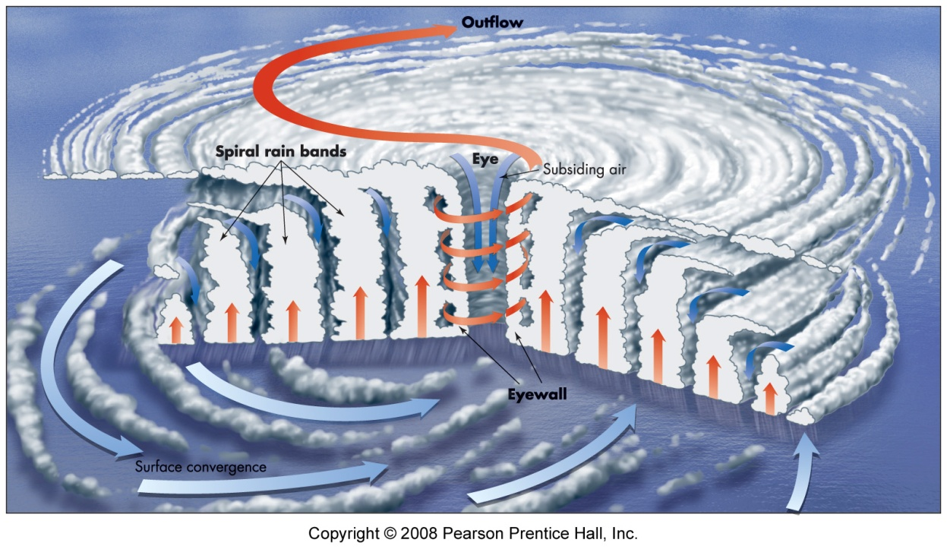
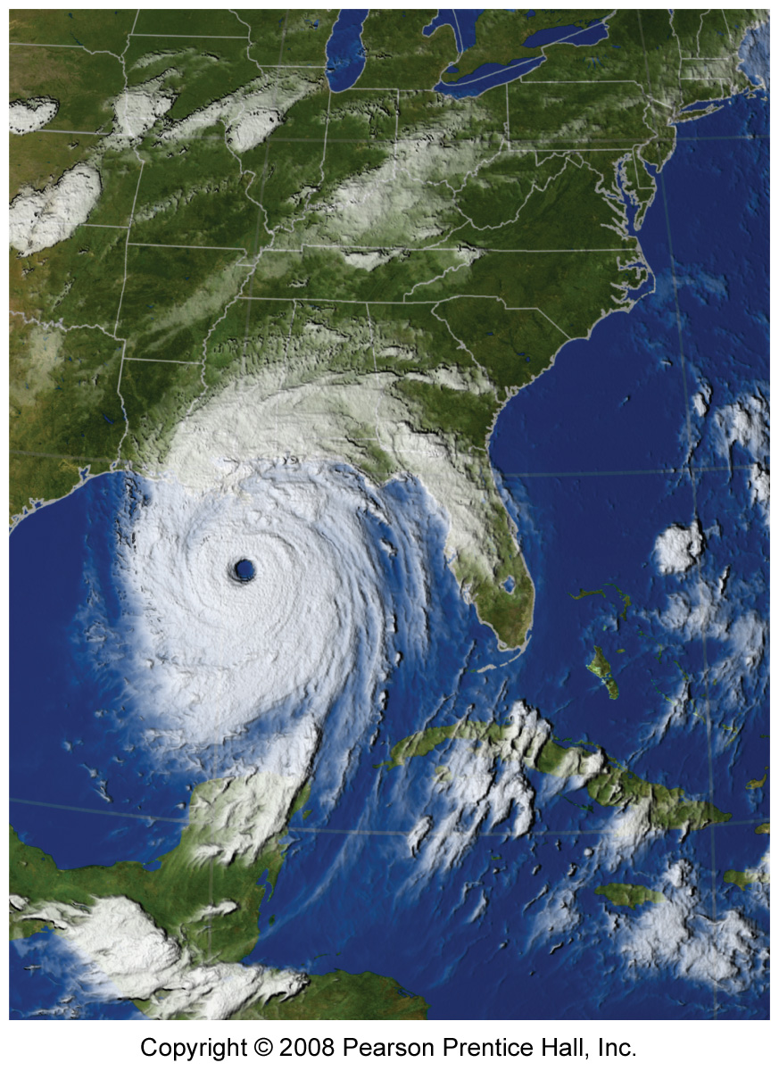
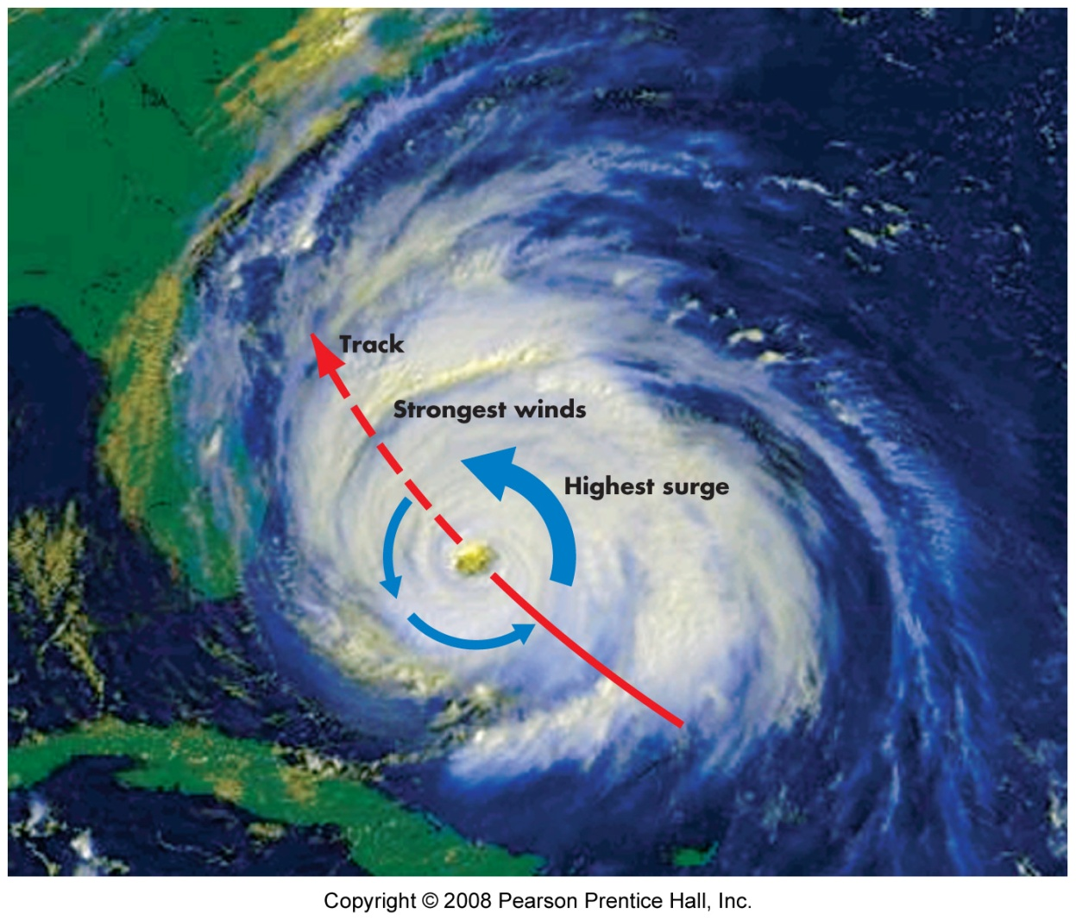
Hurricanes

Slide 6
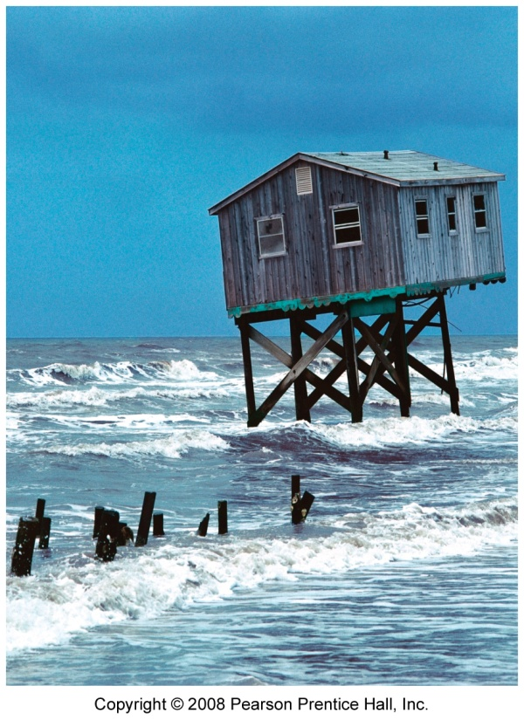
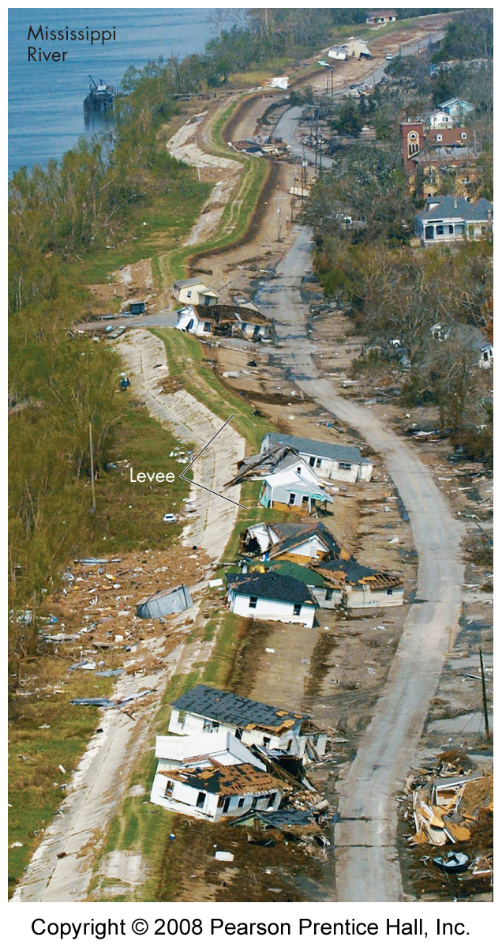
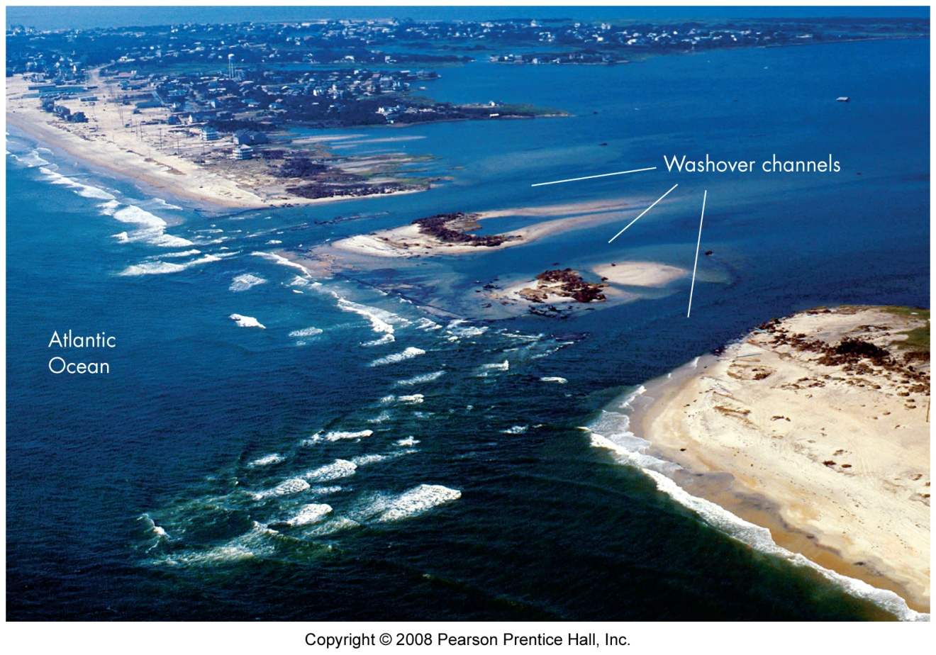
Hurricane Impact
High winds
Heavy rain
Storm surge

Slide 7
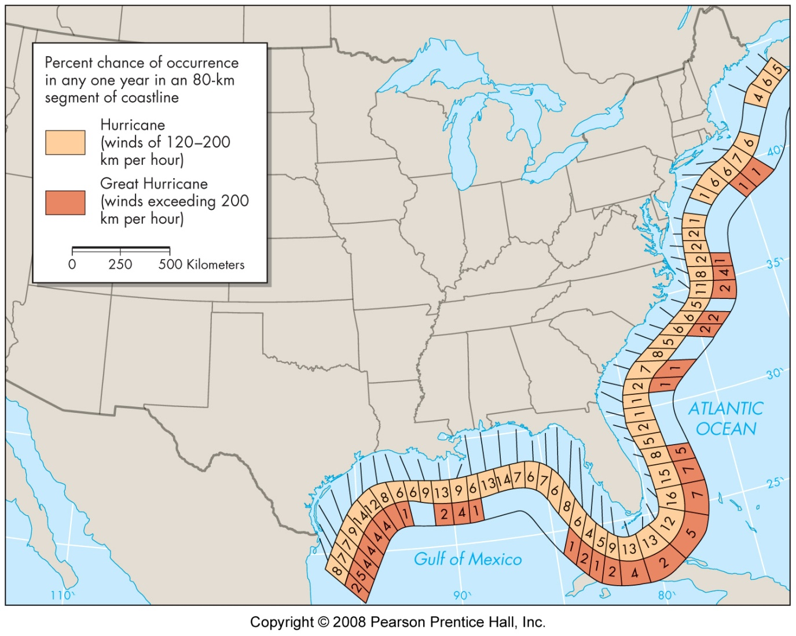
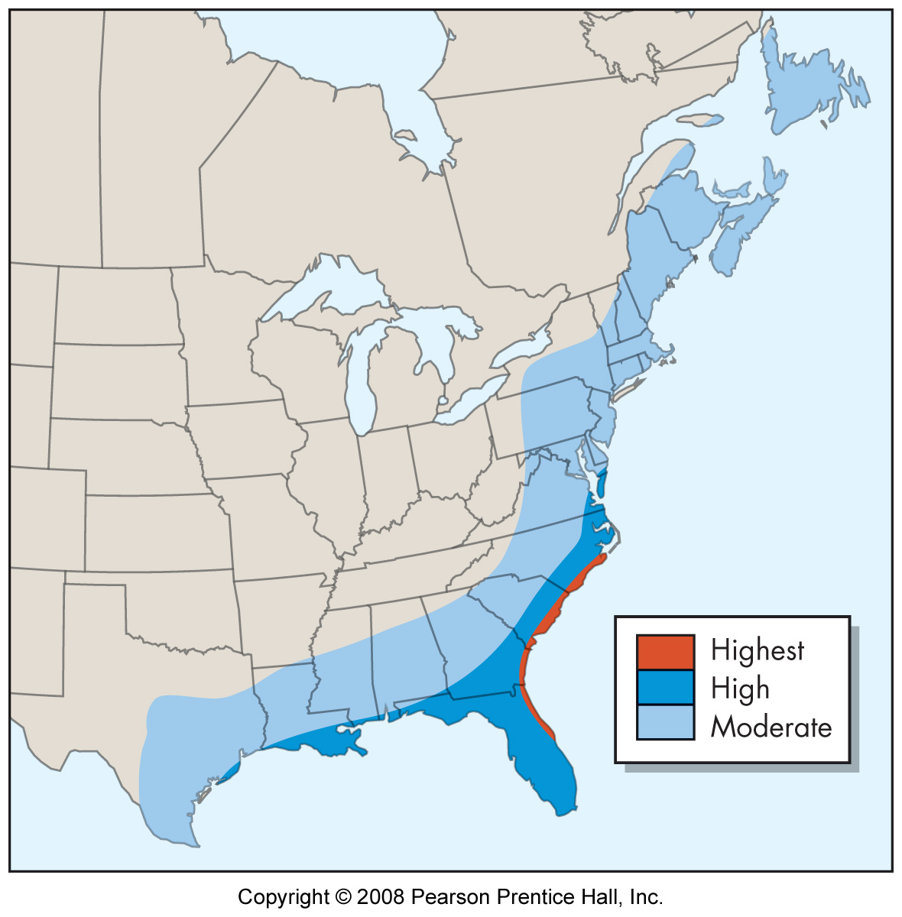
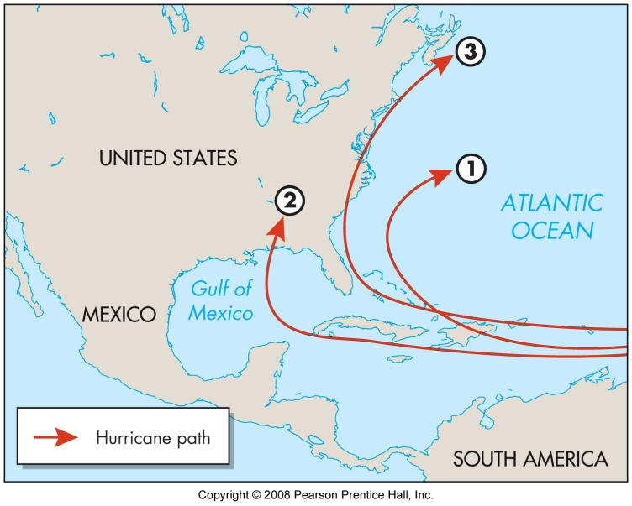
Hurricane Hazard

Slide 8
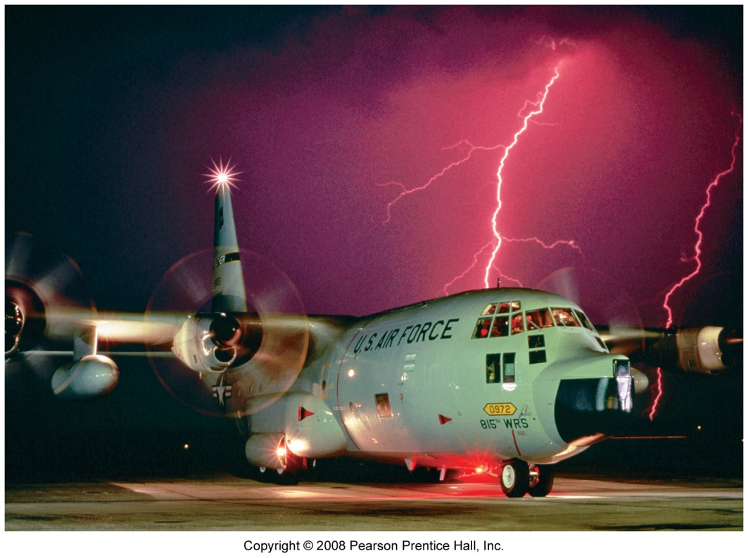
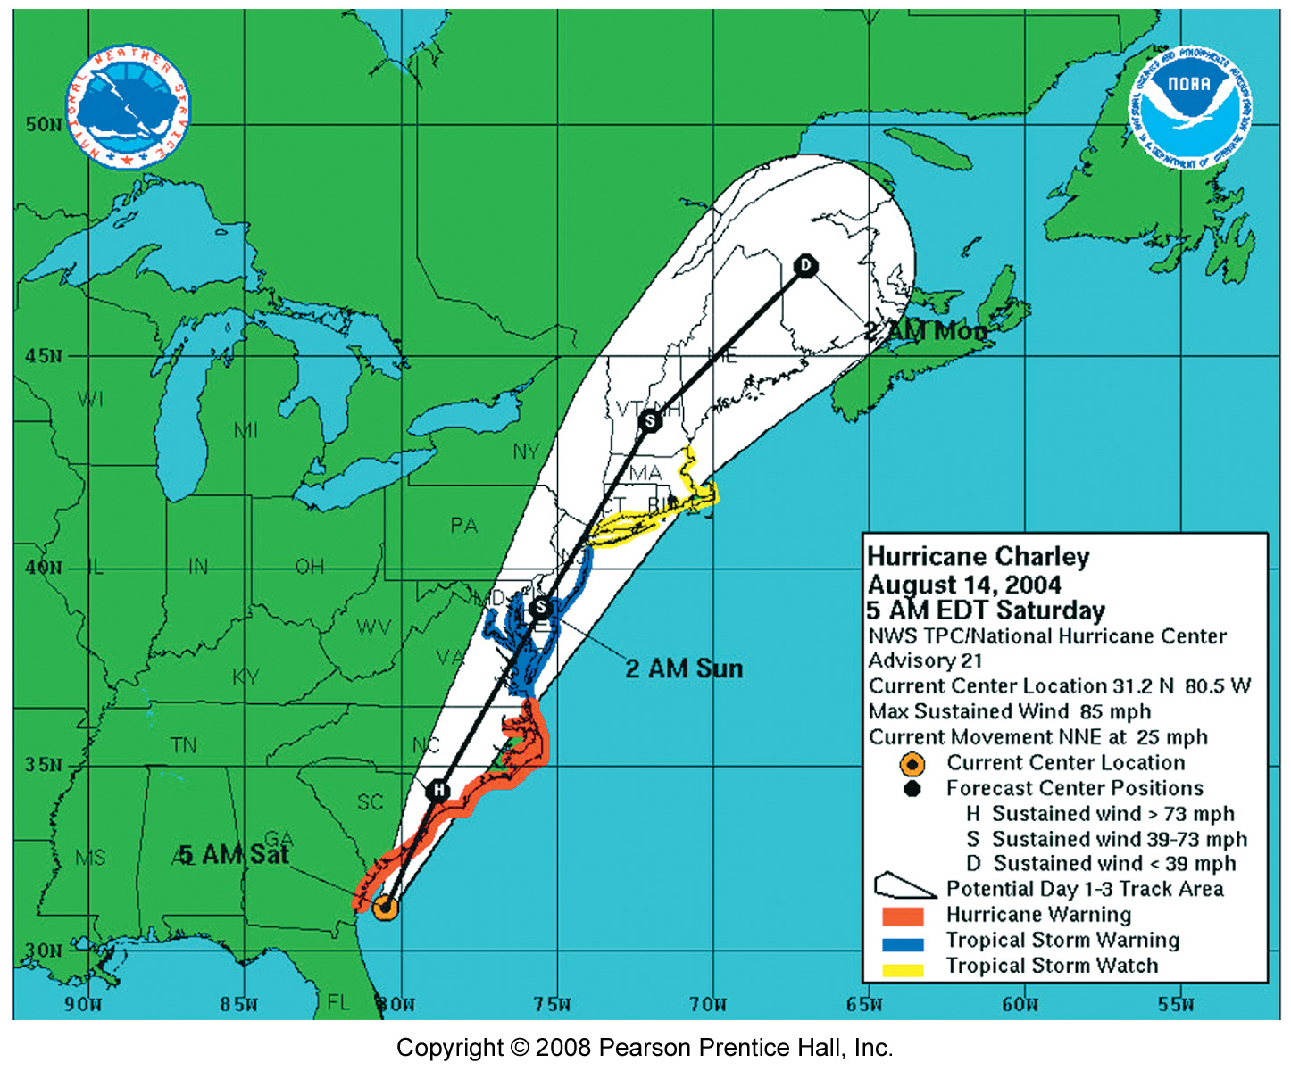
Hurricane Forecast

Slide 9
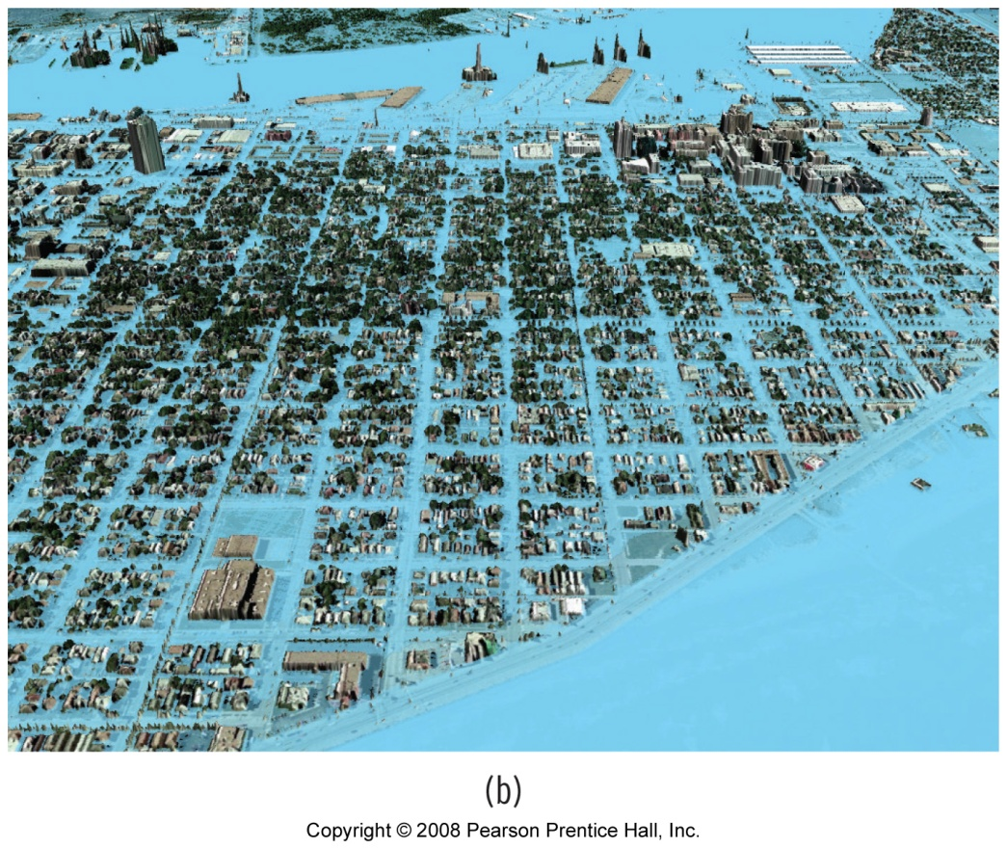
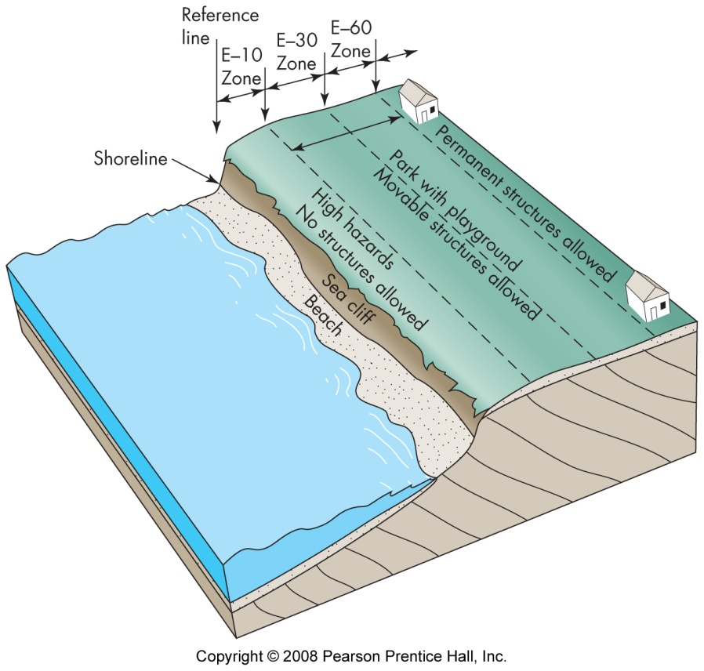
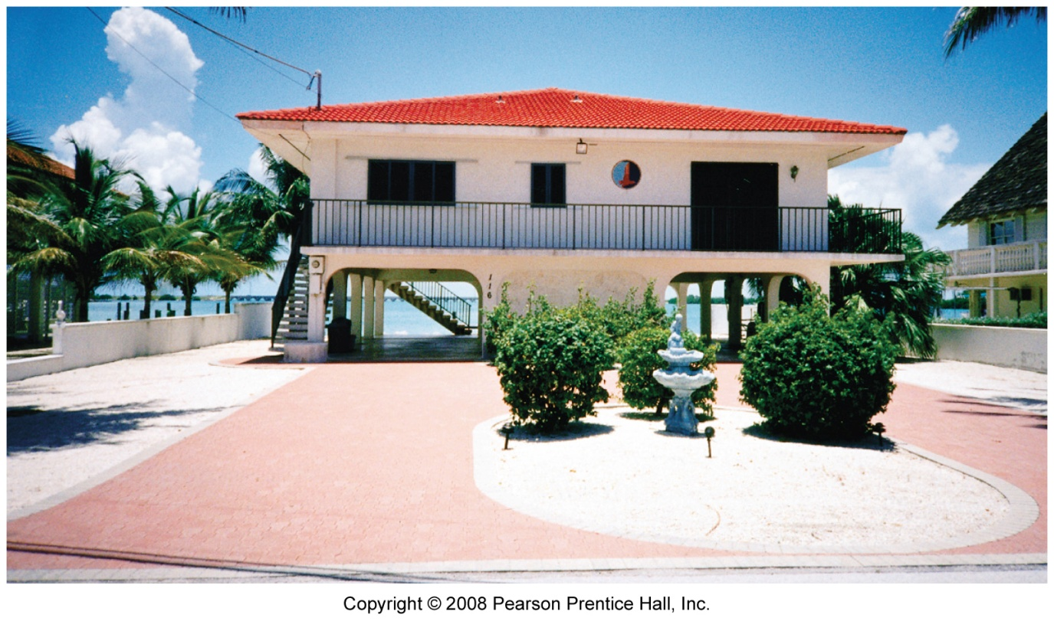
Coastal Preparation
Inundation simulation
Coastal zoning
Structural adjustments
Insurance
Barriers to flooding

