Slide 1
Coastal Hazards: Tsunamis

Slide 2
Homework Questions
Would you live in an area at risk for tsunamis? If so, where?
What level of risk from tsunamis is acceptable to you? (How would you know if the risk was assessed accurately?)
What should be done by people and communities in tsunami-prone areas to prepare for the hazard and prevent catastrophe?

Slide 3
Questions to Consider
What factors influence the impact of tsunamis?
How do coastal hazards vary from place to place? Why?
The five fundamental concepts from Ch. 1

Slide 4
The Coast
Over 50% of the Earth’s people live within 50 miles of a coast!
Typically susceptible to flooding
Impact of flooding
property damage
loss of life
saltwater intrusion

Slide 5
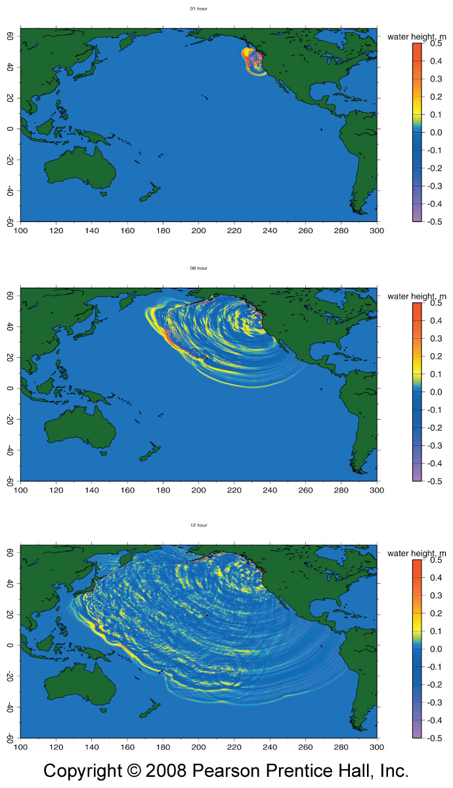
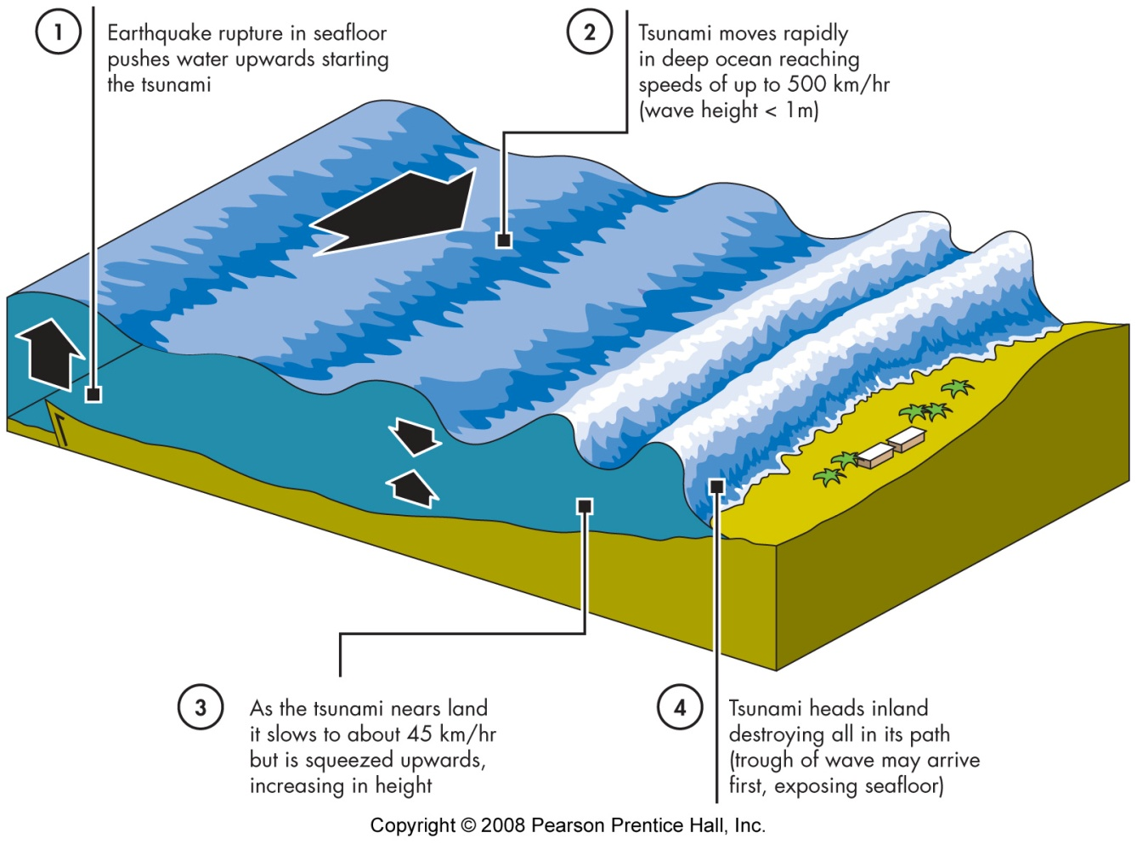
Tsunami Formation & Character

Slide 6
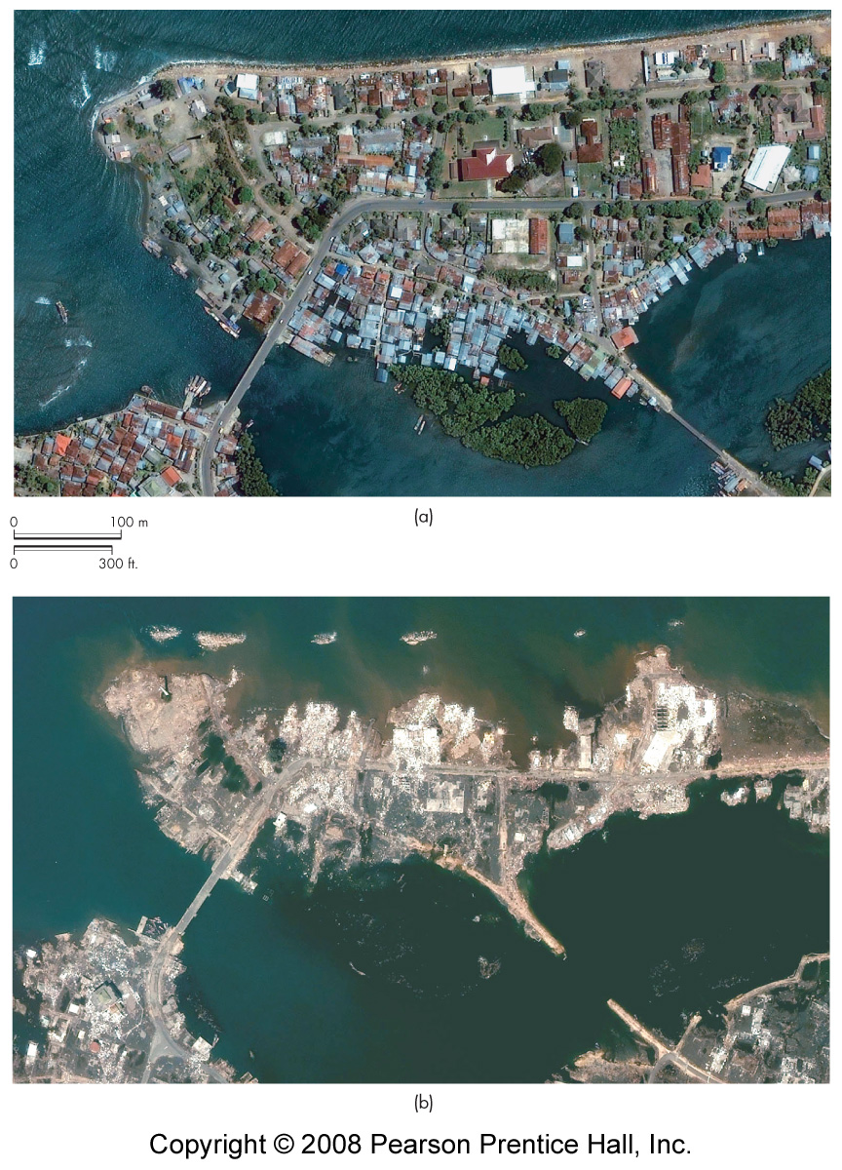
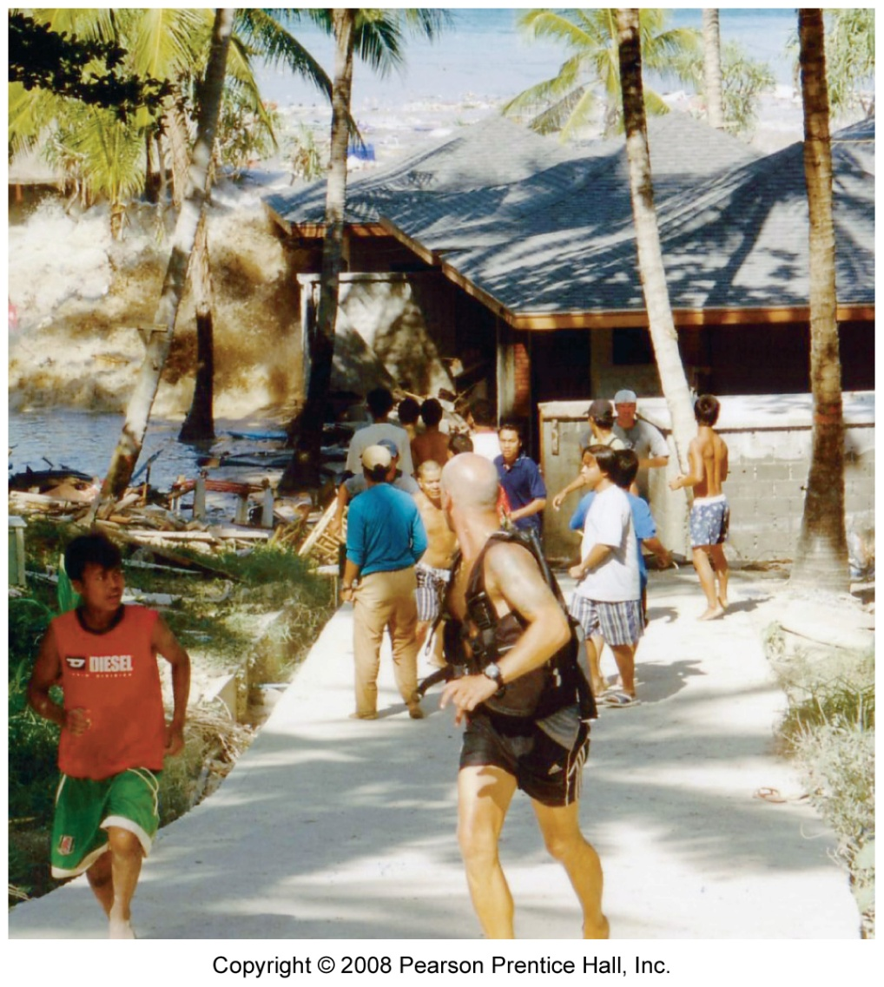
Tsunami Impact

Slide 7
Tsunami Response
Identify areas at risk
Warning system
earthquake monitoring
tsunami detection
Warning signs
earthquake
trough arrival

Slide 8
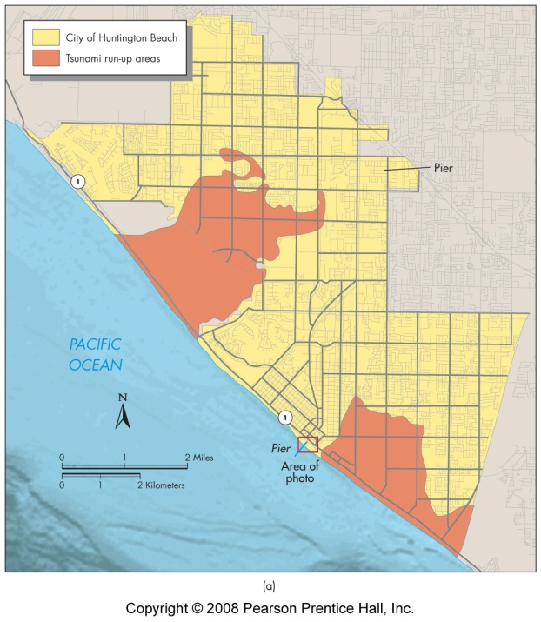
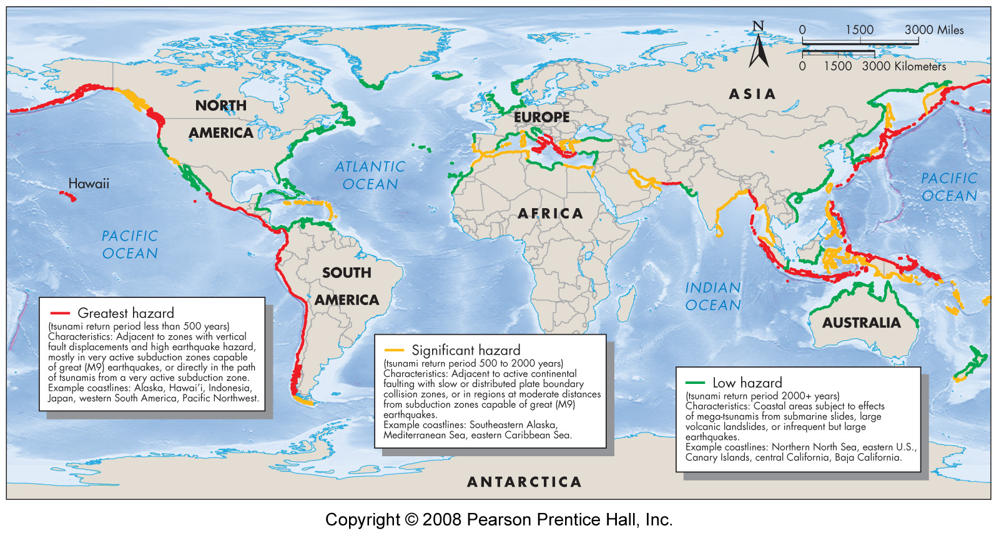
Tsunami Hazard

Slide 9
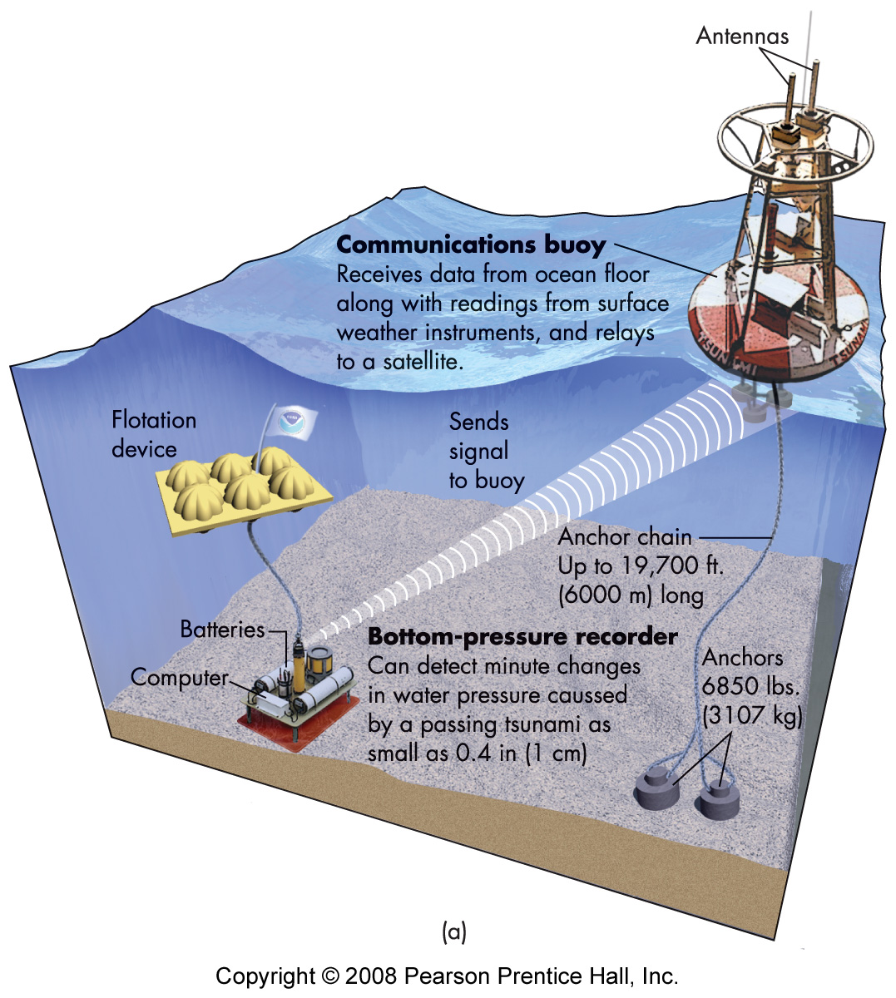
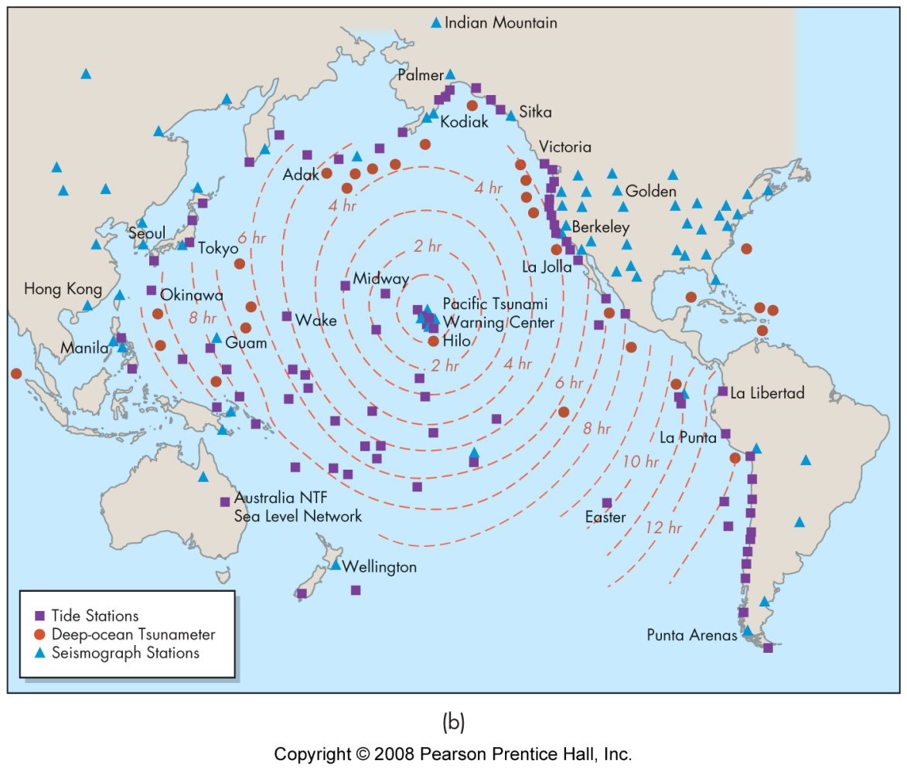
Tsunami Warning

Slide 10
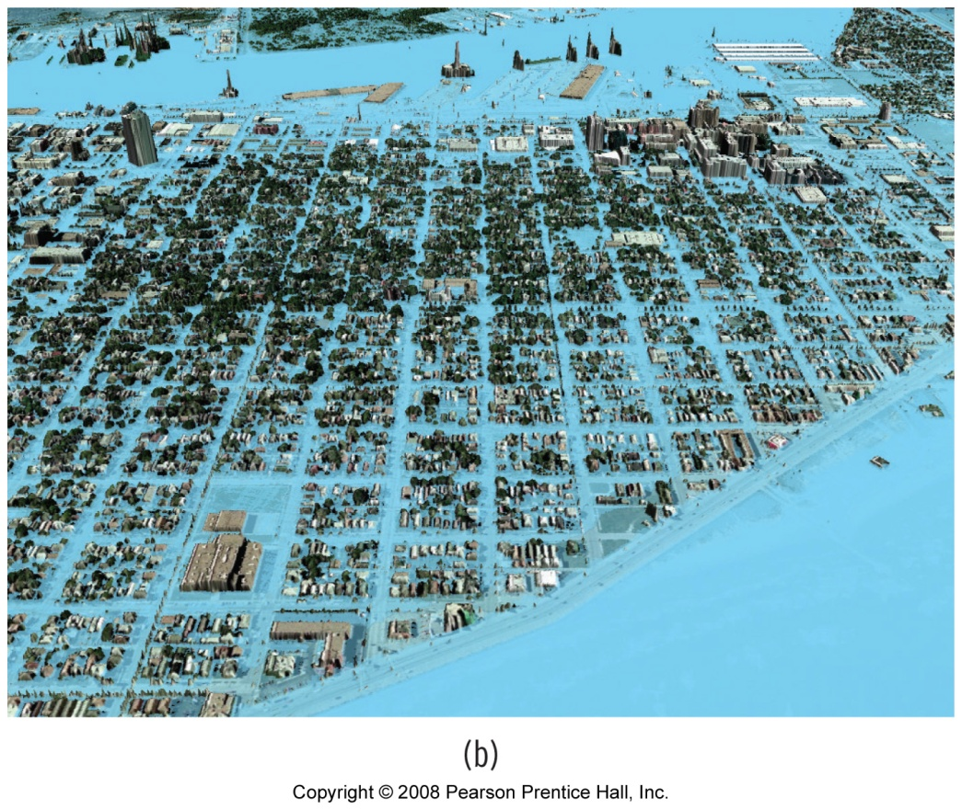
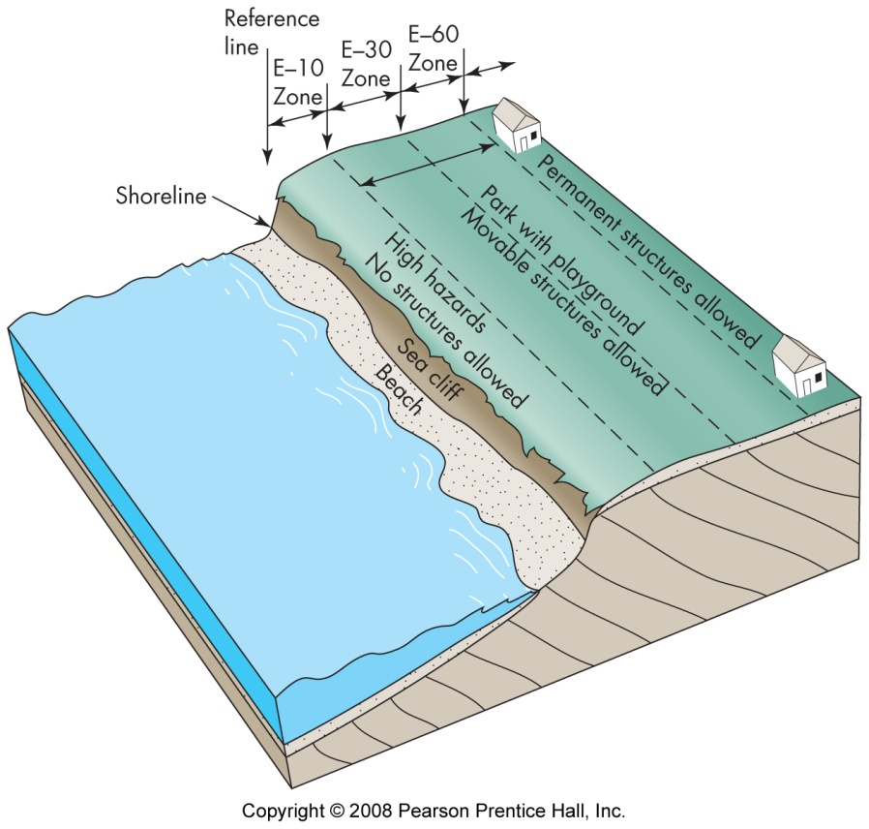
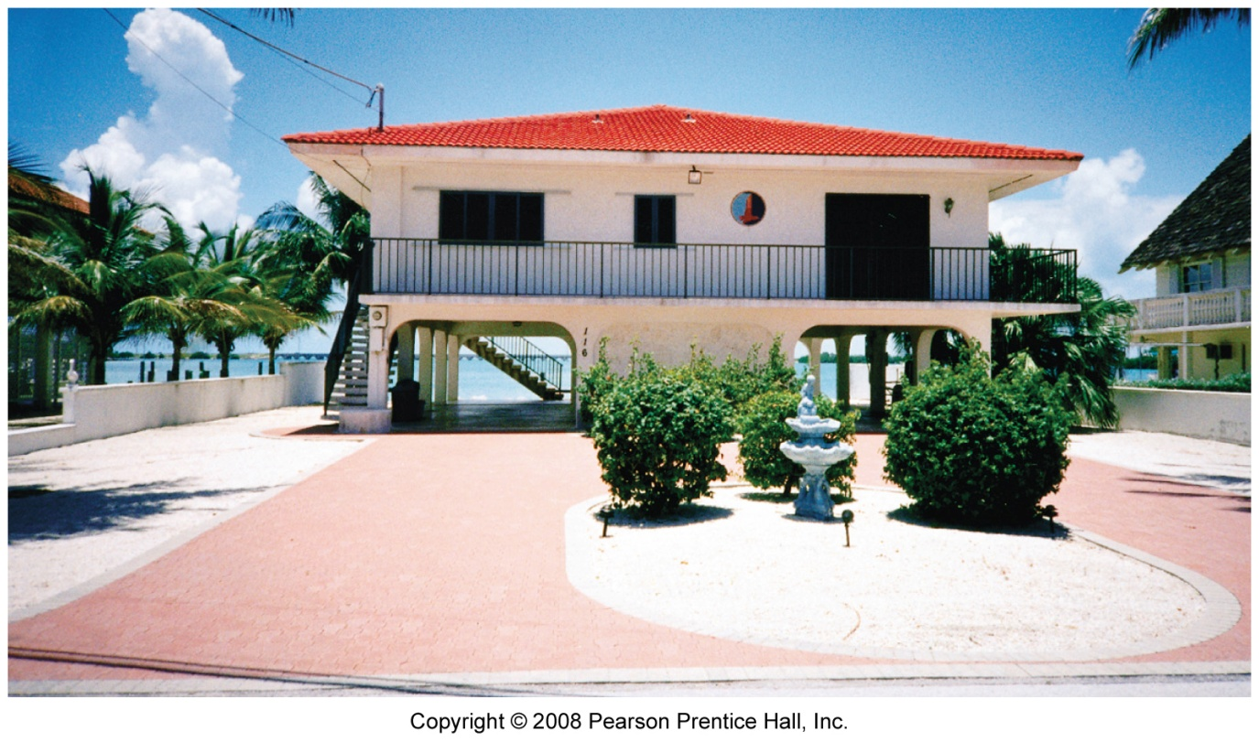
Coastal Preparation
Inundation simulation
Coastal zoning
Structural adjustments
Insurance
Barriers to flooding

