Slide 1
Mass Wasting
Week 6

Slide 2
Questions for Discussion
Would you live on a slope? If so, where?
What level of risk from mass wasting is acceptable to you? (How would you know if the slope risk was assessed accurately?)
What should be done by people and communities in areas prone to slope failure to prepare for the hazard and prevent catastrophe?

Slide 3
Other Questions to Consider
What factors impact the stability of a slope?
The five concepts form Chapter 1

Slide 4
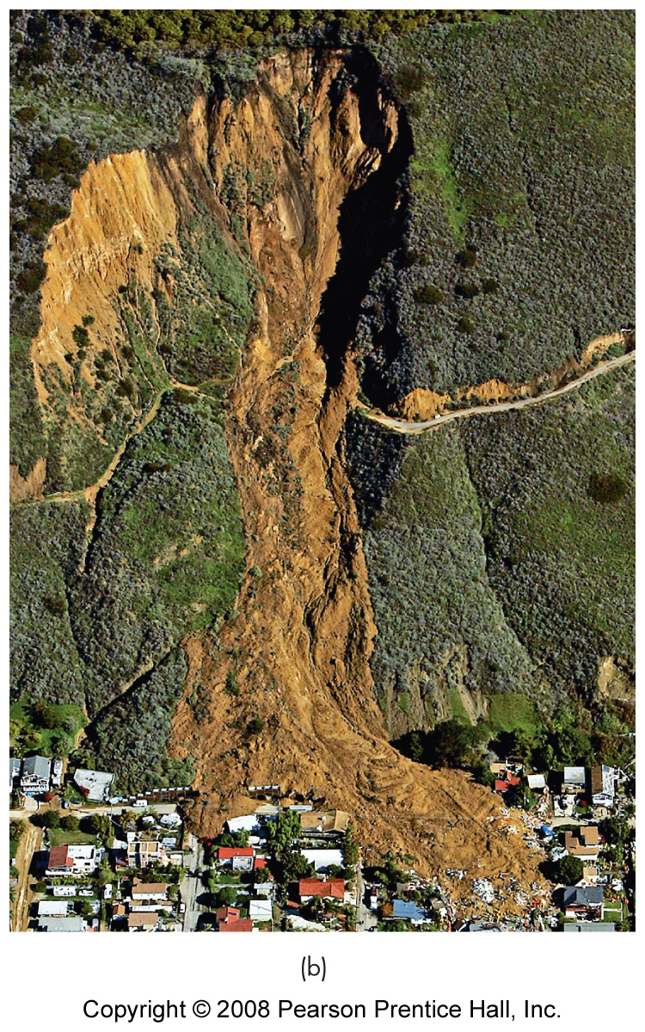
Mass Movements
Mass Wasting
Down slope movement of earth materials
Caused by gravity

Slide 5
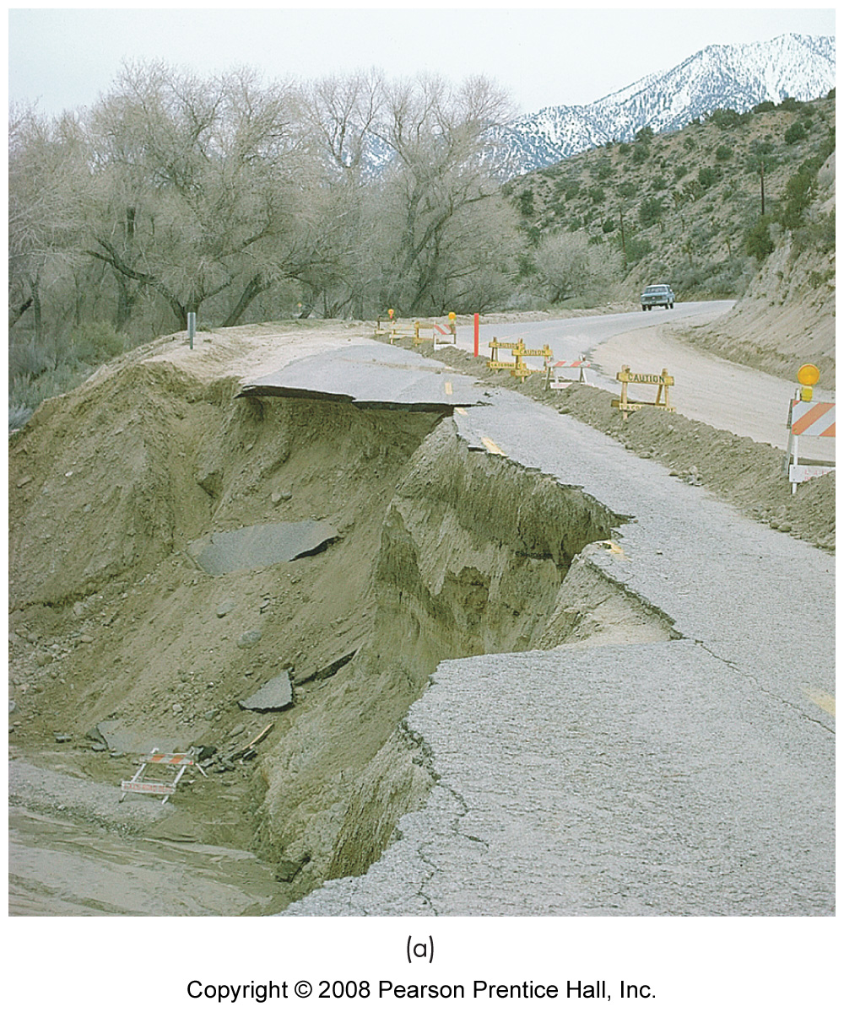
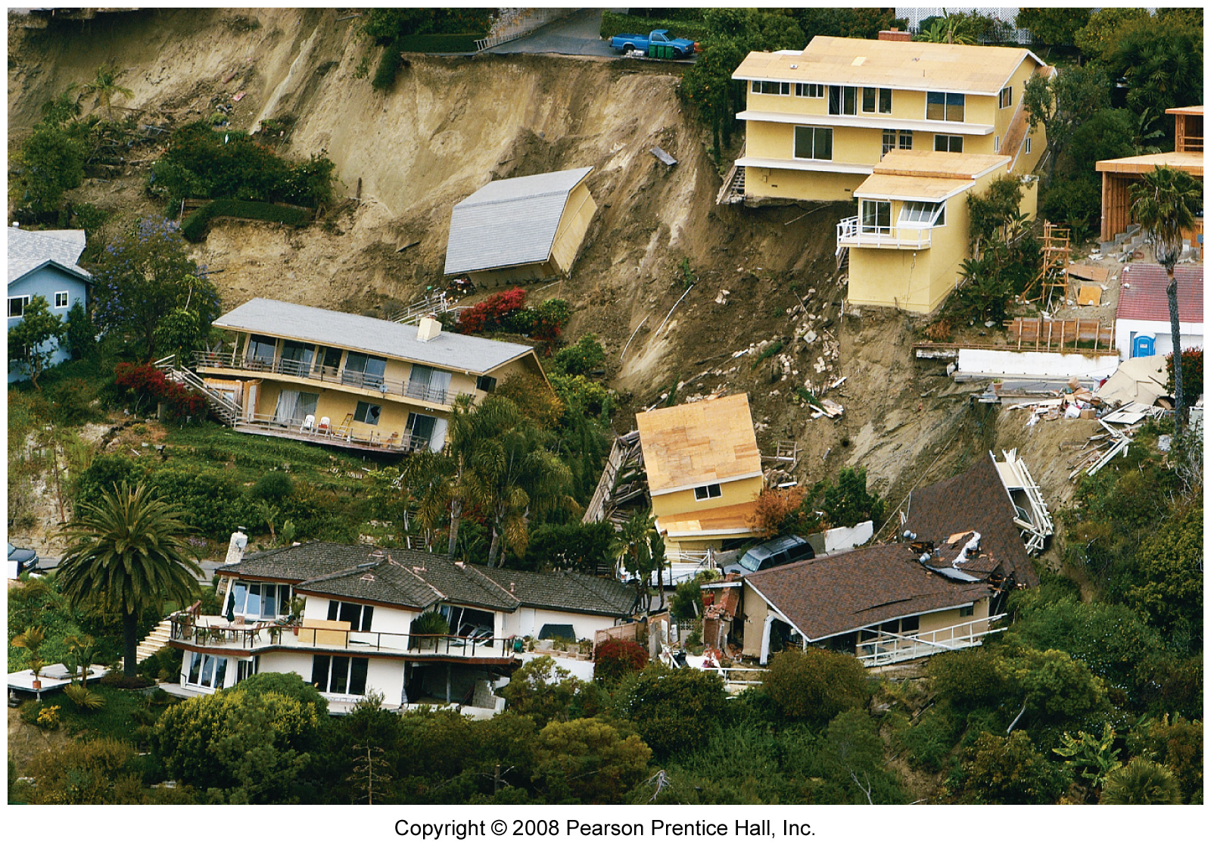
Impact of Mass Movements
Structural damage
Surface disruption

Slide 6
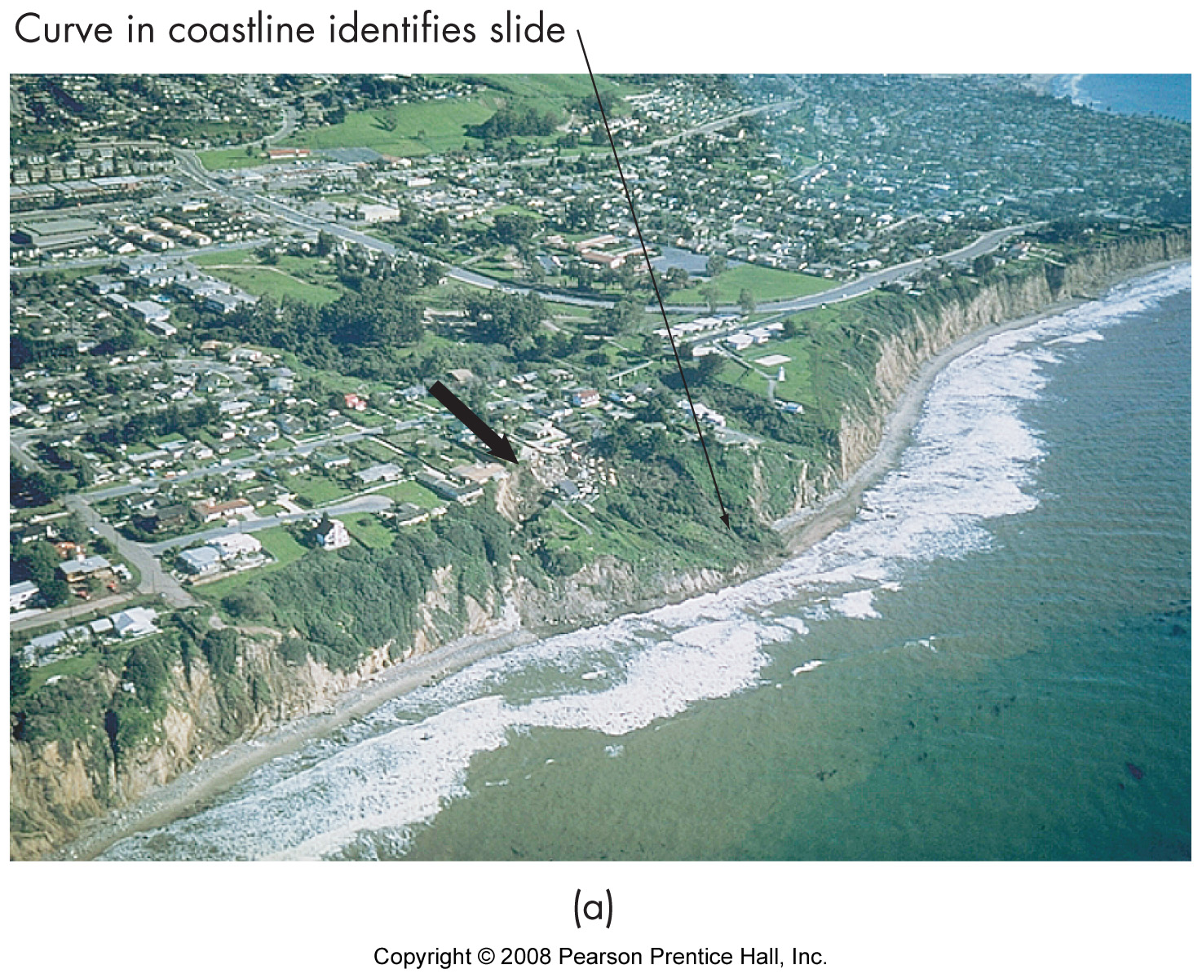
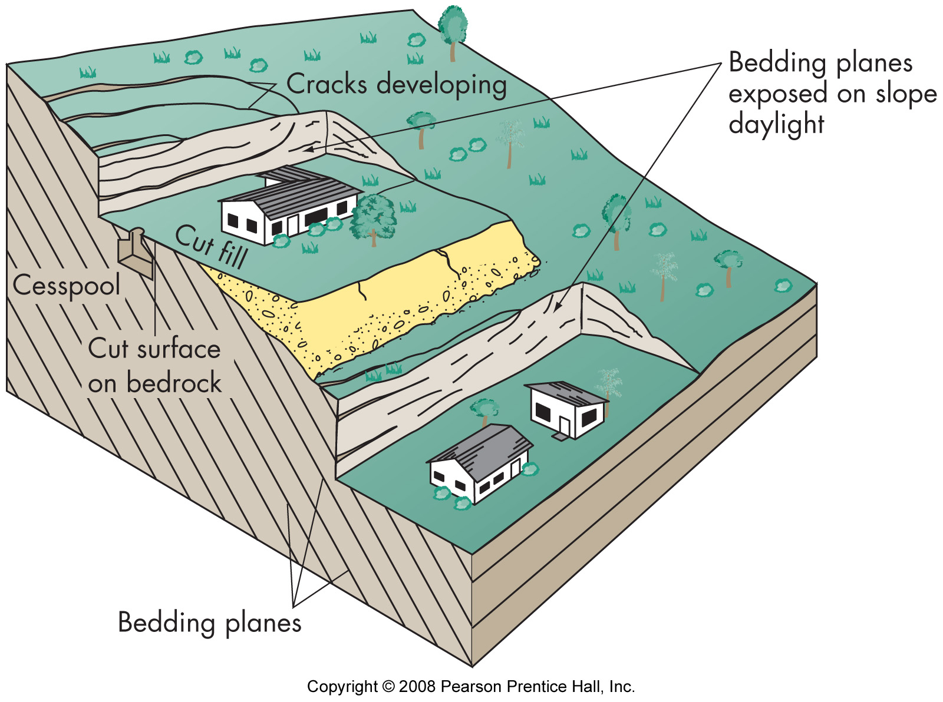
Slope Factors
Angle of slope
Water content
Material composition
Material orientation
Vegetation
Loading
Undercutting
Weathering of materials

Slide 7
Slope Movement Triggers
Rainfall
Vibration
Undermining
Loading

Slide 8
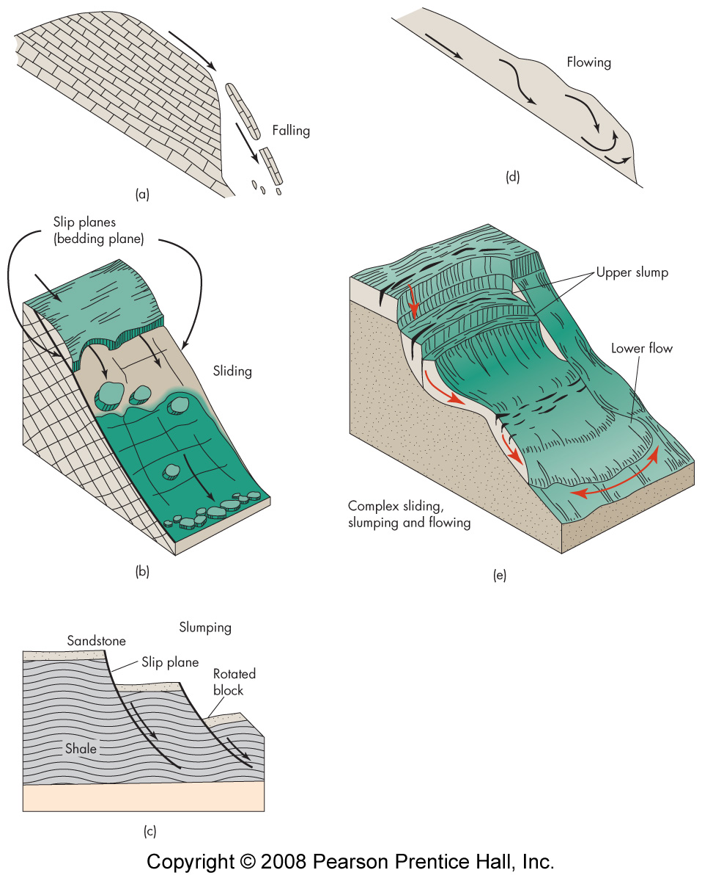
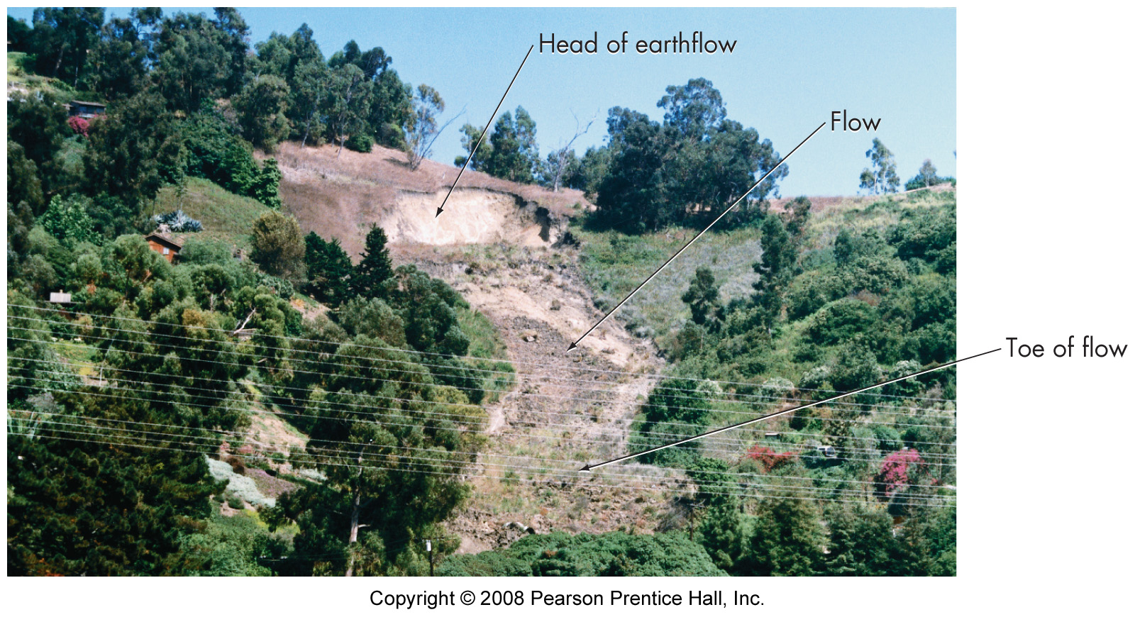
Types of Slope Failures
Slides
Flows
Falls
Creep
Avalanche

Slide 9
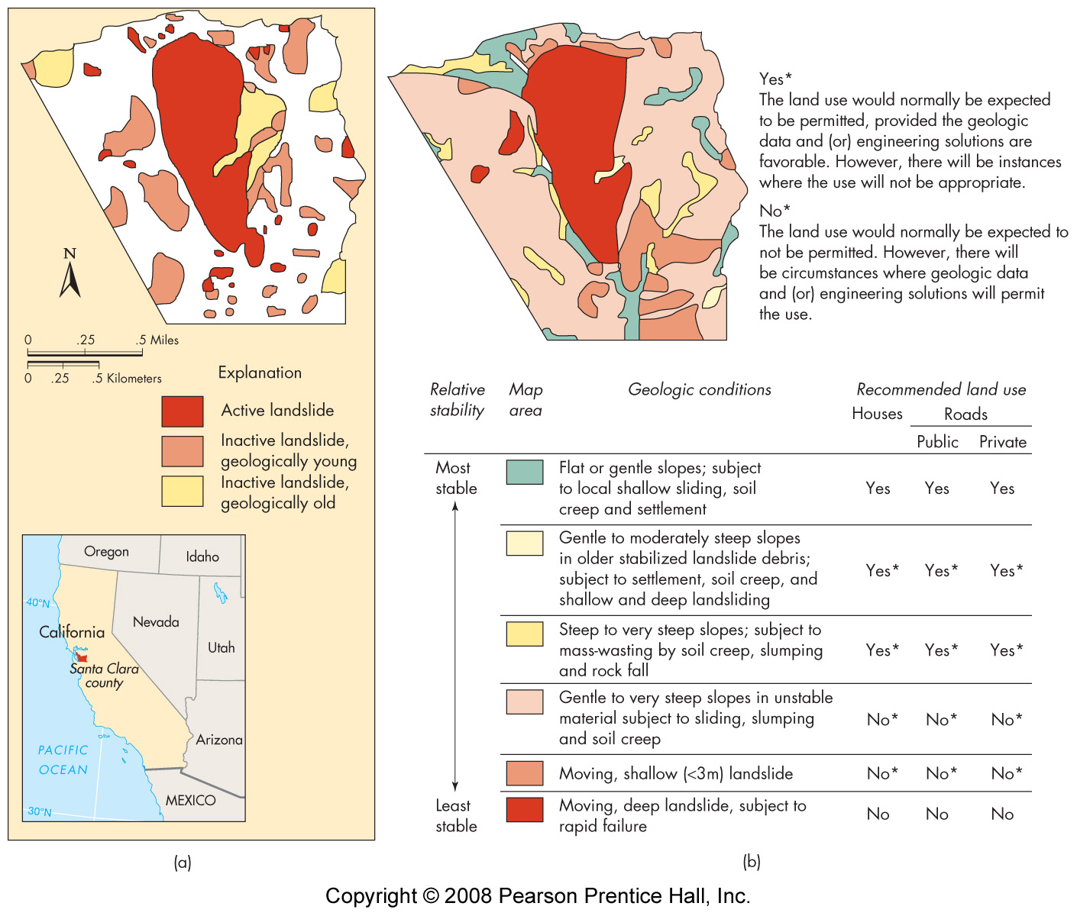
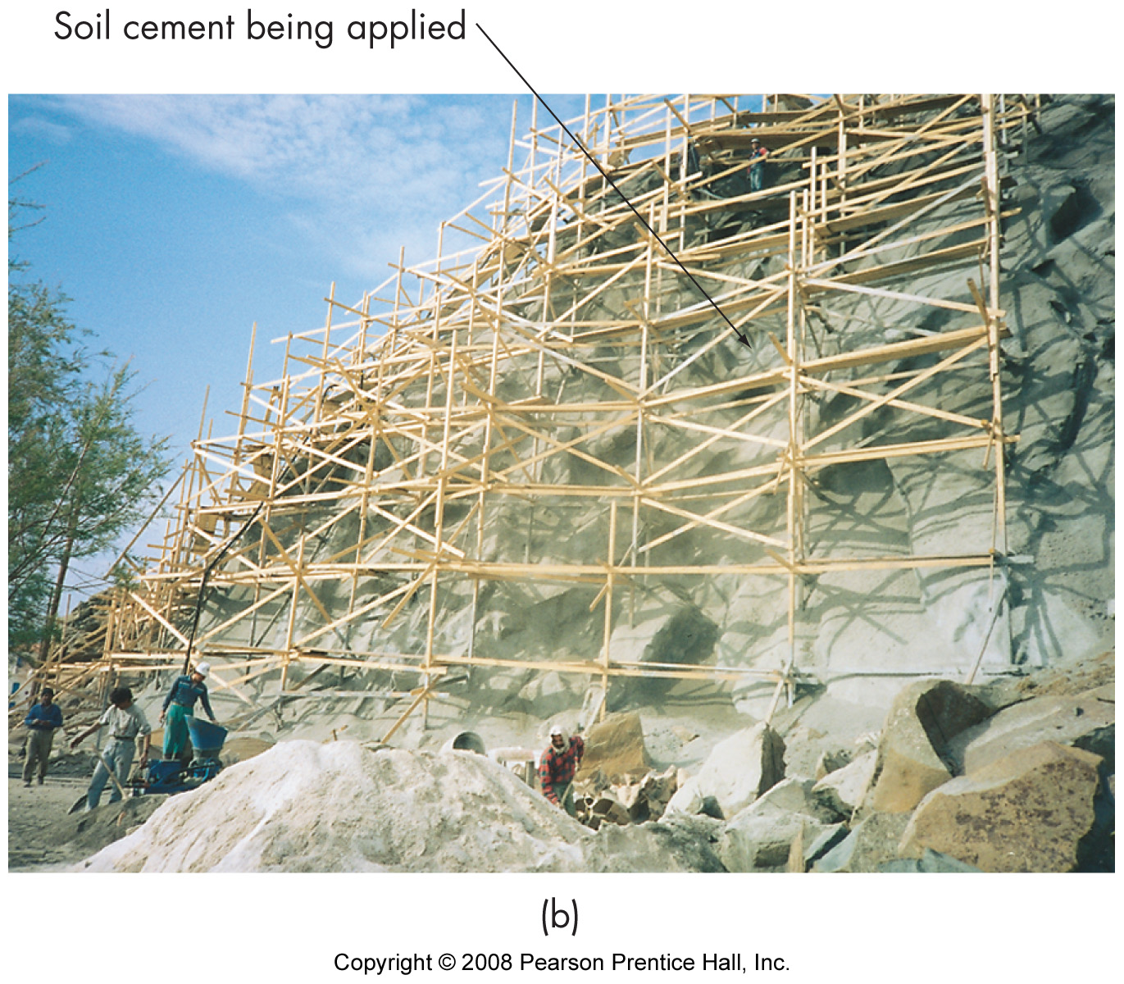
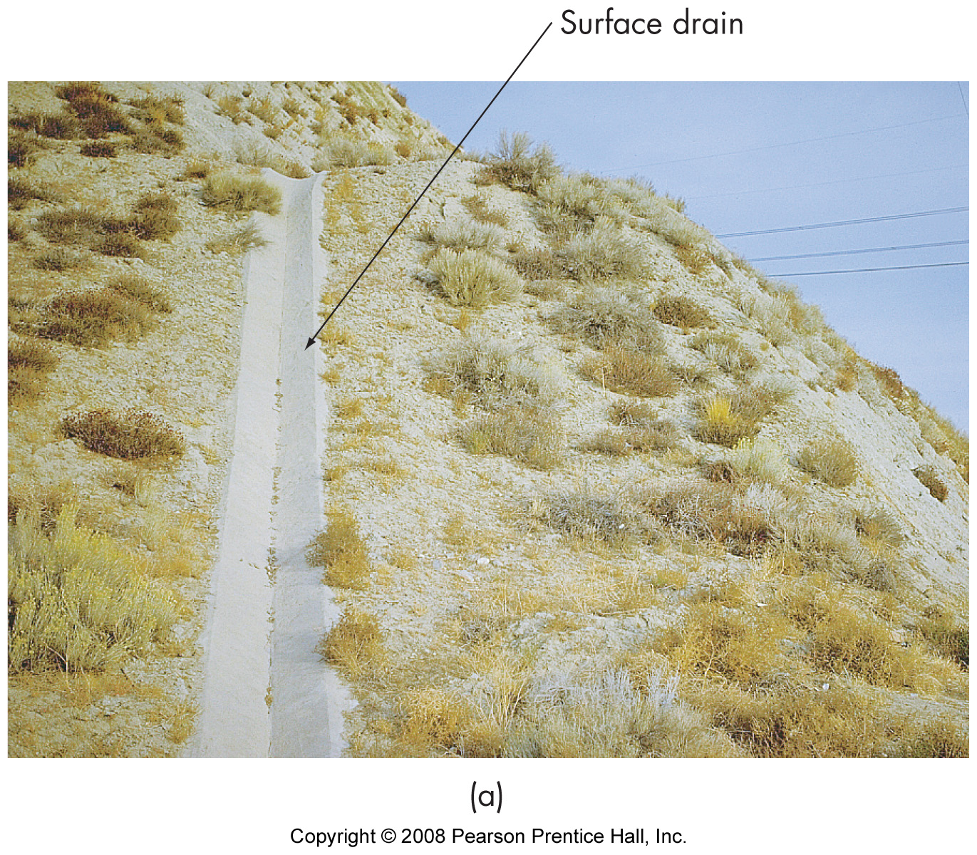
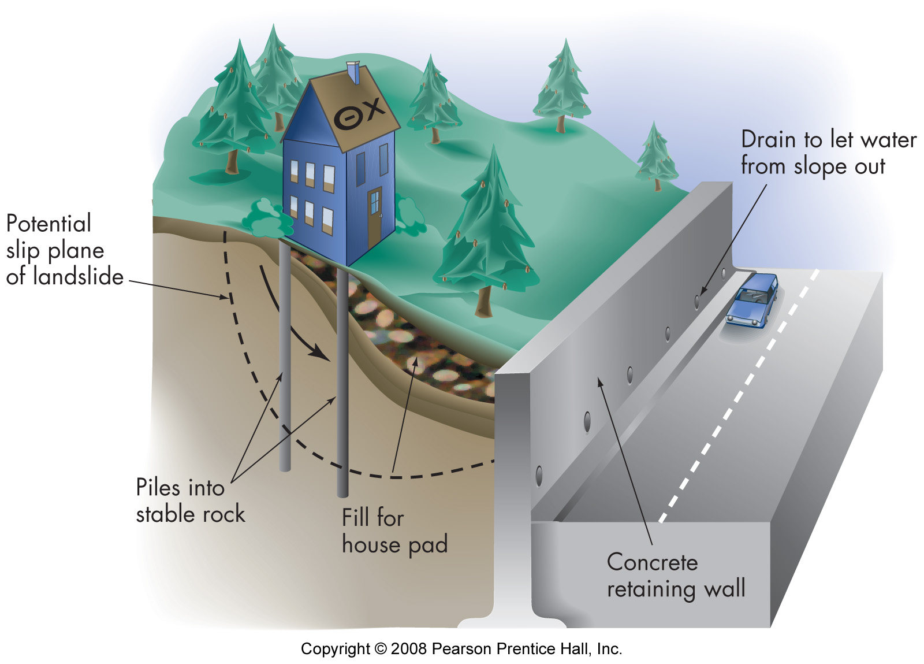
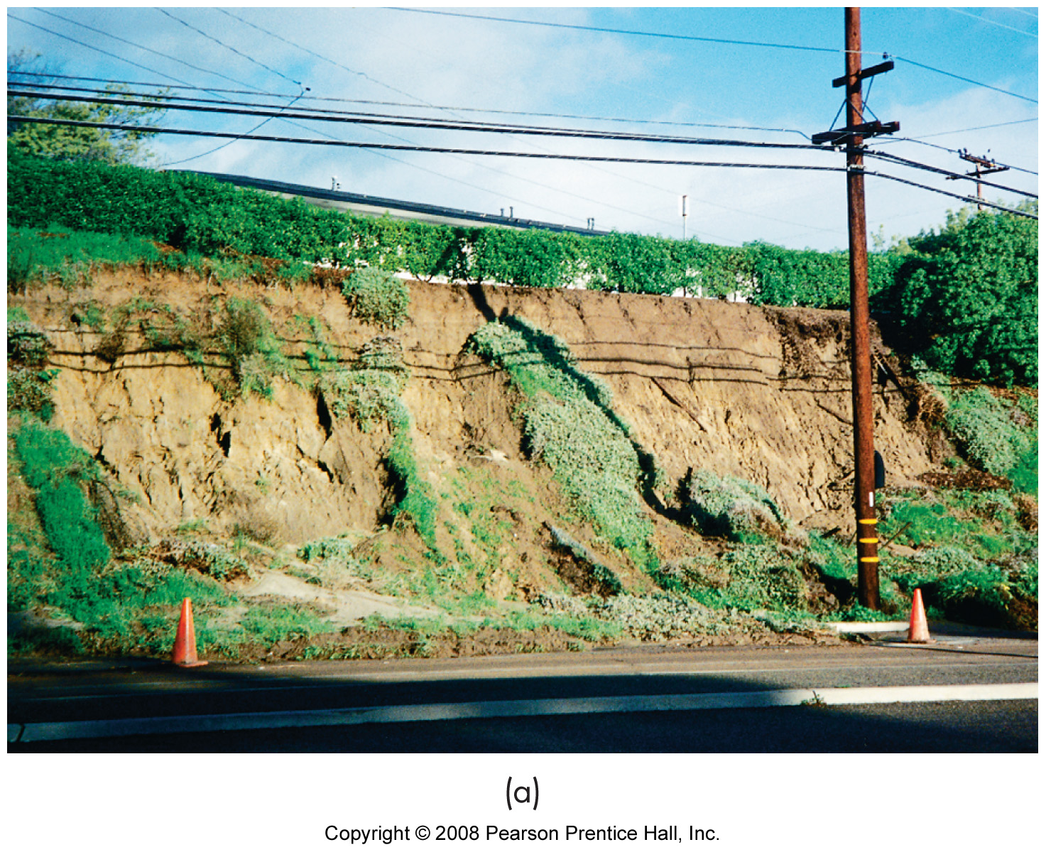
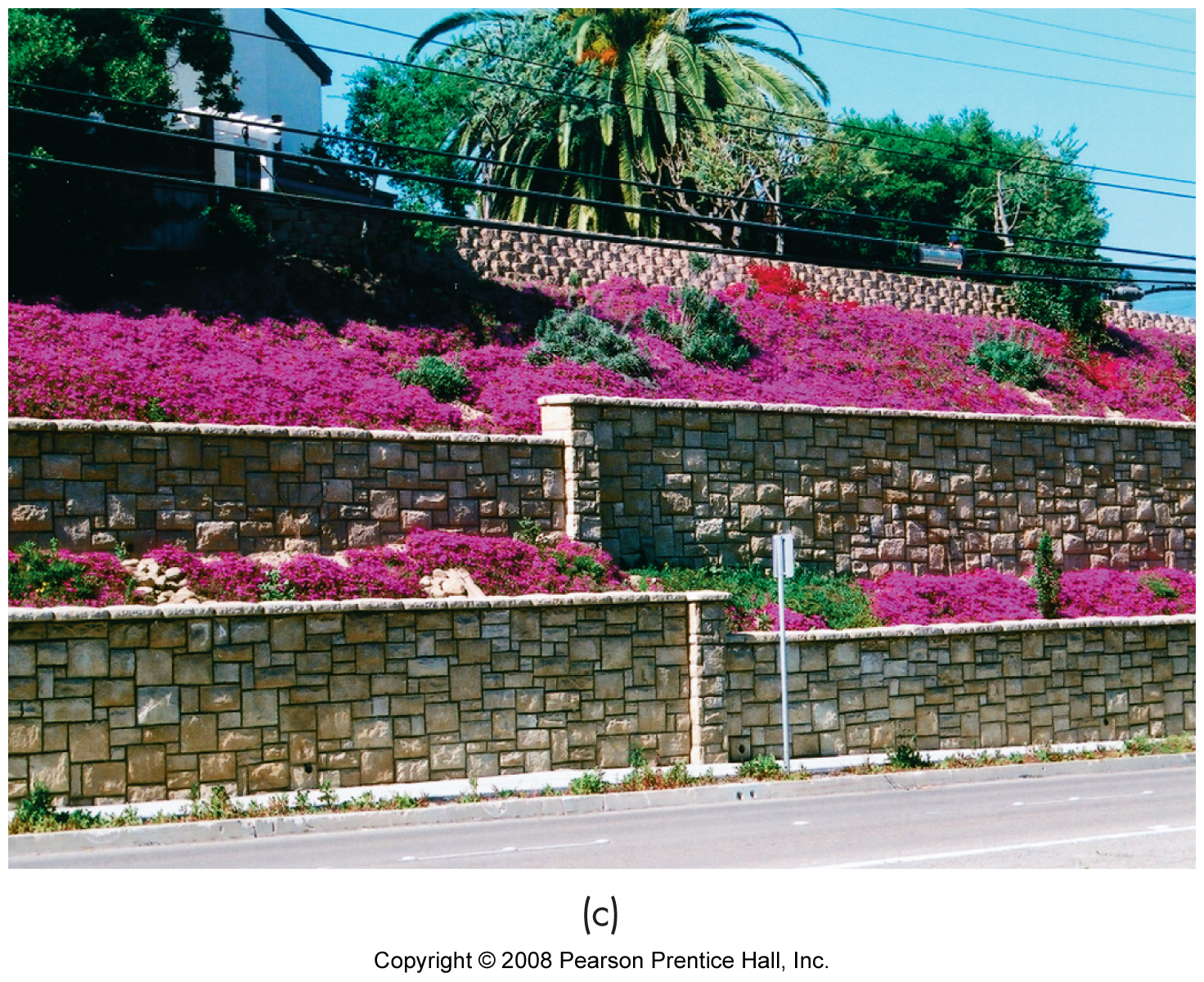
Addressing Unstable Slopes
Identification & mapping
Slope monitoring
Stabilization
vegetation
water removal
structural controls

