Slide 1
Subsidence
Week 7

Slide 2
Questions for Discussion
Would you live in an area prone to subsidence? If so, where?
What level of risk from subsidence is acceptable to you? (How would you know if the subsidence risk was assessed accurately?)
What should be done by people and communities in areas prone to subsidence to prepare for the hazard and prevent catastrophe?

Slide 3
Other Questions to Consider
What factors impact subsidence?
The five concepts form Chapter 1

Slide 4
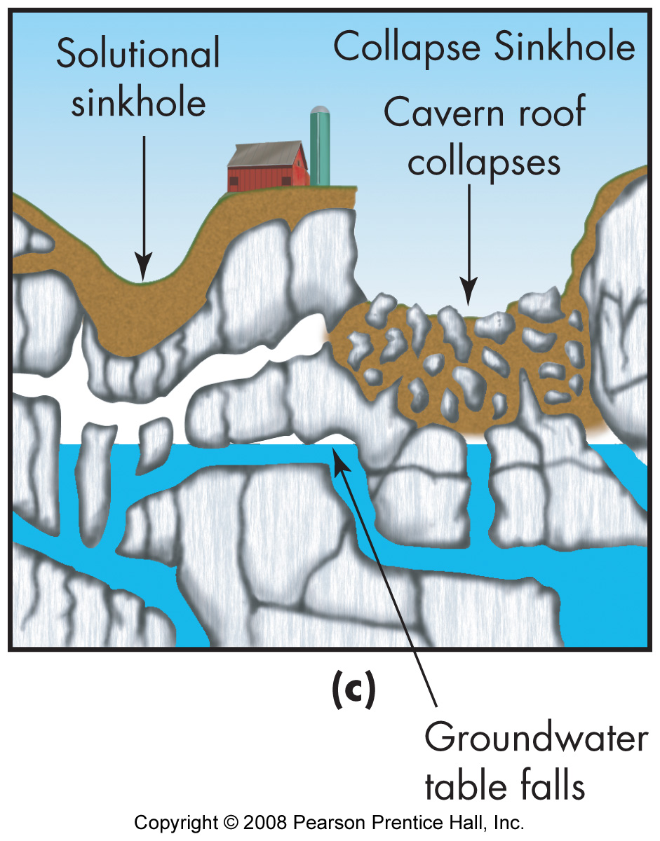
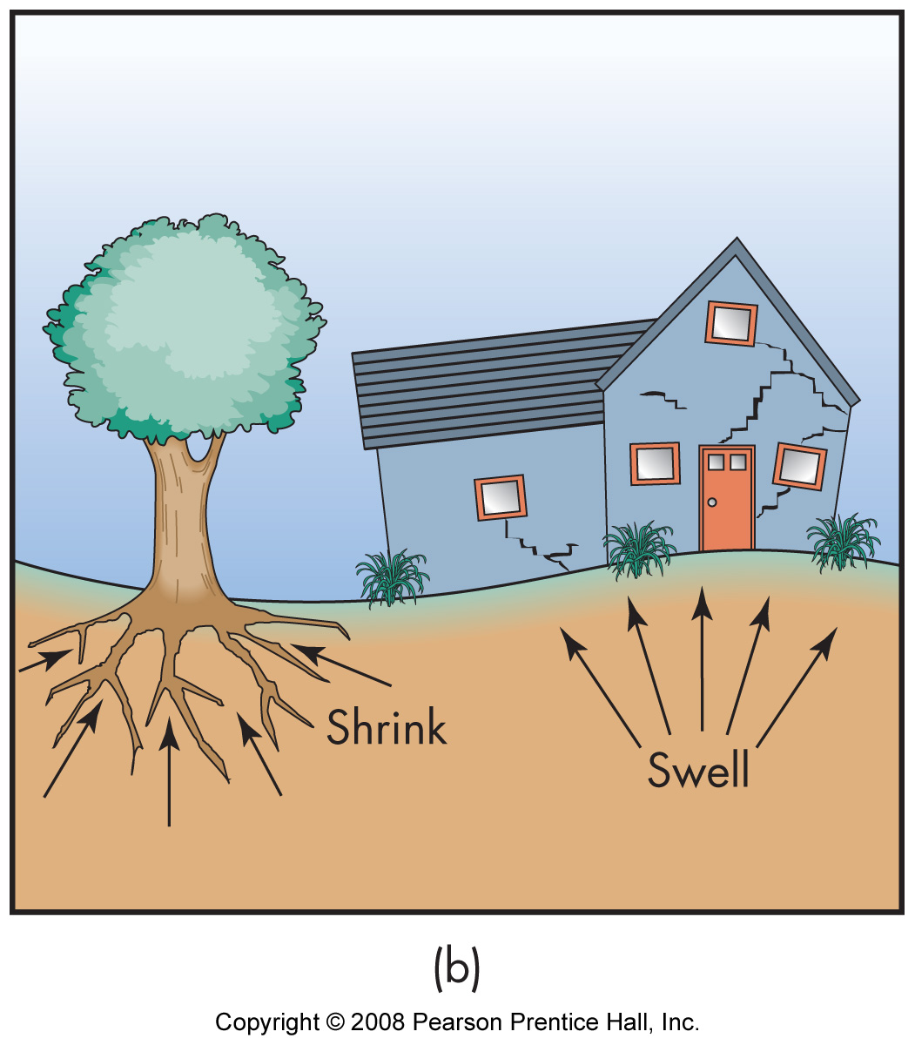
Subsidence Causes: Natural
Cave Collapse
Expandable soils
Tectonic movement

Slide 5
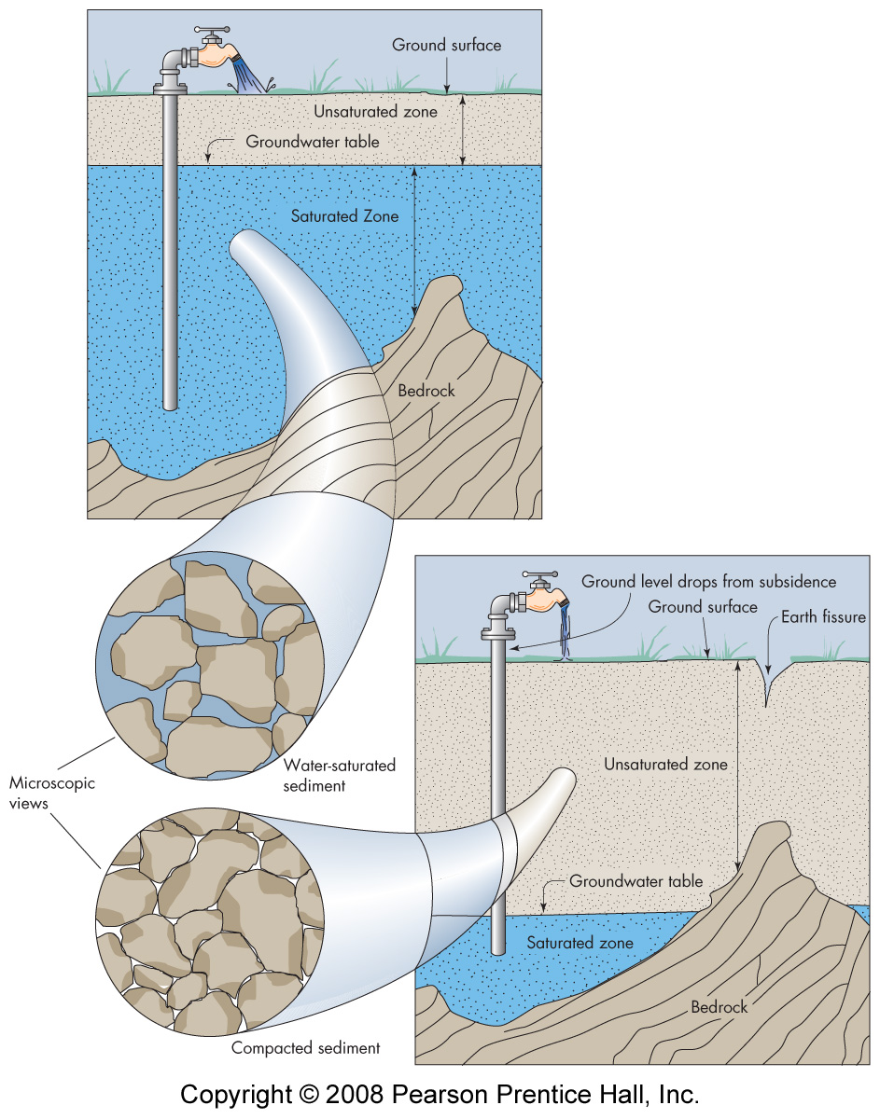
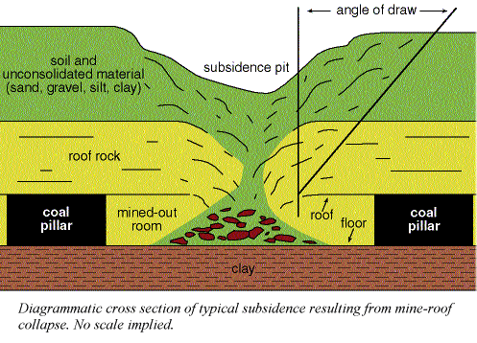
Subsidence Causes: Human Induced
Groundwater loss
Mining

Slide 6
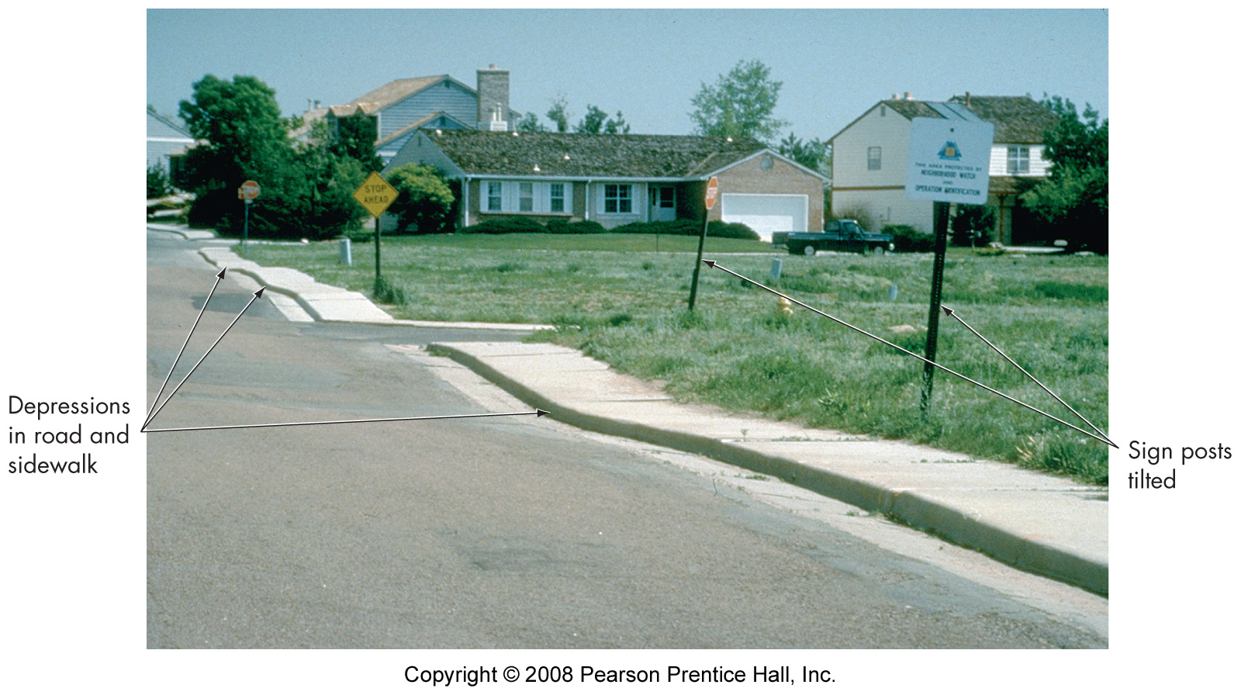
Impact of Mass Movements
Structural damage
Surface disruption

Slide 7
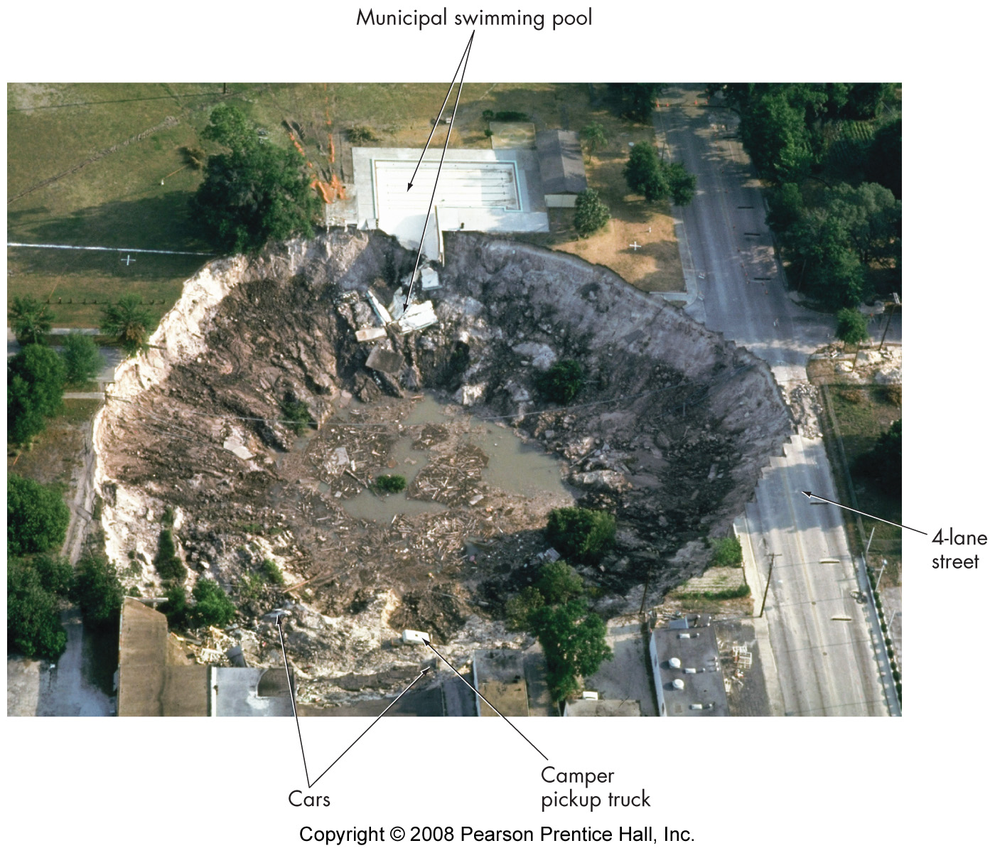
Sinkhole

Slide 8
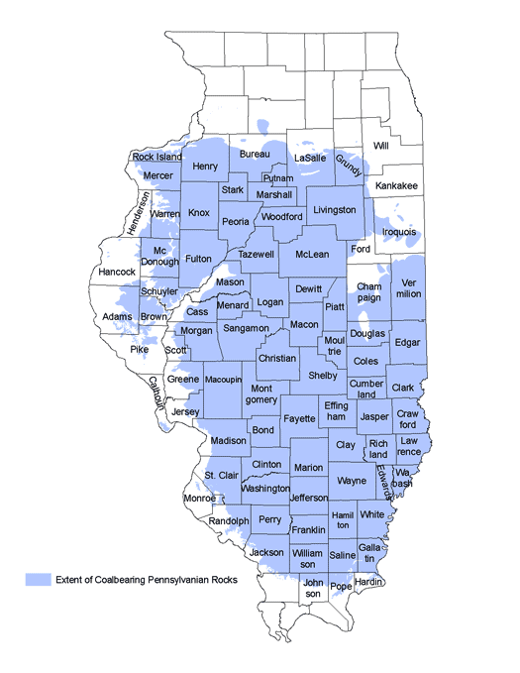
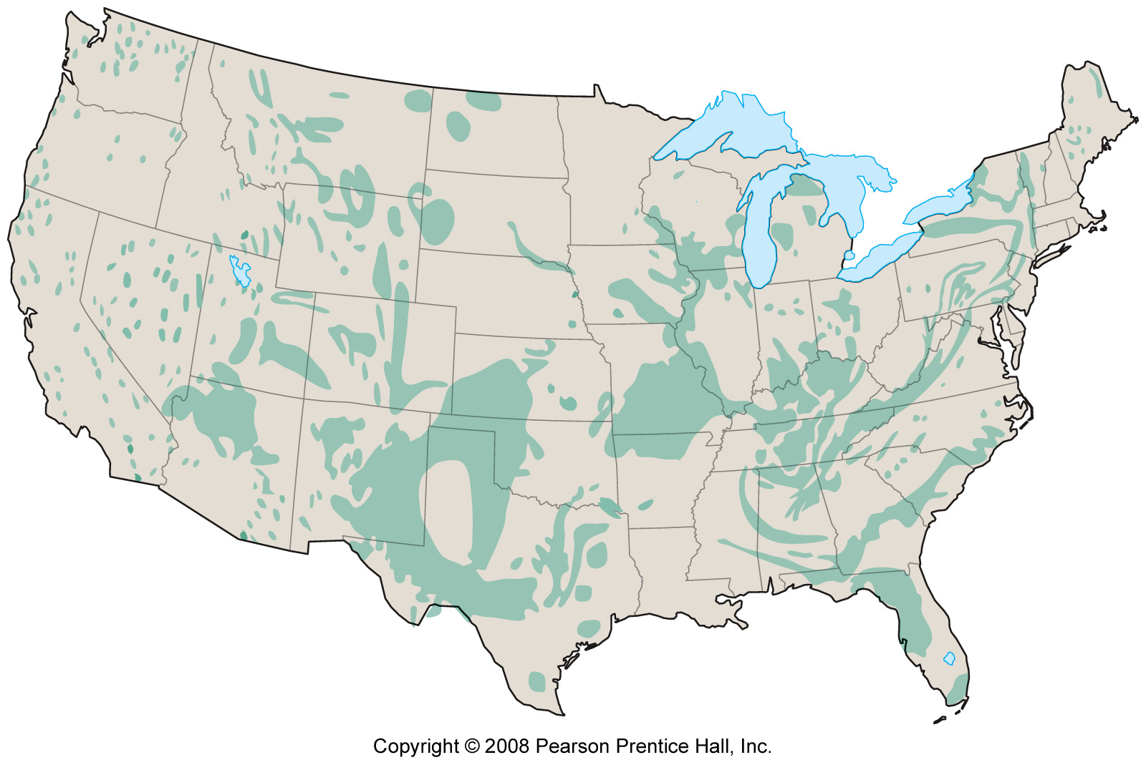
Addressing Subsidence
Identification & mapping
Planned subsidence
Insurance
Potentially Undermined Areas
Karst Prone Areas

