Slide 1
Chapter 6: Earthquakes & Related Phenomena

Slide 2
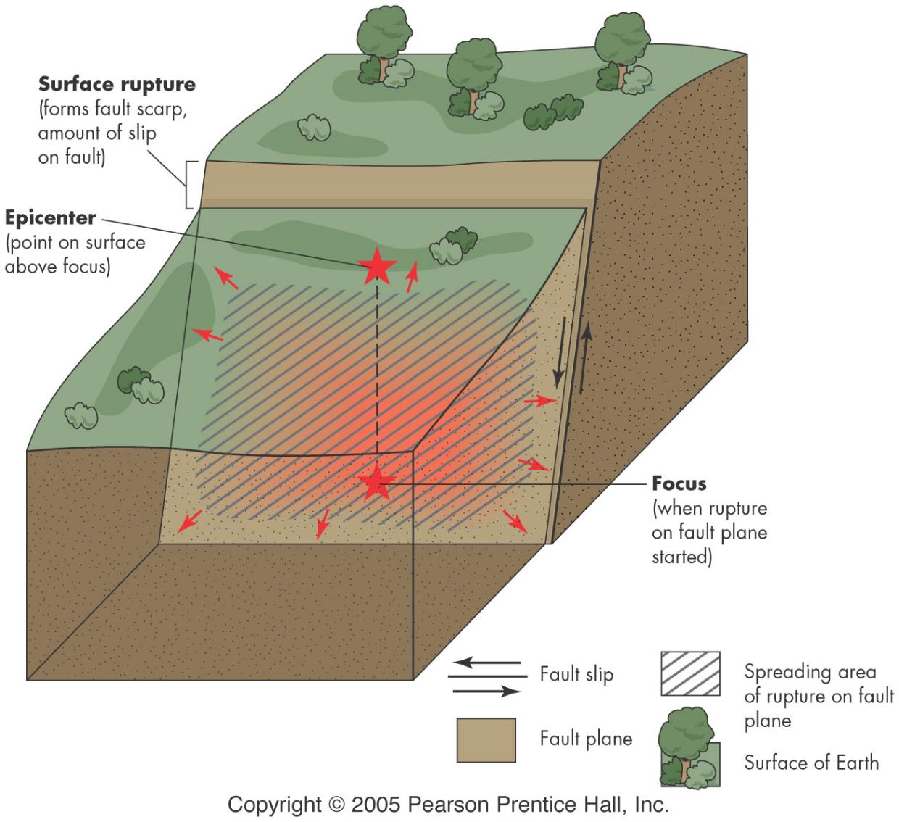
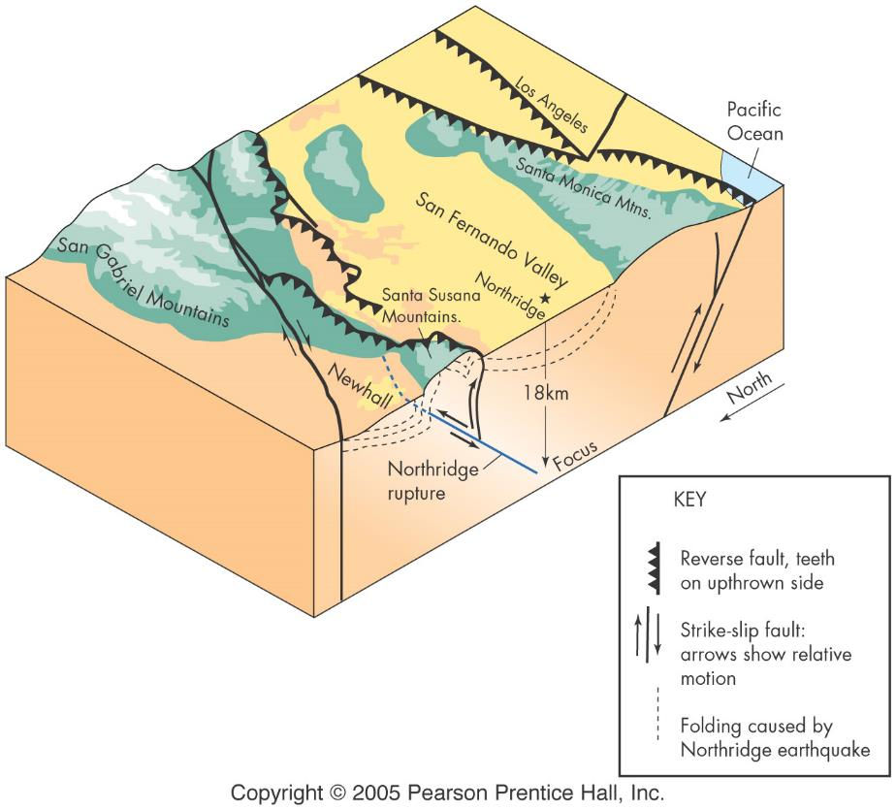
EQ features
epicenter
hypocenter (focus)
seismic waves
fault
rupture
below ground
surface

Slide 3
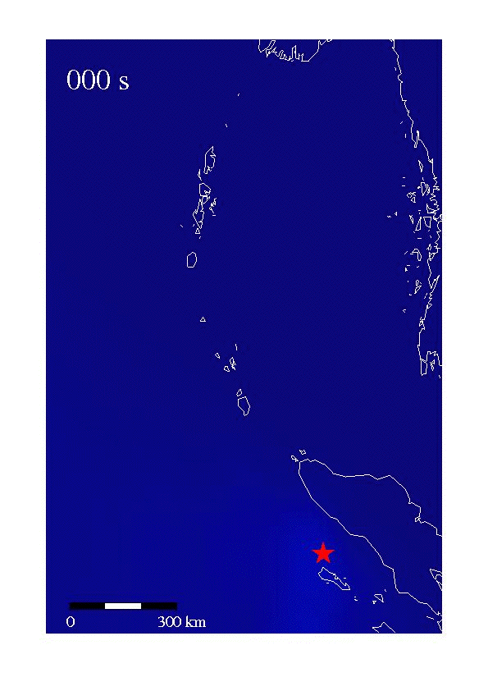

Slide 4
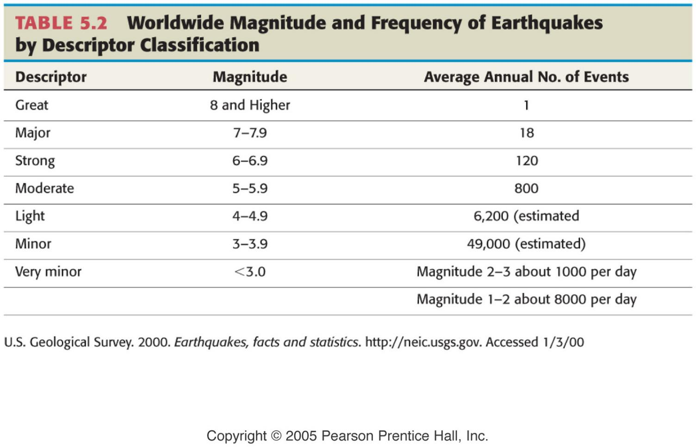
Magnitude
amount of shaking
normalized to set distance
Richter magnitude
largest amplitude S-wave
logarithmic scale
energy is 30X for each level
Moment magnitude
seismic moment based on
average amount of slip on fault
area actually ruptured
strength of rx that failed
more quantitative and accurate

Slide 5
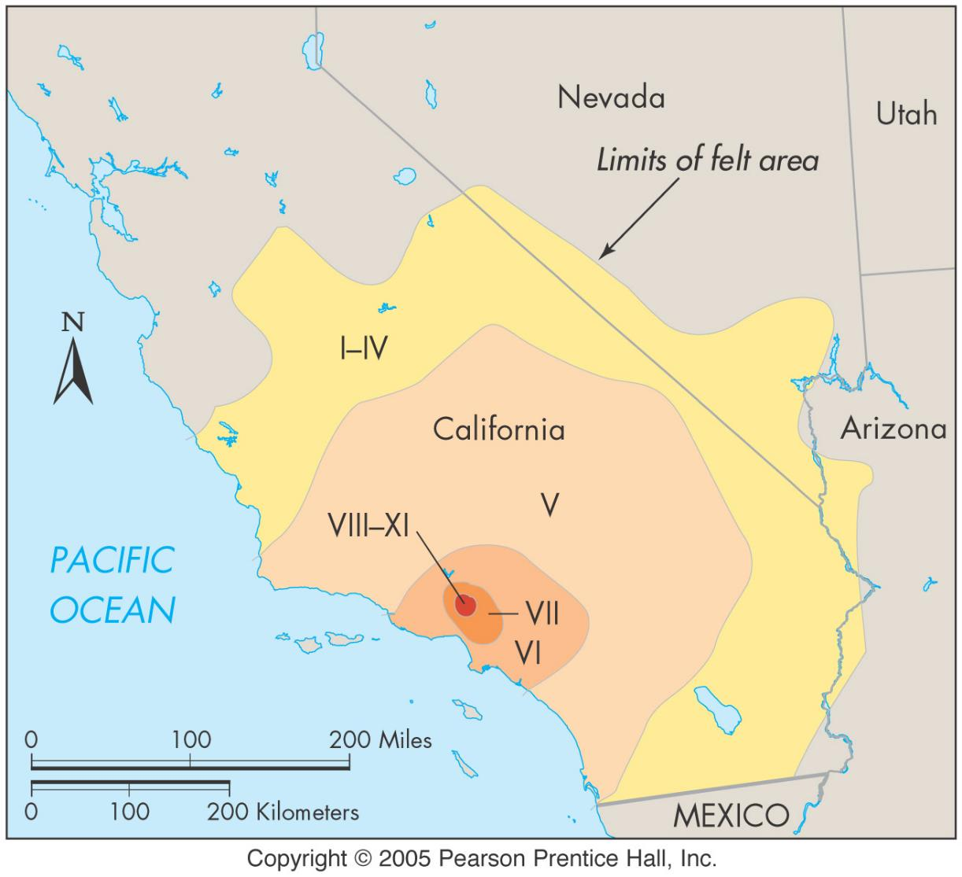
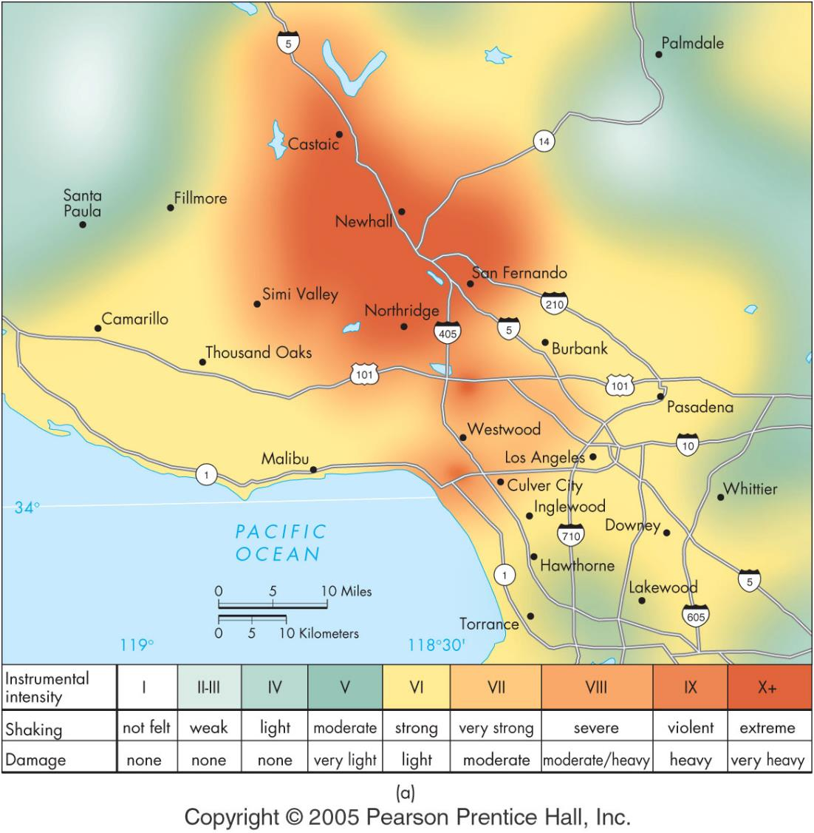
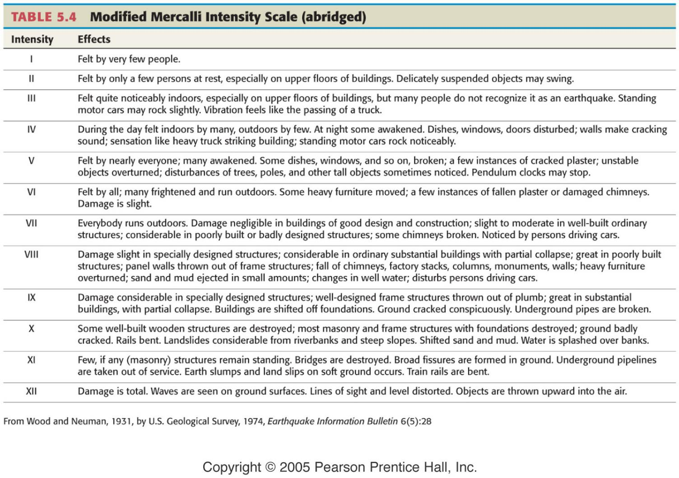
Intensity
based on personal observations of severity of shaking
quantifies damage – mag. doesn’t
Shows variation for different areas affected by EQ
modified Mercalli scale

Slide 6
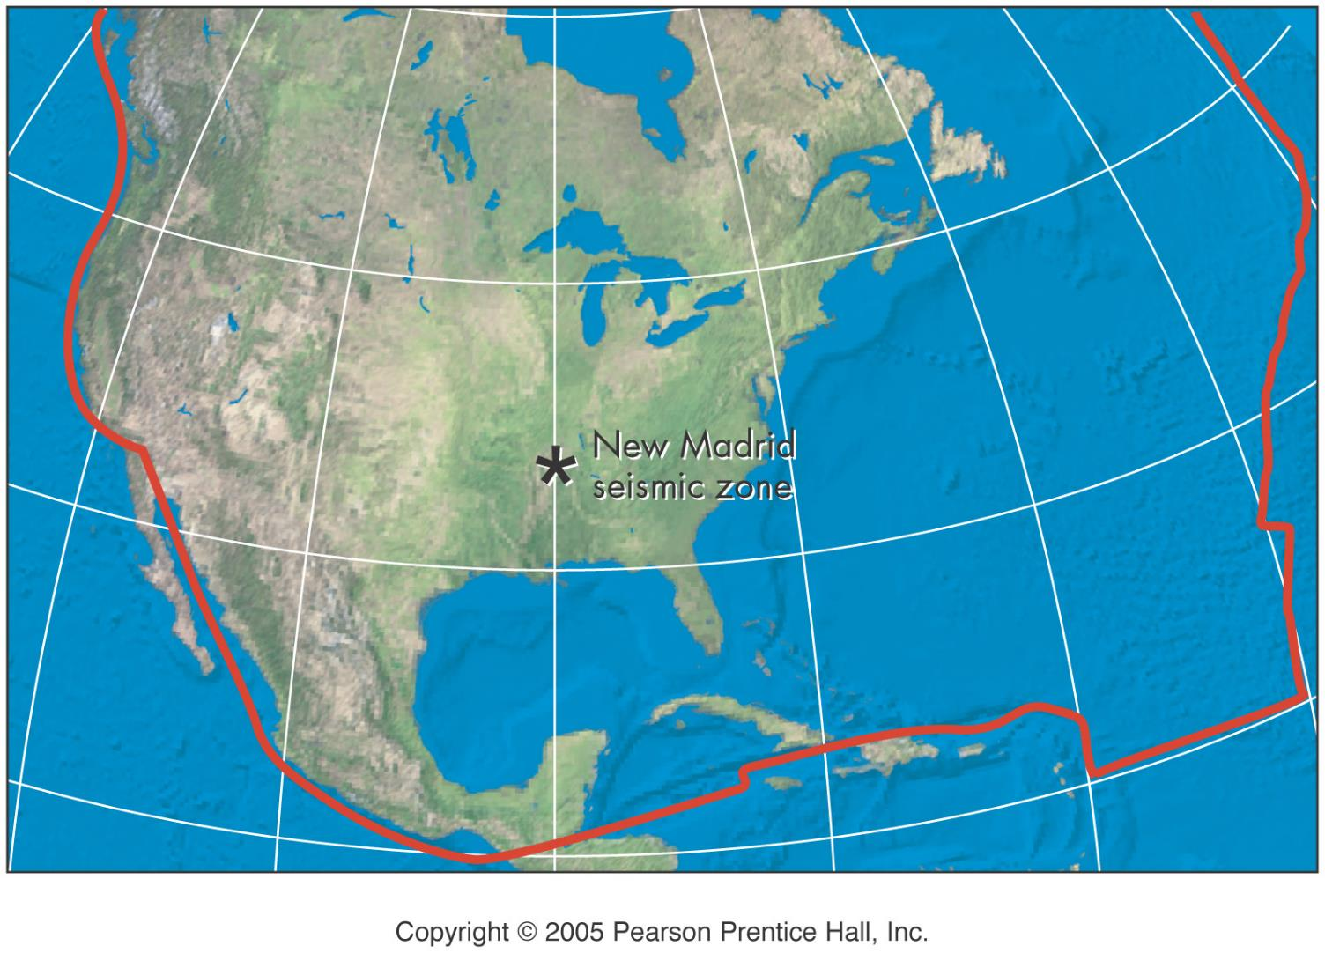
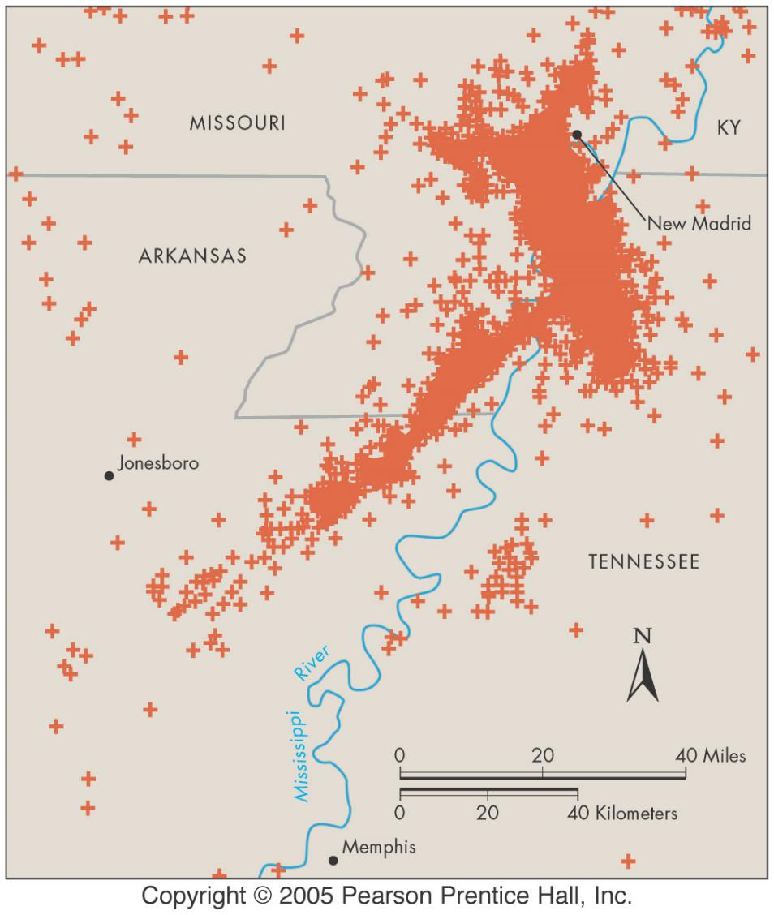
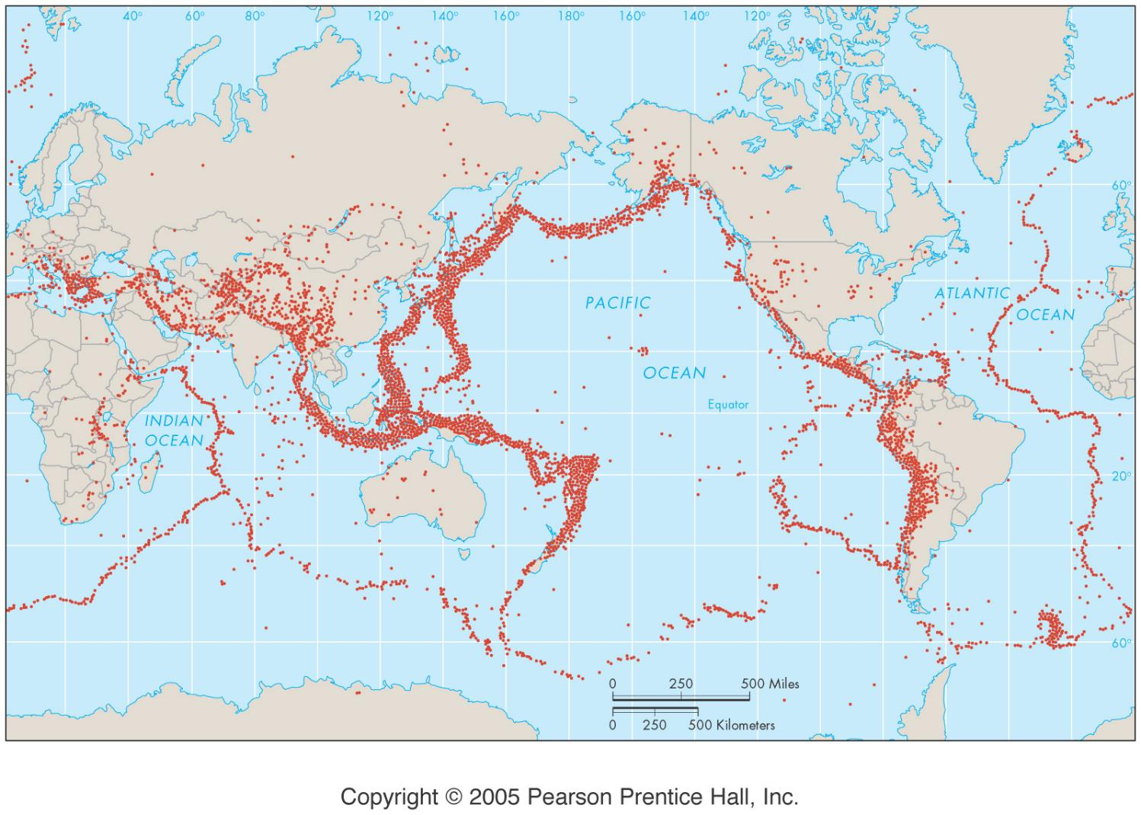
Faults
cause
plate boundary
note: may be far from actual boundary
intraplate - weak zones
former plate boundaries
Addition or removal of material
zone - related faults may be of several types
buried/blind faults - no surface trace

Slide 7
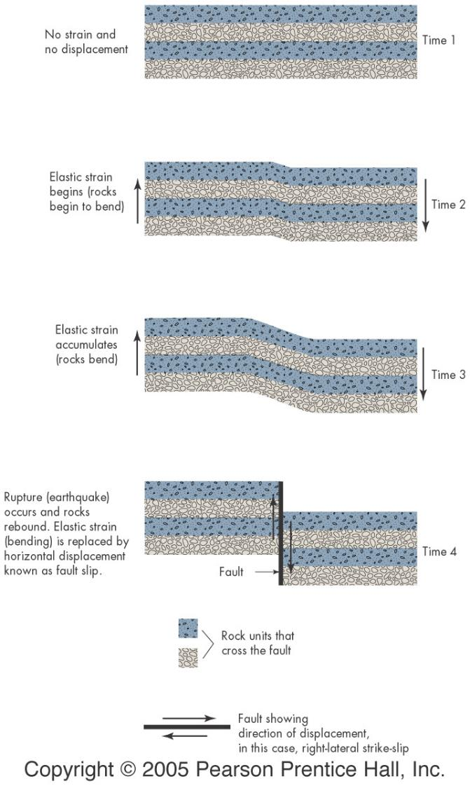
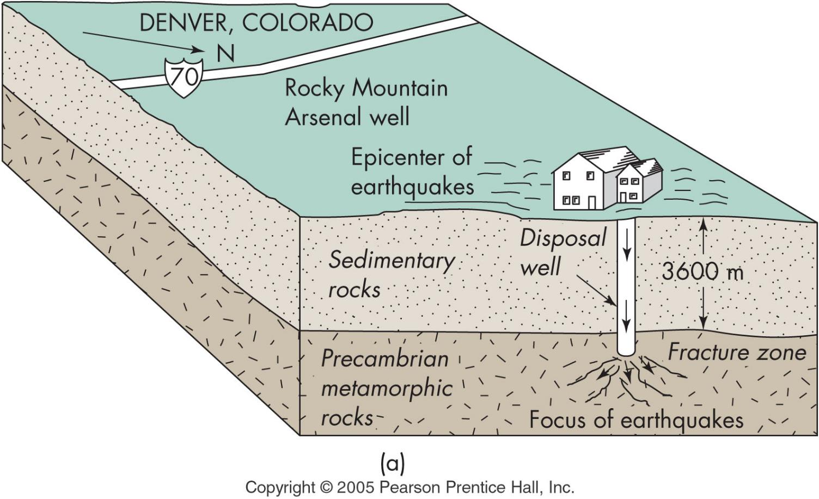
EQ causes
EQ cycle - Elastic rebound theory
stress builds up
exceeds strength
rocks snap back
vibrations = EQ
recurrence depends on rock strength
Human induced EQs
addition of water
reservoirs (increases pressure and lubricates fault
fluid injection
explosions & nuclear tests

Slide 8
Seismic activity
Identification
plot foci
date movements of soils and other features
study stress field and measure stain
tectonic creep - constant movement (small or no EQs)
classification
active fault zone - Holocene (10K yr)
potentially active - Quaternary (2M yr)
inactive - no activity for 2M yr

Slide 9
Seismology
Measuring seismic waves
seismograph
seismic station
seismogram

Slide 10
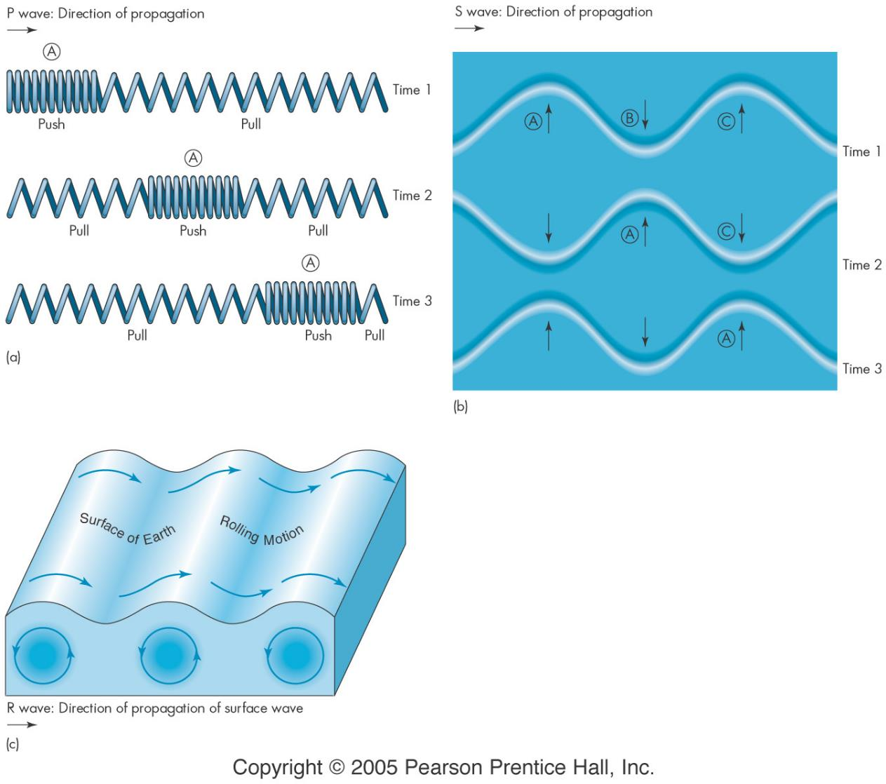
Seismic Waves
Body waves - hi freq 05 -20hz
P-wave
fastest
S-wave
thru solid only
Surface waves - lo freq <1hz
Love - shear (side to side)
Rayleigh - oscillation - fig p 139

Slide 11
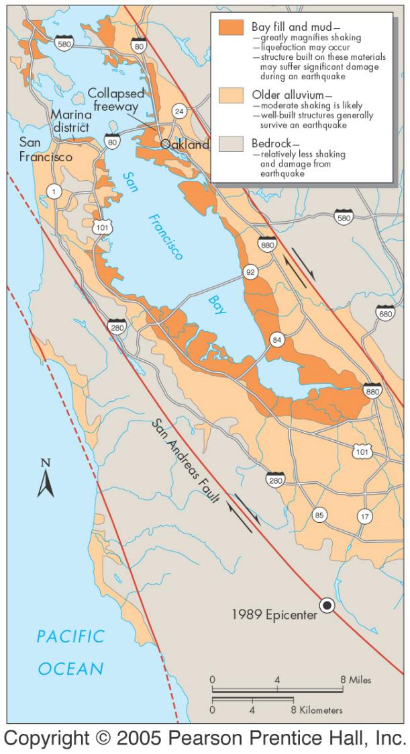
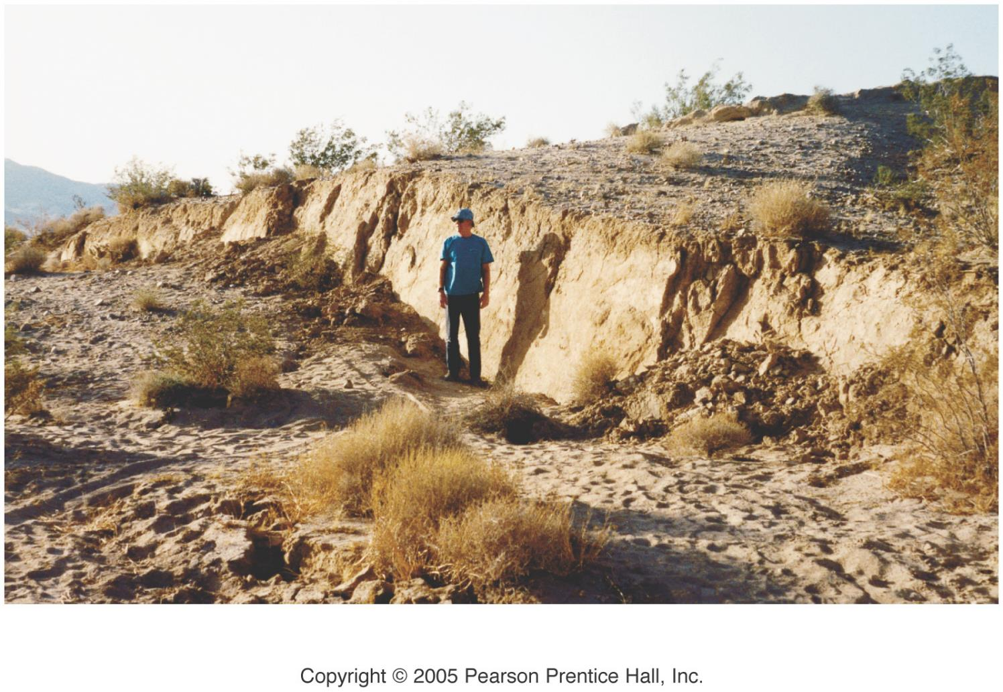
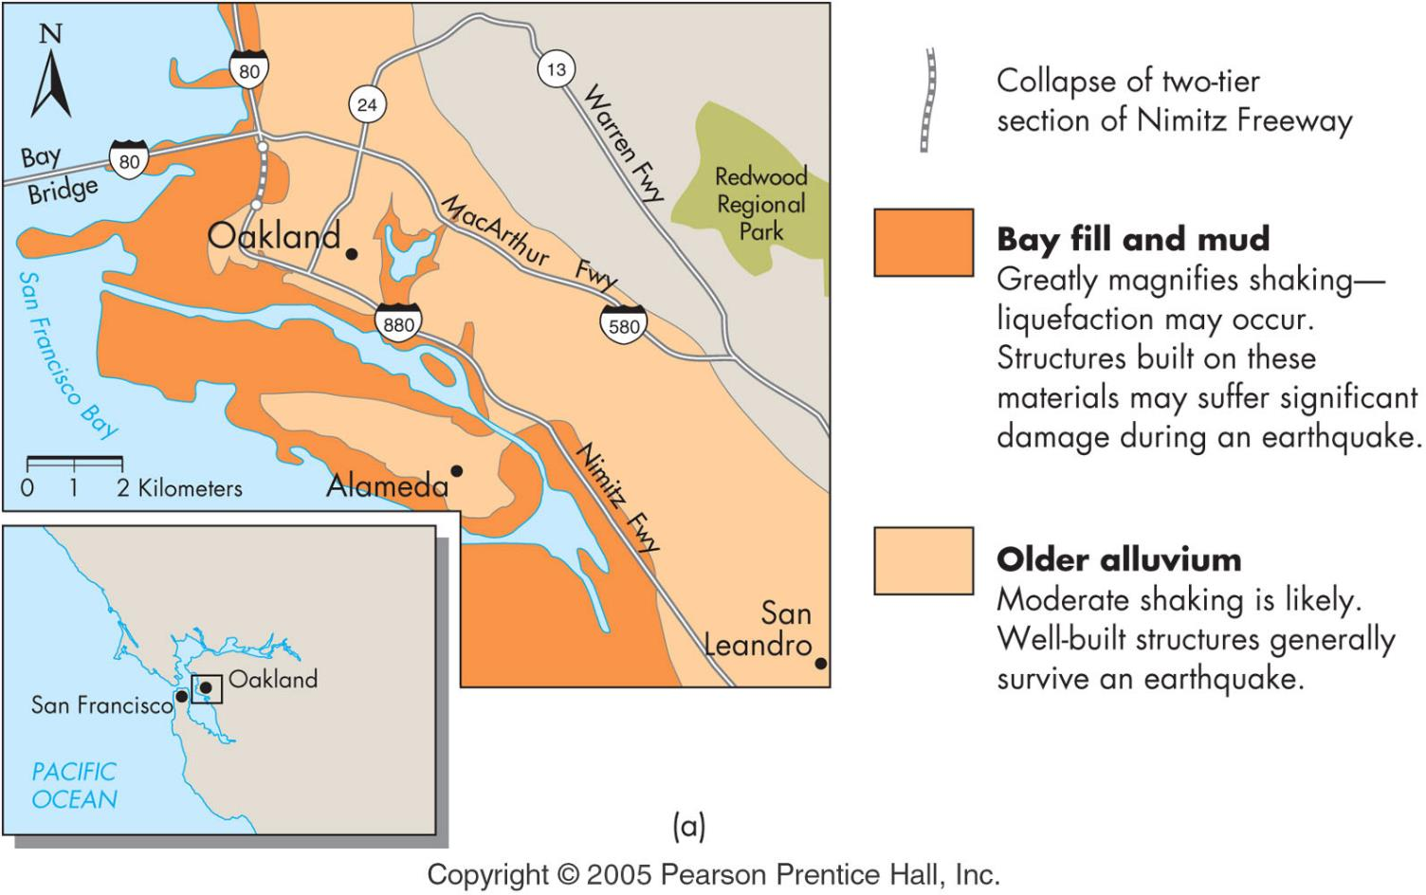
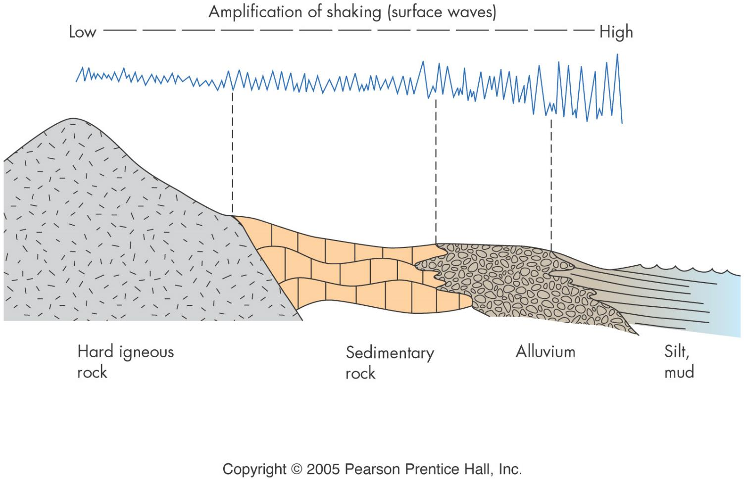
Primary Effects of EQs
Fault rupture - very localized
Shaking
frequency: building vs EQ wave
material properties
distance: depth & horizontal

Slide 12
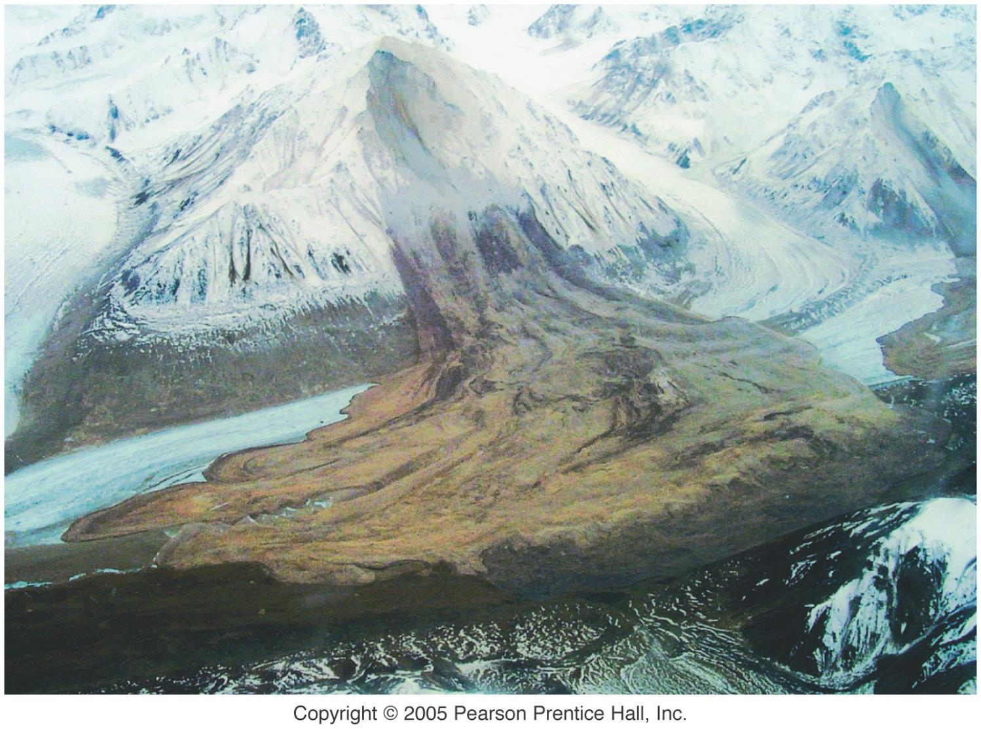
Secondary effects of EQs
liquefaction
landslides
fires
tsunamis & seiches
changes in land elevation
disease
loss of business

Slide 13
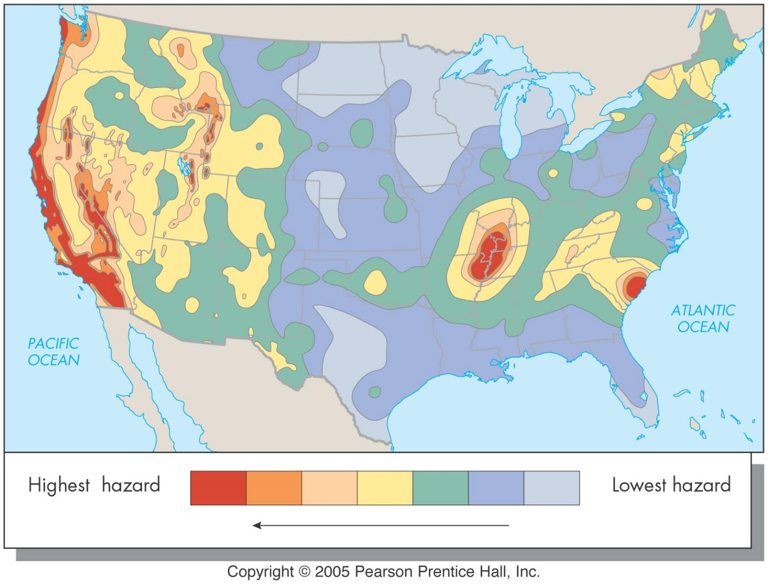
Estimation of seismic hazard
Max. magnitude/intensity
effect at surface
estimated fault location

Slide 14
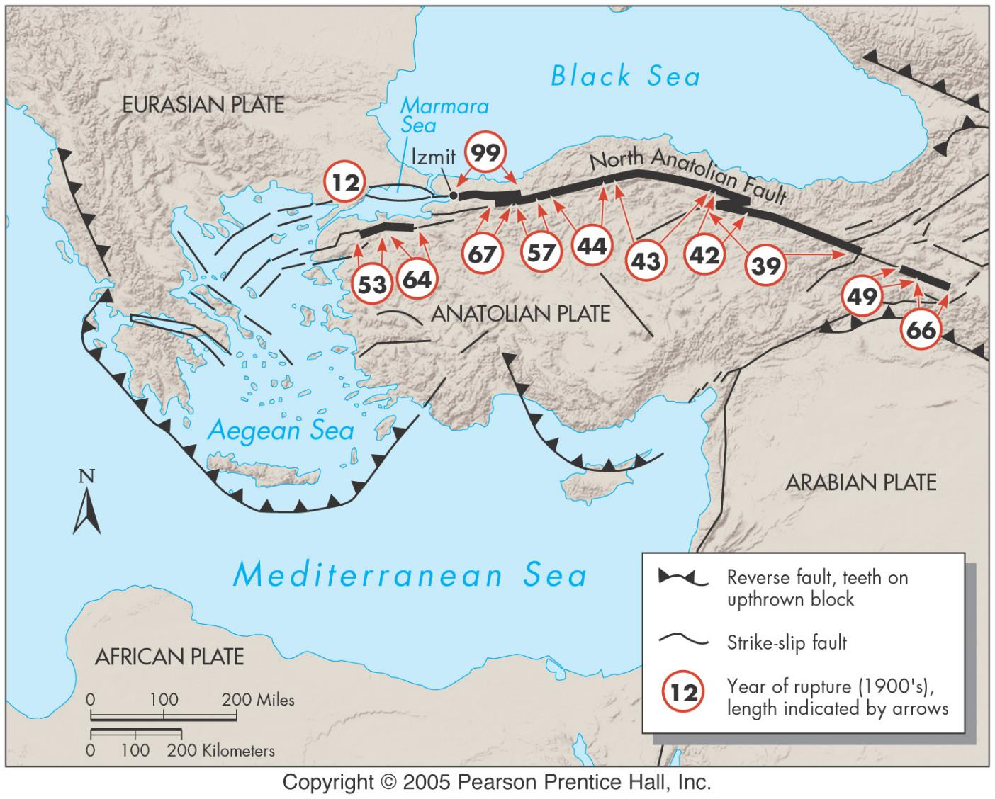
EQ forecast
recurrence interval
expected magnitudes
all based on
fault assessment
historical record
earth materials
stress field measurements

Slide 15
EQ prediction
Precursors - don’t always occur
micro earthquake swarms
preseismic deformation of ground surface
rates of uplift or subsidence
radon gas release may increase
seismic gaps (locked fault
magnetic fluctuations
electrical resistivity
varies with earth materials, groundwater, and others
changes before EQ
animal behavior
not reliable
could relate to other precursors

Slide 16
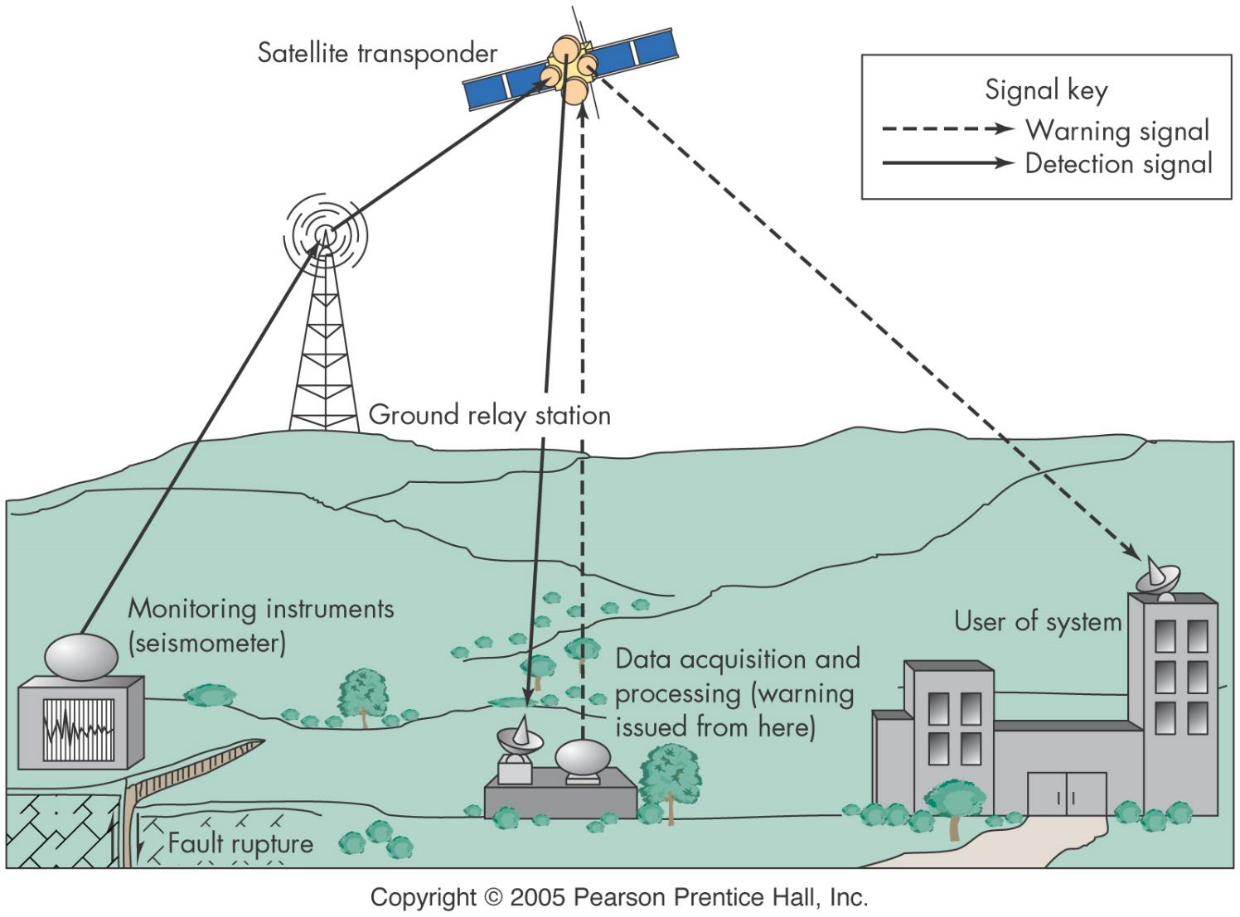
EQ hazard reduction
mapping
active fault zones
earth materials sensitive to shaking
research to predict and control EQs
develop and improve adjustment
building design
land-use planning & hazard assessment
siting assessment for new facilities
hazard assessment for existing facilities
Insurance and relief
warning systems
small seismic sensors
15sec - 1min warning

