Slide 1
Chapter 8: Volcanic Activity

Slide 2
Volcanoes
Magma rises to surface
eruption
lava
pyroclastics
gas
landform: Paricutin
vent
cone
caldera
rift

Slide 3
Eruption factors
High gas content = explosive
High Si content = explosive
High viscosity = explosive

Slide 4
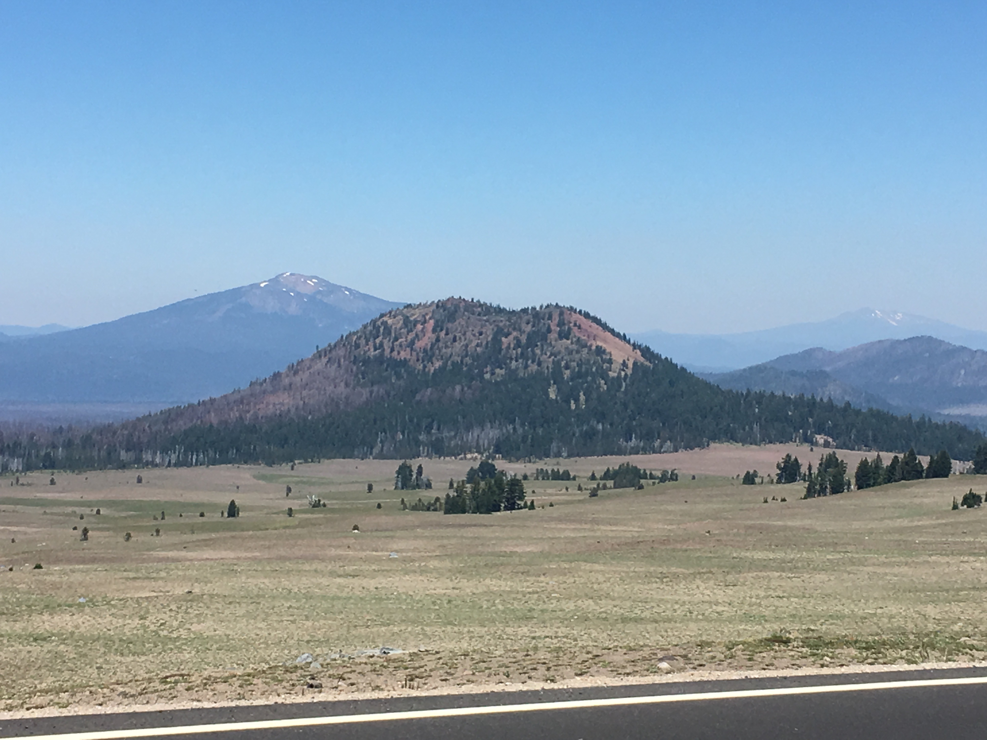
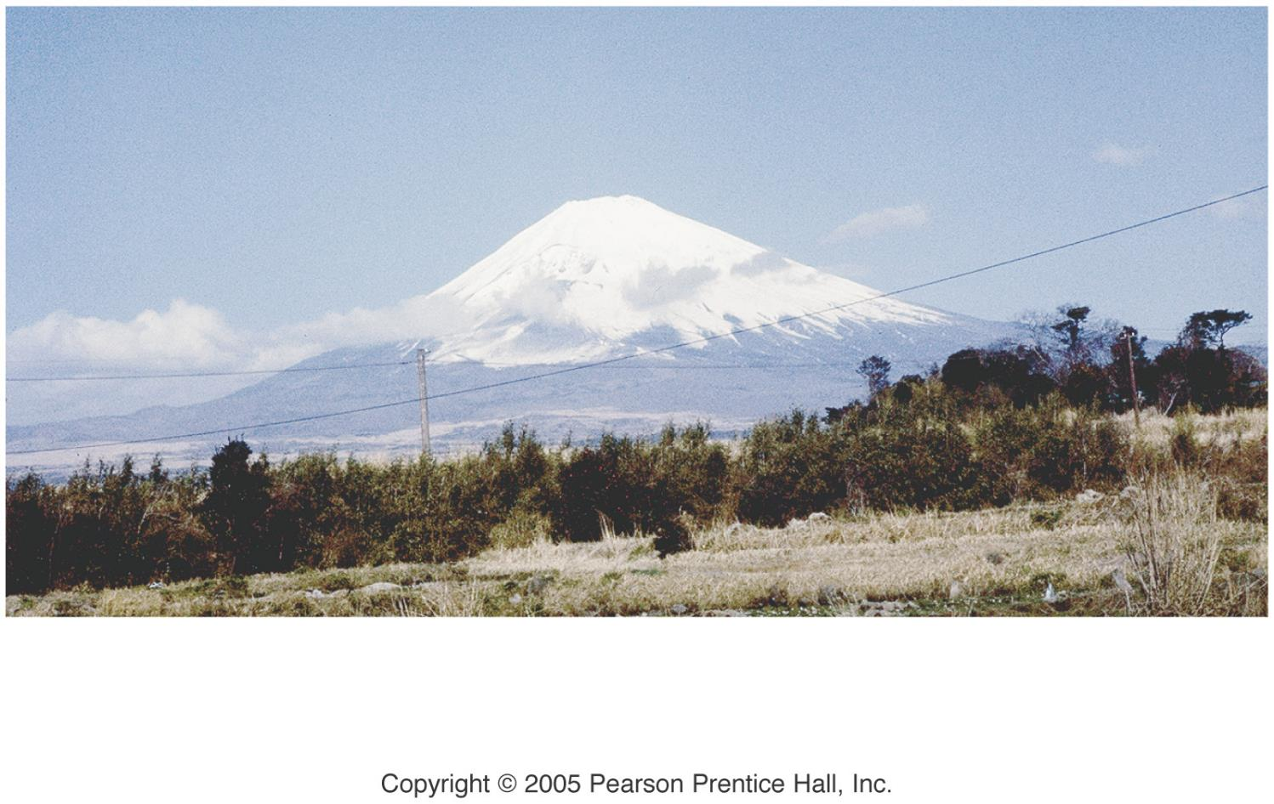
Volcano types
Shield - quiet
Cinder - explosive
Composite - quiet/explosive
Volcanic domes - explosive
Flood basalts - quiet

Slide 5
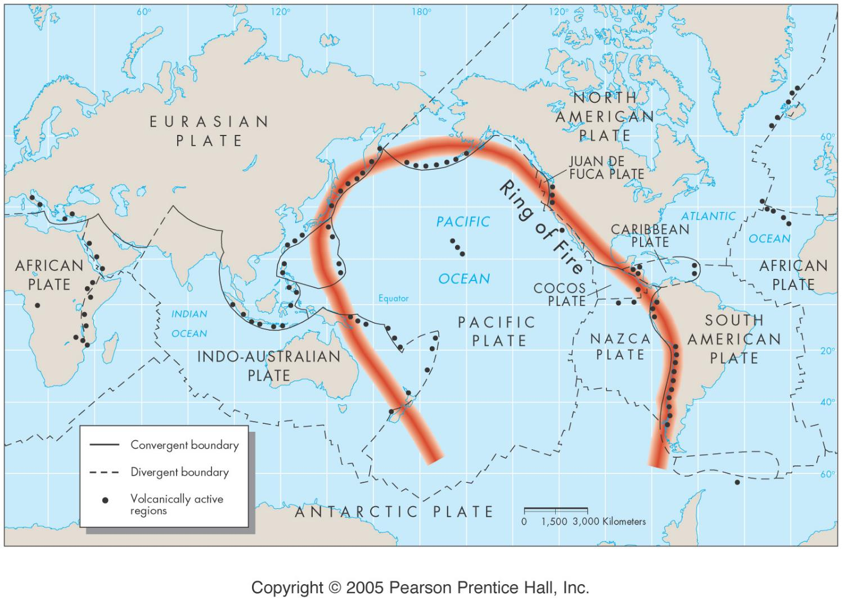
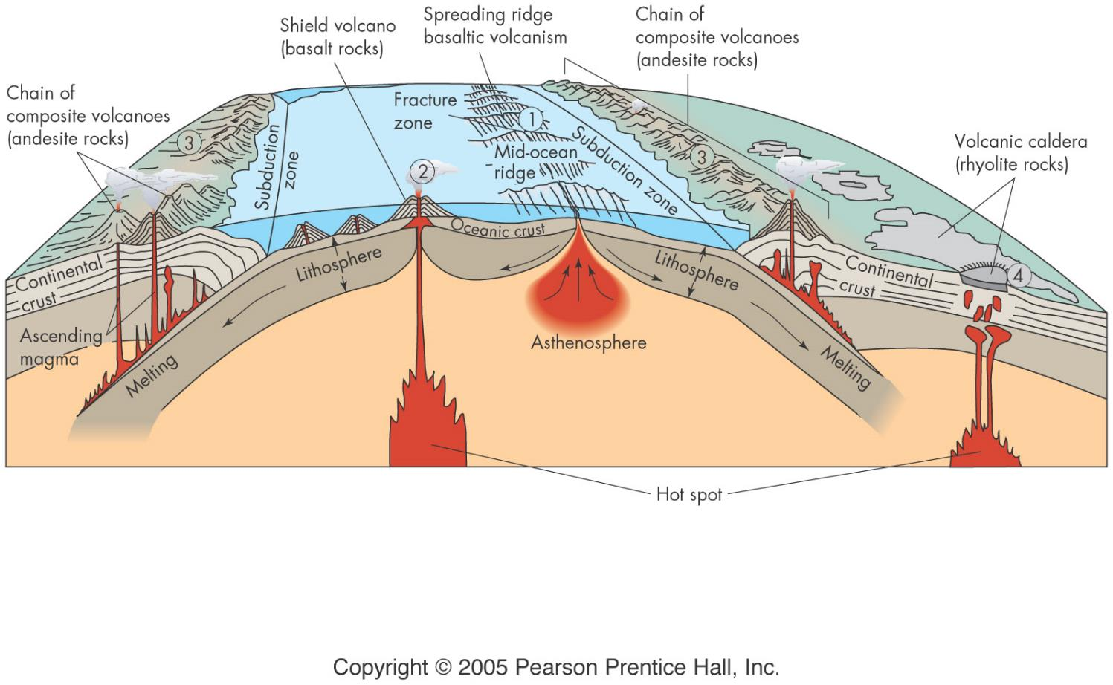
Origins: plate tectonics
mid-ocean ridge
hot spots
subduction zones

Slide 6
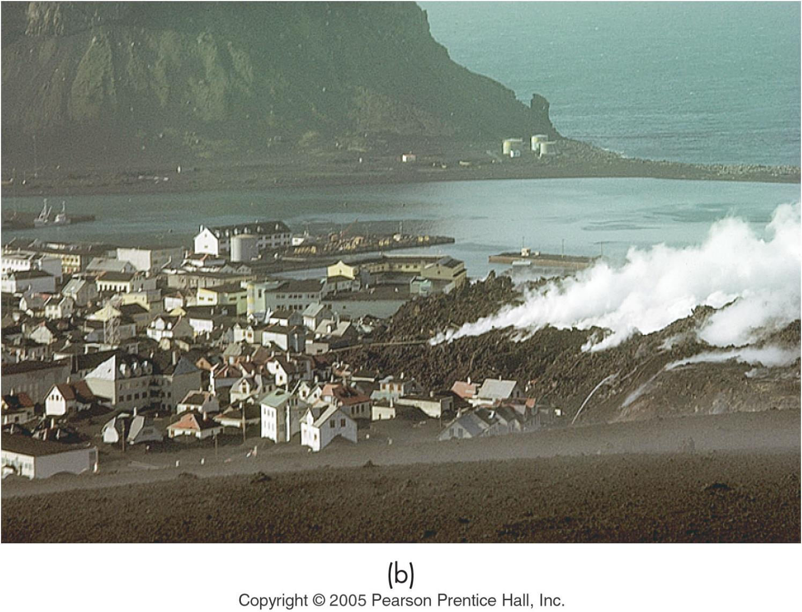
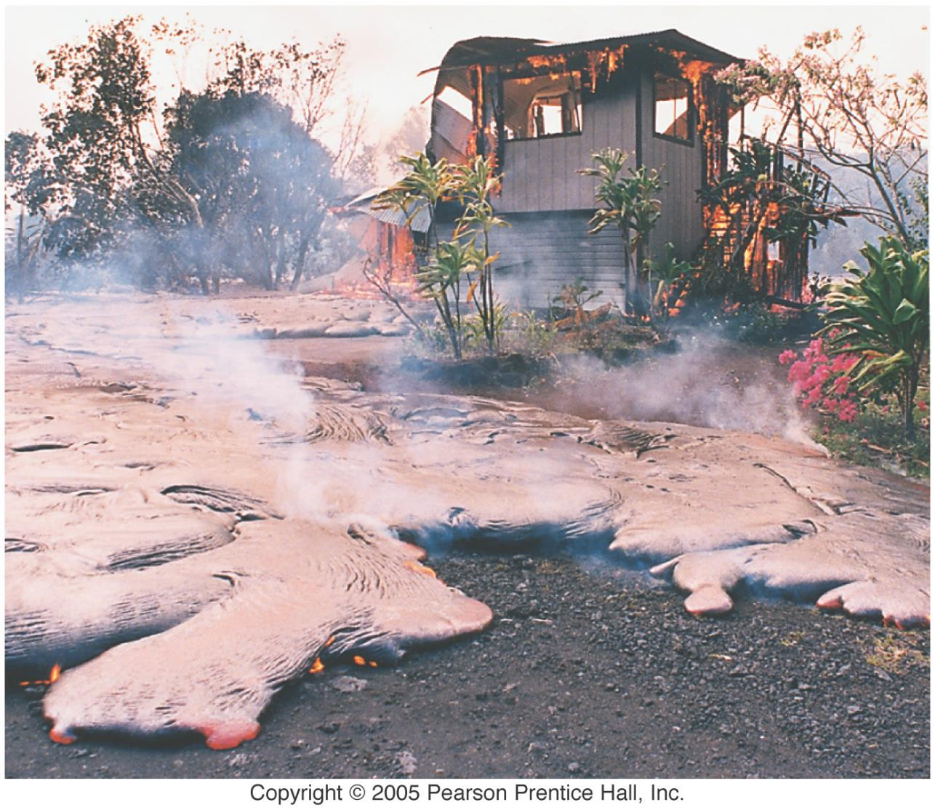
Volcano Effects
Lava flows
Aa, slow blocky
Pahoehoe, fast ropey

Slide 7
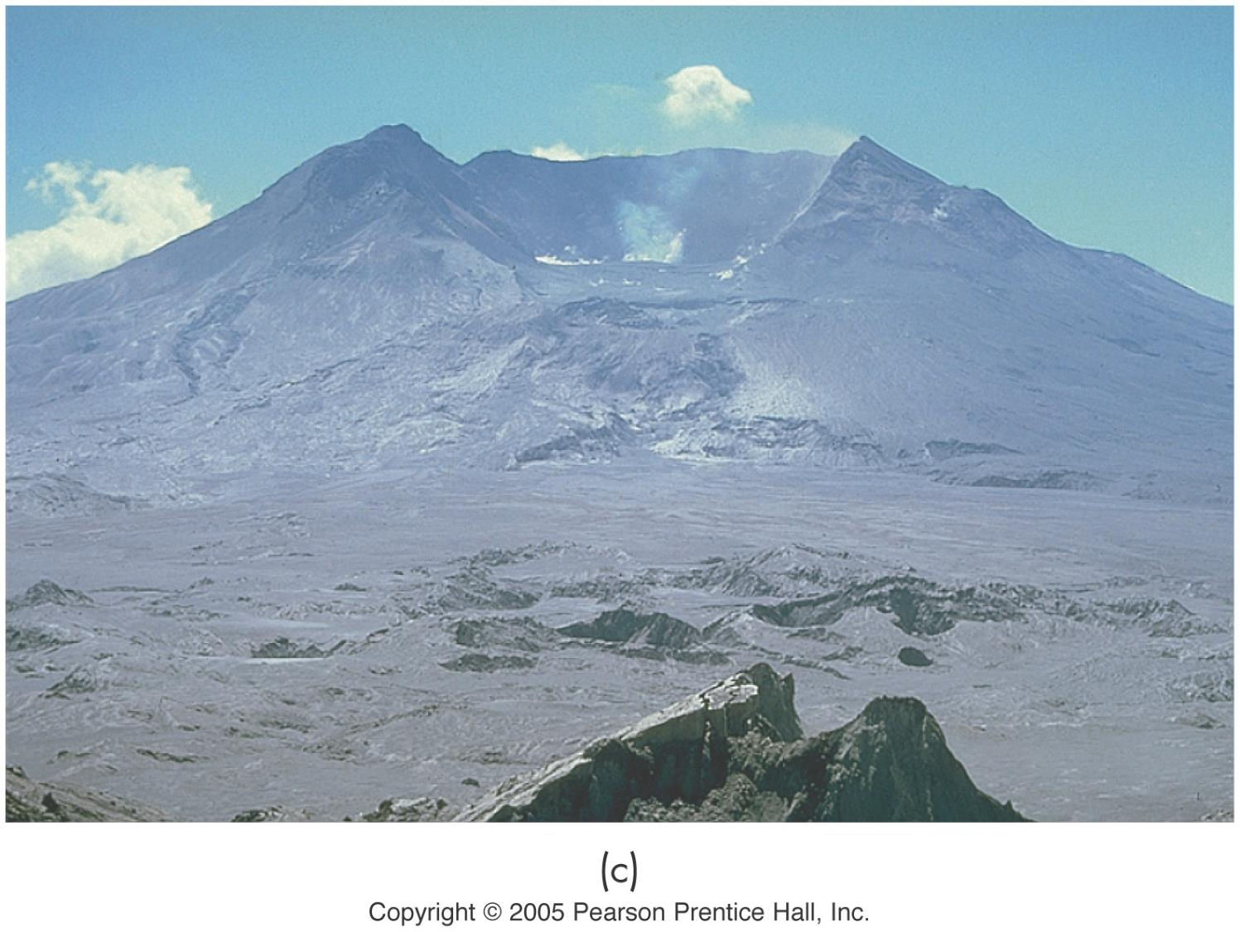
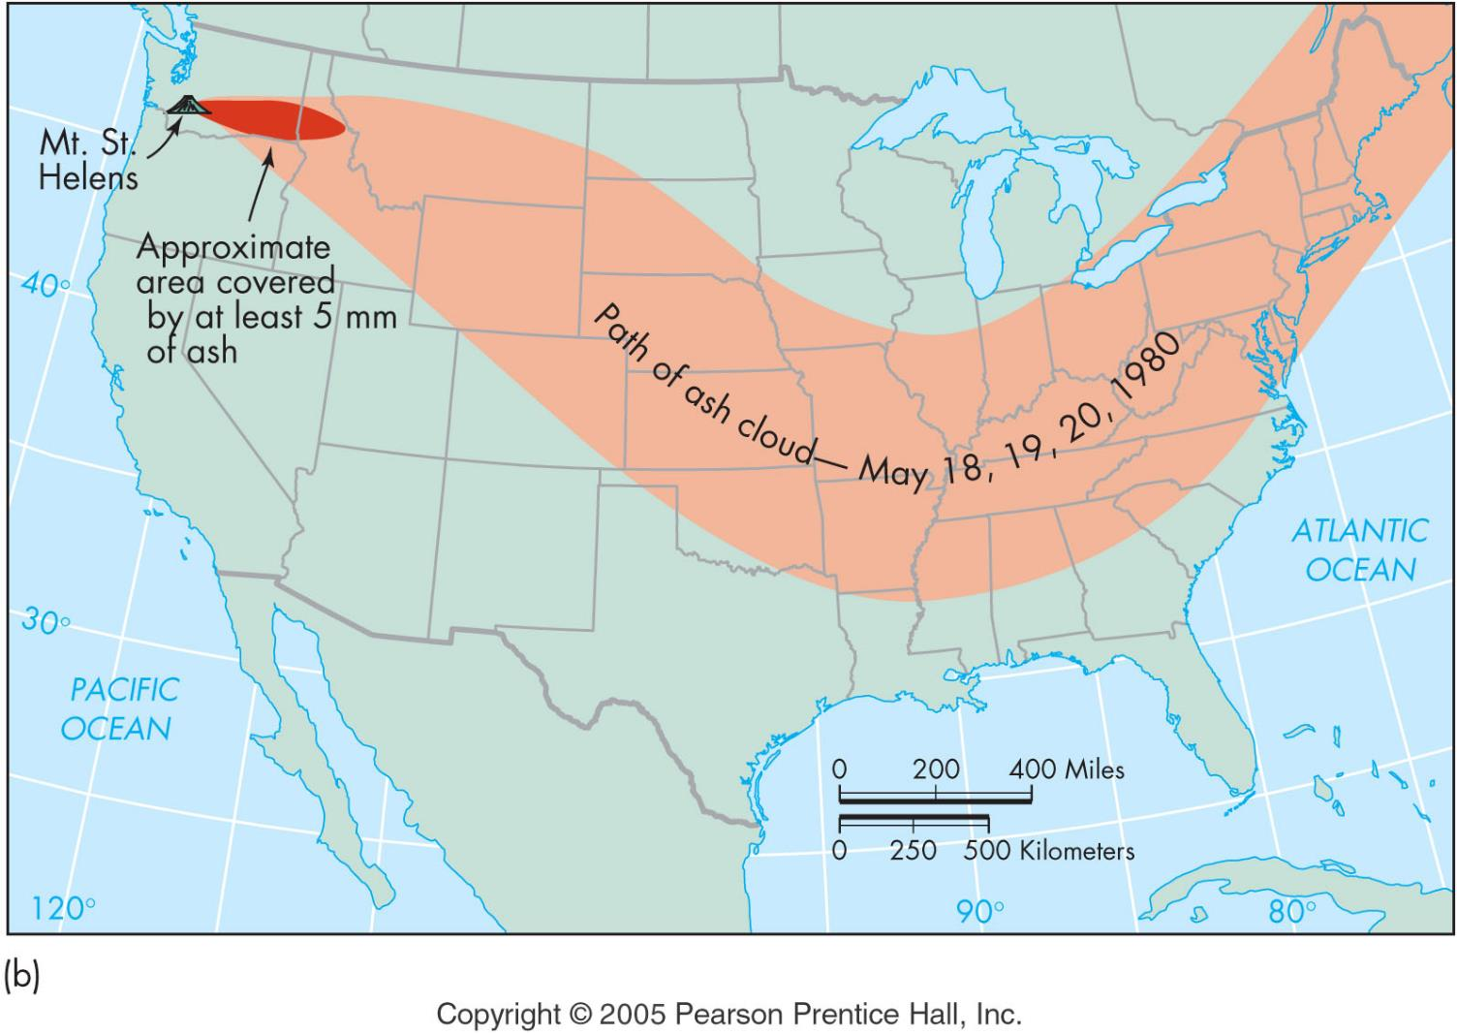
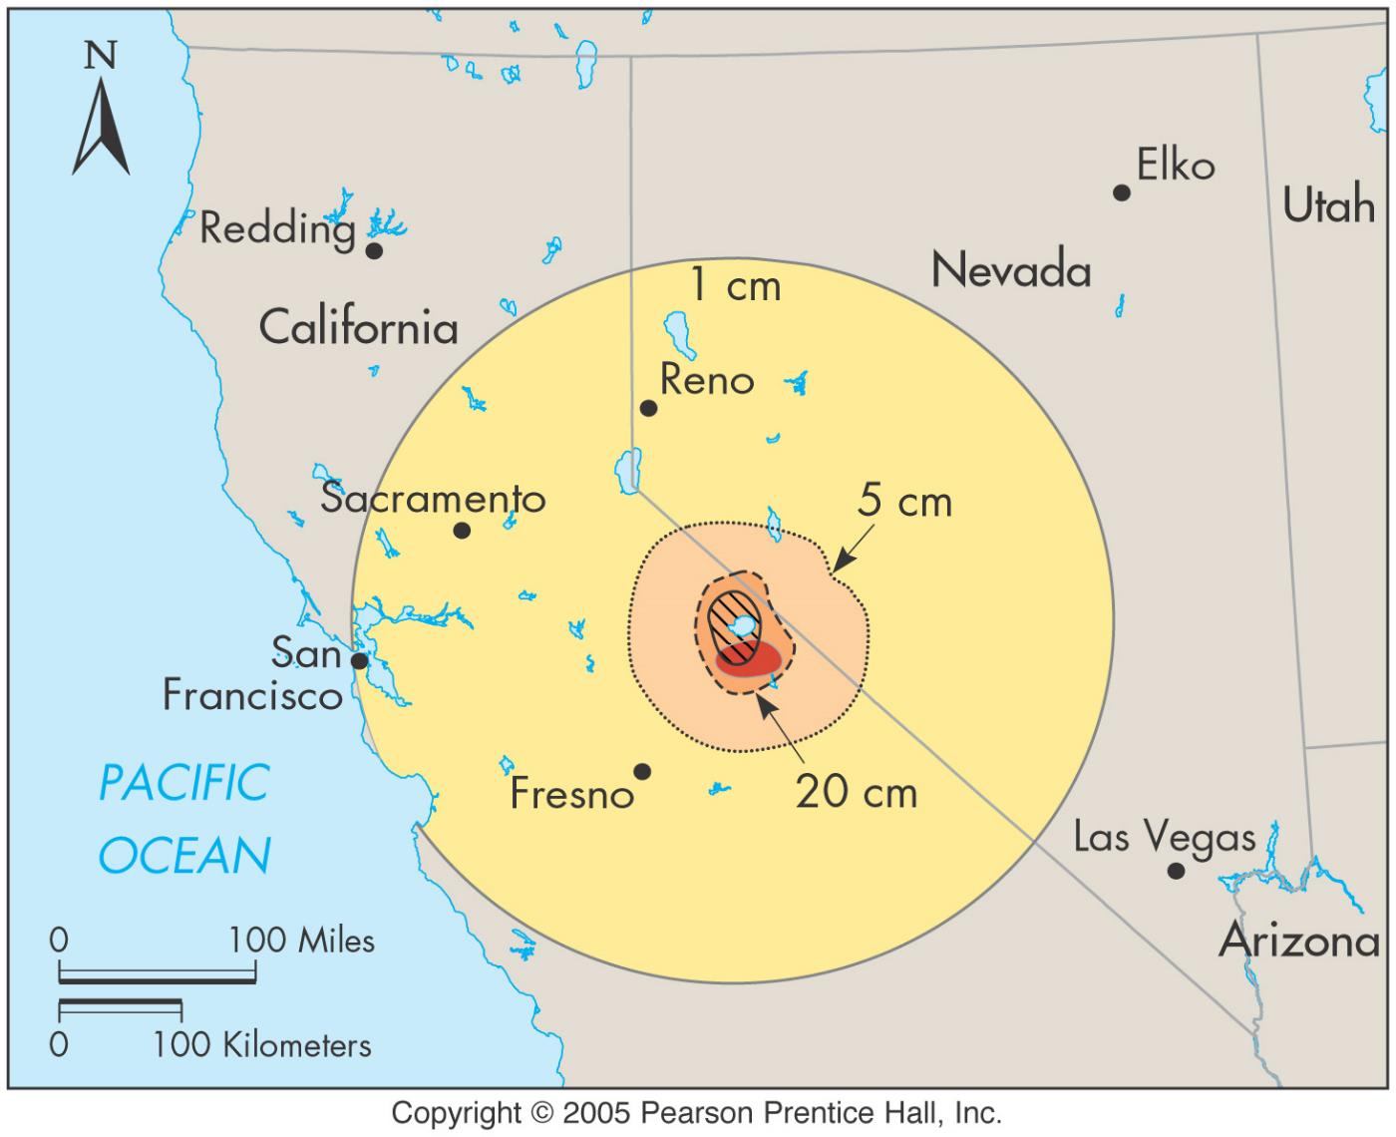
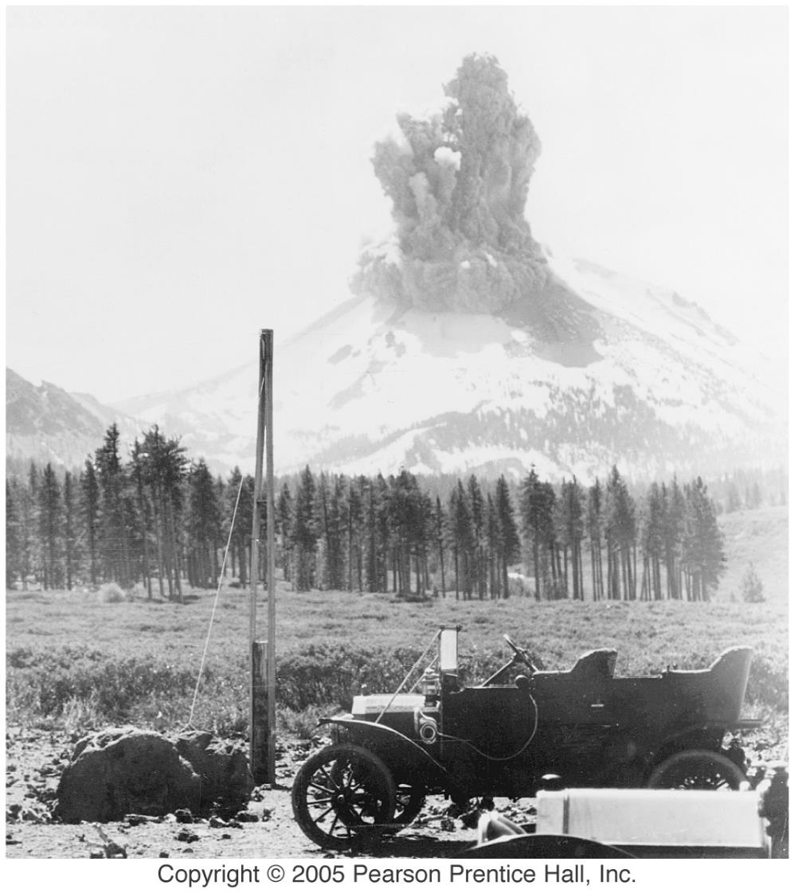
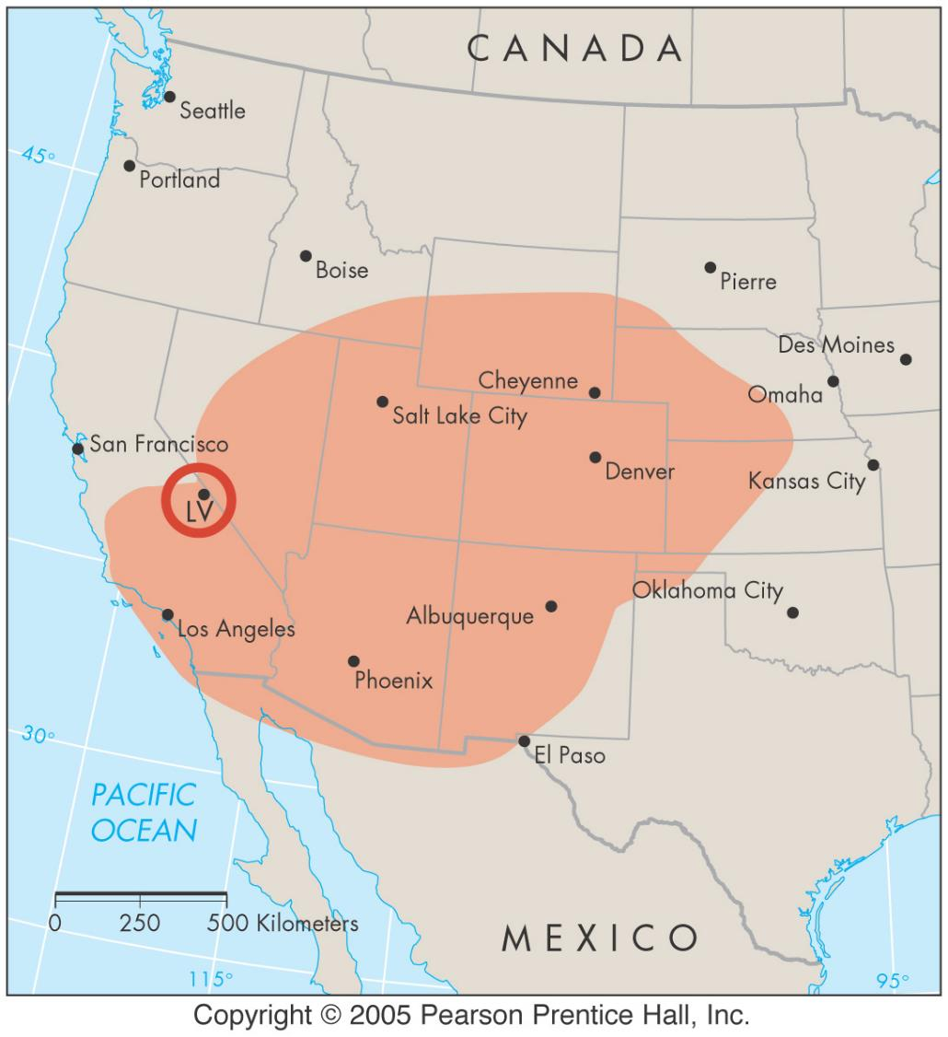
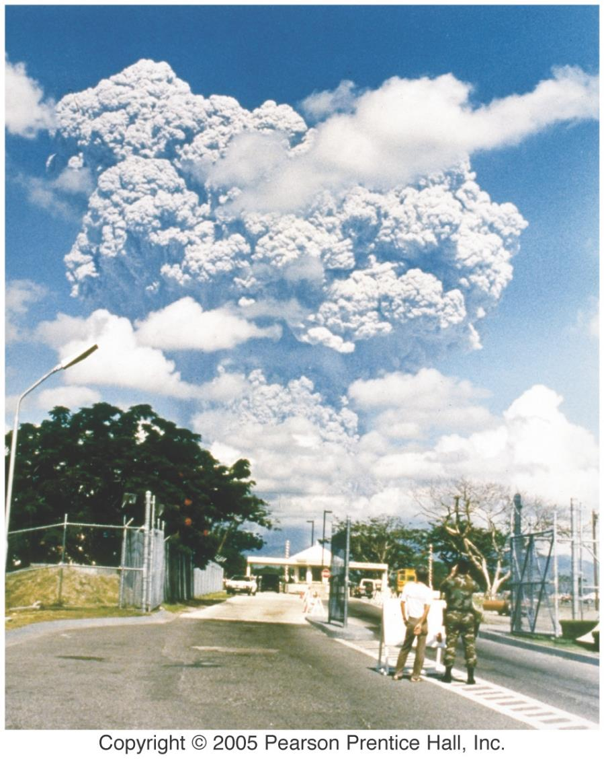
Volcano Effects
Pyroclastic activity
blocks & bombs
ash flow
http://www.geo.mtu.edu/volcanoes/west.indies/soufriere/govt/images/051296/
ash fall

Slide 8
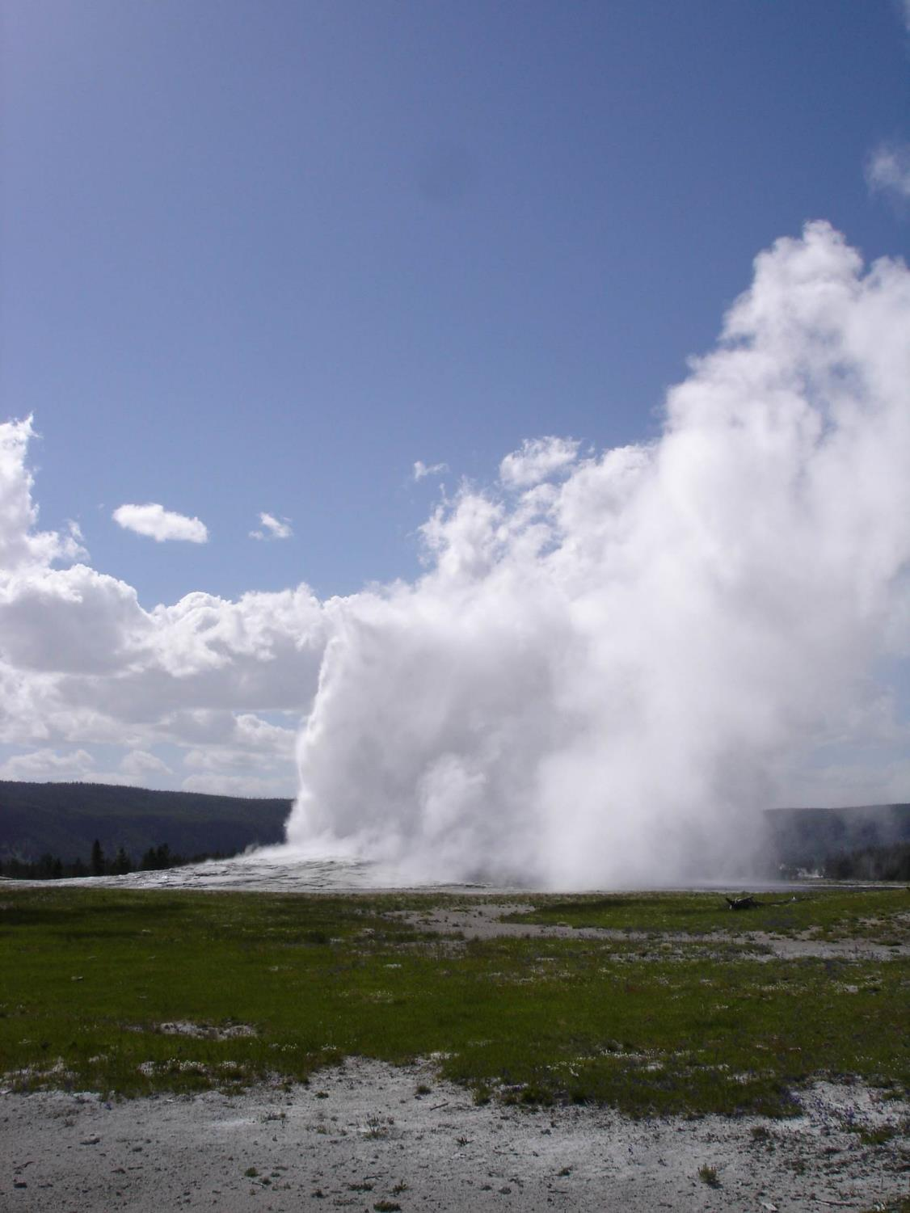
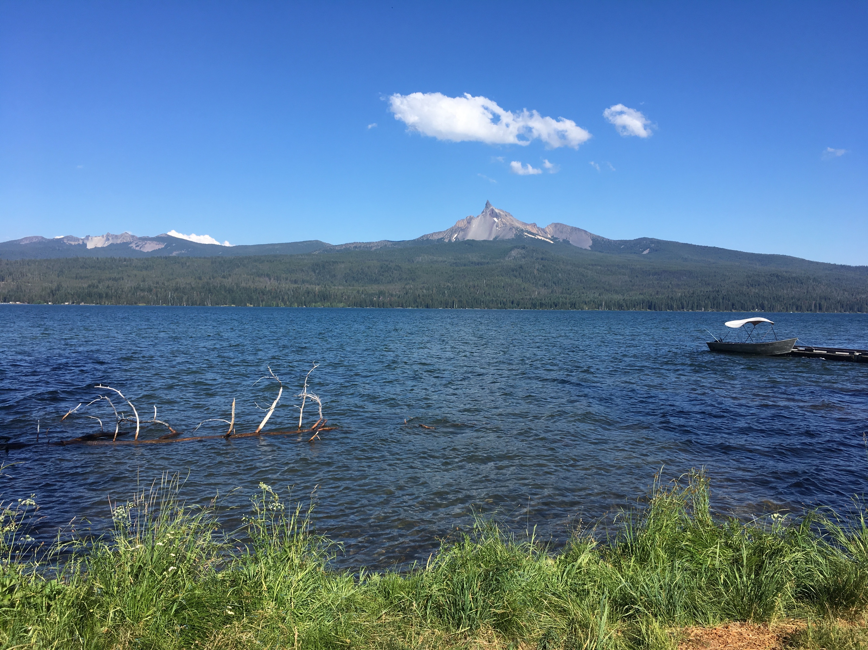
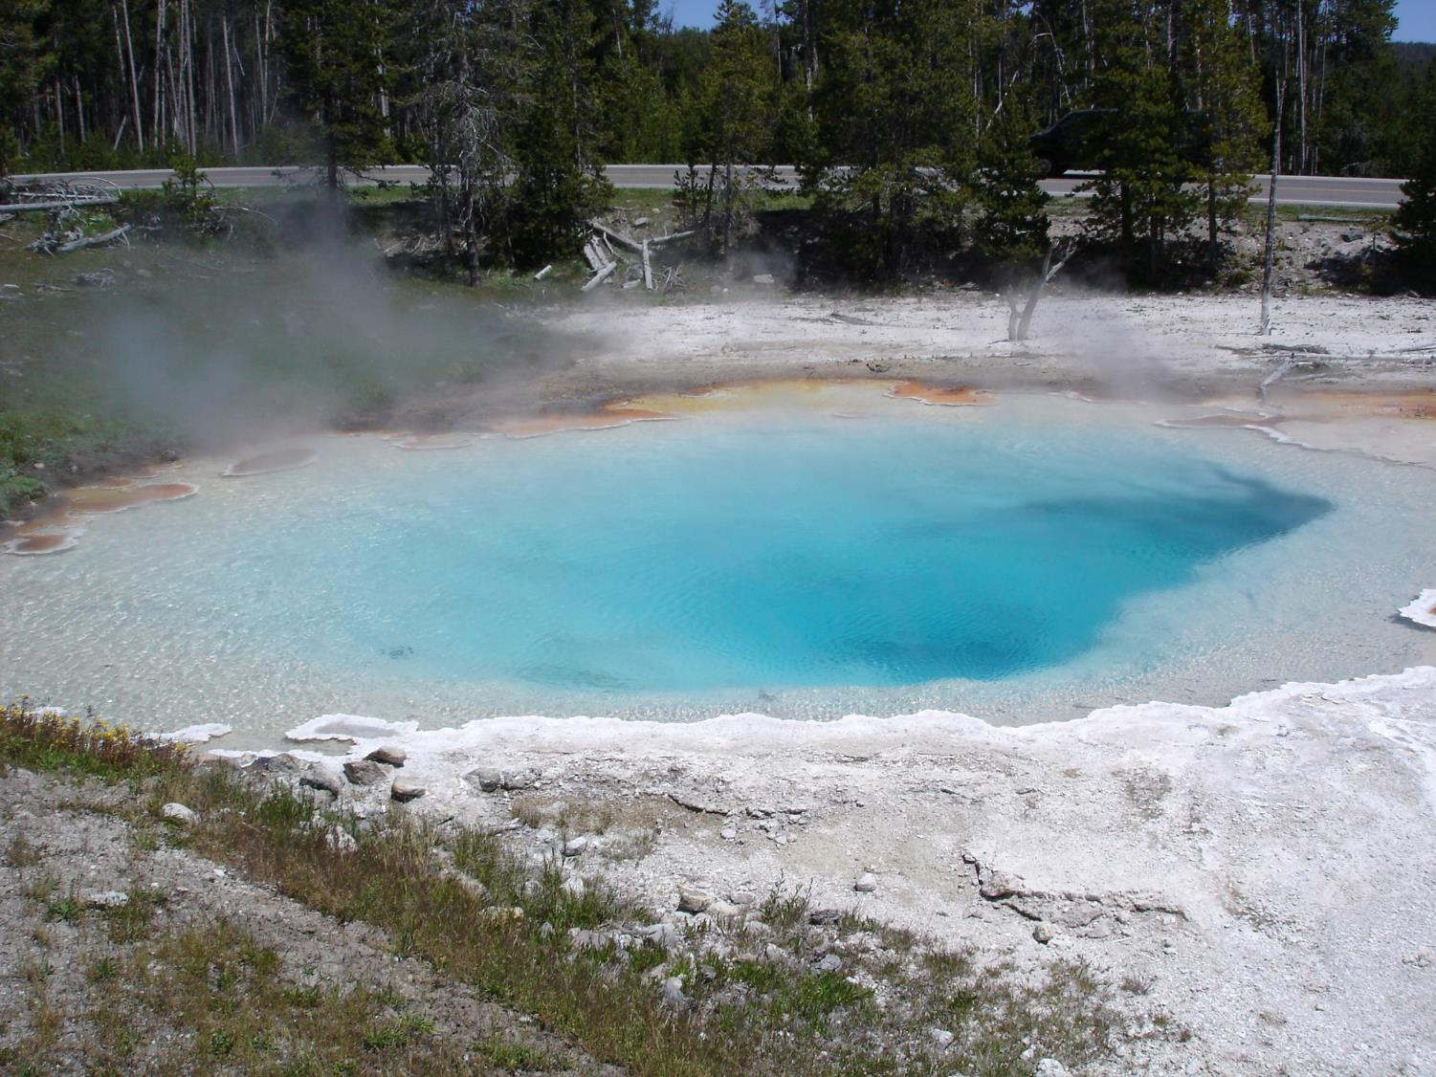
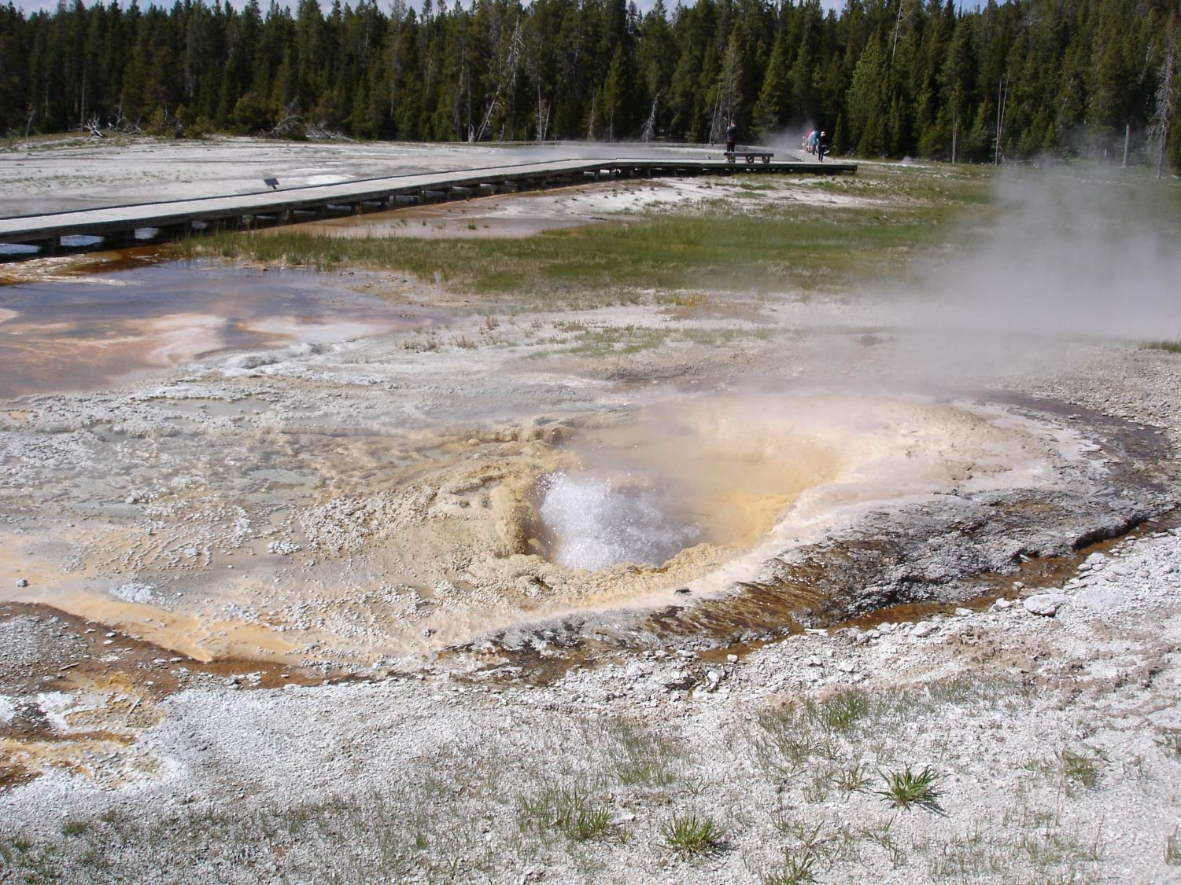
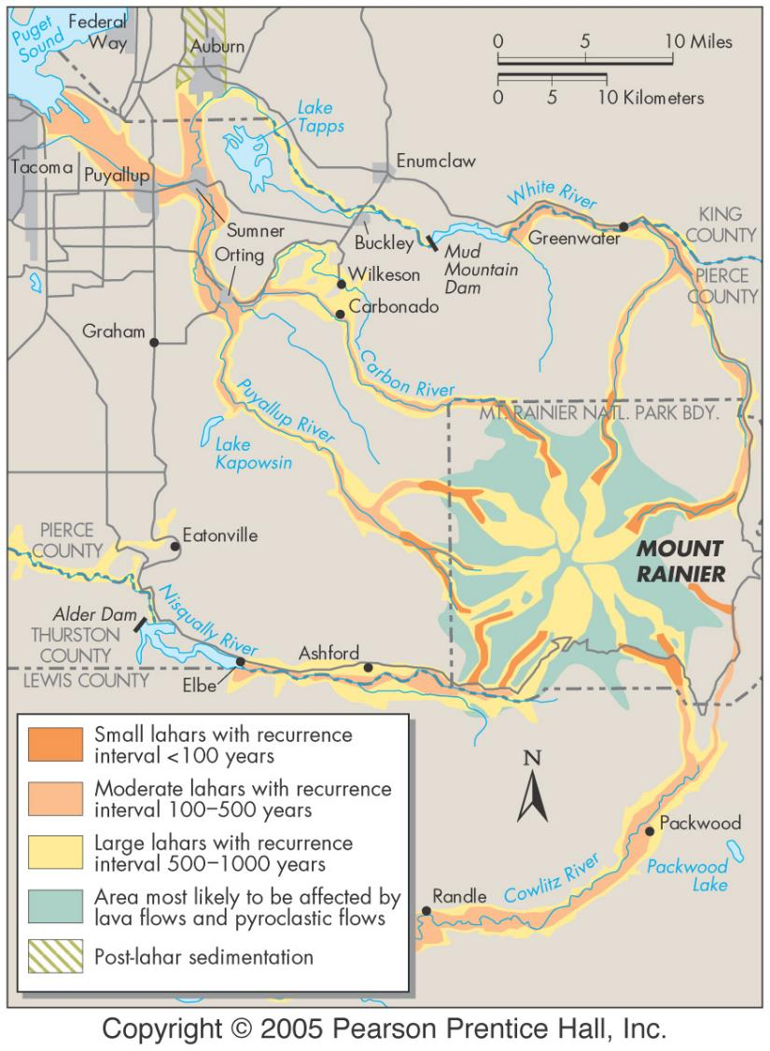
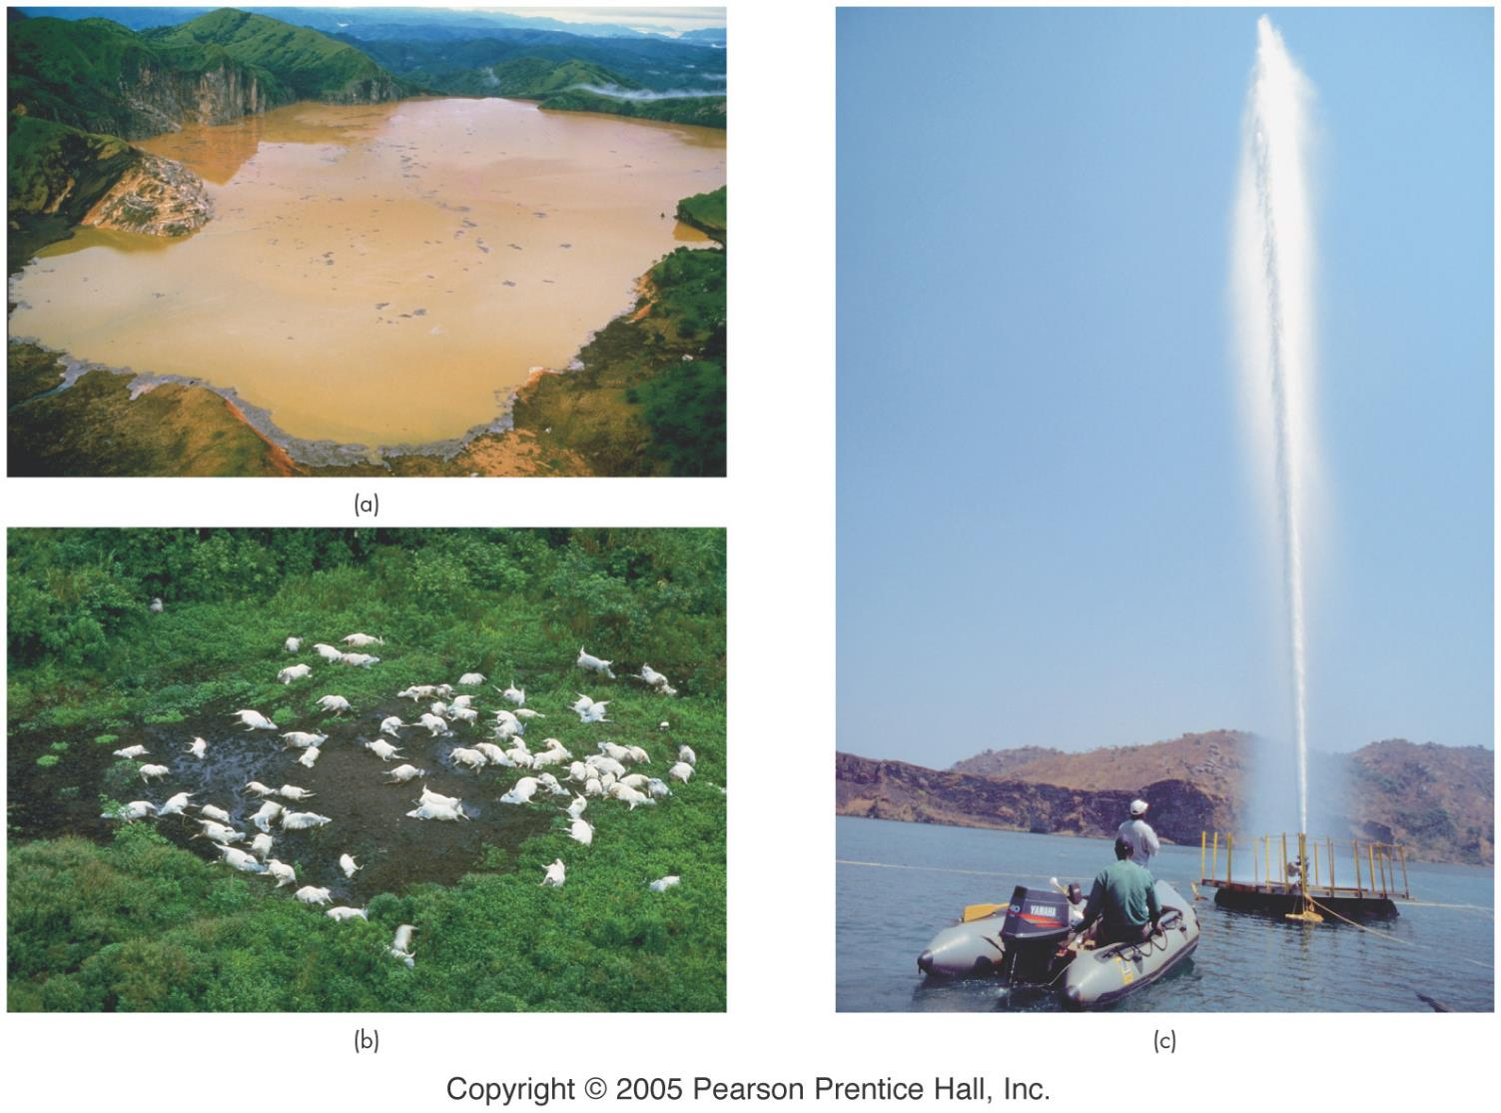
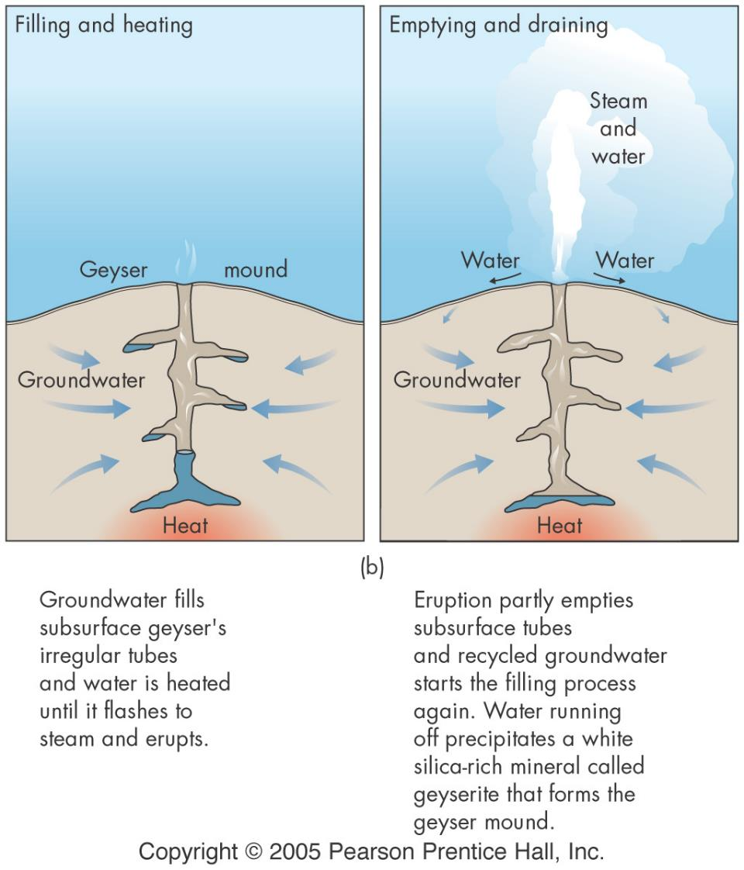
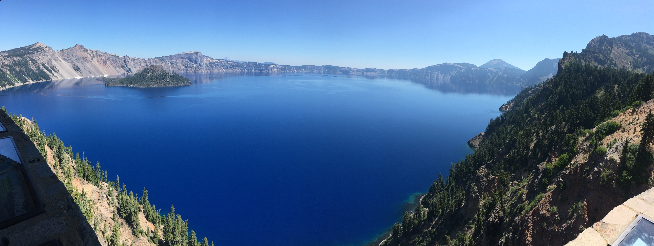
Volcano Effects
gases
H₂O, CO₂ CO, SO₂, H₂SO₄
during eruption or dormancy
debris flows and mudflows (lahars)
fires
Caldera forming eruptions
hot springs & geysers

Slide 9
Identification of volcanic hazard
active - dormant - inactive
hazardous areas
identify effects of previous eruptions
examine current conditions

Slide 10
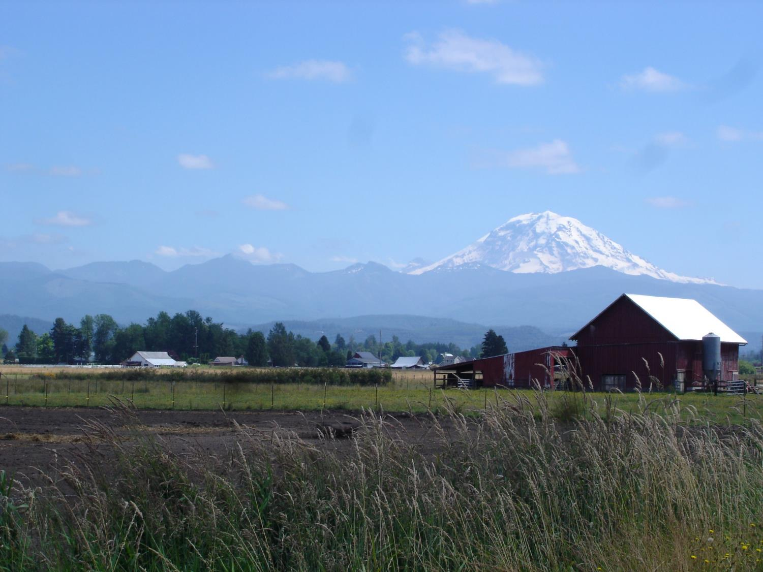

Slide 11
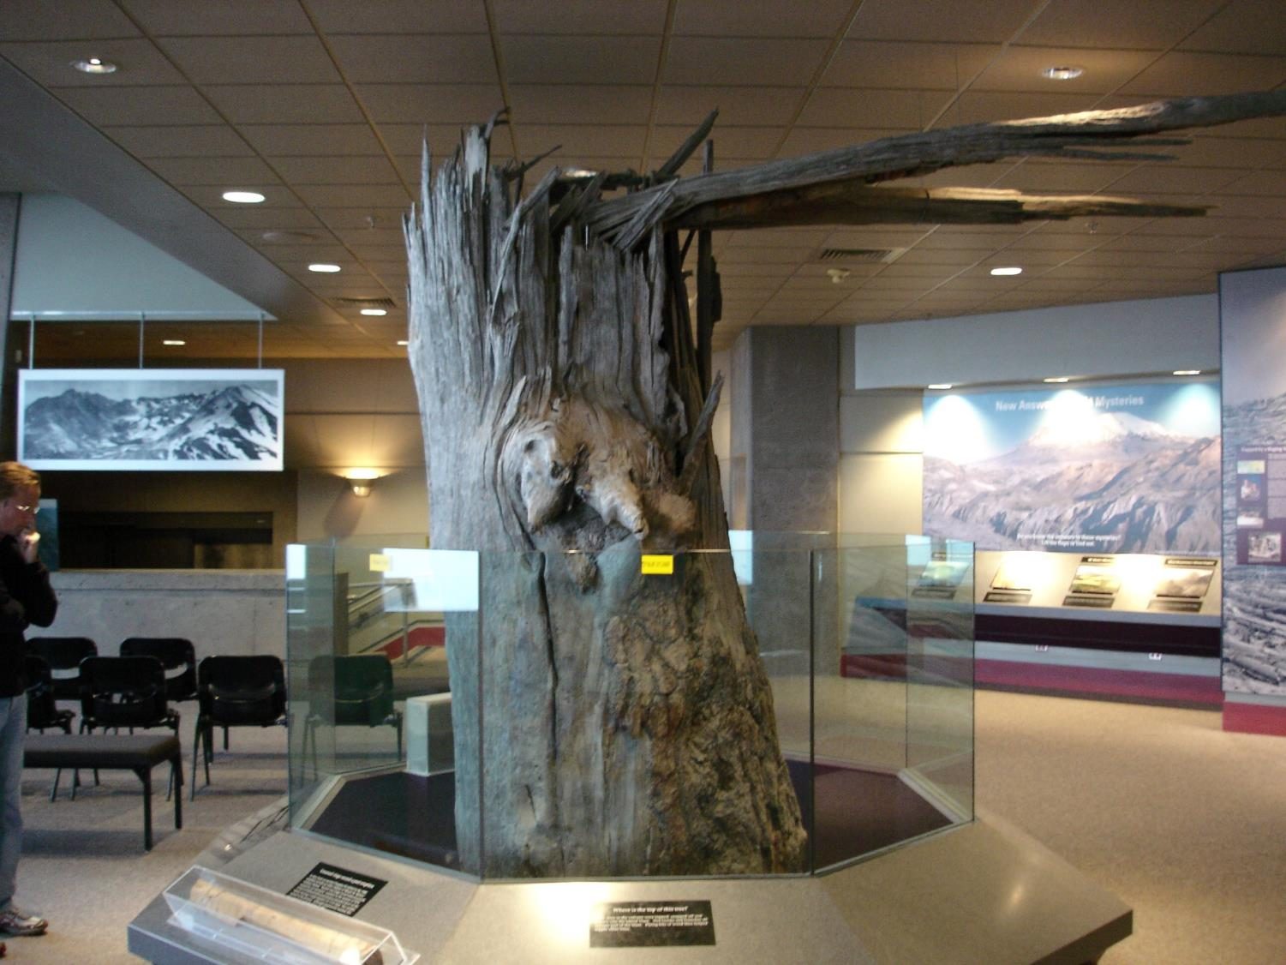
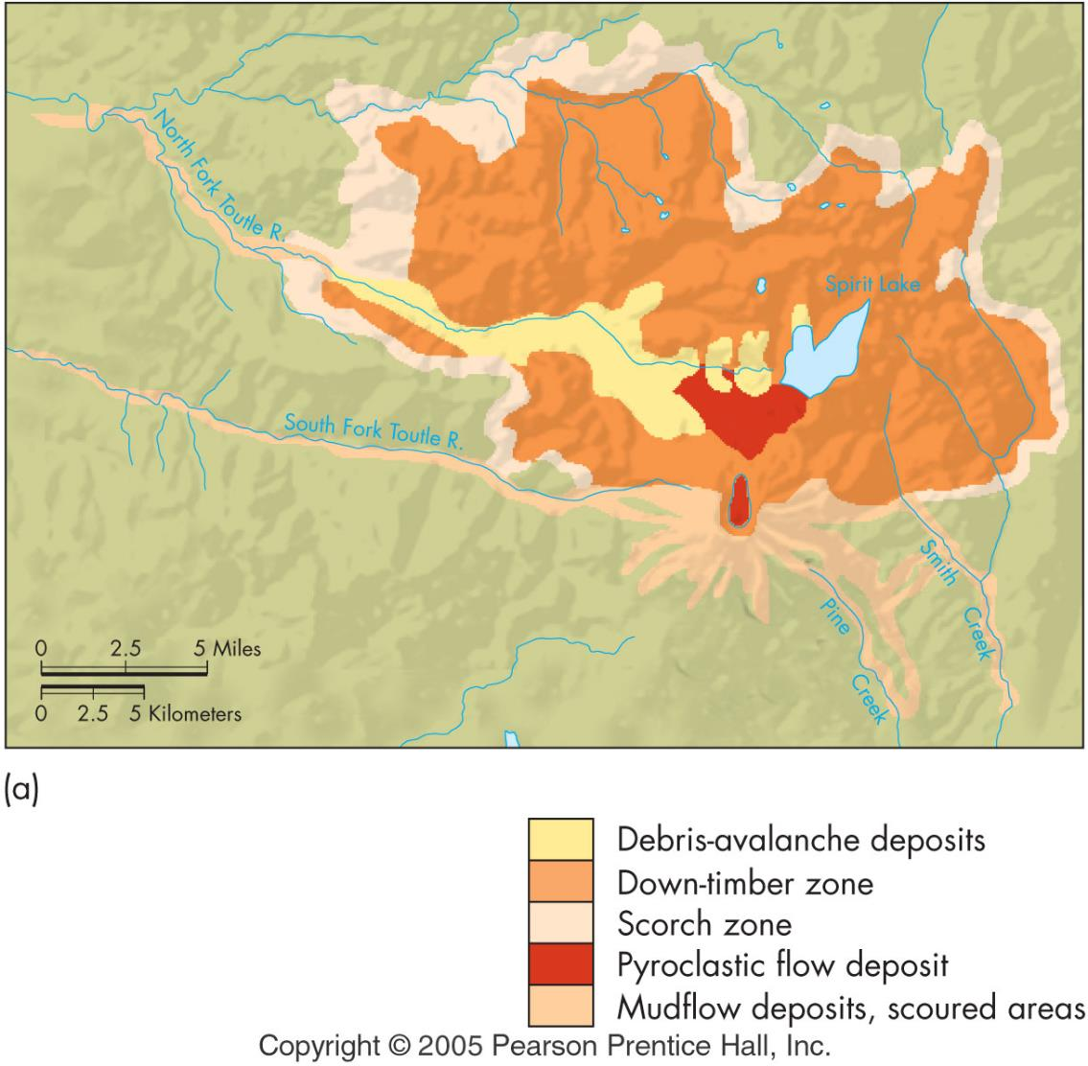

Slide 12
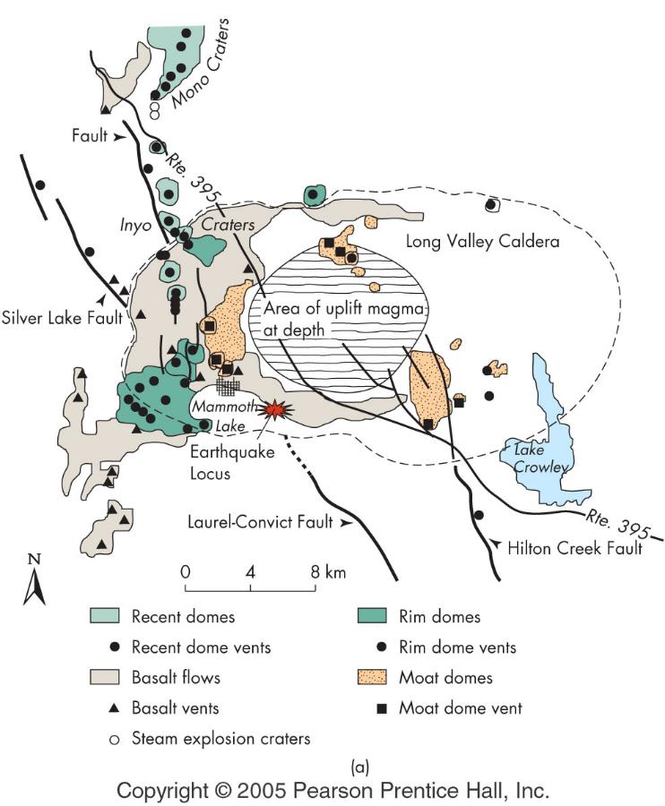
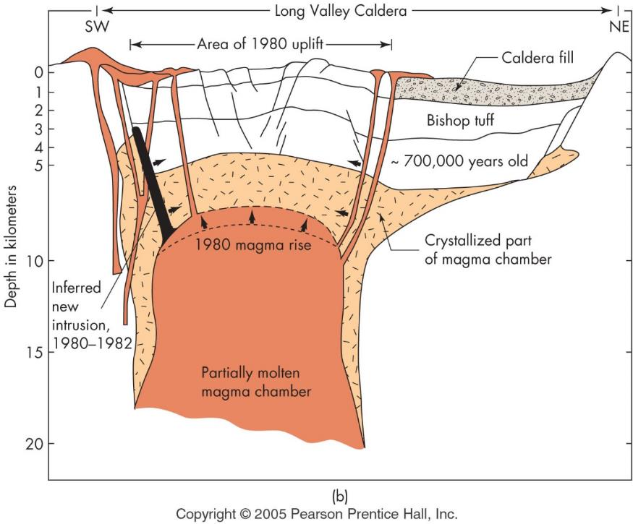
Prediction of eruptions
geophysical monitoring
topographic changes
gas emissions
geologic history

Slide 13
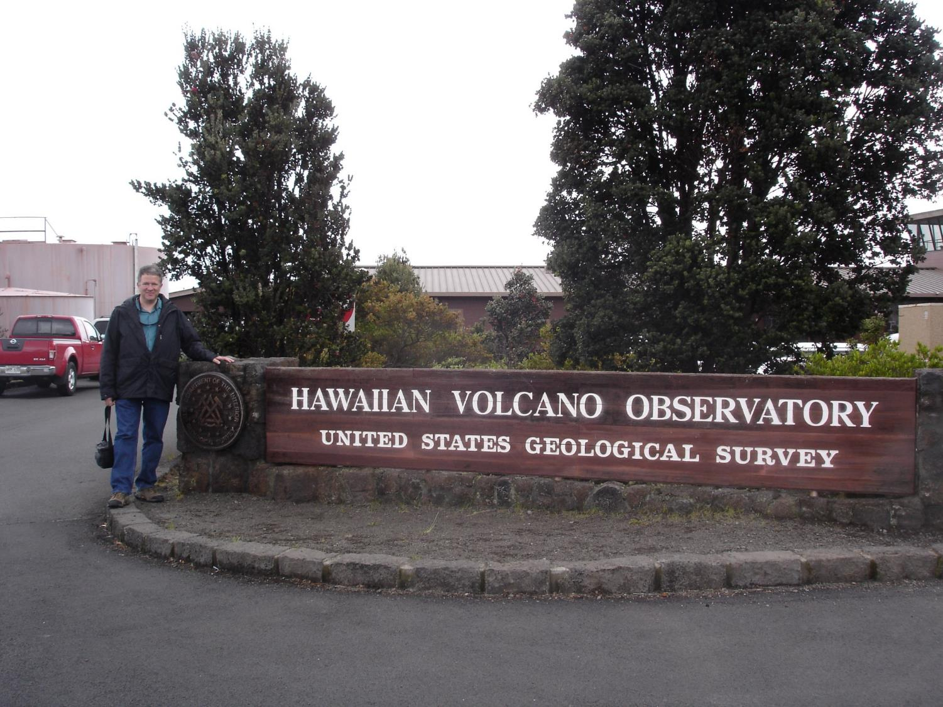

Slide 14
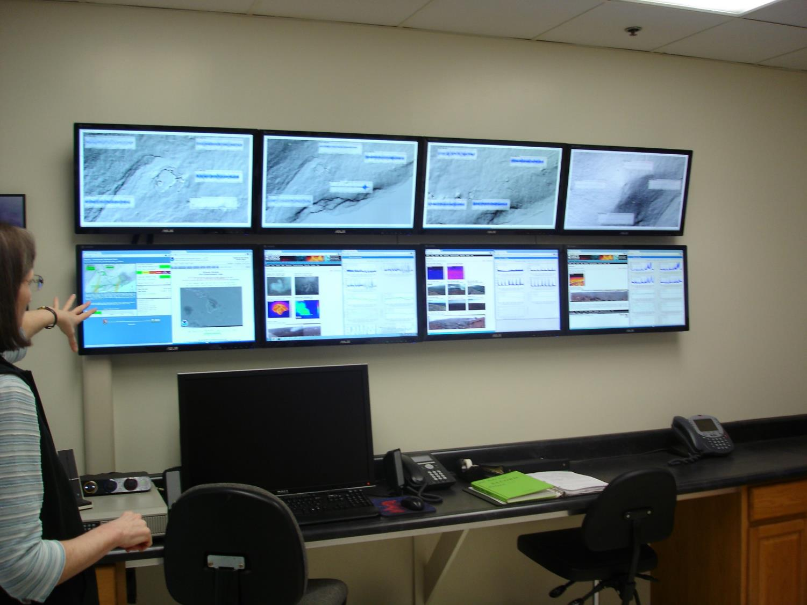

Slide 15
