Slide 1
GEL 1007
Environmental Geology

Slide 2
Basics
Mike Phillips
224-0394
Office B-317
mike_phillips@ivcc.edu
put “GEL 1007” in the subject line
https://facultyweb.ivcc.edu/mphillips/
my courses>GEL 1007
about me>contact info

Slide 3
Chapter 1: Philosophy and Fundamental Concepts

Slide 4
Geology
science
study of the earth
physical - how the earth works
historical - what the earth was like in the past

Slide 5
Environment
total set of circumstances that surround an individual or community
all physical conditions
social and cultural conditions

Slide 6
Environmental Geology
applied geology
interactions between humans and the earth

Slide 7
Environmental Geology – areas of focus
earth materials
hydrologic processes
geologic processes
resources
natural hazards
impacts of human activity

Slide 8
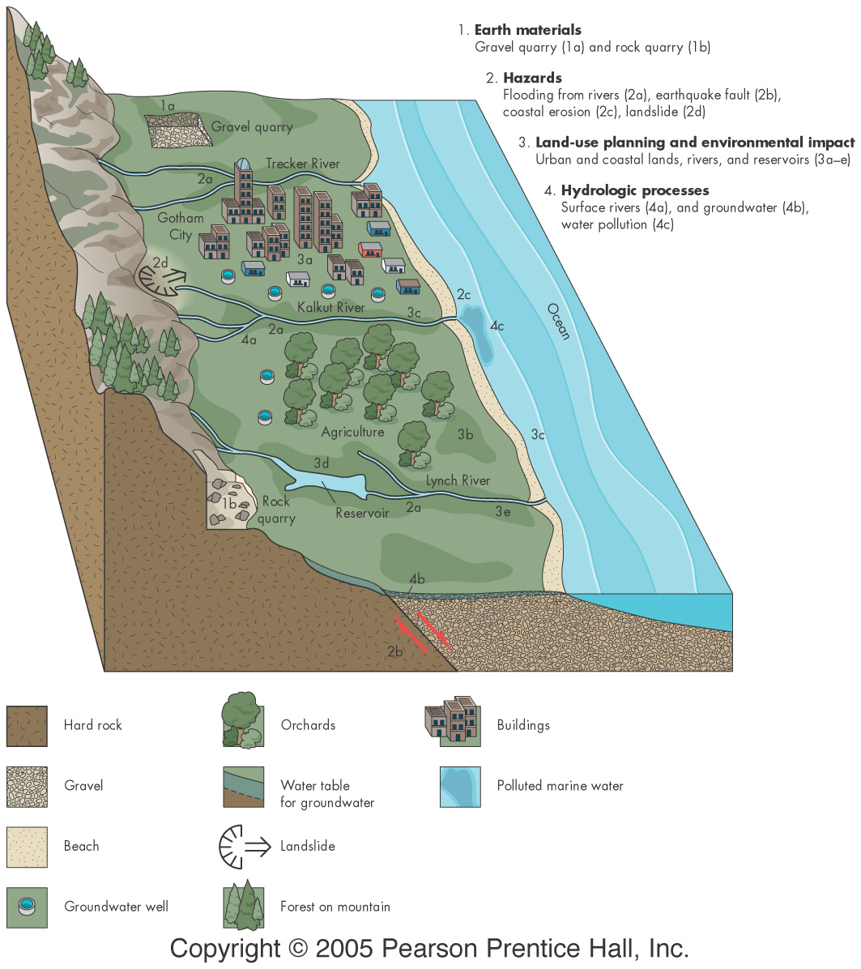
01_01

Slide 9
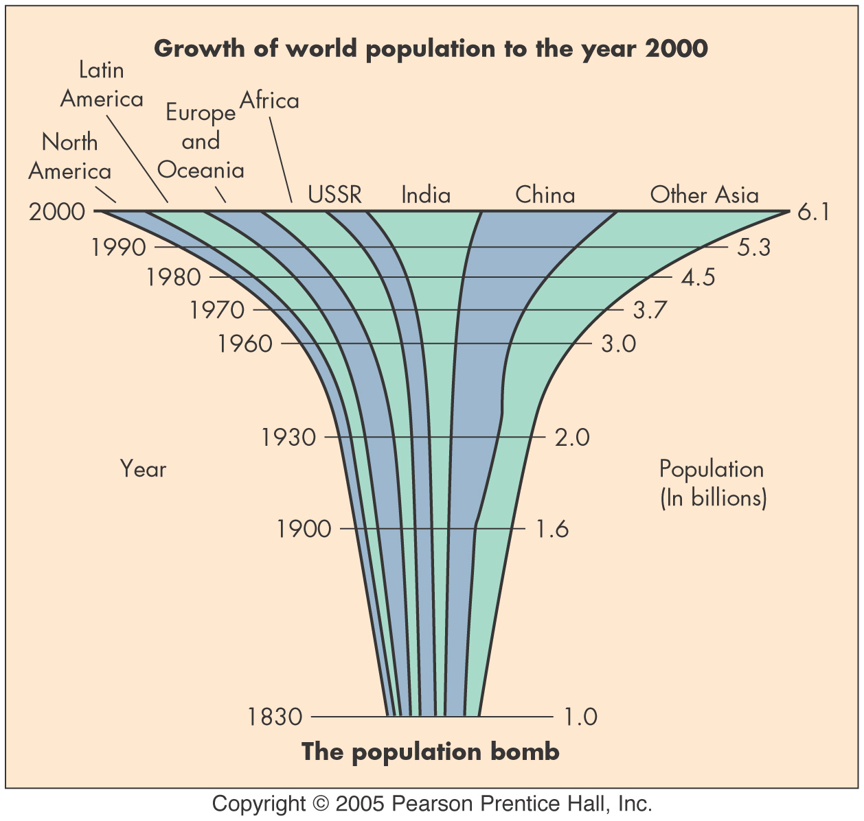
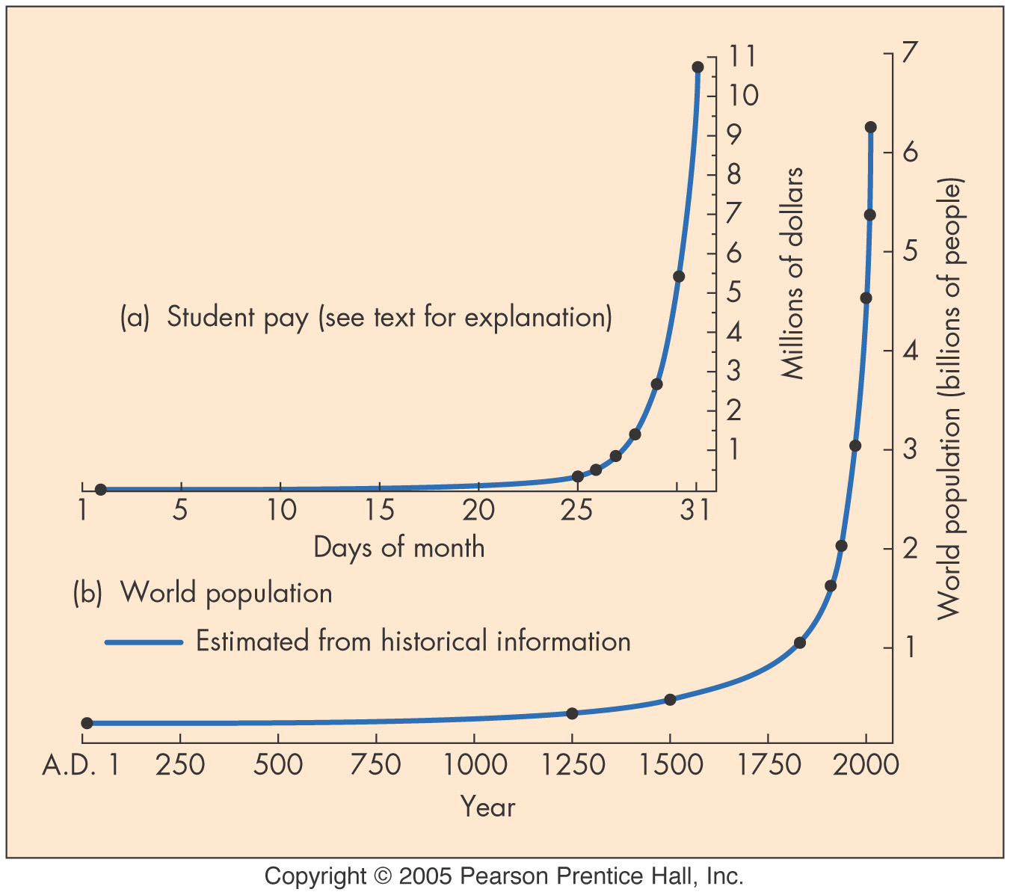
Fundamental Concepts
Human Population Growth
Number one environmental problem
What is the carrying capacity?
local ecosystem
Earth

Slide 10
Fundamental Concepts
Sustainability
What can the earth support for the long haul?
Earth as a set of interconnected systems
Hazardous Earth Processes

Slide 11
Fundamental Concepts
Scientific Knowledge & Values
Goal: Objective examination
scientific “method”
reliance on data
peer reviewed
Uniformitarianism/Actualism

Slide 12
Traditional Environmental Knowledge
Embedded understanding
Indigenous peoples & their life-ways
Place-based
Culturally integrated
Incorporates important information
historical conditions
location-based adaptations

Slide 13
Other Key Concepts
Ethics
Economics
Politics

Slide 14
Important Considerations
Obligations to future generations
Affects of land use are cumulative
Importance of aesthetic considerations
Environmental justice

Slide 15
Environmental Justice
environmental health as it relates to:
race
social standing
wealth
clean environment is a civil right
examples
environmental racism
toxic colonialism

Slide 16
Common Property
usually “owned” by all (or by no one)
poor use due to
open, unregulated access
benefits of use are focused
costs are widely distributed
must be carefully managed

Slide 17
What do you hope to gain?
How does environmental geology relate to your field of study? (be creative)
How has geology impacted your life?
What are you curious about?
If you can relate this subject to something that interests you…you will be more successful in this class.

