Slide 1
Chapter 2: Internal Structure of the Earth & Plate Tectonics

Slide 2
Earth’s Interior
evidence
seismology
samples
volcanoes
drilling
meteors
gravity
magnetics

Slide 3
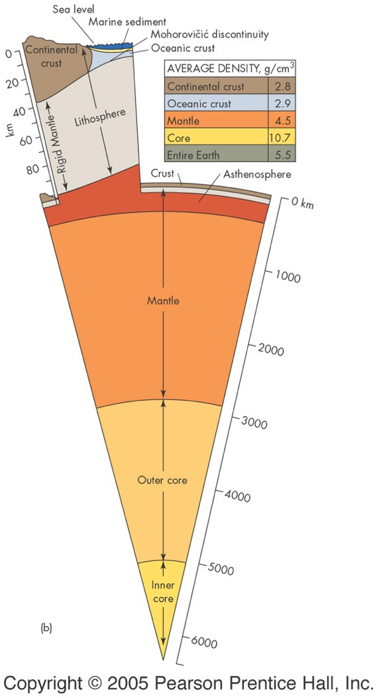
Earth layers - core
Fe & Ni
10.7 g/cm³
inner core - solid
outer core - liquid
convects (see next slide)
source of Earth’s magnetic field

Slide 4
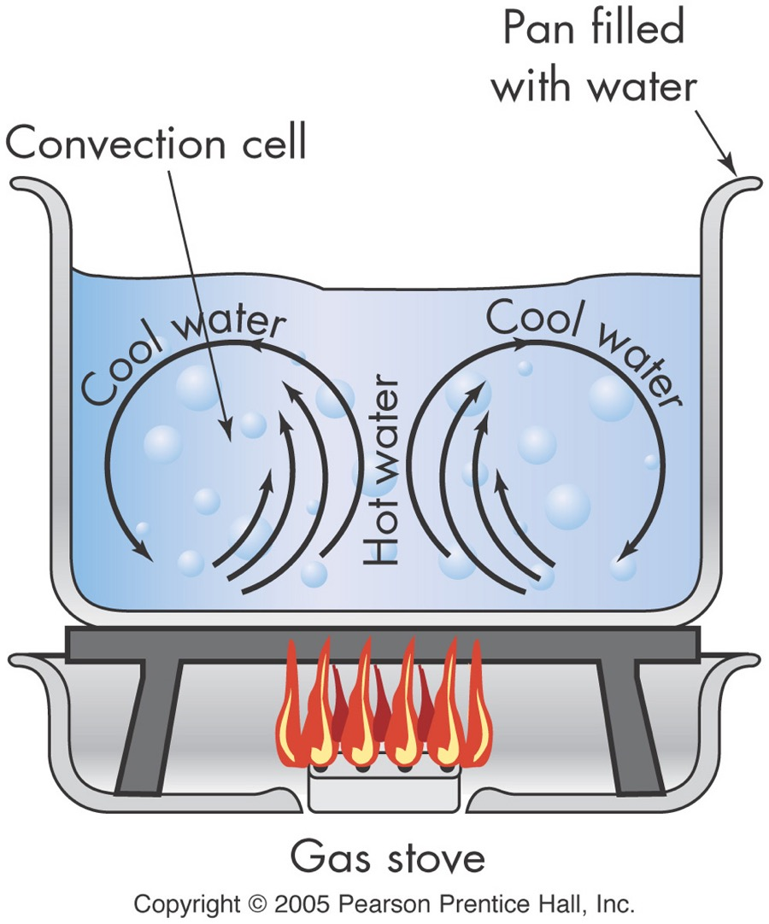
Convection

Slide 5
Earth layers - mantle
ultramafic (Fe, Mg, Si, O)
4.5 g/cm³
lower mantle
ductile solid
asthenosphere
partially molten
uppermost mantle
lower lithosphere – rigid

Slide 6
Earth layers - crust
rigid
ocean
5 km (3 mi) thick
mafic igneous (Fe, Mg, Ca, Si, O)
2.8-3.0 g/cm³
continental
20-35 km (12-25 mi) thick
intermediate to felsic igneous
(Si, O, Al, K, Na)
2.6-2.8 g/cm³

Slide 7
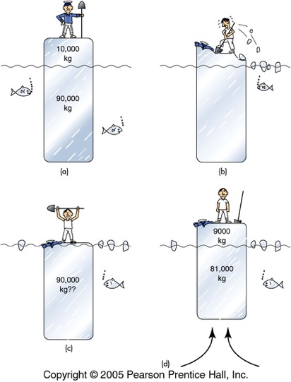
Plate Tectonics
Lithospheric plates
rigid upper mantle & crust
float on asthenosphere
appx 100 km thick
move
horizontal - 2-15 cm/yr
vertical - isostacy

Slide 8
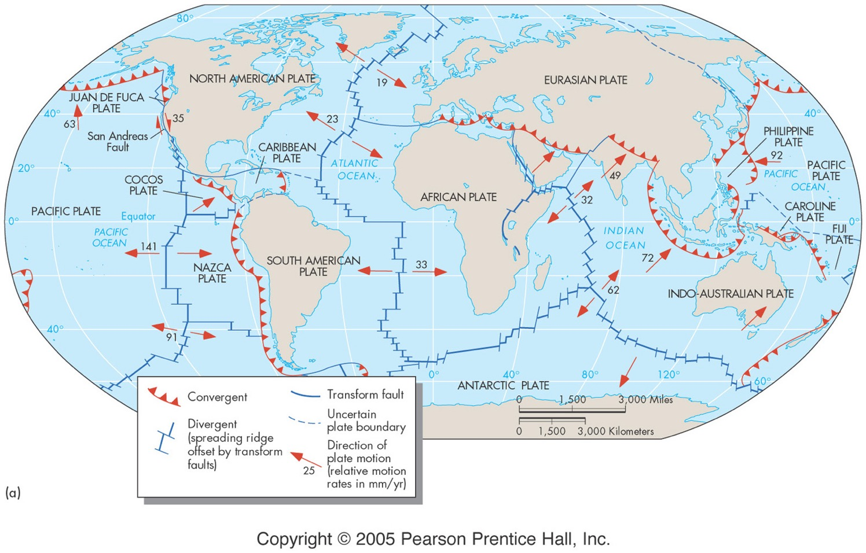

Slide 9
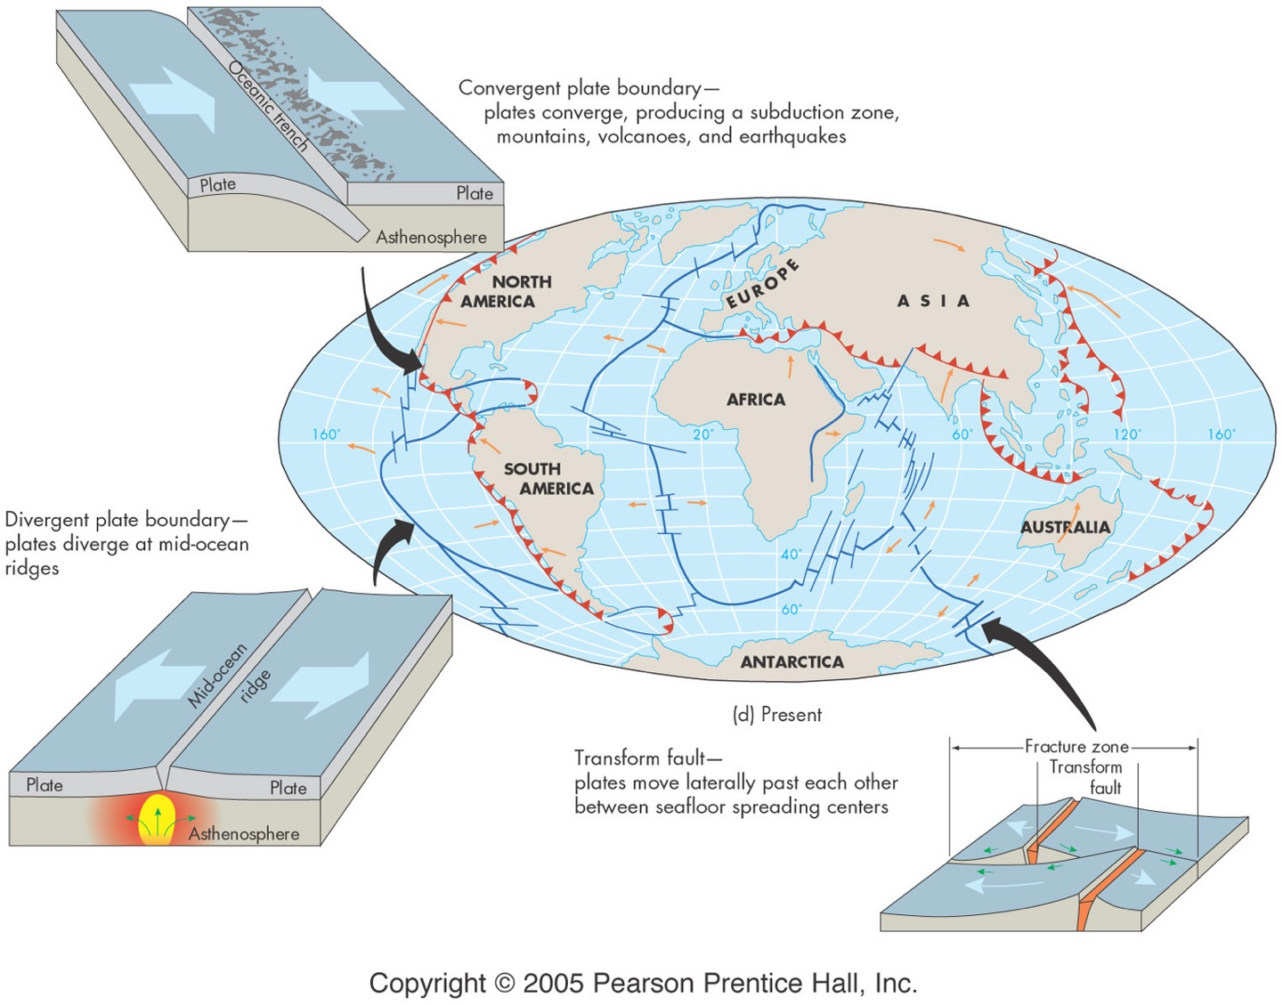

Slide 10
Divergent boundaries
plates pull apart
ocean basins form
topographic features
rift valley (normal faulting)
mid-ocean ridge
geologic activity
shallow EQ’s
igneous activity - mafic & ultramafic
history - age of the sea floor

Slide 11
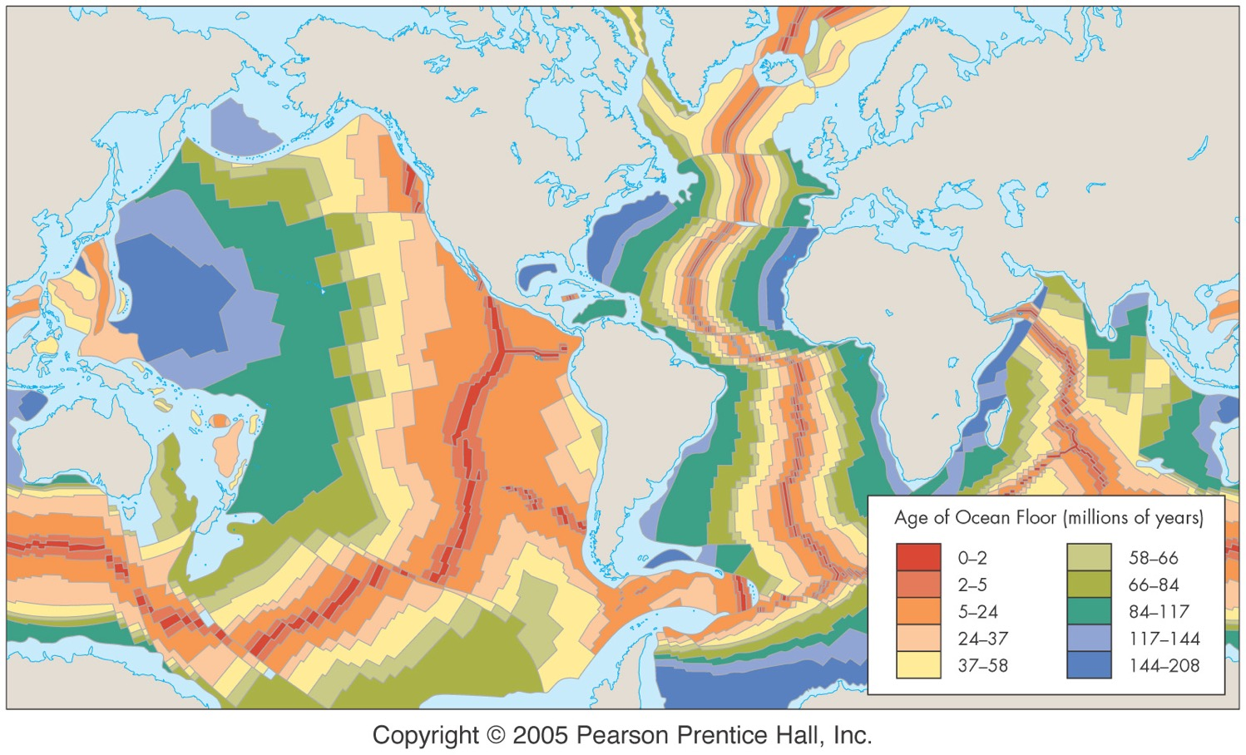

Slide 12
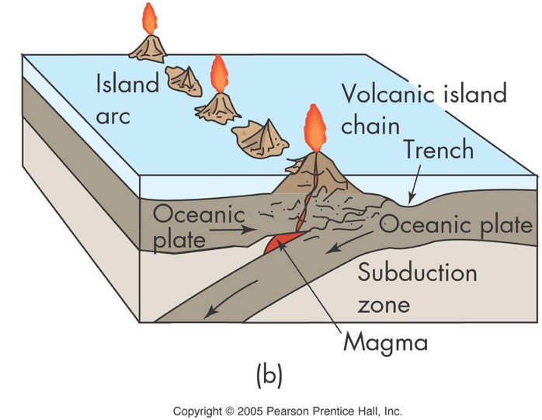
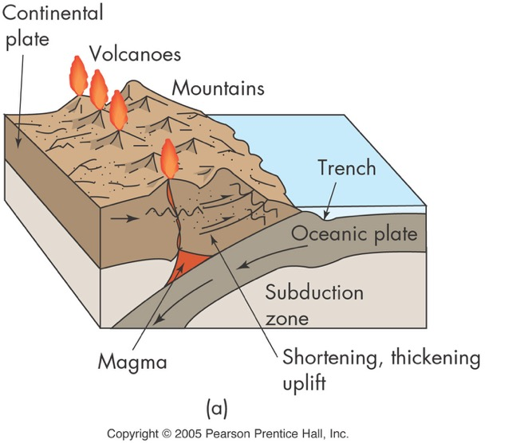
Convergent Boundaries O-O and O-C
subduction
ocean lithosphere overrun
topographic features
mountain ranges
volcanoes
ocean trench
faults (reverse & thrust)

Slide 13
Convergent Boundaries O-O and O-C
geologic effects
shallow and deep EQ’s
igneous activity - intermediate & felsic
regional metamorphism (in long belts)
ophiolites (ocean lithosphere pushed onto a continent)
accreted terranes (continental lithosphere joined)
Japan, Andes Mtns., Cascade Mtns., New Zealand, Philippines, Aleutian Islands, Caribbean Islands

Slide 14
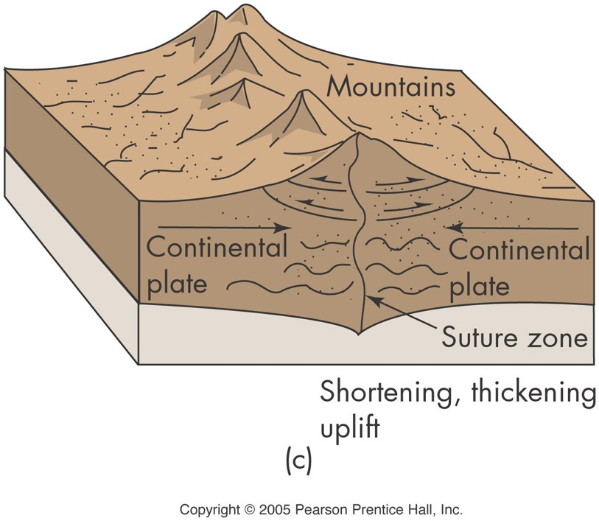
Convergent Boundaries C-C
topographic features
large mountains
faults
geologic effects
shallow EQs
Himalayas &
Appalacians

Slide 15
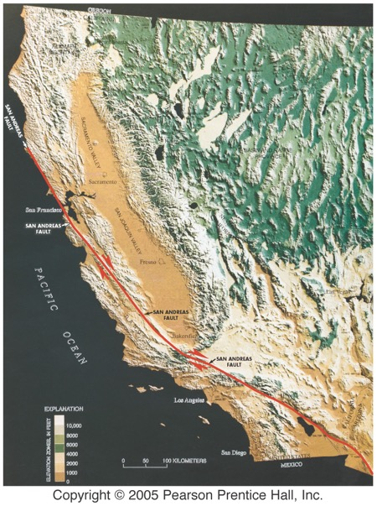
Transform Boundaries
topographic features
complex faulting
small mountains
geologic effects
shallow EQ’s
California, Turkey

Slide 16
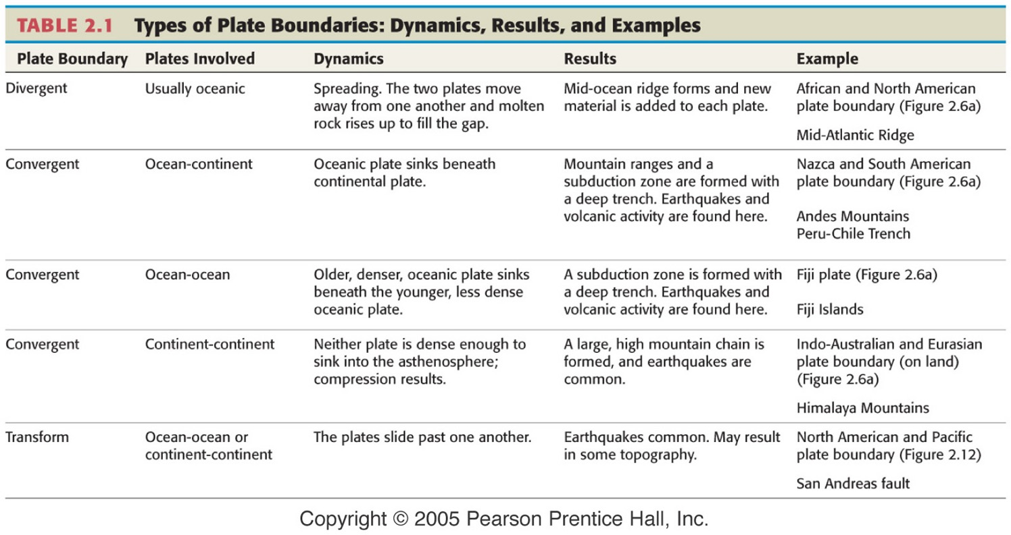

Slide 17
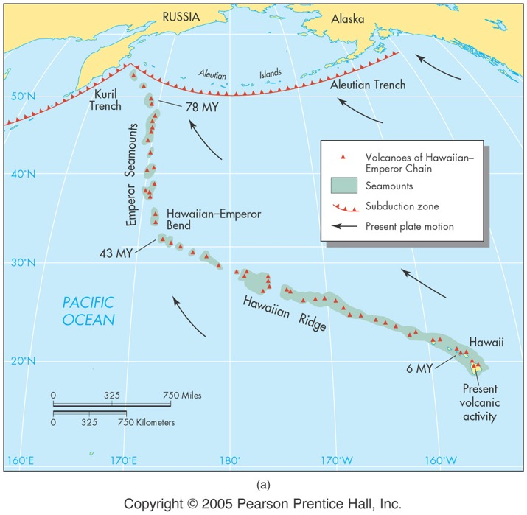
Hot Spots
not a boundary
topographic features
volcanic chain (one or two active volcanoes at end of chain)
geologic effects
isolated igneous activity
Hawaii, Yellowstone

Slide 18
Plate Tectonics and Environmental Geology
resource zones
fossil fuels
minerals
hazard zones
earthquakes
volcanoes
landscapes
climate effects

Slide 19
