Slide 1
Chapter 9: Rivers & Flooding

Slide 2
Basics of rivers
flowing surface water within a channel
source of water – precipitation via:
overland flow
groundwater

Slide 3
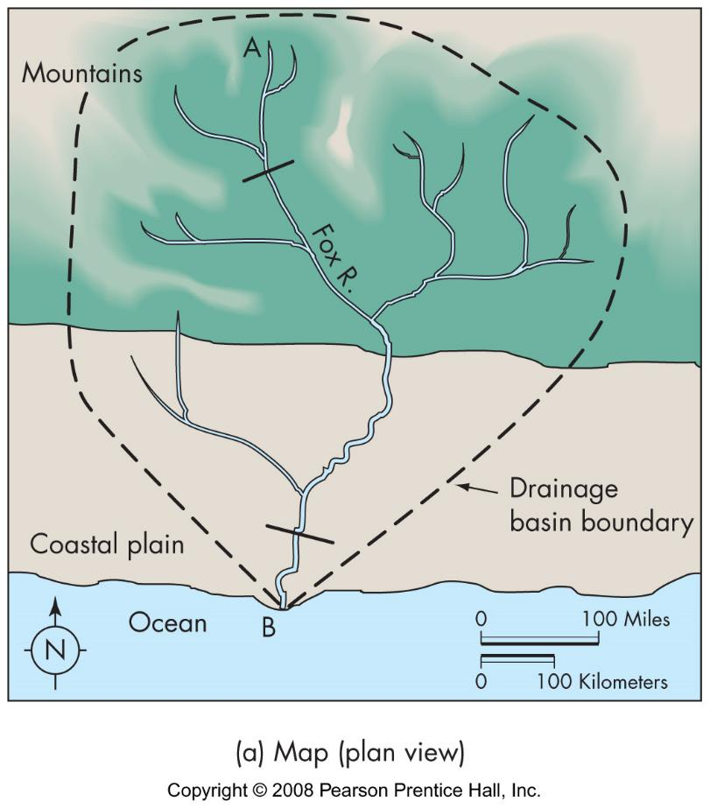
Basics of rivers
basin (watershed)
area drained by stream
characteristics
size
drainage density
relief
infiltration capacity

Slide 4
Basics of rivers
channel characteristics
shape - width and depth
gradient
velocity
discharge - volume/time
pattern

Slide 5
Basics of rivers
sediment load
suspended load
bed load
dissolved load
erosion and deposition

Slide 6
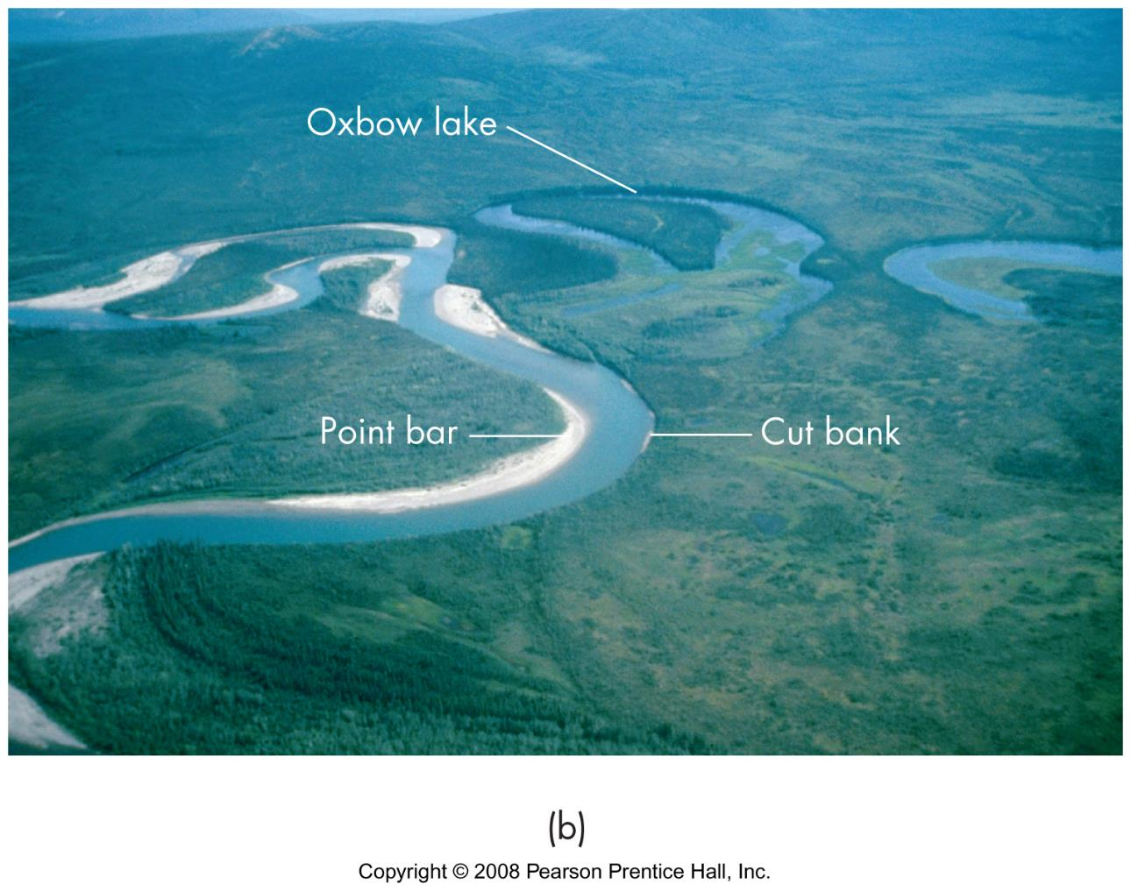
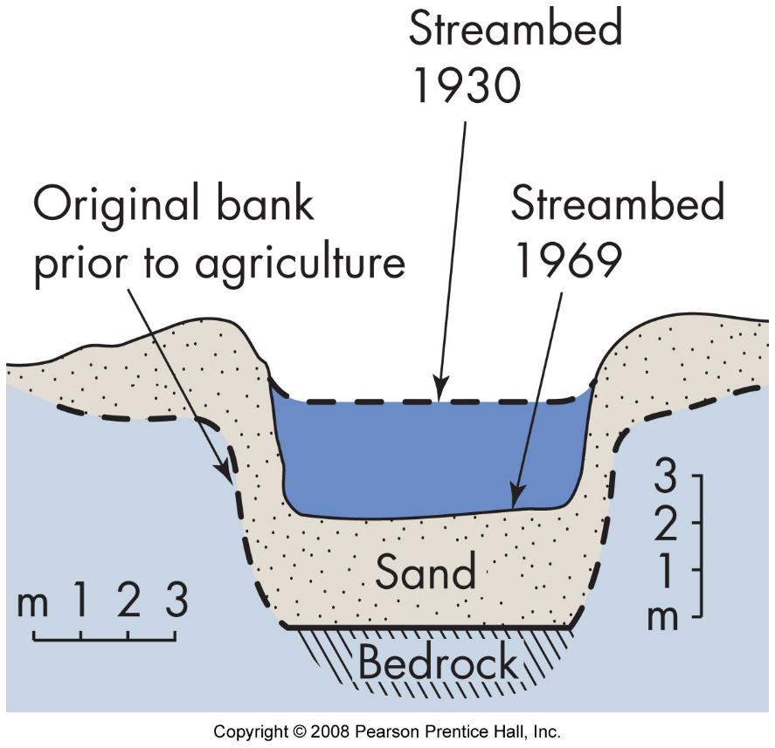
Dynamic equilibrium
describes relationship between all of a river’s characteristics
disturbing one disturbs all
stream will change until a new balance is reached

Slide 7
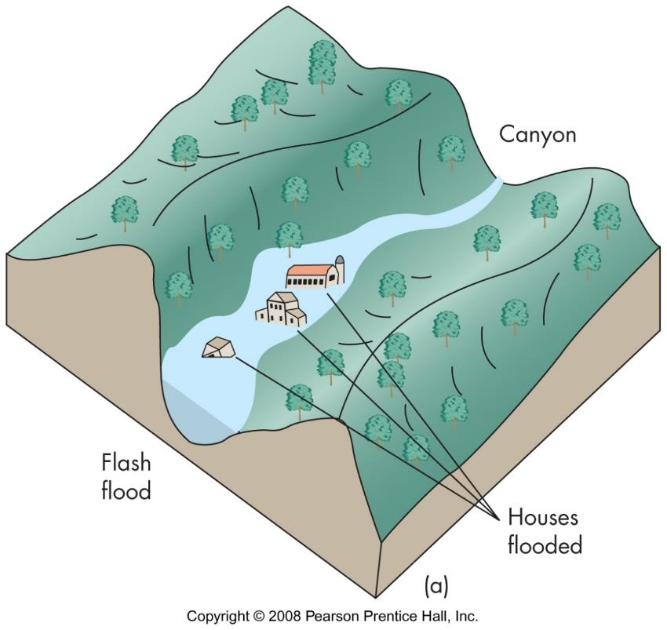
Flood types: flash flood
short intense rainfall over small area
dam failure
dissipate
downstream

Slide 8
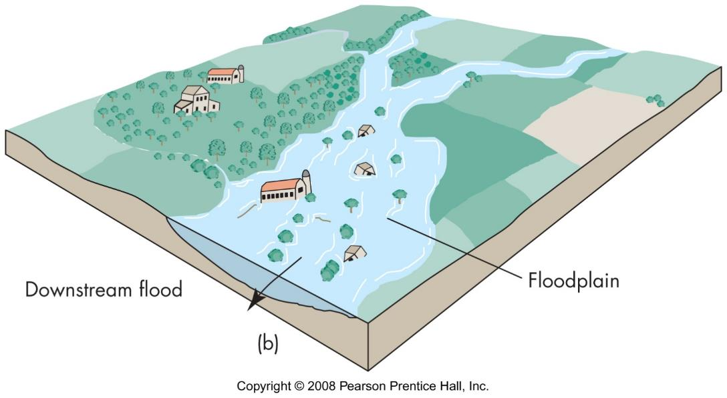
Flood types: downstream
long duration, wide spread storms
cumulative effect of many streams
long duration due to flood plain storage

Slide 9
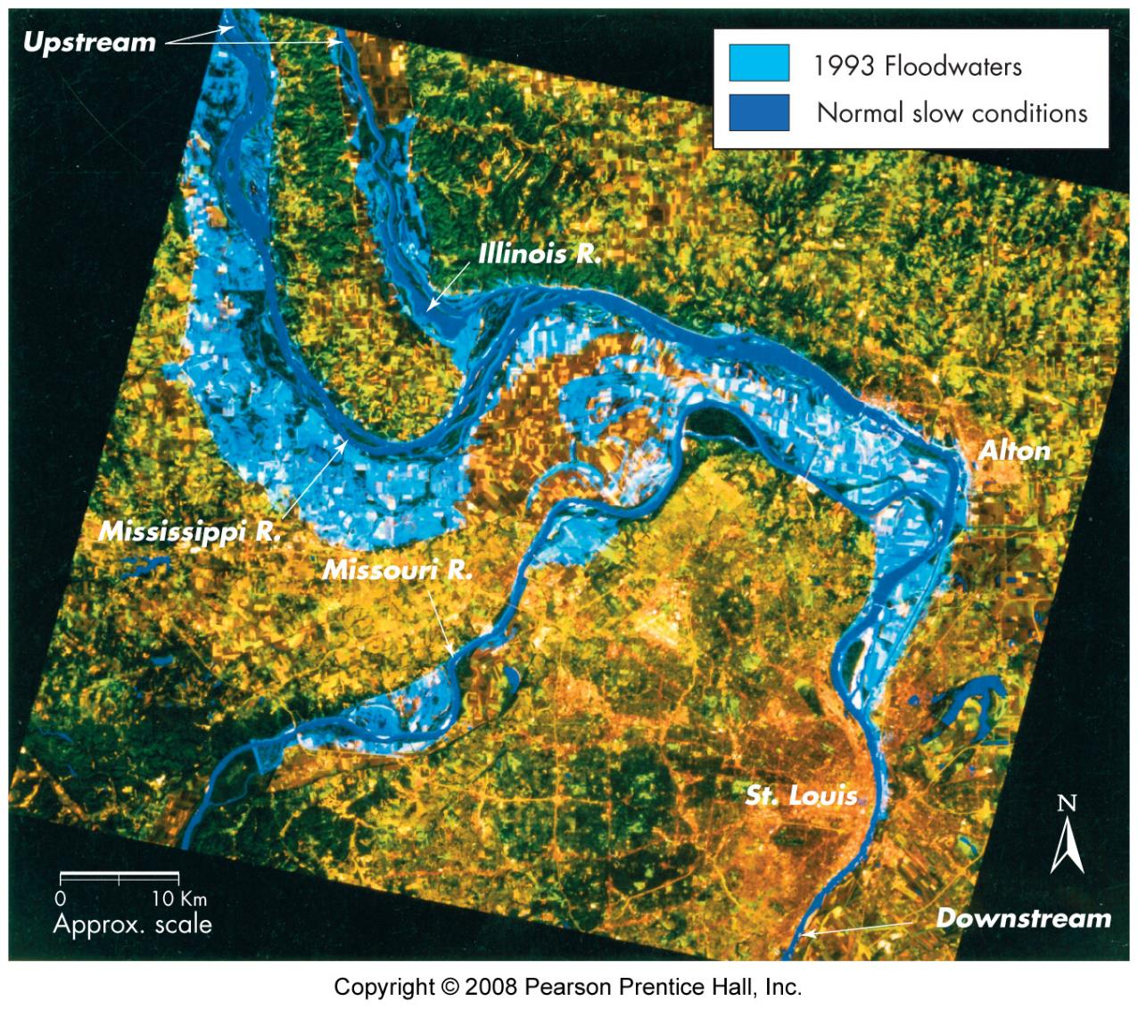
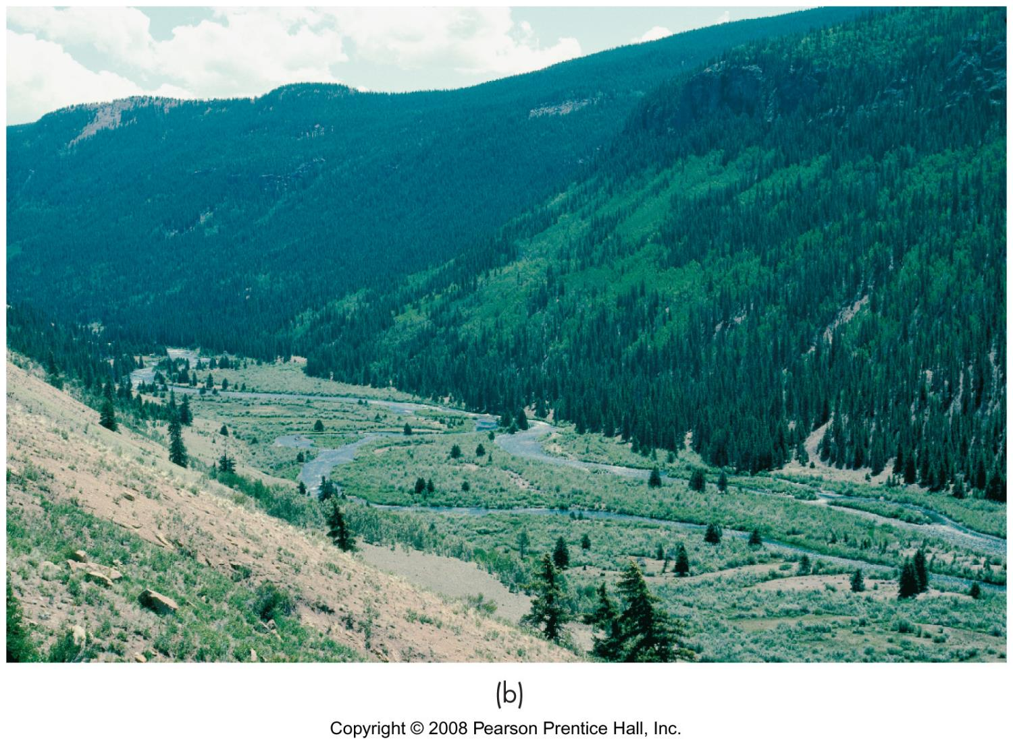
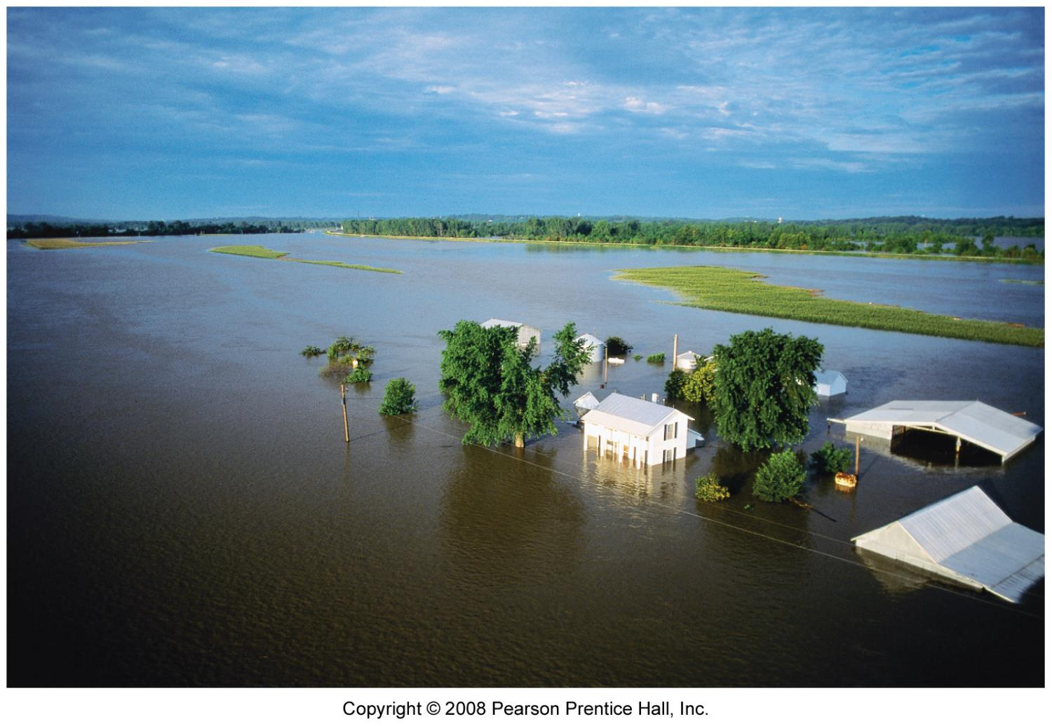
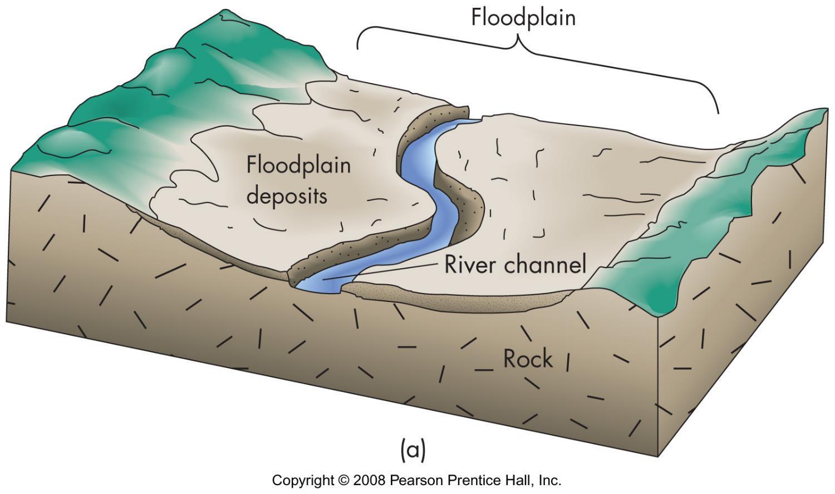
Floodplain
plain adjacent to river, subject to flooding
geomorphic definition
formed by migration of river
overbank deposition includes natural levees
engineering/legal definition
area covered by flooding
stores water –esp. wetlands

Slide 10
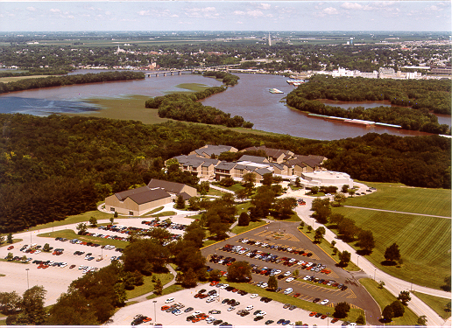

Slide 11
Flood effects
primary effects
human injury and death
water damage
sediment damage
erosion - note bank erosion
secondary effects
hunger
disease
displacement
fires

Slide 12
Special flooding problems
building in the path of over-land flow
bank erosion

Slide 13
Damage impacted by
land use
flood magnitude
rate of rise
duration
season
sediment load
effectiveness of warning

Slide 14
Identification of flood prone areas
topography
soils
wetlands
vegetation zones
historical development
historical floods

Slide 15
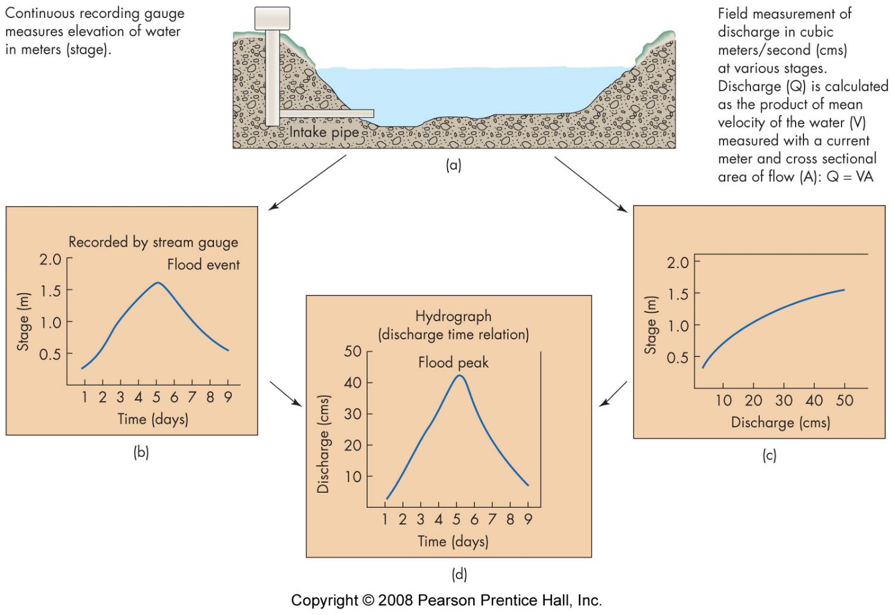
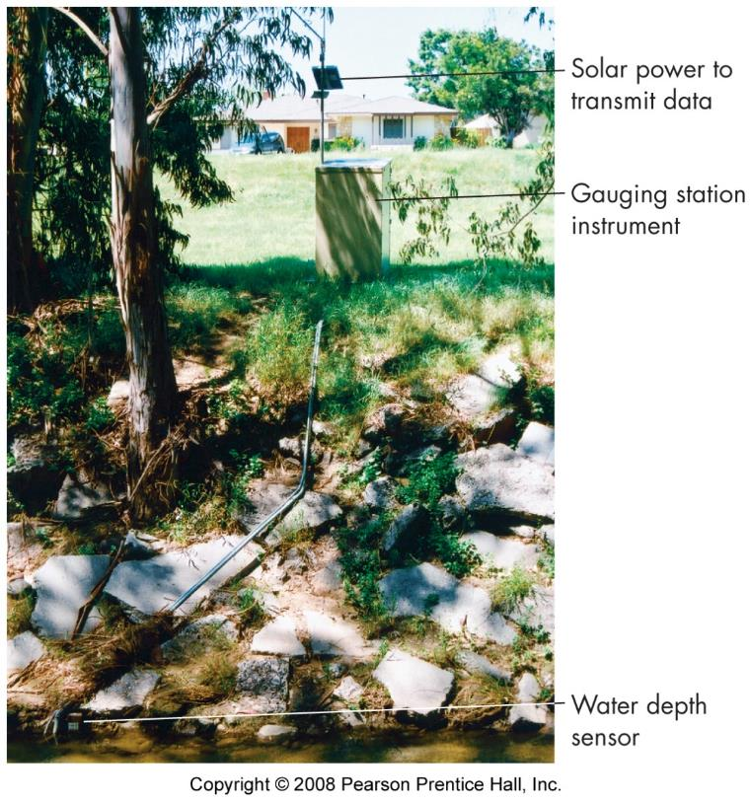
Measuring flood magnitude
gauging station
stage
discharge
flow events - hydrograph

Slide 16
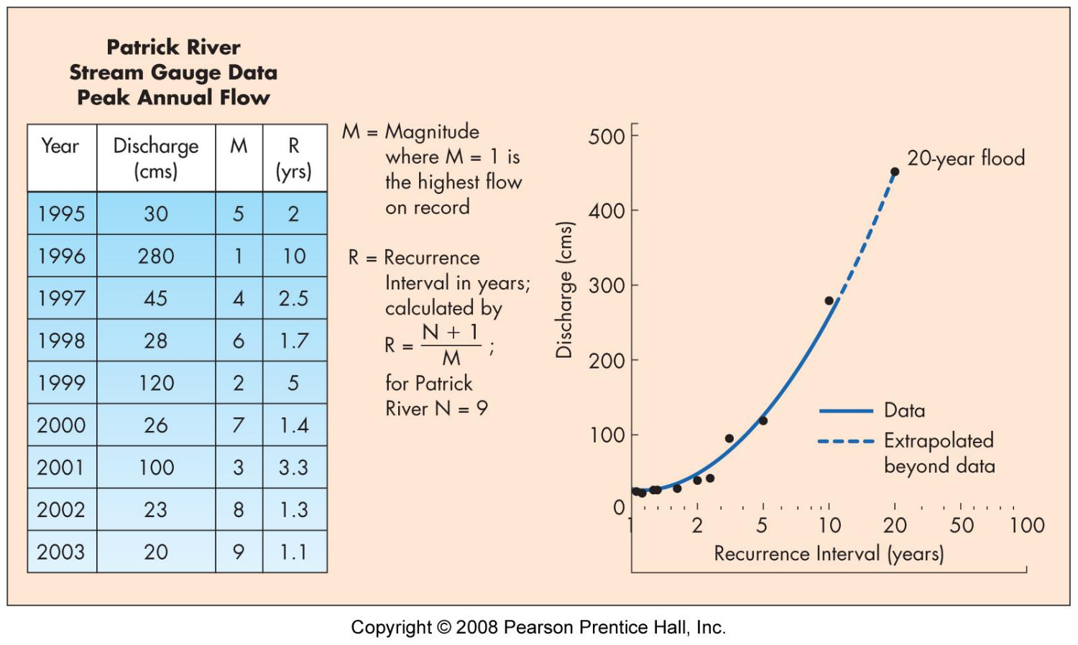
Flood frequency
express as ___- year flood or % chance/year
R = (N+1)/M
N = number of years of record
M = rank of flow
pick highest flow from each year
all flows exceeding a given stage
recurrence interval of largest flood is always years of record + 1

Slide 17
Importance of the flood record
quality of the record
more record = better analysis
climate change ➔ system change

Slide 18
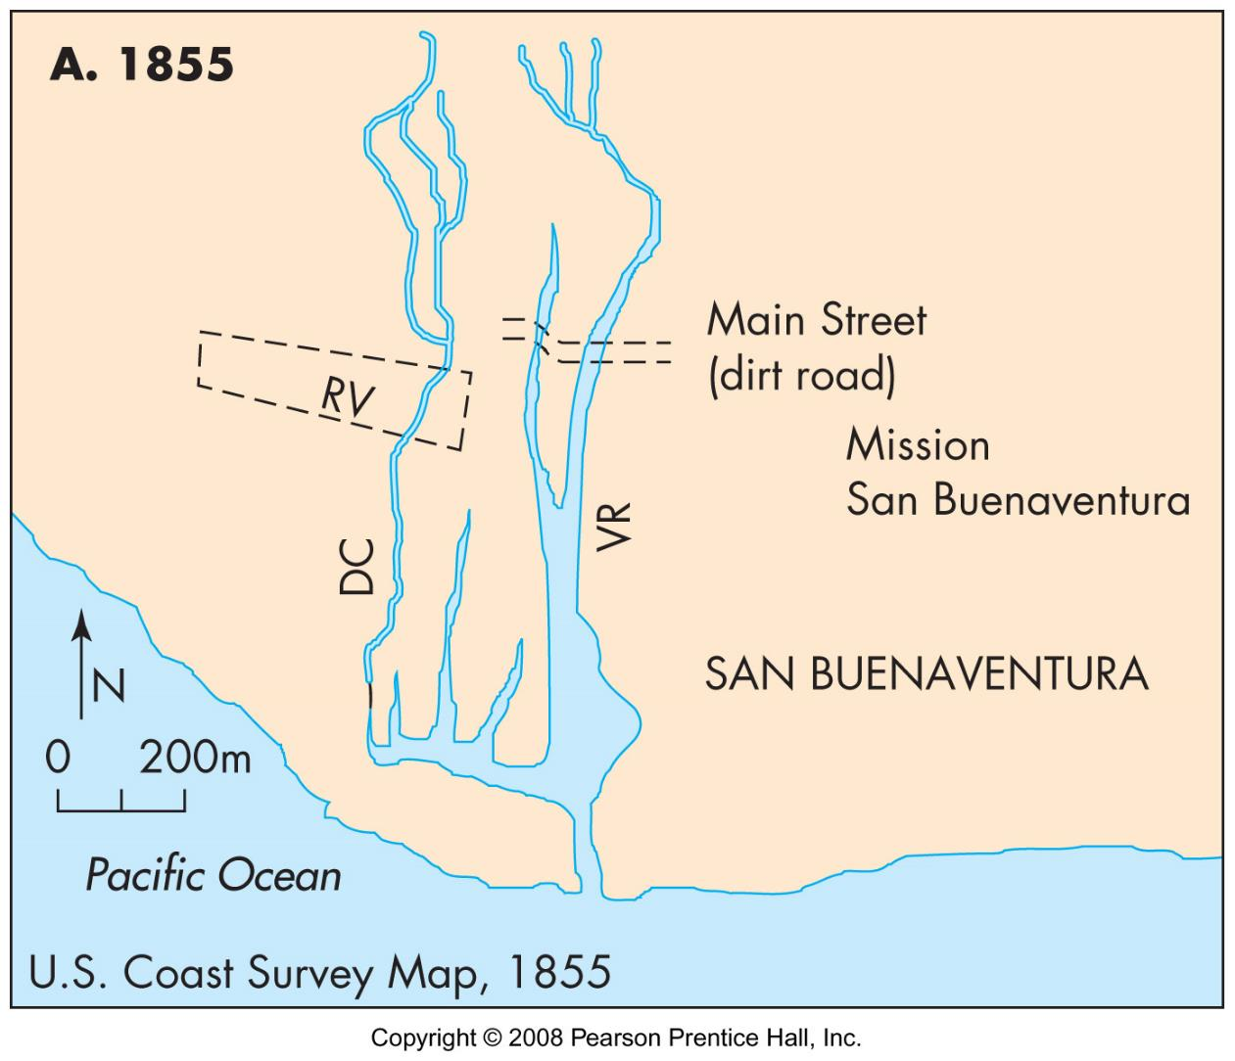
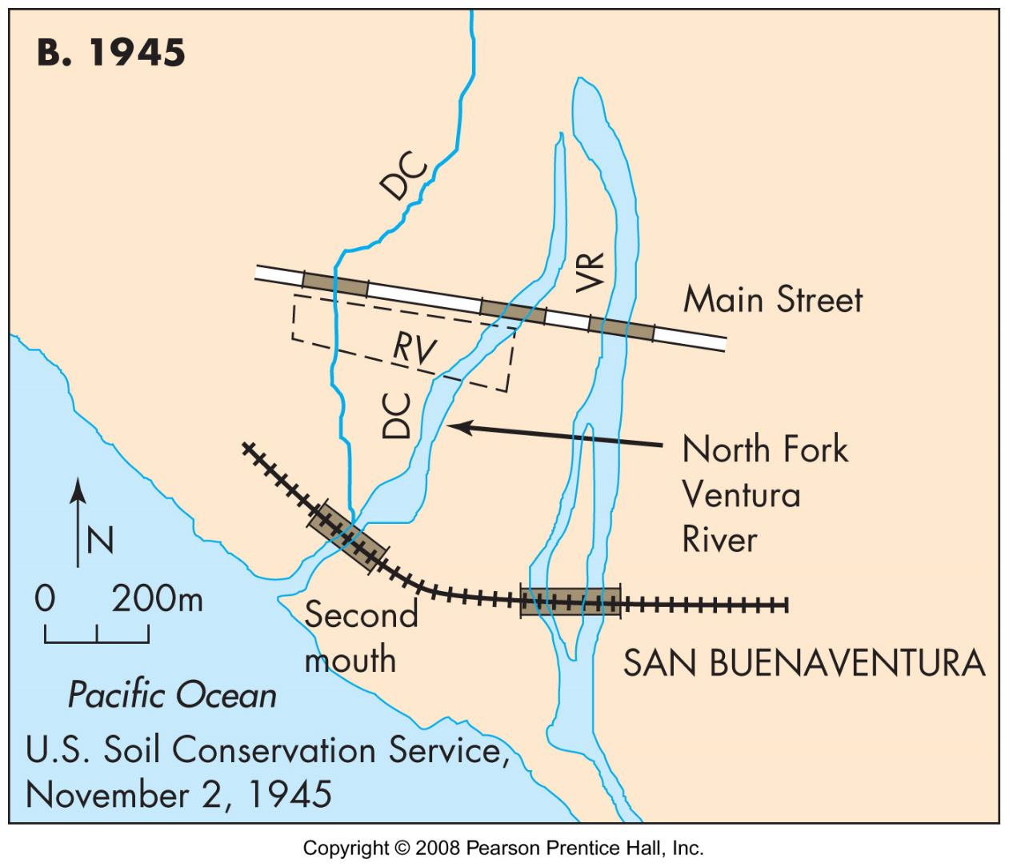
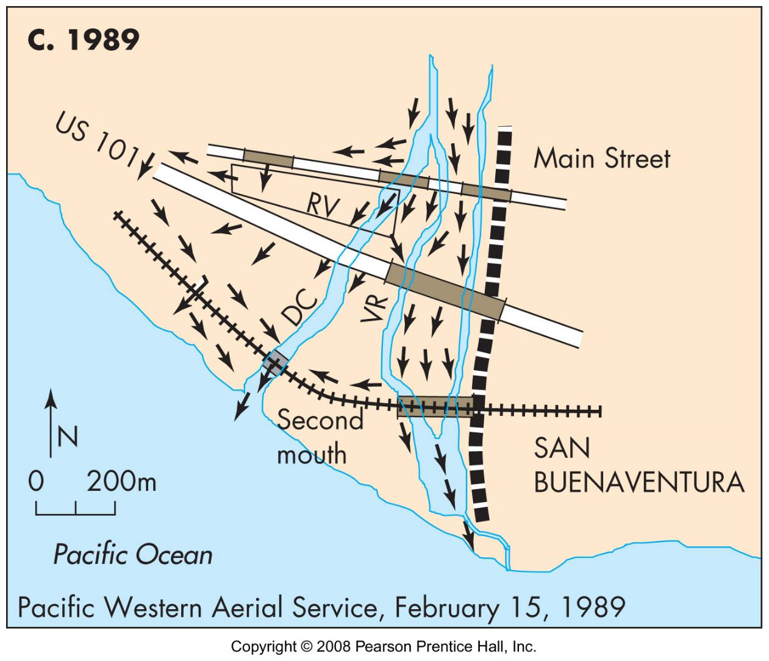
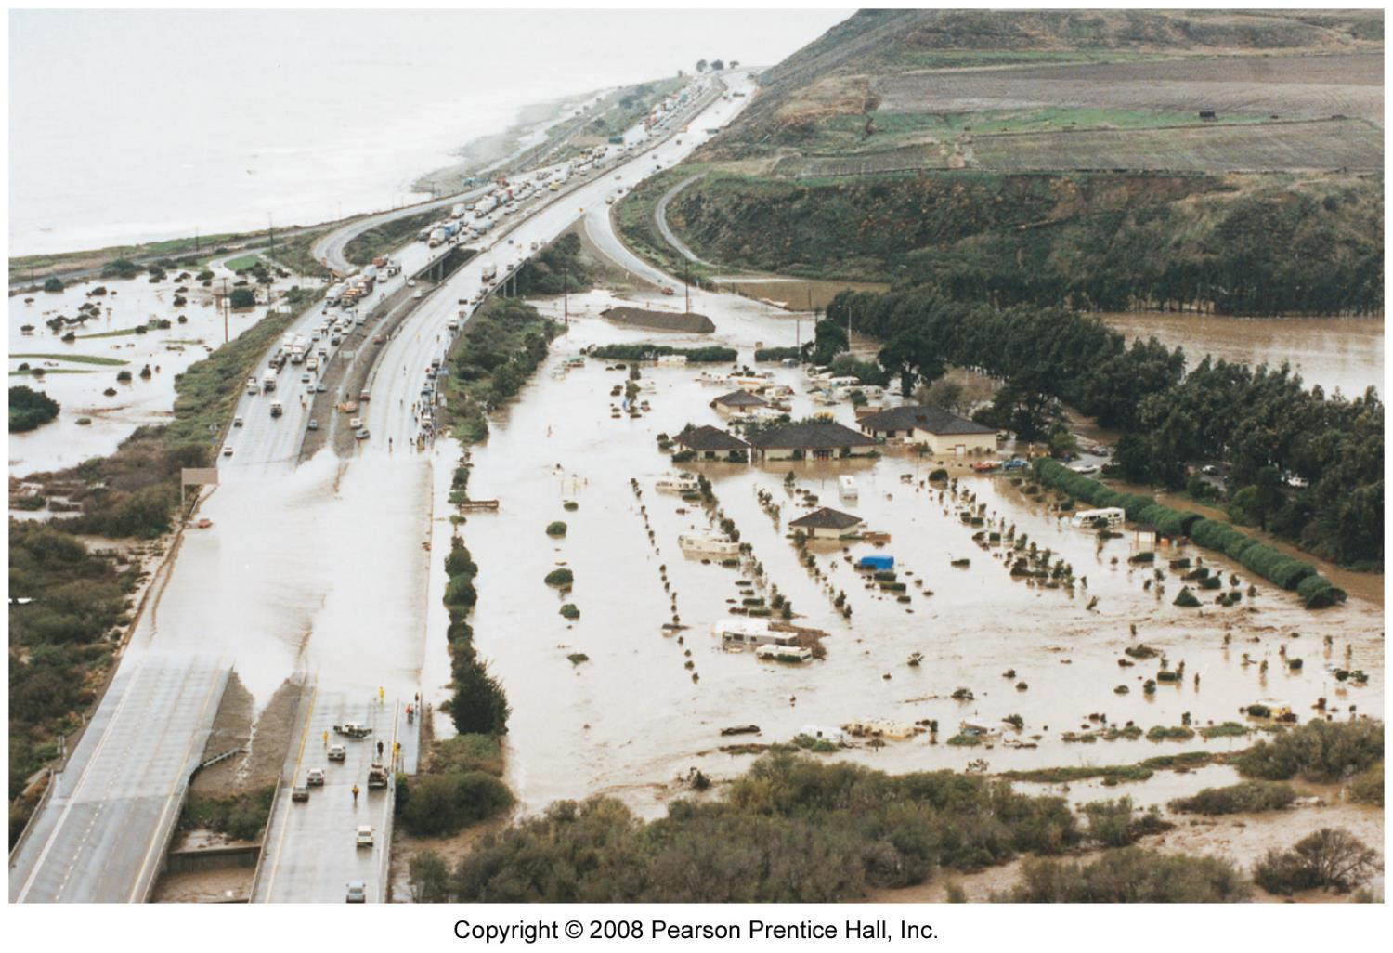
Urbanization
changes flow patterns

Slide 19
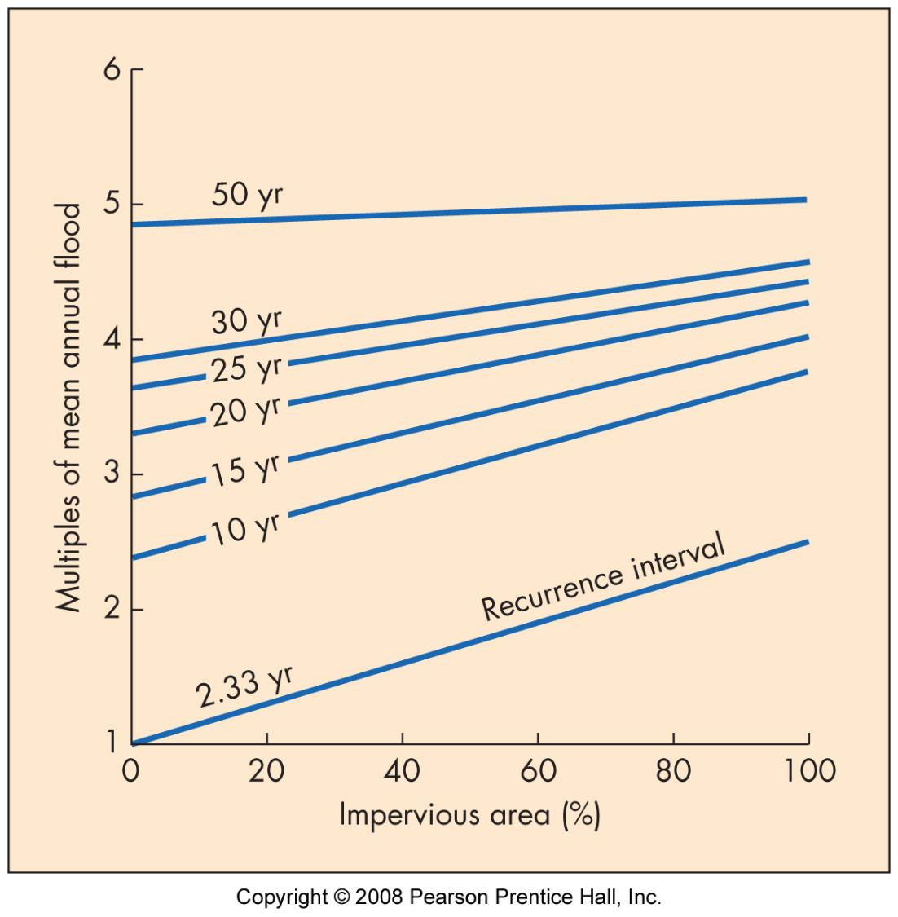
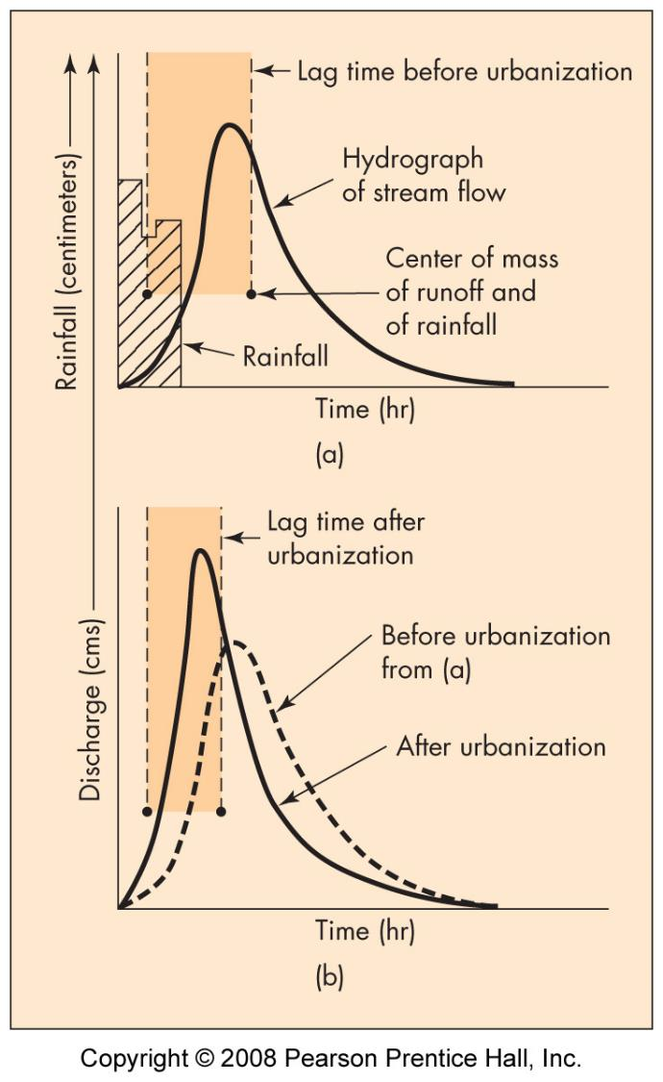
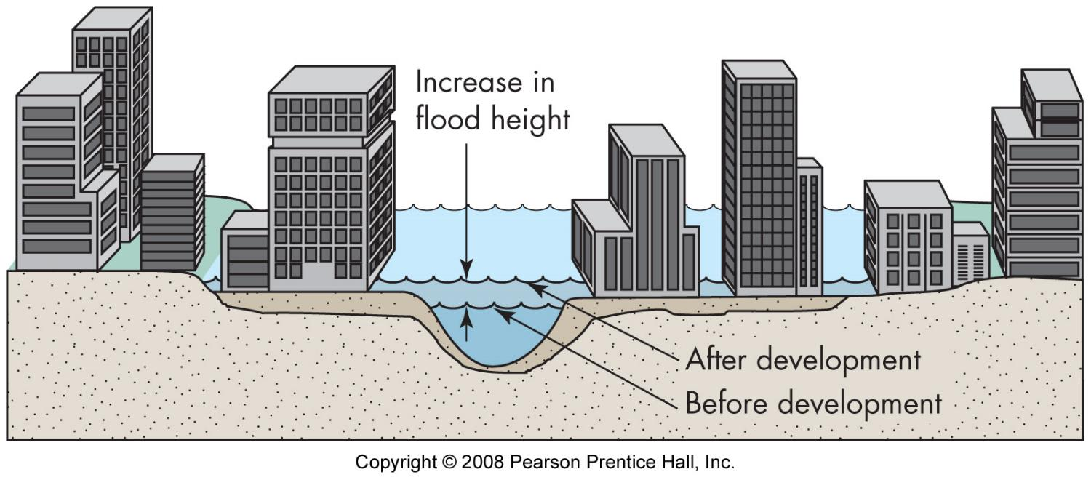
Urbanization
alters rainfall to runoff relationship
increases drainage density
decreases permeability and infiltration capacity
results
increases frequency
increases flood stages
flashier floods

Slide 20
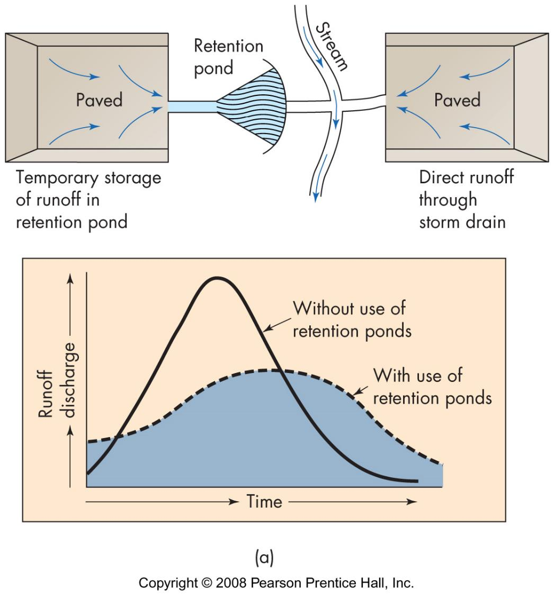
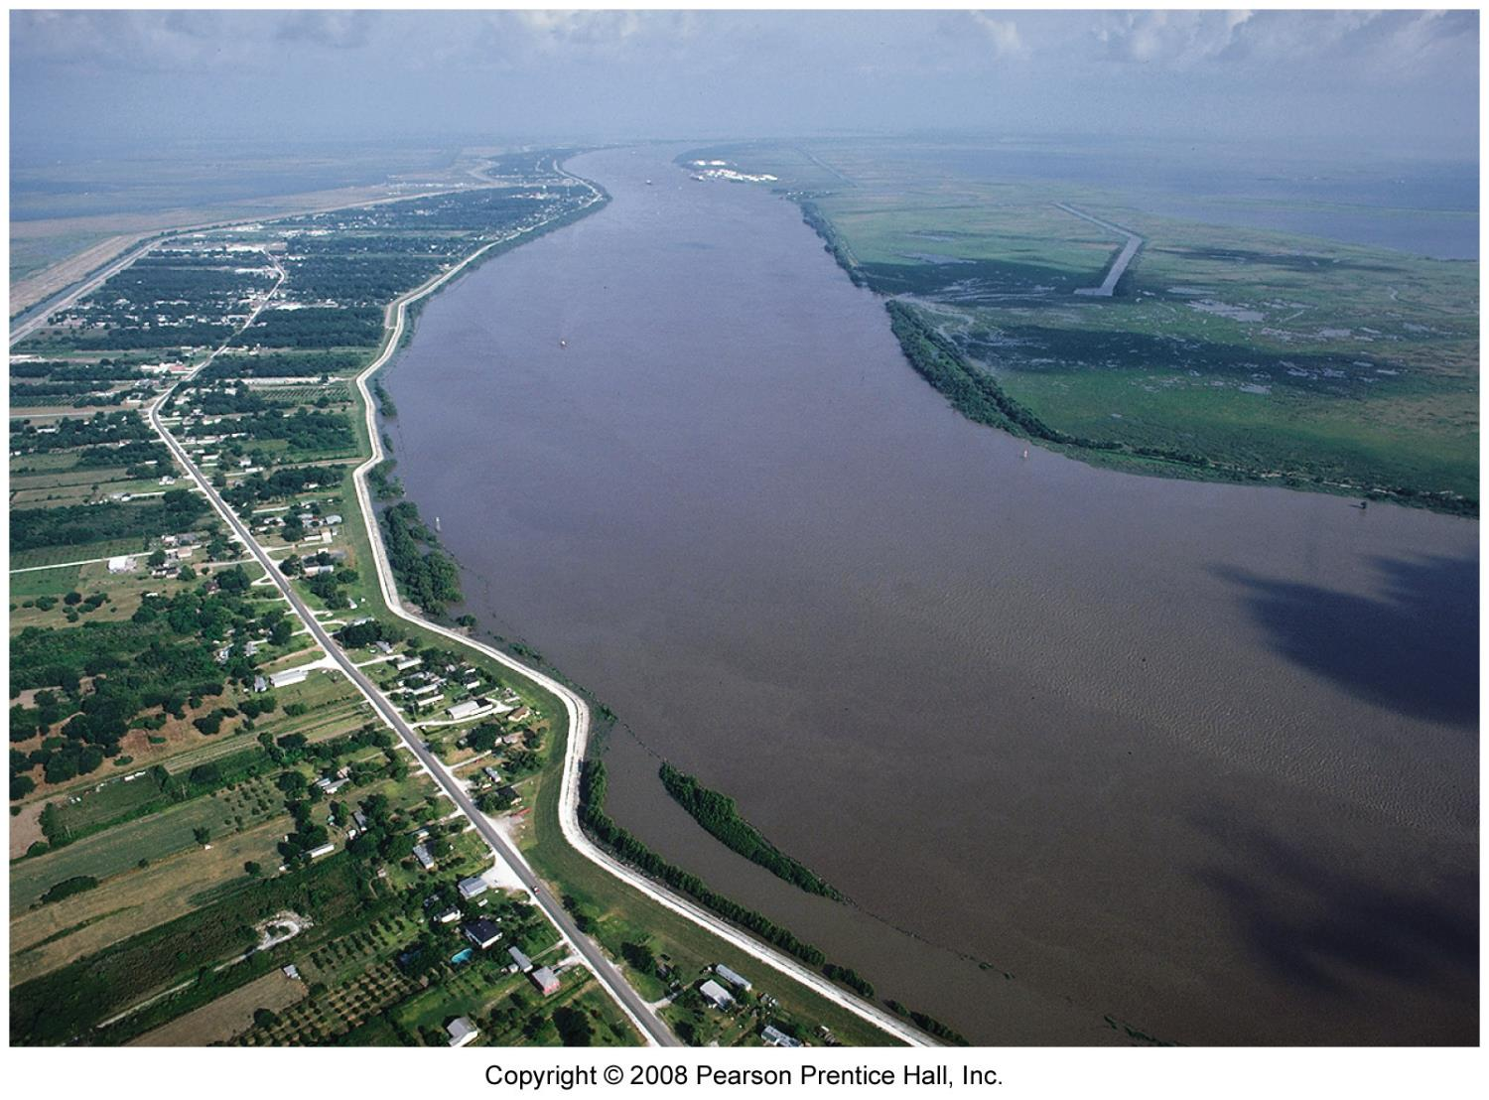
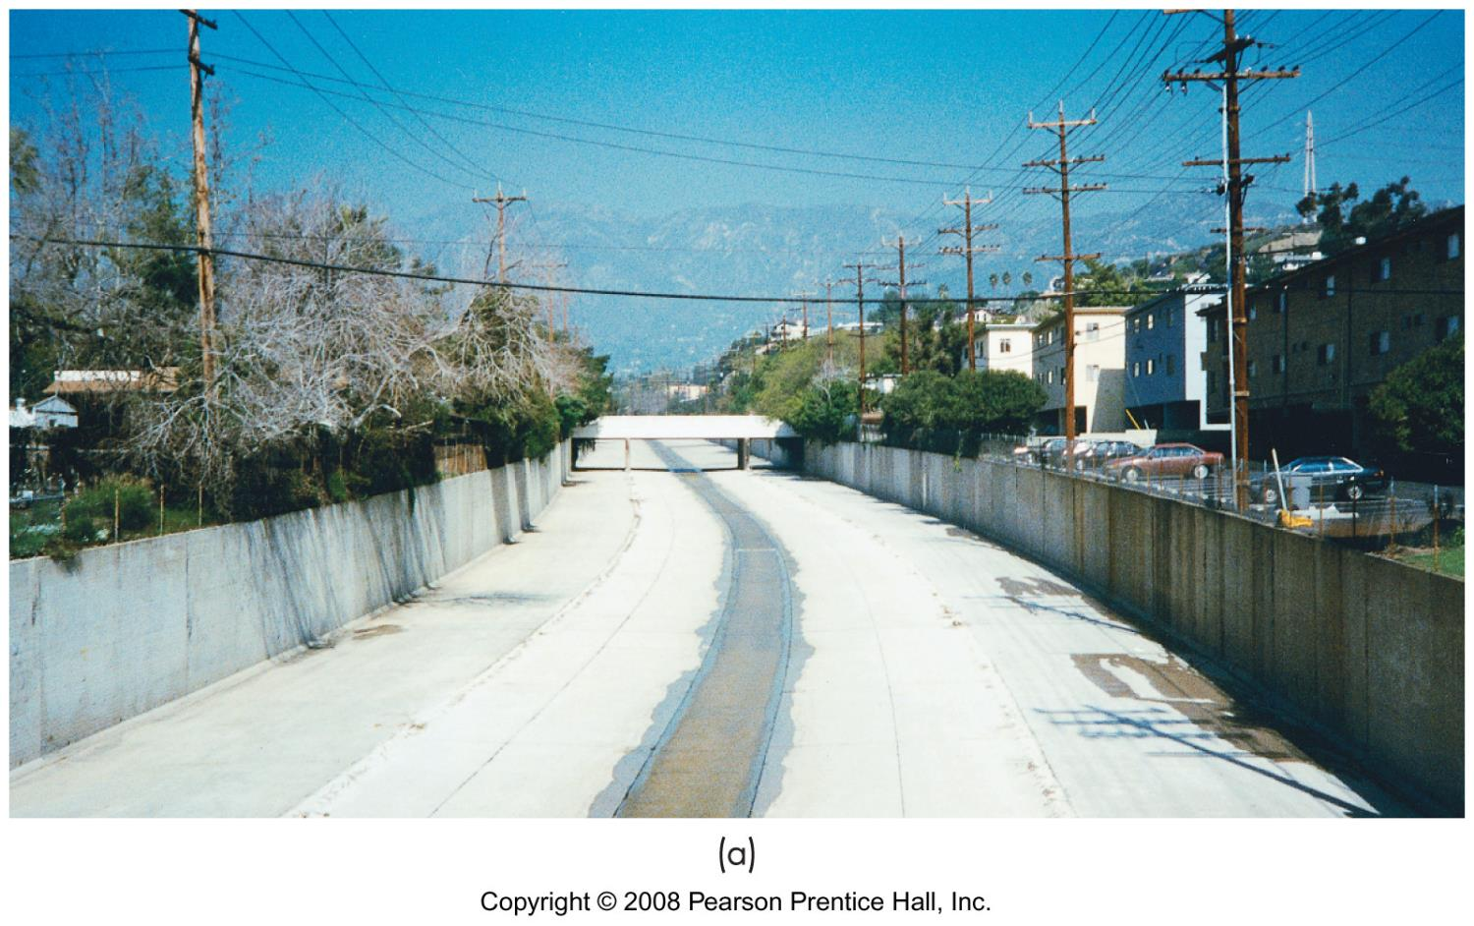
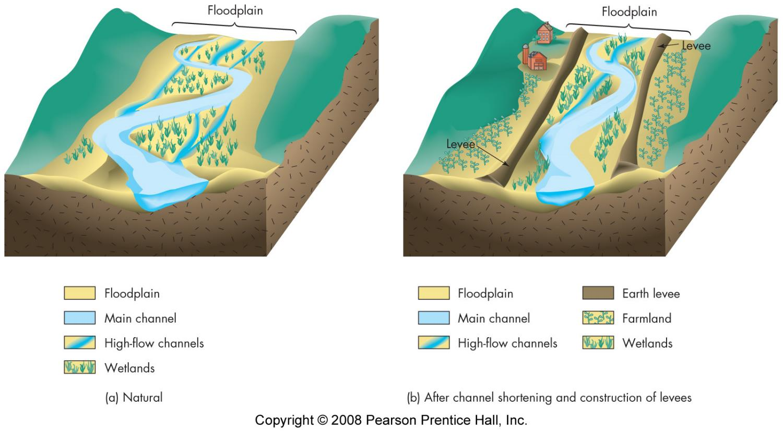
Flood prevention methods
levees
dams
channelization
retention ponds
problems
restricts floodwaters, increases stage
encourages more development

Slide 21
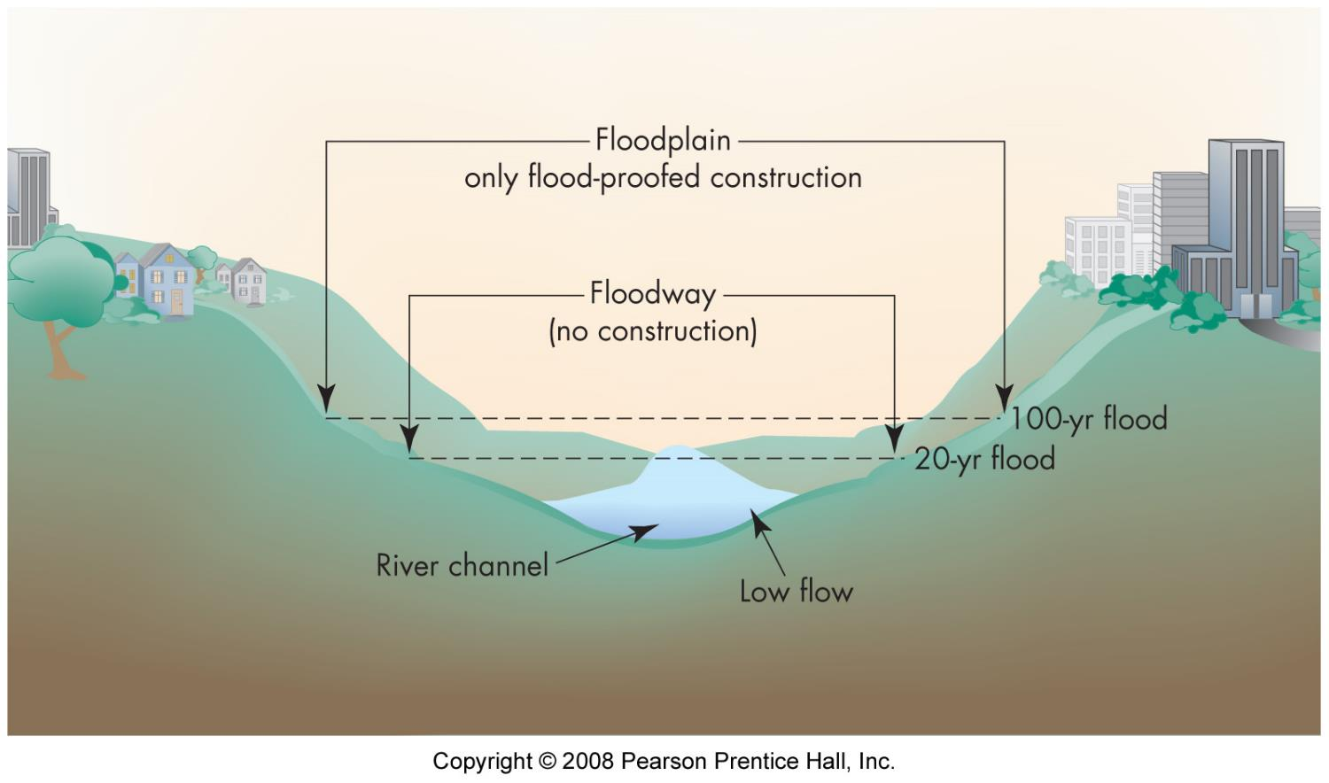
Adjustment to flood hazard
work w/ nature
flood proofing
regulations
flood hazard maps
zoning

