Slide 1
Chapter 5 - Natural Hazards: An Overview

Slide 2
Problems
hazardous zones: geologically active
few if any places are free from all hazards
may have some benefits…

Slide 3
Fundamental Principles
Hazards are known from scientific evaluation.
Risk analysis is an important component in our understanding impacts resulting from hazardous processes.
Hazards are linked.
Hazardous events that previously produced disasters are now producing catastrophes.
Consequences of hazards can be minimized.

Slide 4
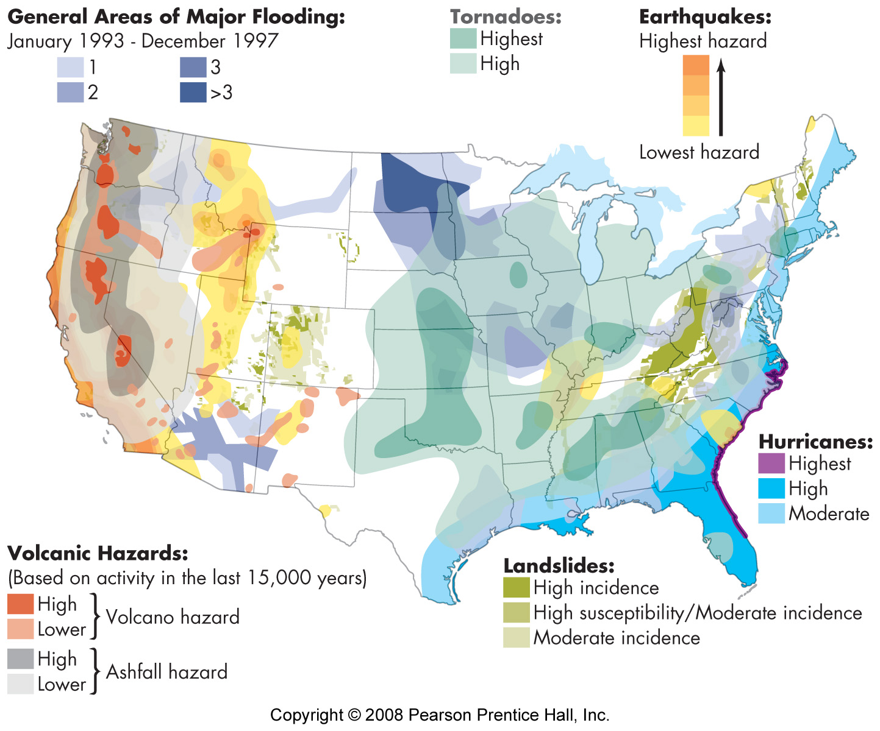

Slide 5
Addressing hazardous processes
Research
How does the process work?
What is its history?
Application
Identify hazardous areas
Reduce risk to people

Slide 6
magnitude and frequency
magnitude: size of event
frequency: recurrence interval
% chance per year
hi magnitude, low frequency usually most dangerous

Slide 7
Evaluation of hazards
purpose - to minimize loss
identify risky areas
make appropriate adjustments
methods:
studies of process
past events - history of area

Slide 8
Evaluation of Hazards
prediction
warning – this will happen
specific
time
place
magnitude
based on
precursors
ie heavy rain = flood
non or pseudo science - beware
often wrong
certain to be correct occasionally
dangers
boy who cried wolf
affects people and businesses
forecast
general location
magnitude range
chance of occurrence
not specific
ratio = 1:100 or 100 yr flood
percent - 50% over next 15 yrs

