Slide 1
Chapter 10: Slope Processes, Landslides, and Subsidence

Slide 2
Mass wasting
Down slope movement of material

Slide 3
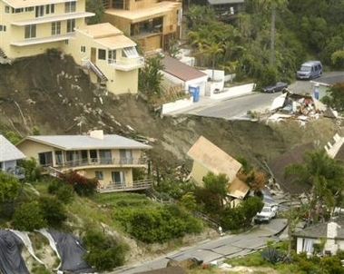

Slide 4
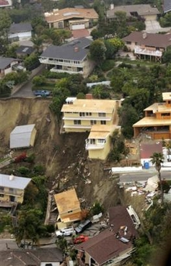

Slide 5
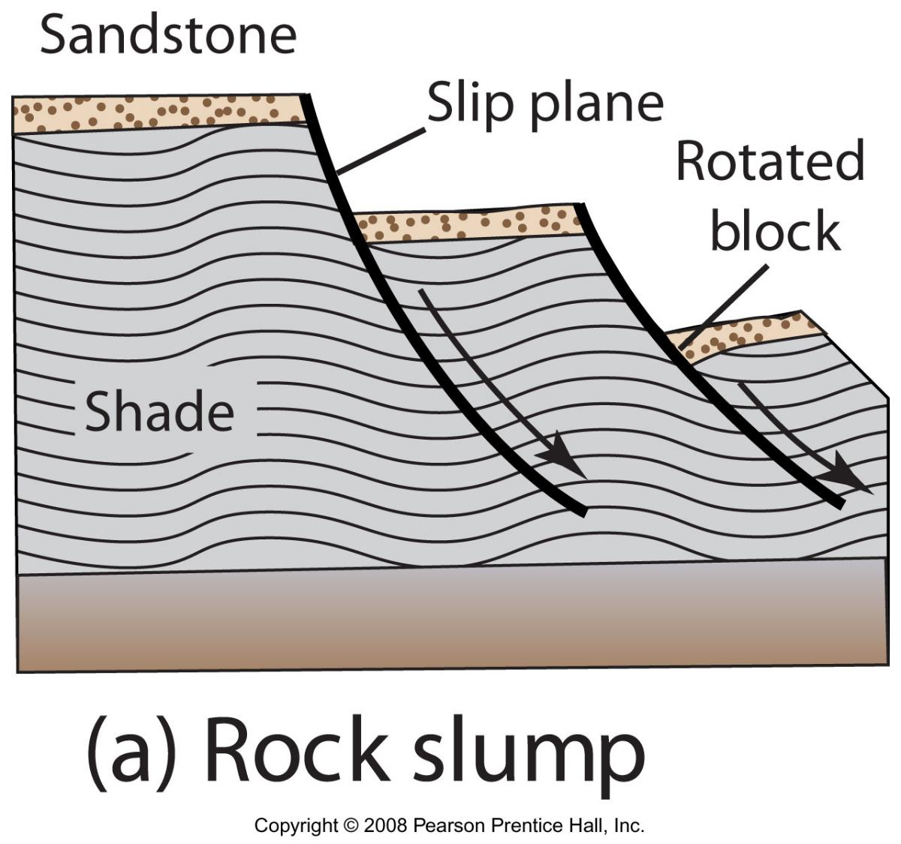
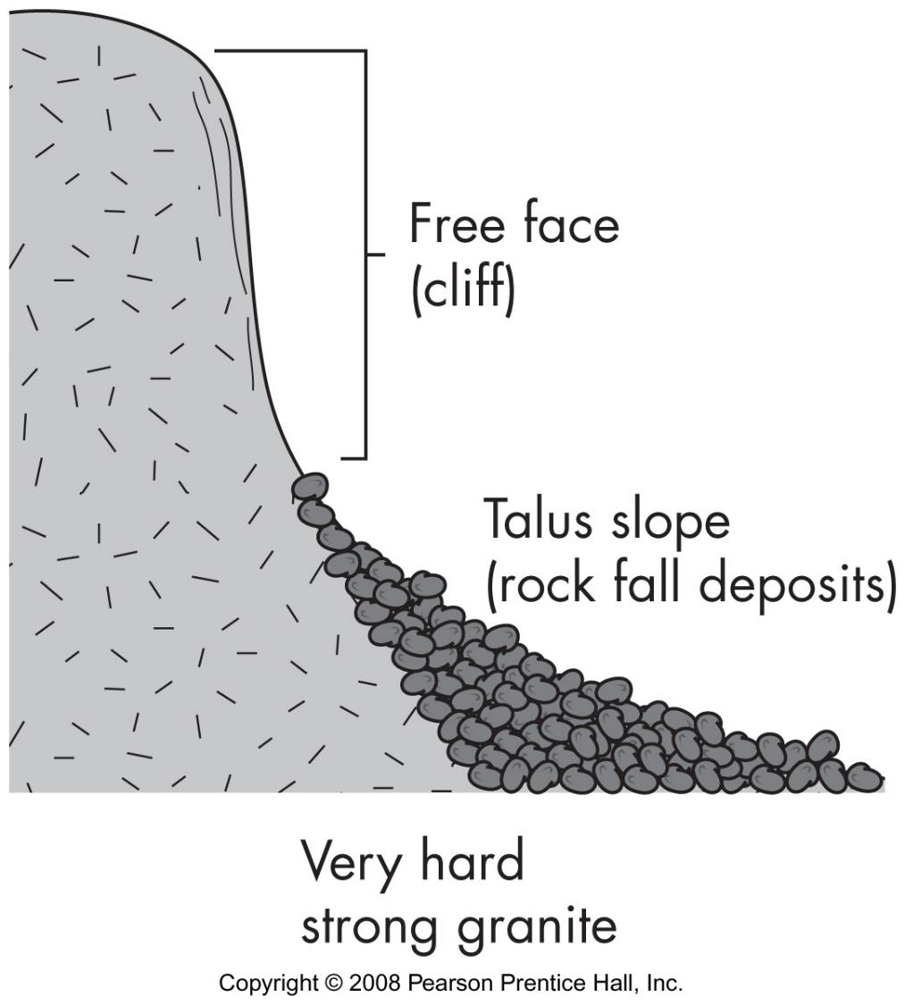
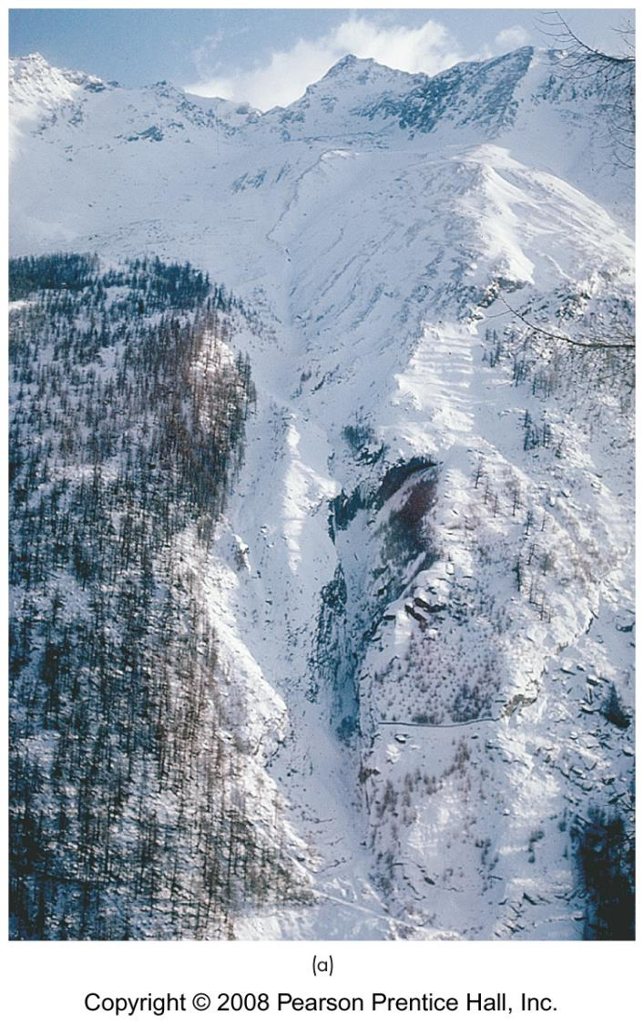
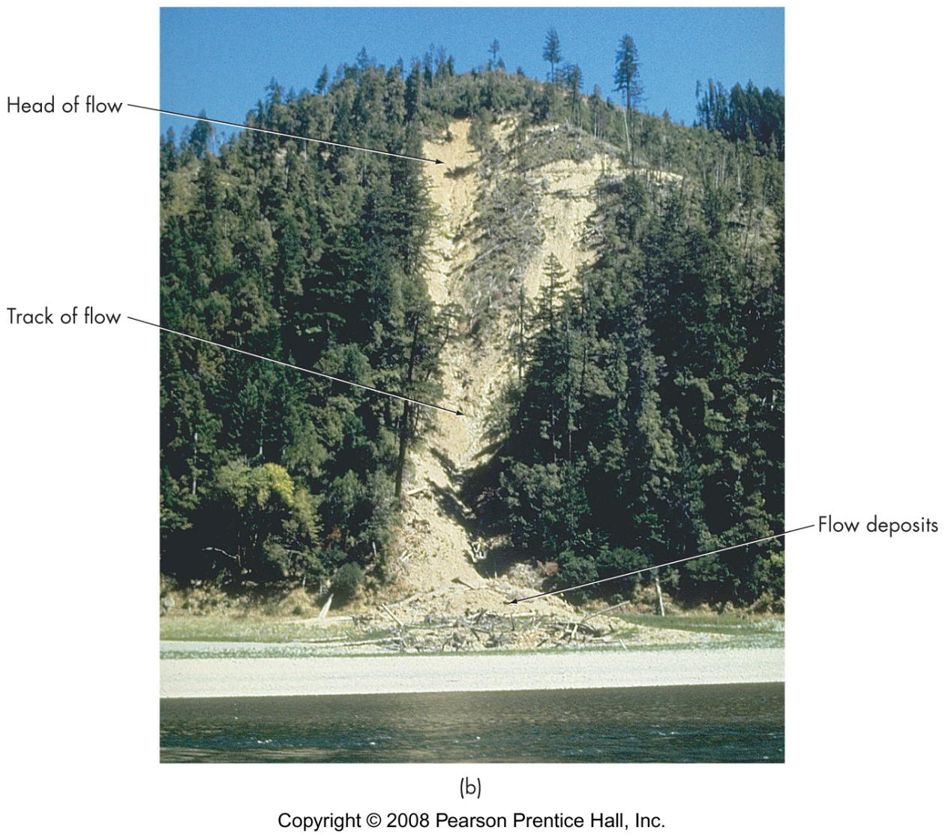
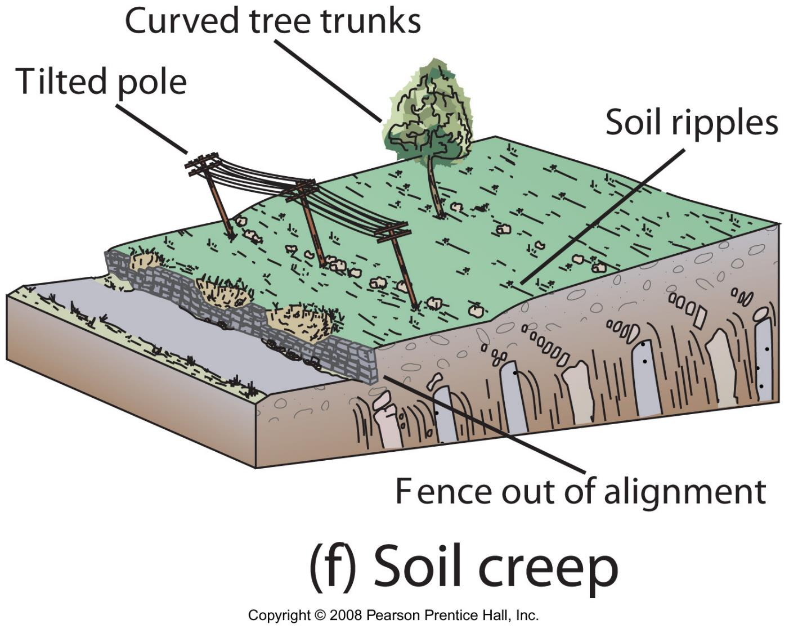
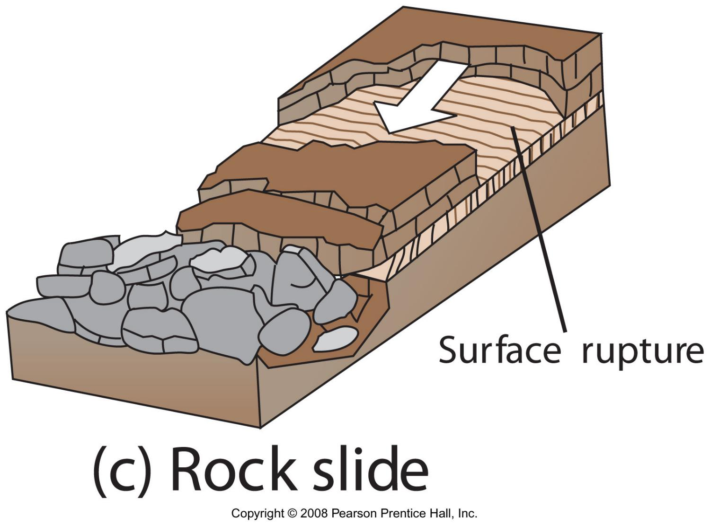
Types of mass movement
slope failures
flows - incoherent
slides - coherent
falls
creep
subsidence
snow avalanche

Slide 6
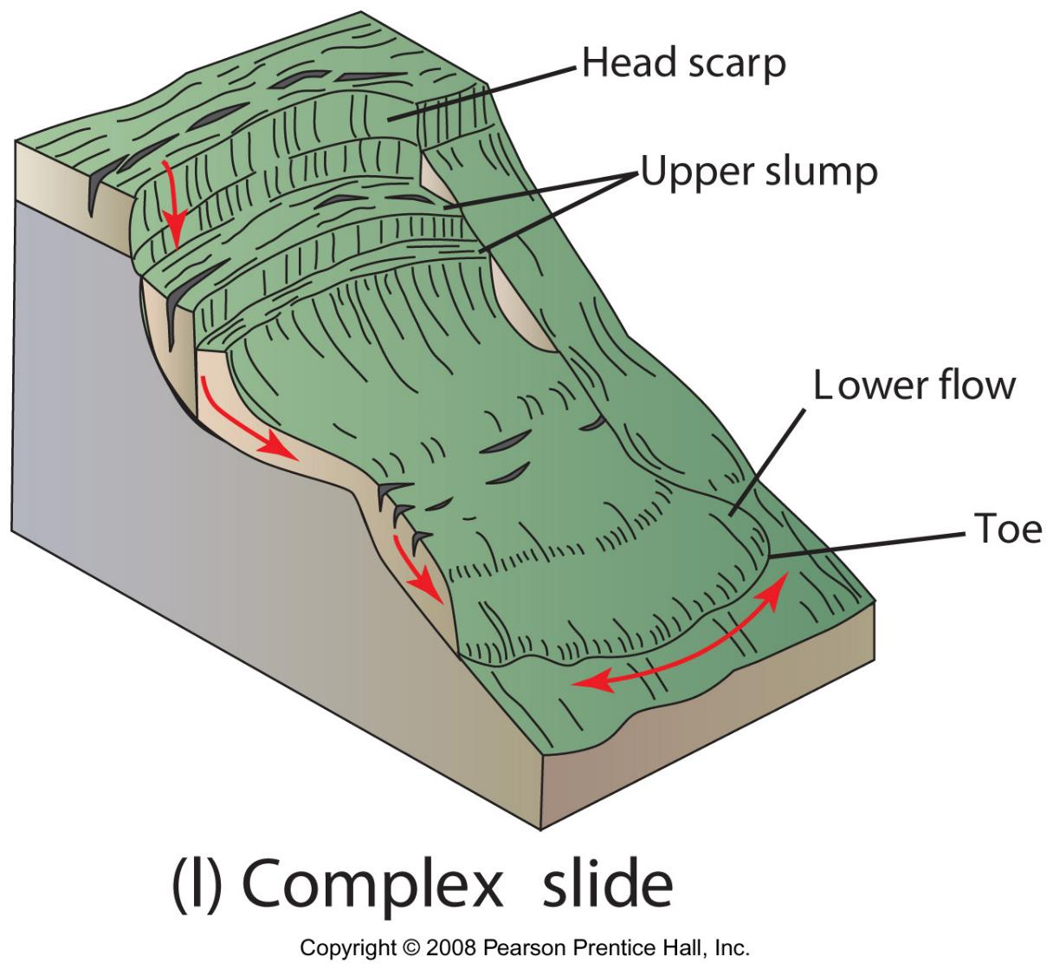
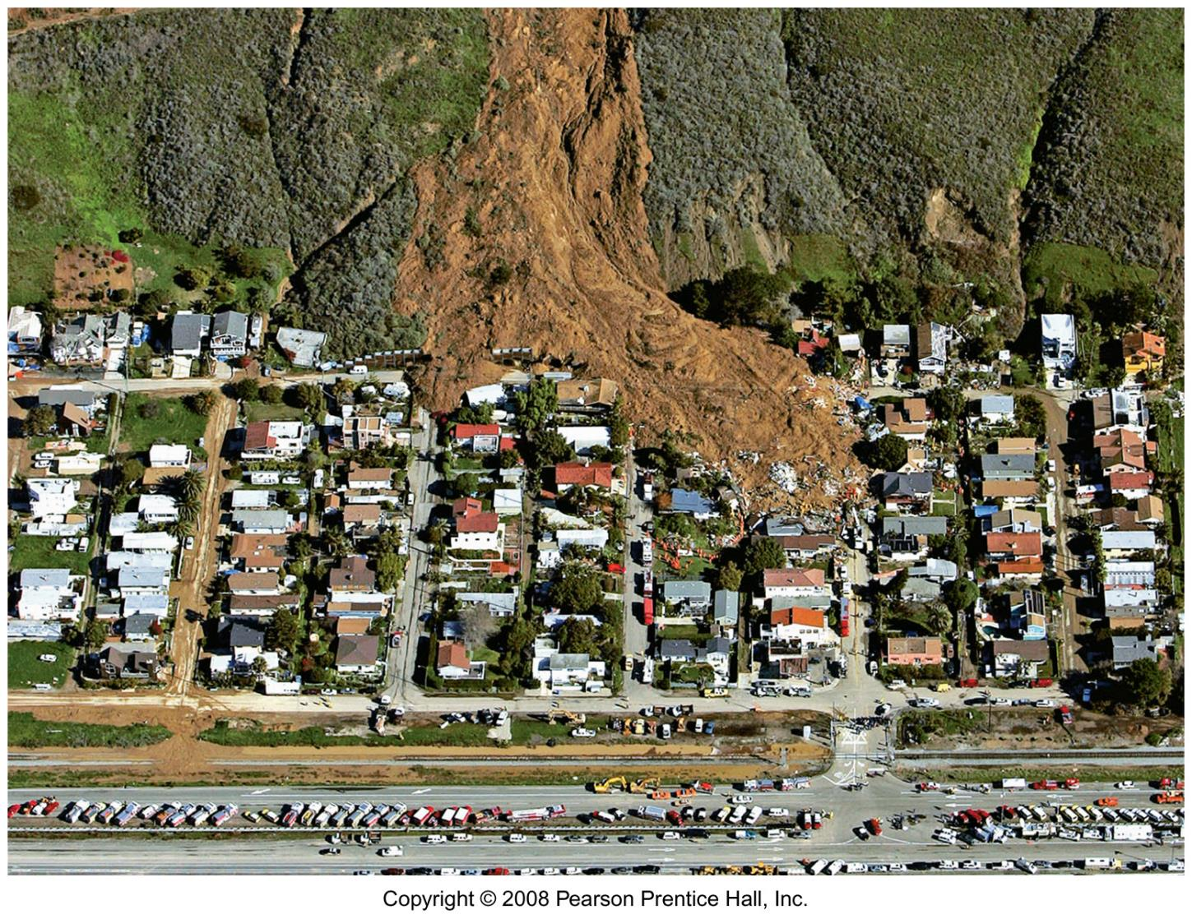
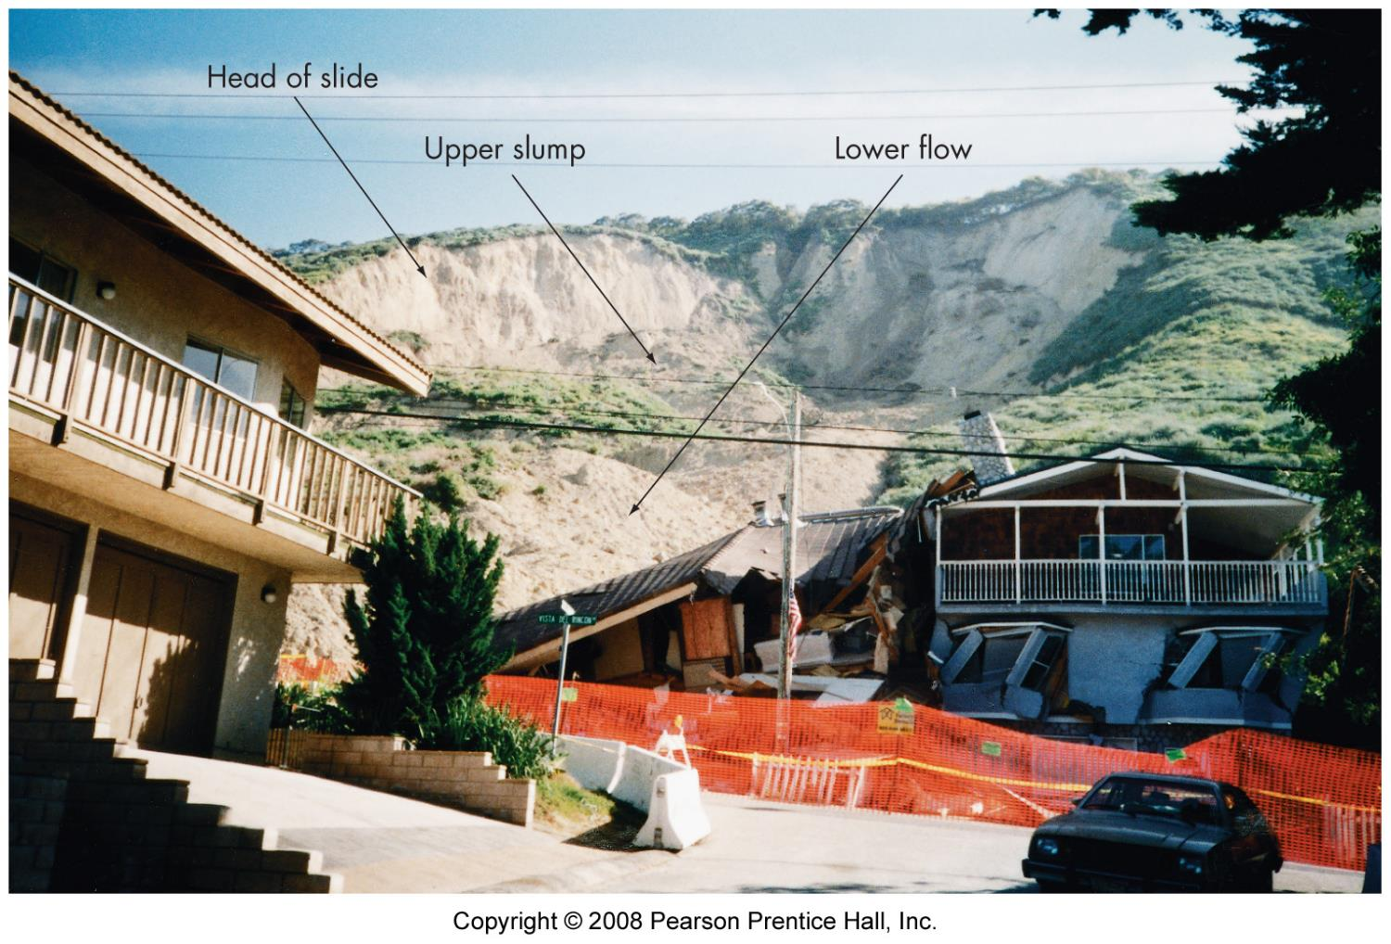
Figure 9.4l

Slide 7
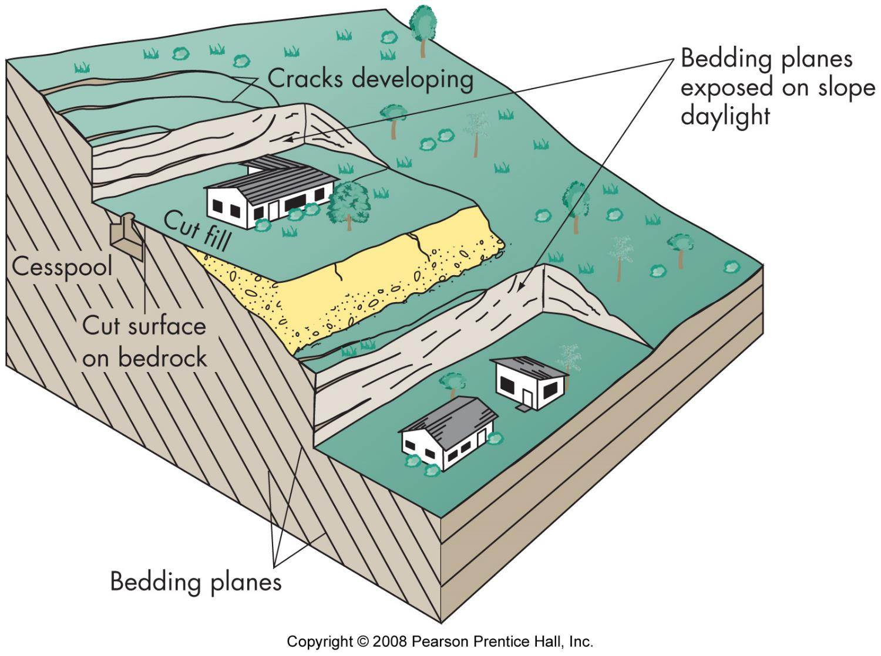
Slope stability factors
Material type
Slope angle
Climate
Vegetation
Water
Addition or removal of material
Time

Slide 8
What causes slope failure?
core causes
weathering & erosion
gravity
trigger – immediate cause
vibration (inc. earthquakes)
rapid moisture increase
addition or removal of slope materials

Slide 9
slopes and humans
humans building in the way
enhanced by humans - humans induce long-term changes and triggers
timber harvesting
urbanization/development
humans create unstable situations

Slide 10
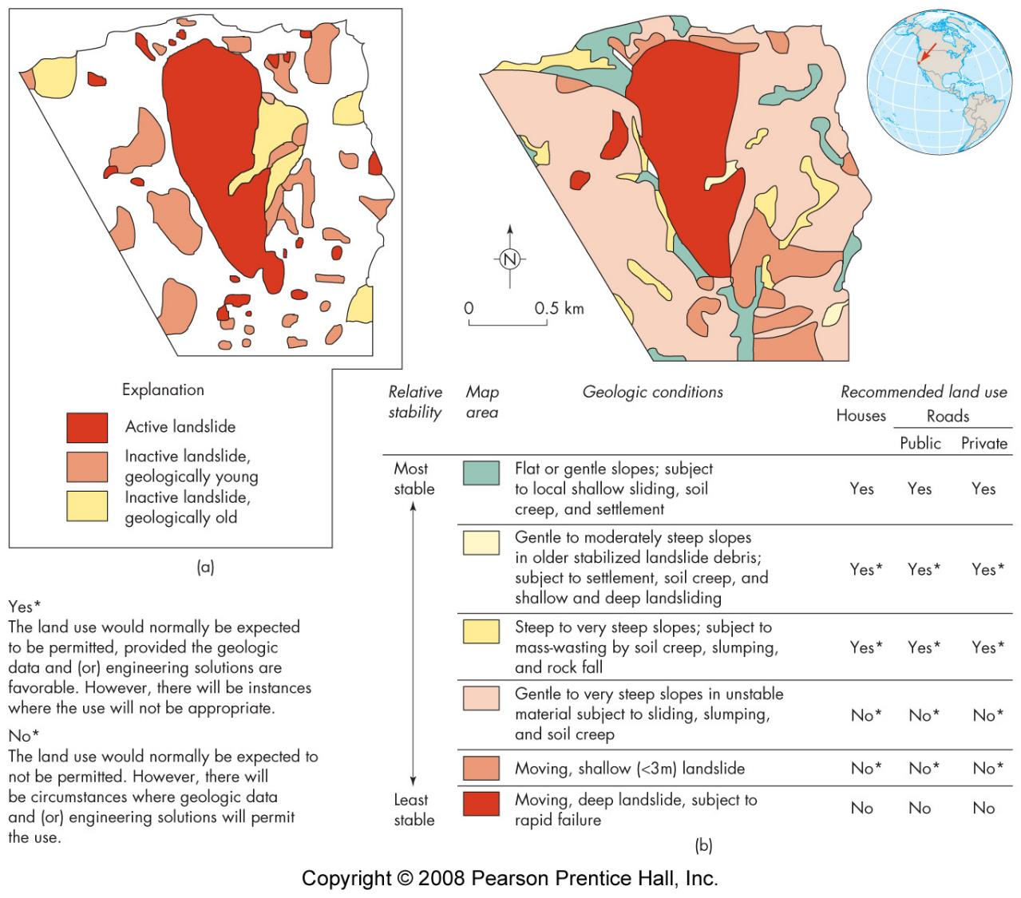
Hazard recognition
slope stability maps
landslide inventory
slope inspection

Slide 11
Evidence of an unstable slope
buildings - cracked, stuck doors
crooked fences and retaining walls
broken underground pipes
uneven pavement
uneven ground
cracks in ground
trees - tilted - buttressed
rockfalls
slump features

Slide 12
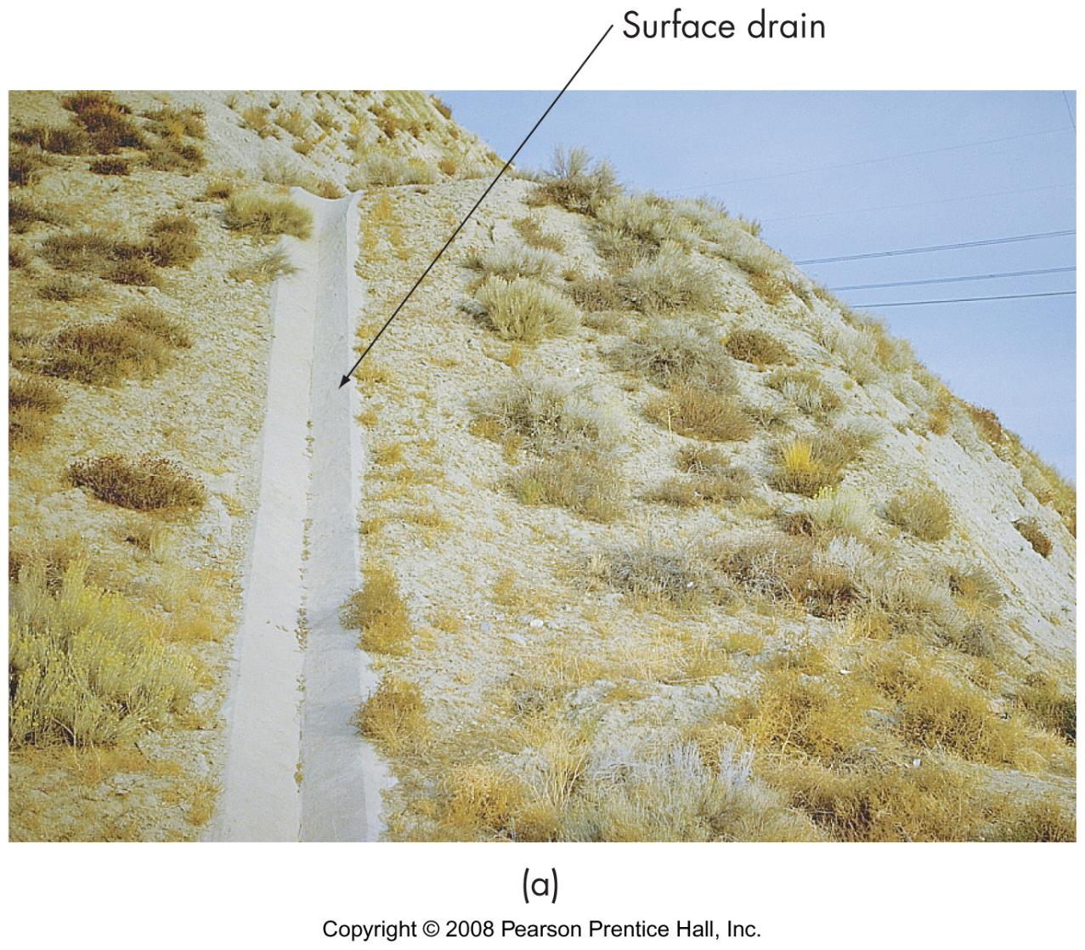
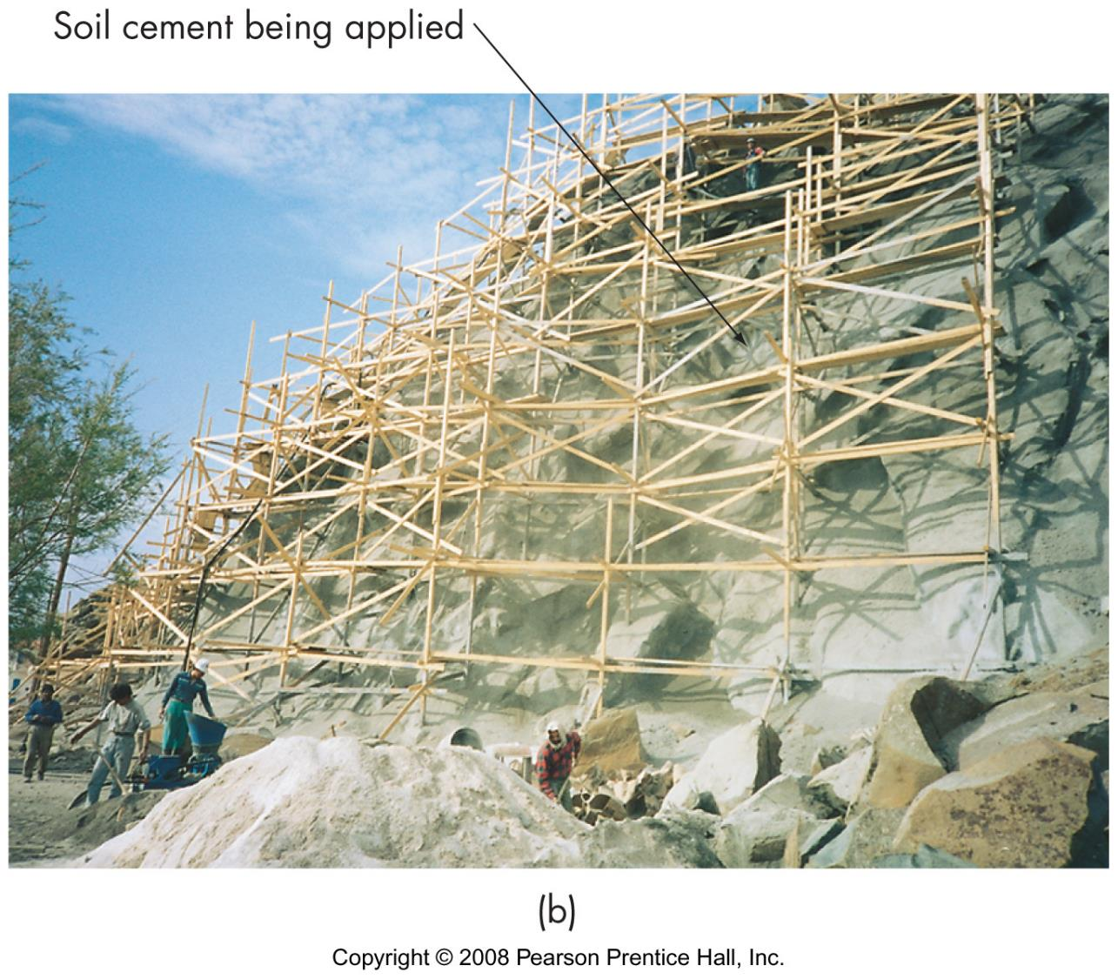
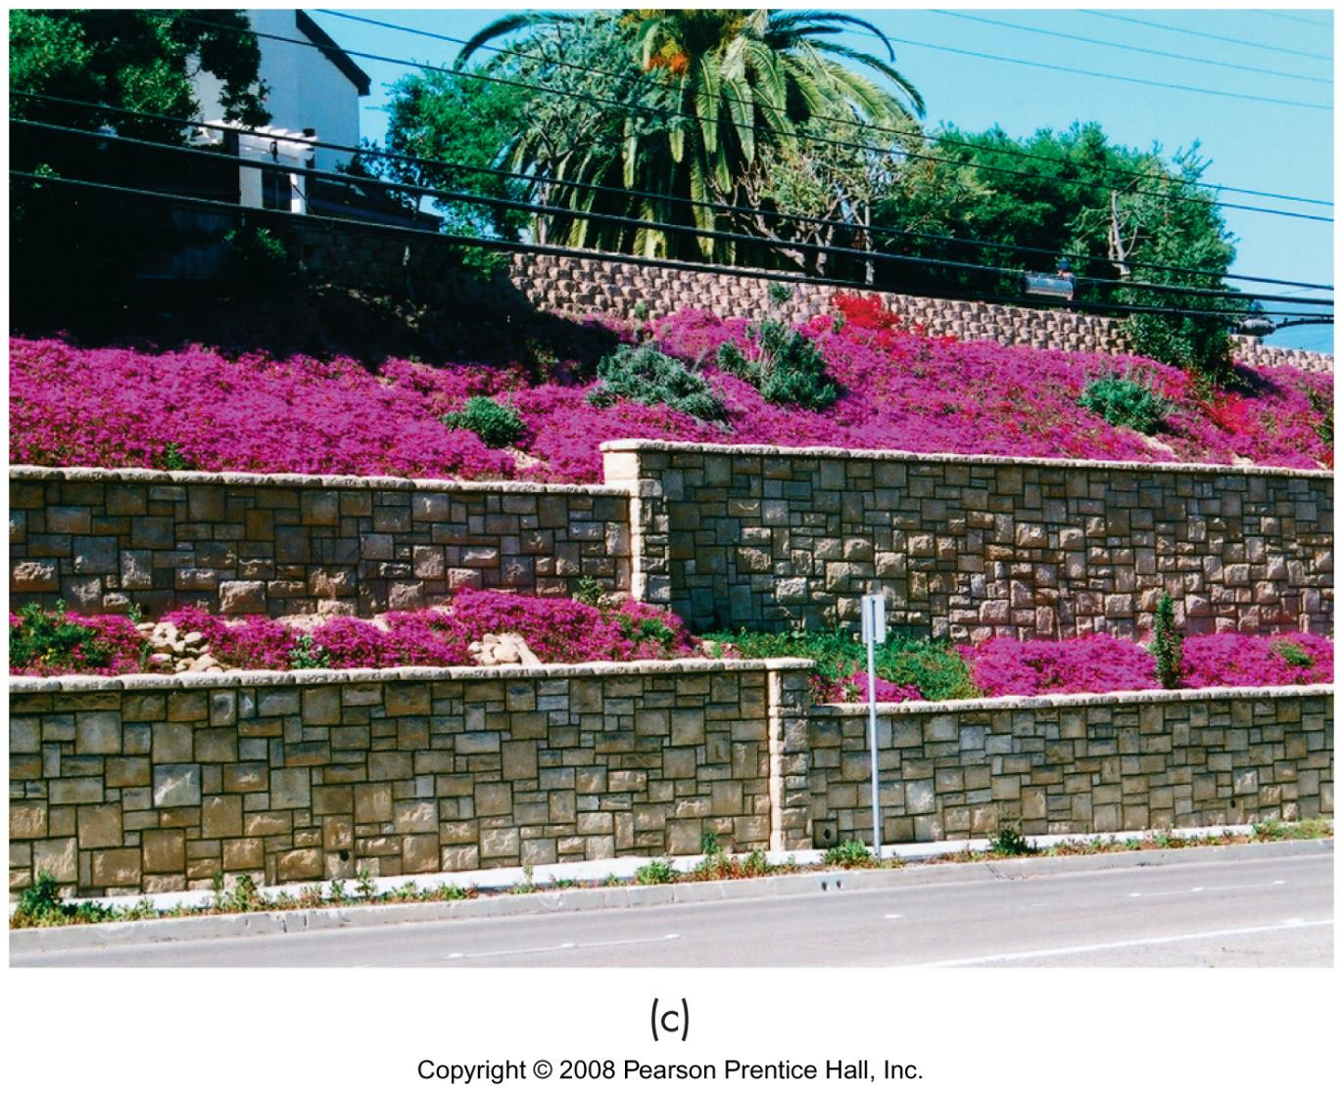
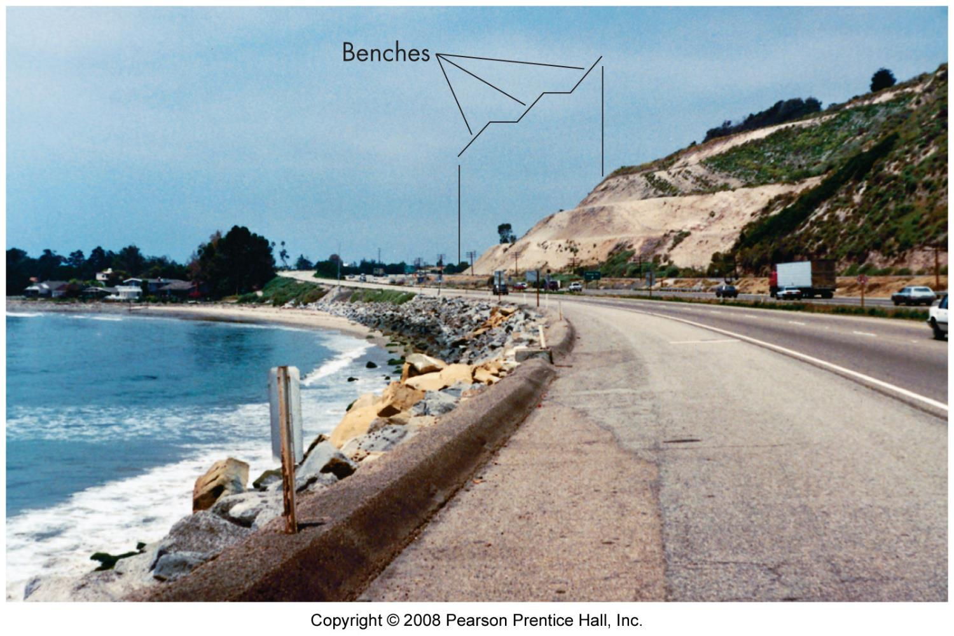
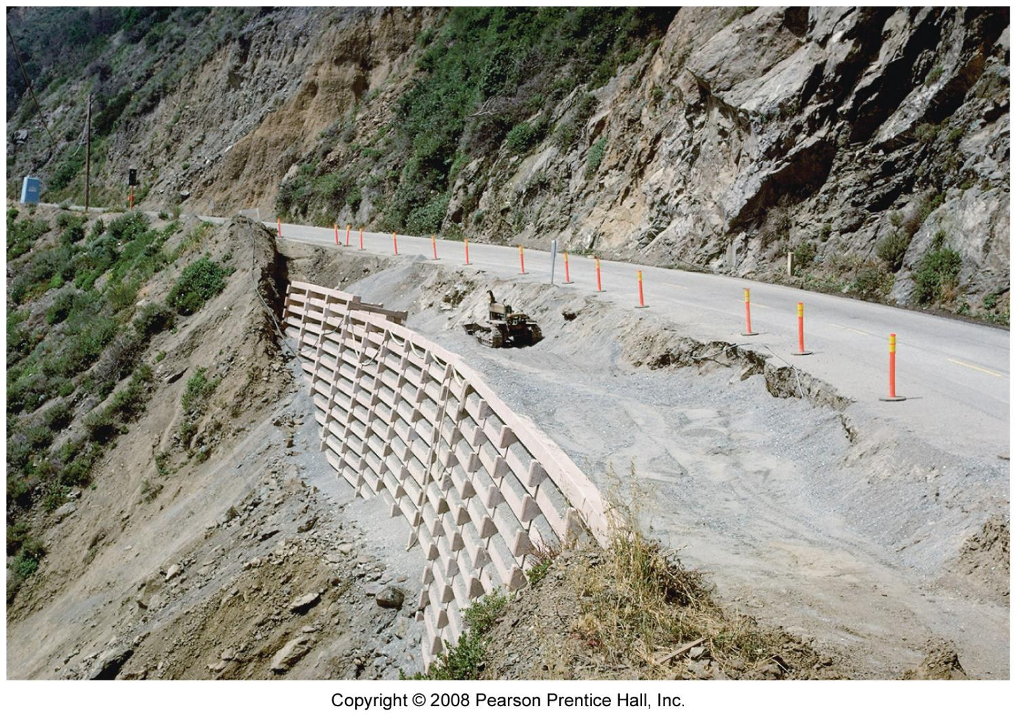
Preventing slope failure
careful planning of human activities
drainage and dewatering
grading and benching
retaining walls
bolting, netting, spray crete

Slide 13
Response to unstable slopes
Warning systems
surveillance
tilt meters
geophones
Landslide correction
stopping active slide
removal of water - drainage

Slide 14
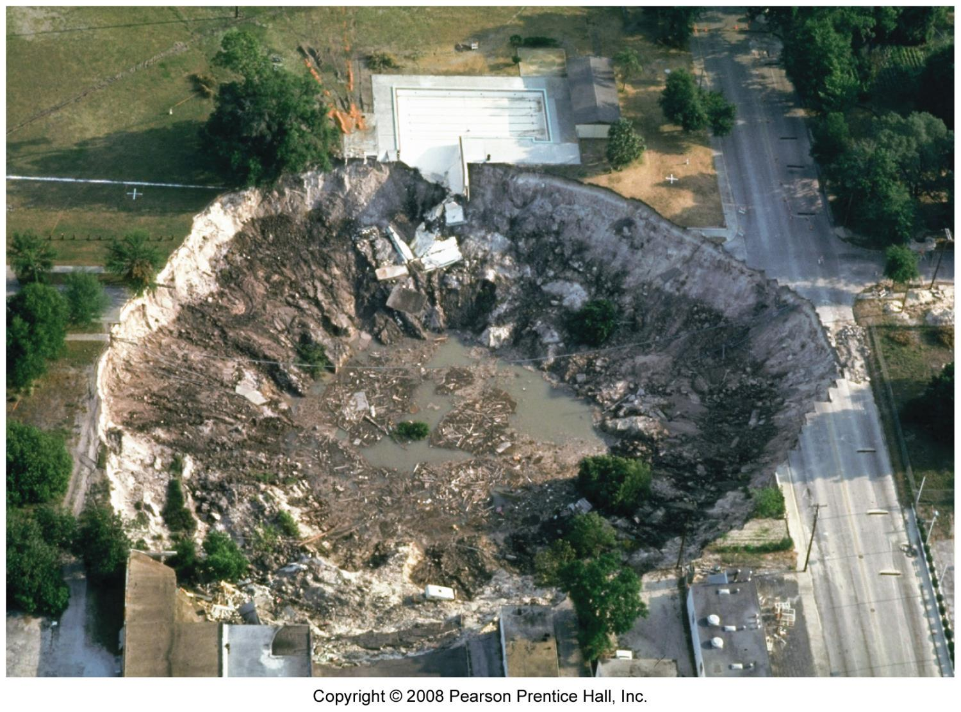
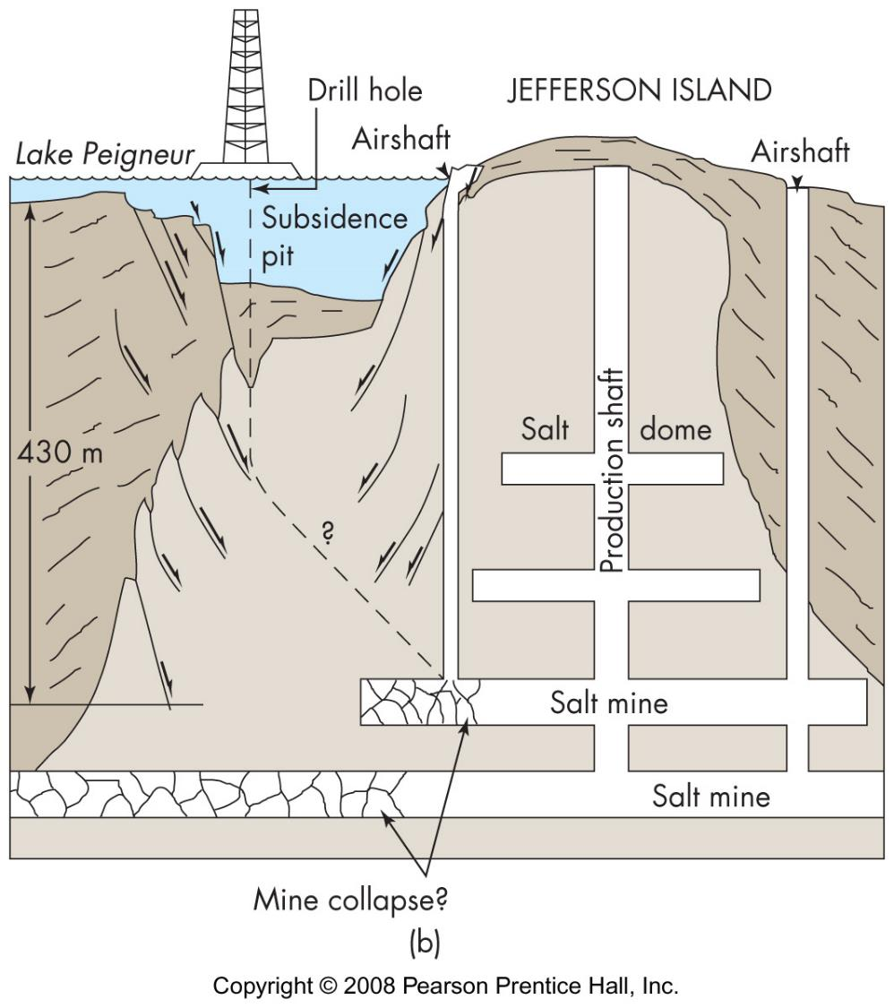
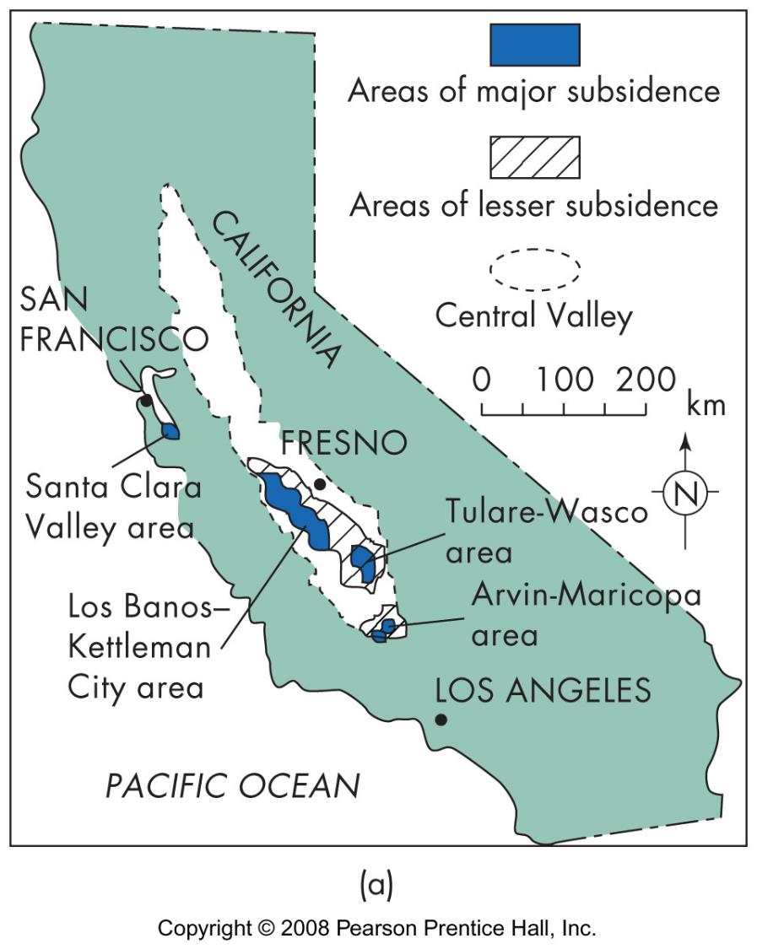
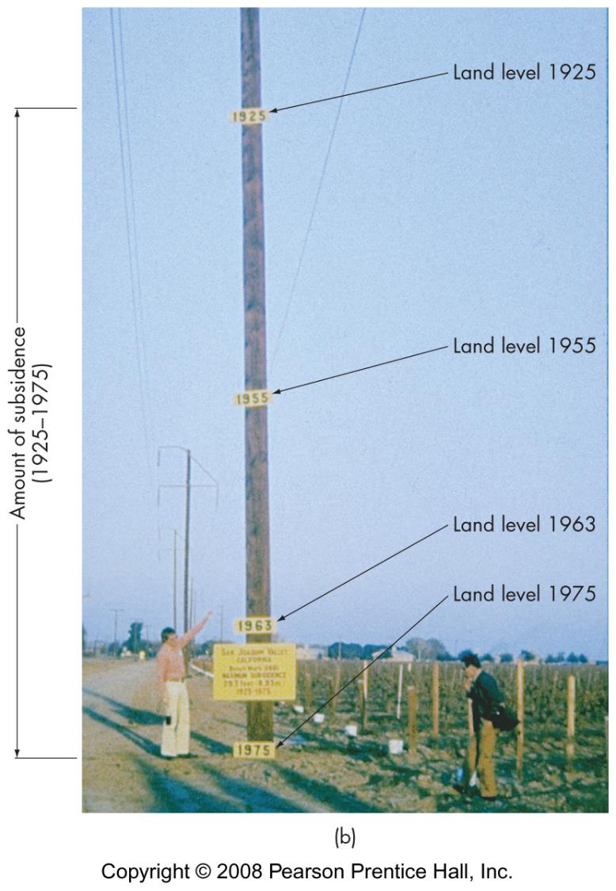
Land subsidence causes
withdrawal of fluids
mining
rock dissolution

Slide 15
Land subsidence risk areas
above mines
areas of heavy GW withdrawal
soluble bedrock

Slide 16
Chapter 19: Radon Gas

Slide 17
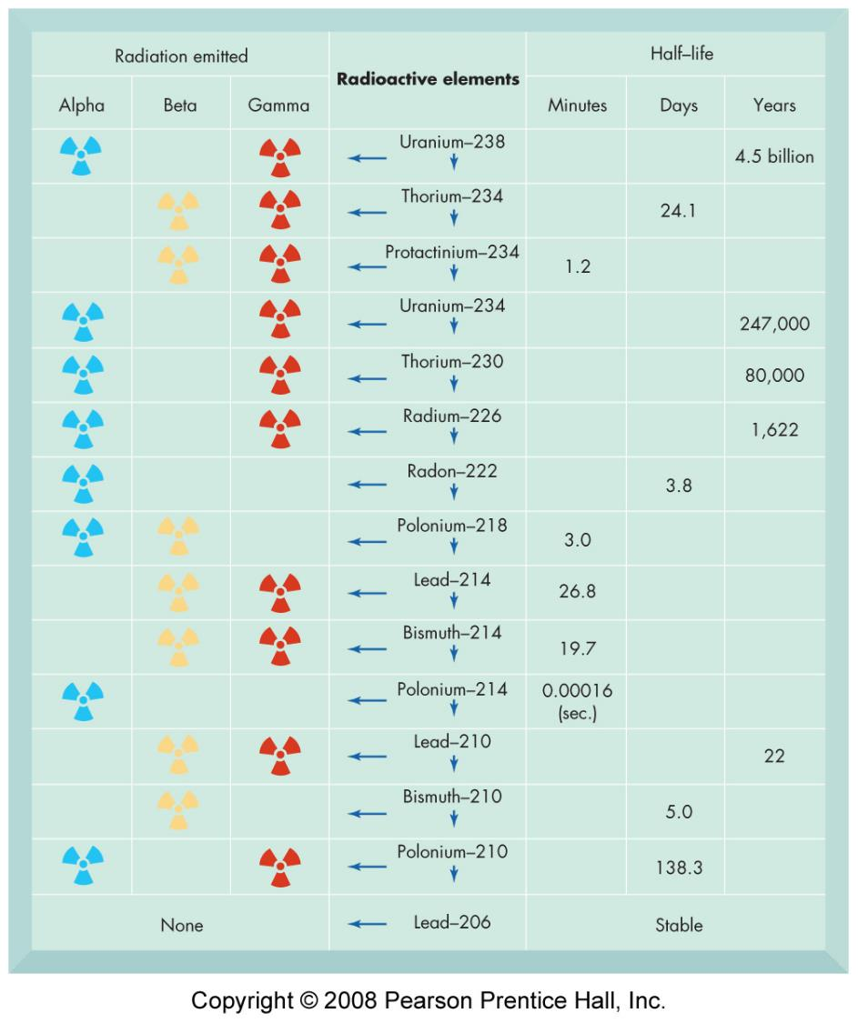
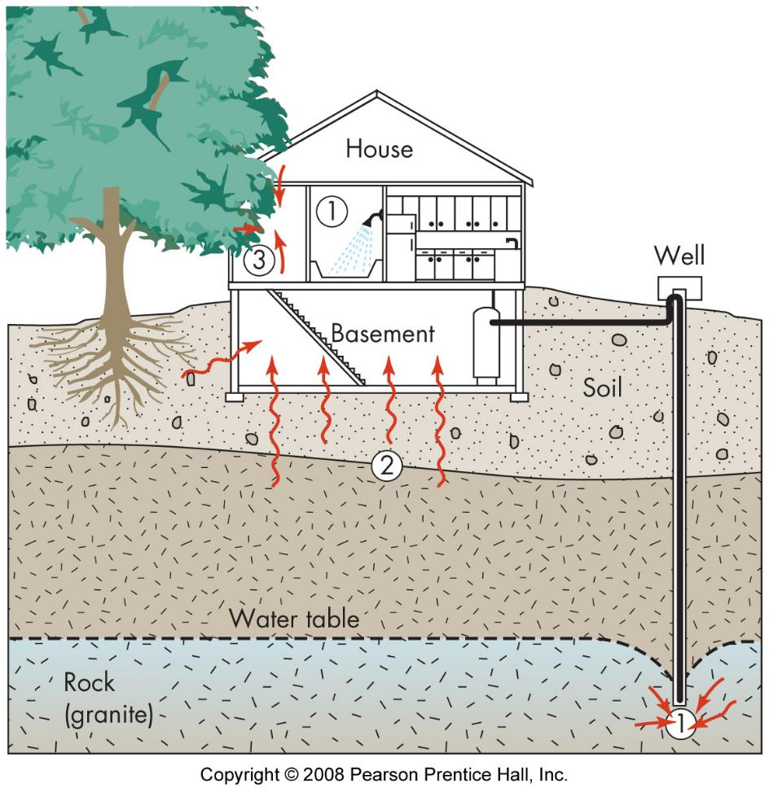
Radon Gas
naturally occurring
enters home & cannot escape
carcinogen

