Slide 1
Chapter 15: Energy Resources

Slide 2
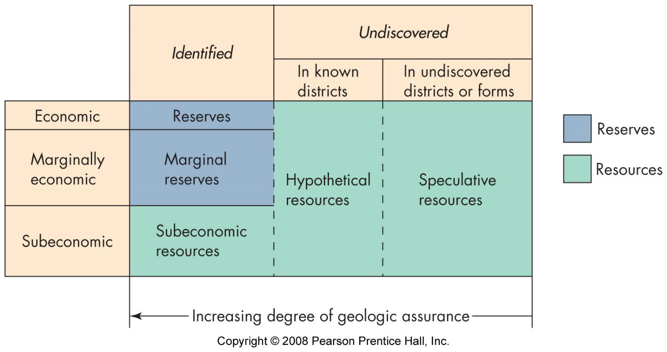
Resources and reserves
potentially useful materials
identified
useable
legally retrievable
economically viable

Slide 3
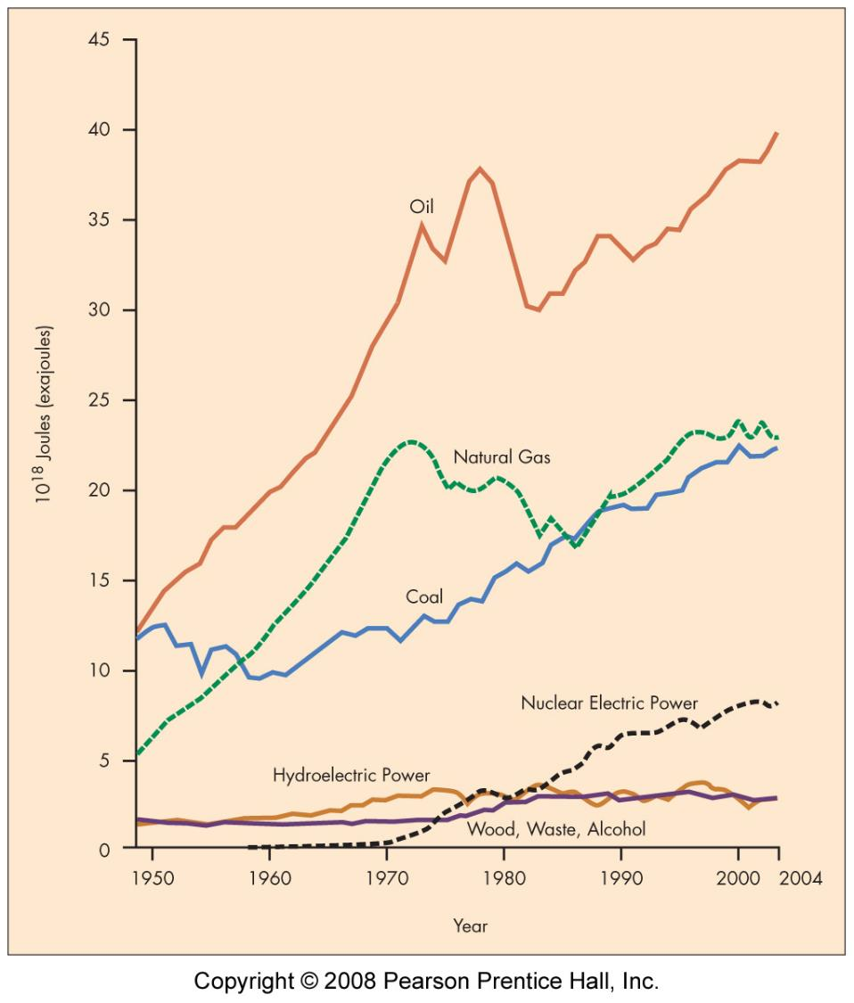
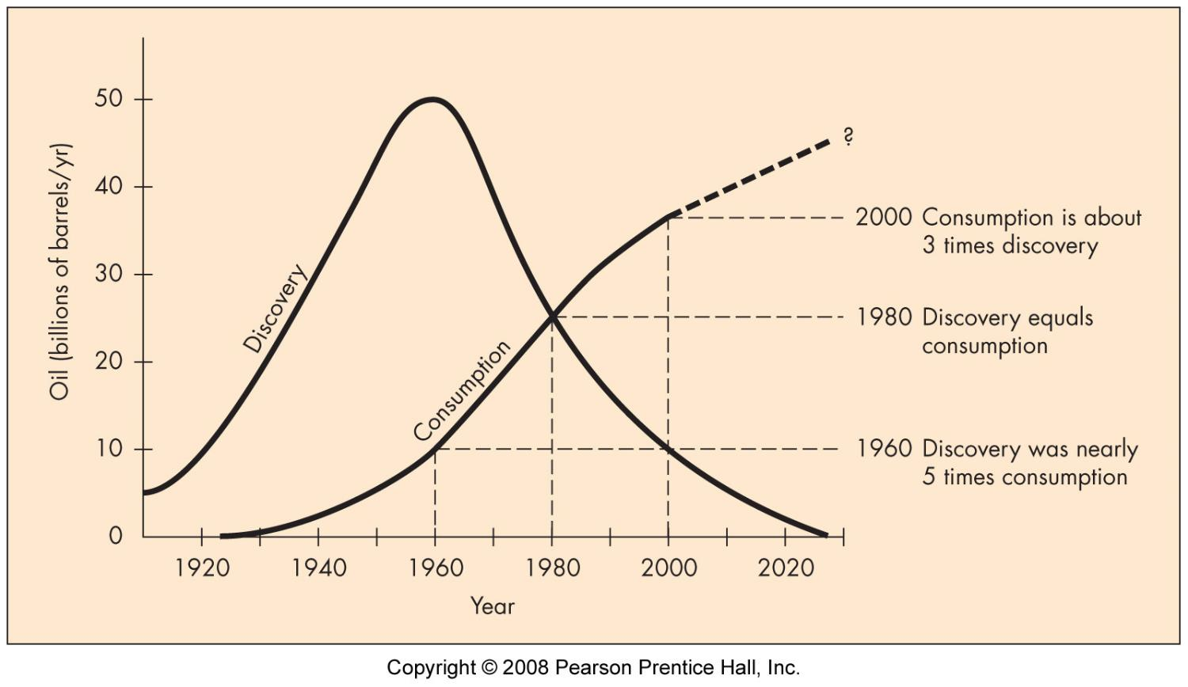
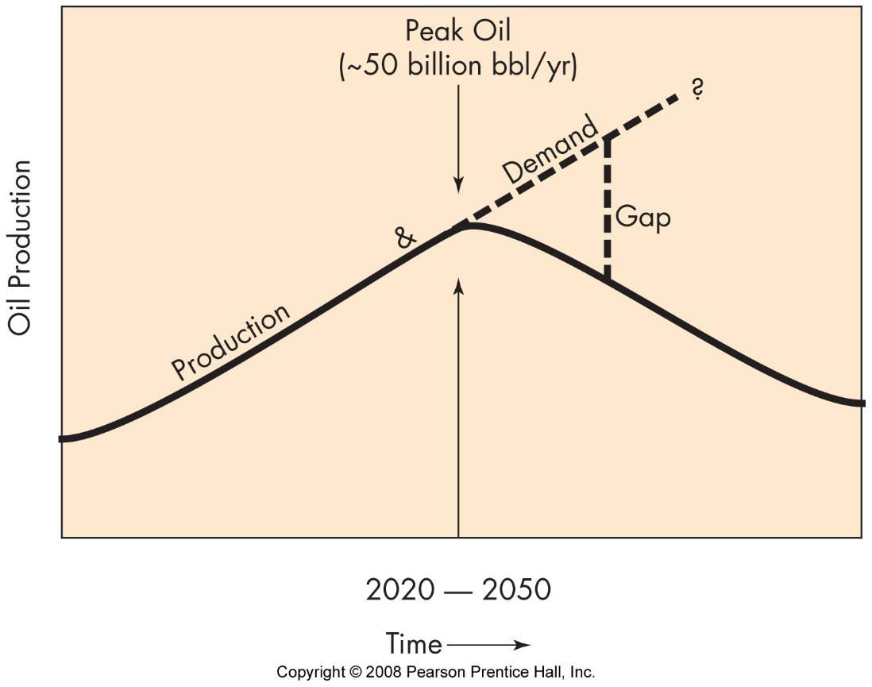
energy consumption
U.S.
World
http://www.eia.doe.gov/emeu/international/total.html

Slide 4
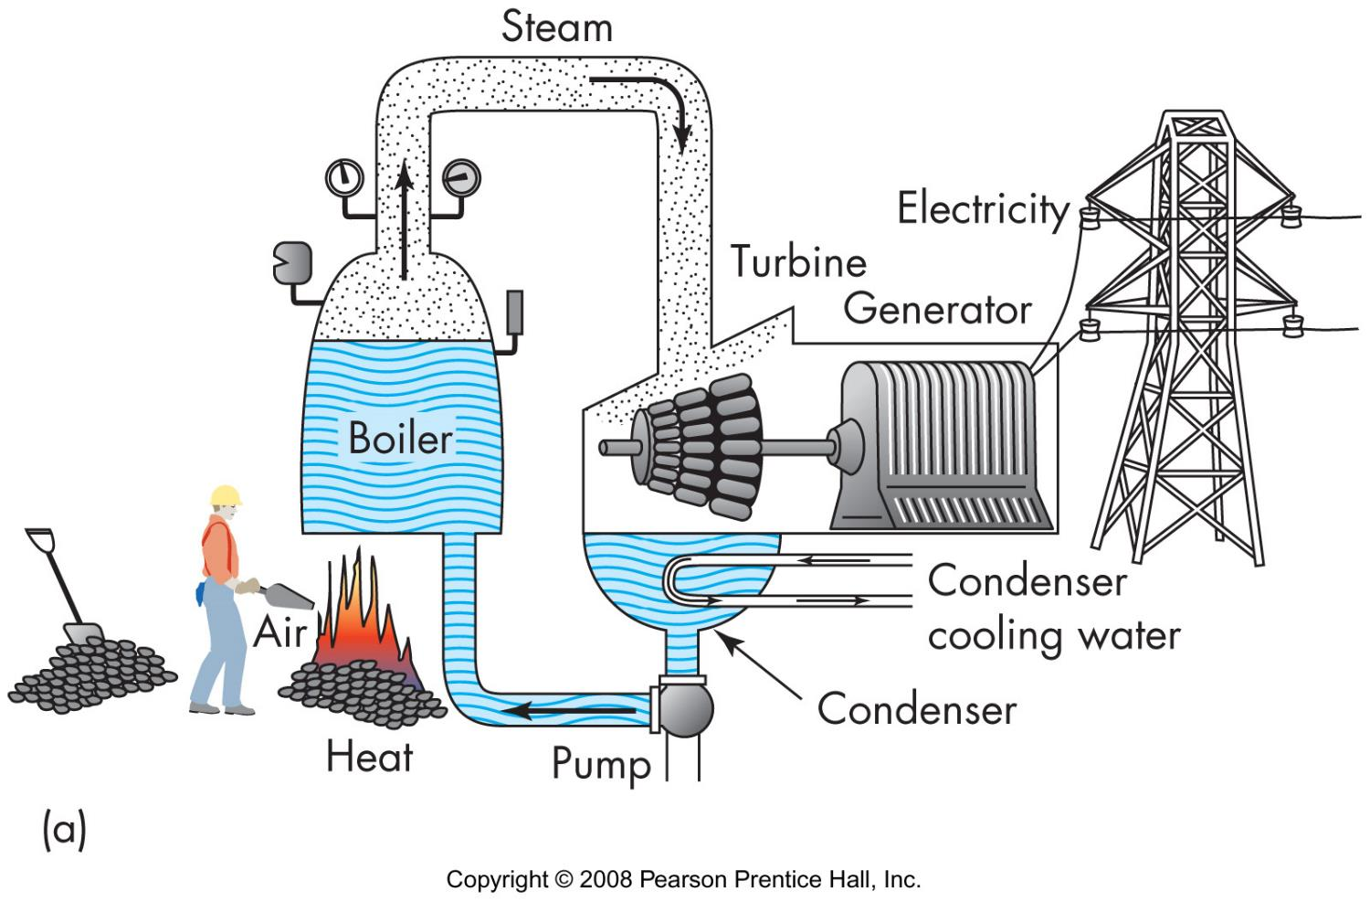

Slide 5
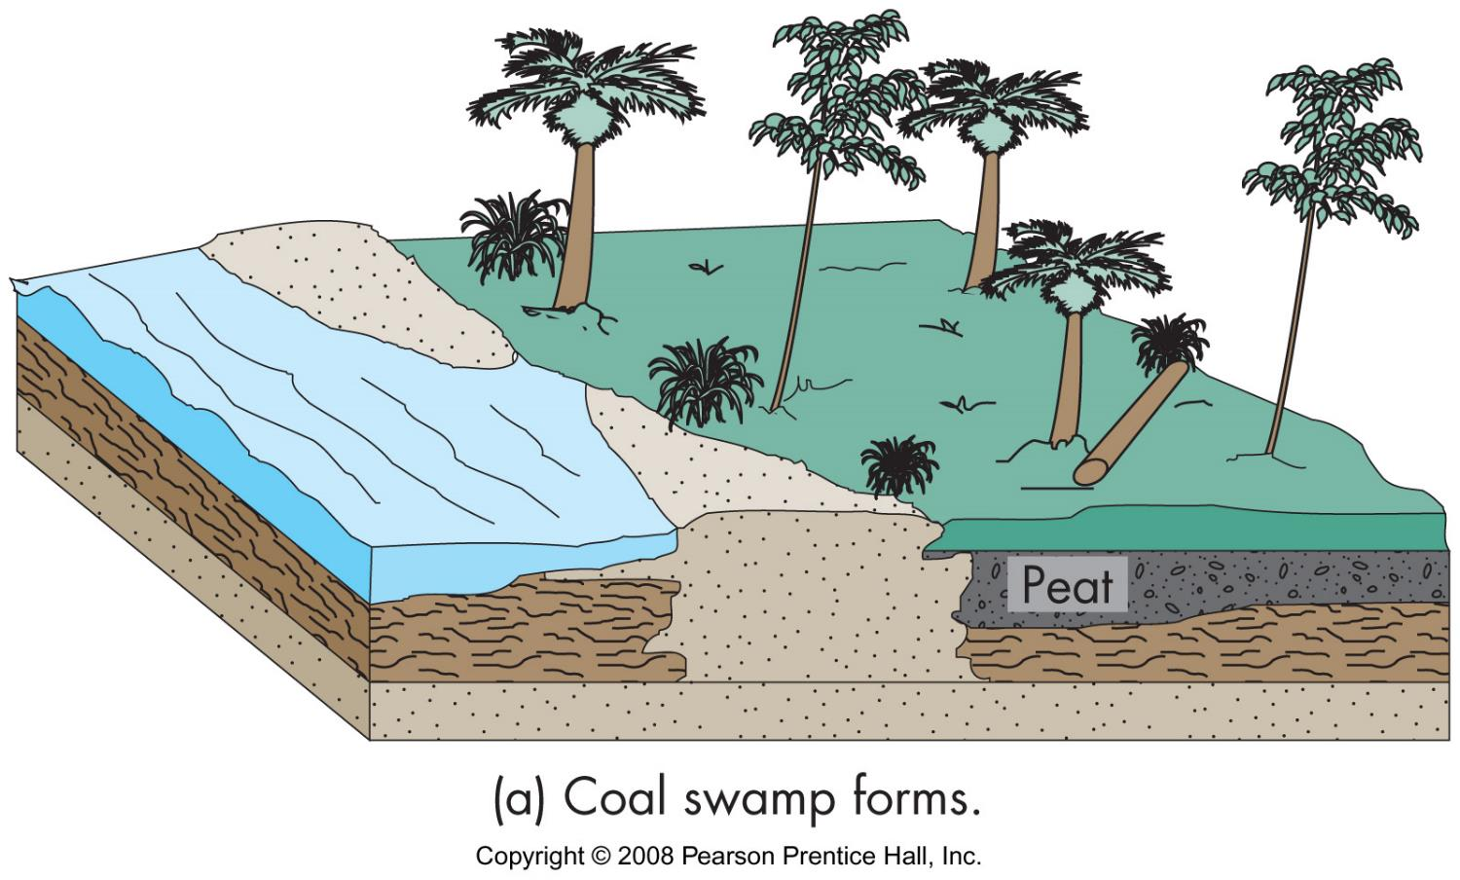
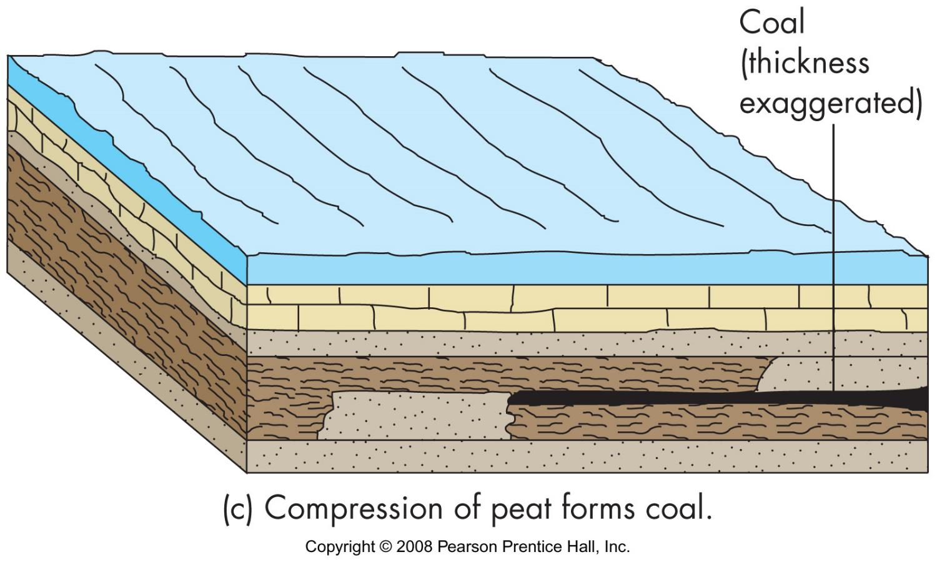
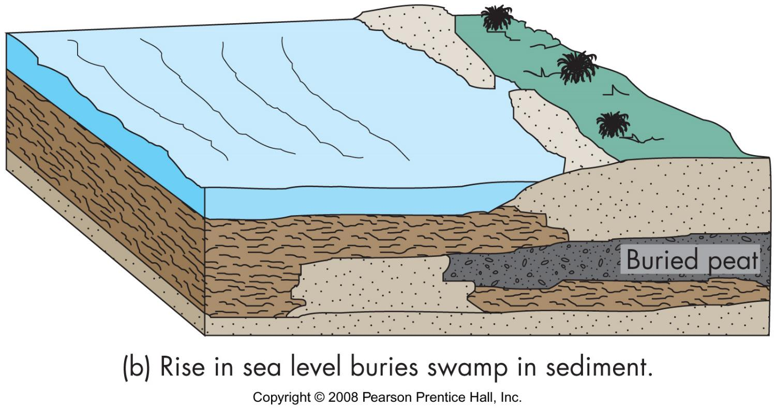
Coal
Coal forming process
plant material deposited in low oxygen environment

Slide 6
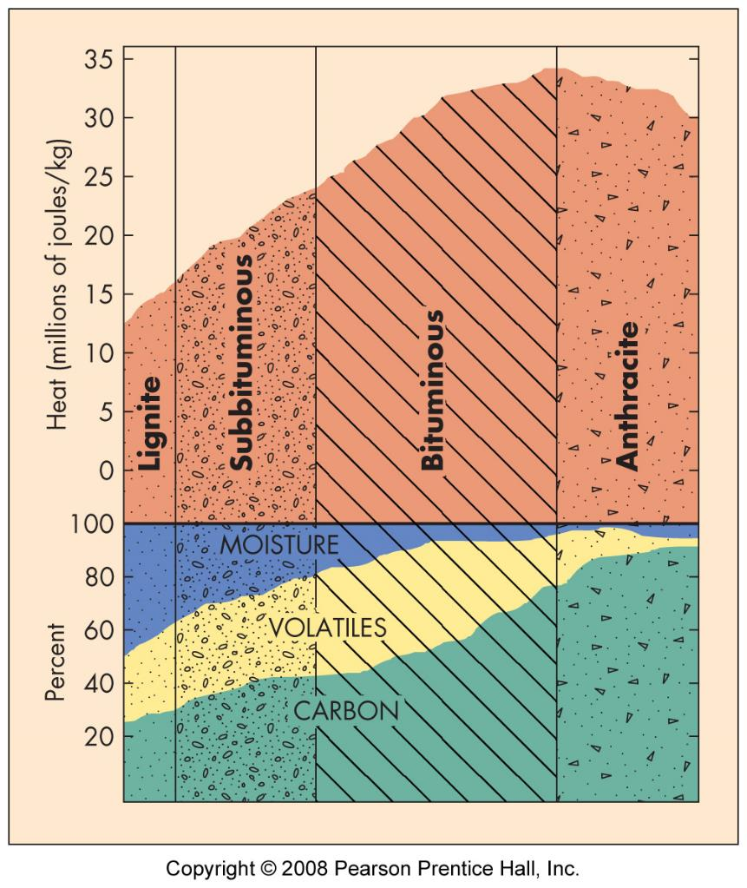
Coal classification
Heat content
Sulfur content
low 0-1%
med 1-3%
high >3%
Lignite
Subbituminous
Bituminous
Anthracite

Slide 7
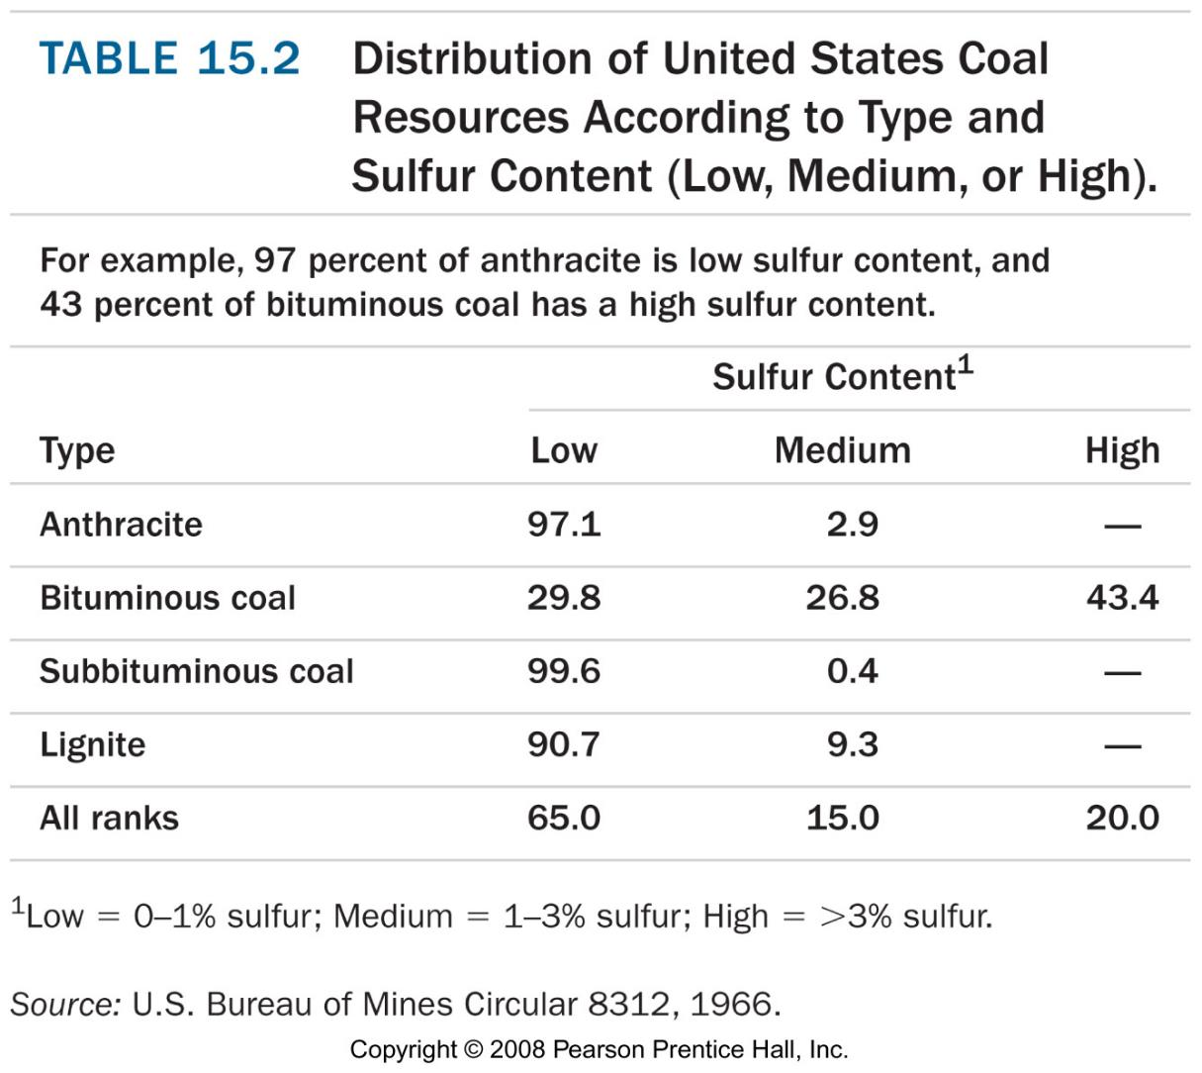
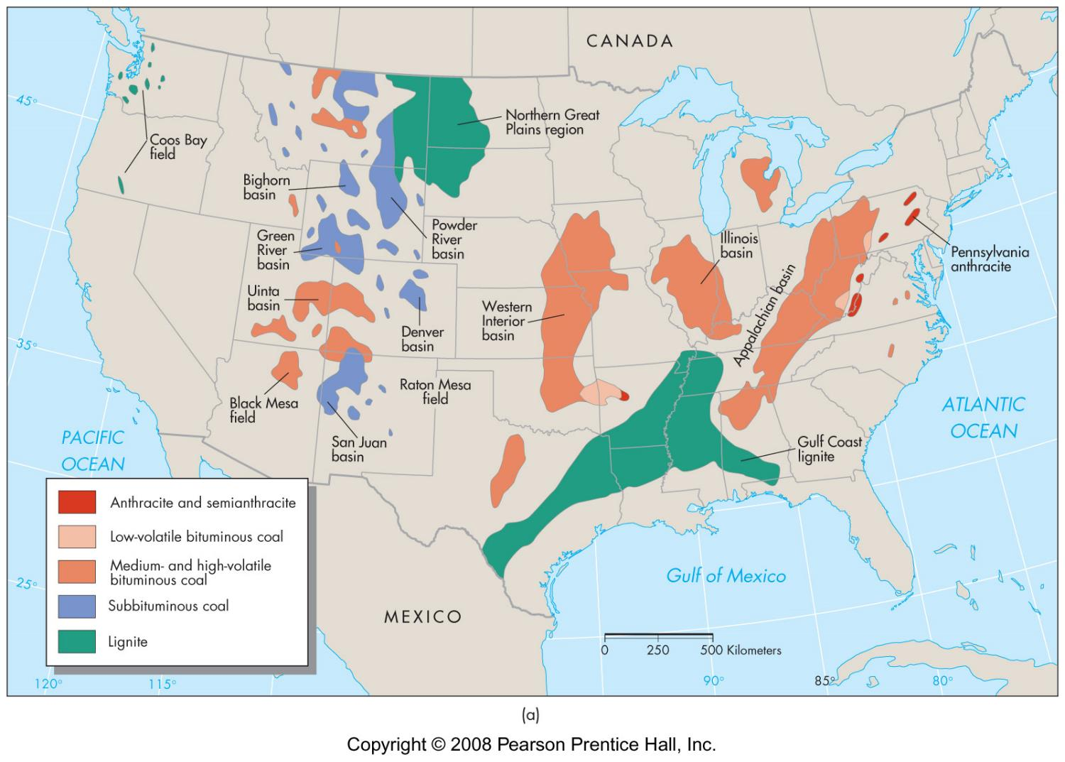
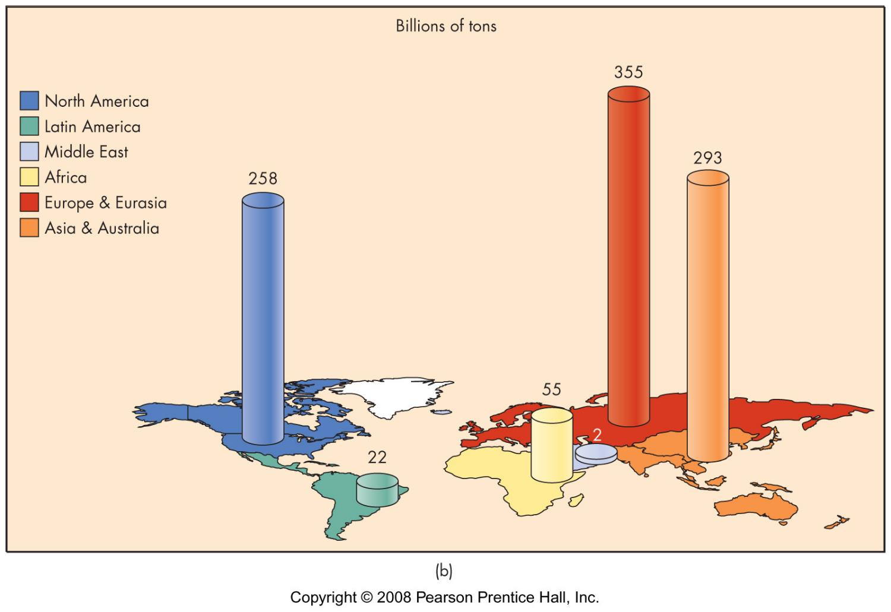

Slide 8
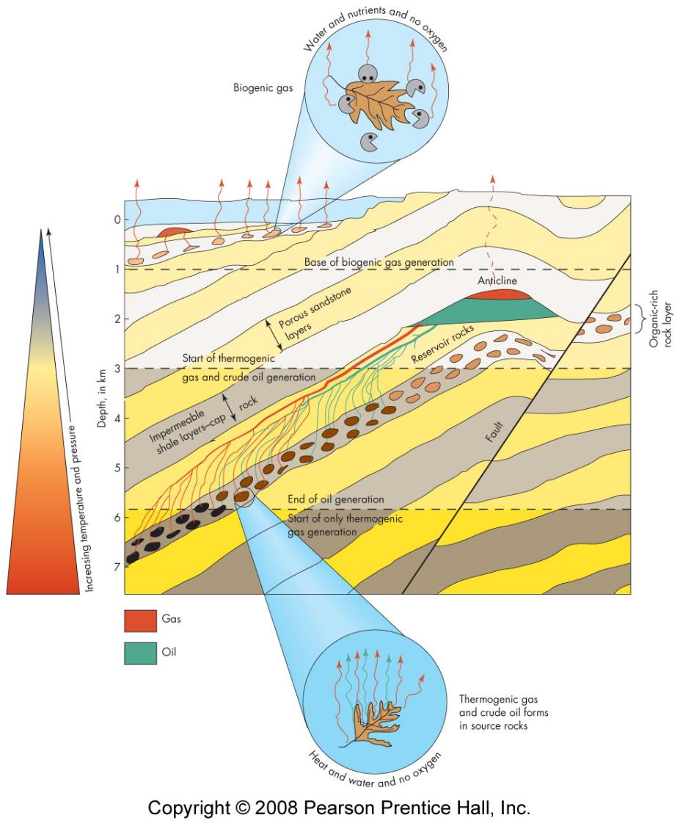
Oil and Gas Formation
natural gas (methane)
biological decomposition of organic material in a no oxygen environment
thermal decomposition of organic material in a no oxygen environment
petroleum
thermal decomposition of organic material in a no oxygen environment (must be just right temp and pressure)

Slide 9
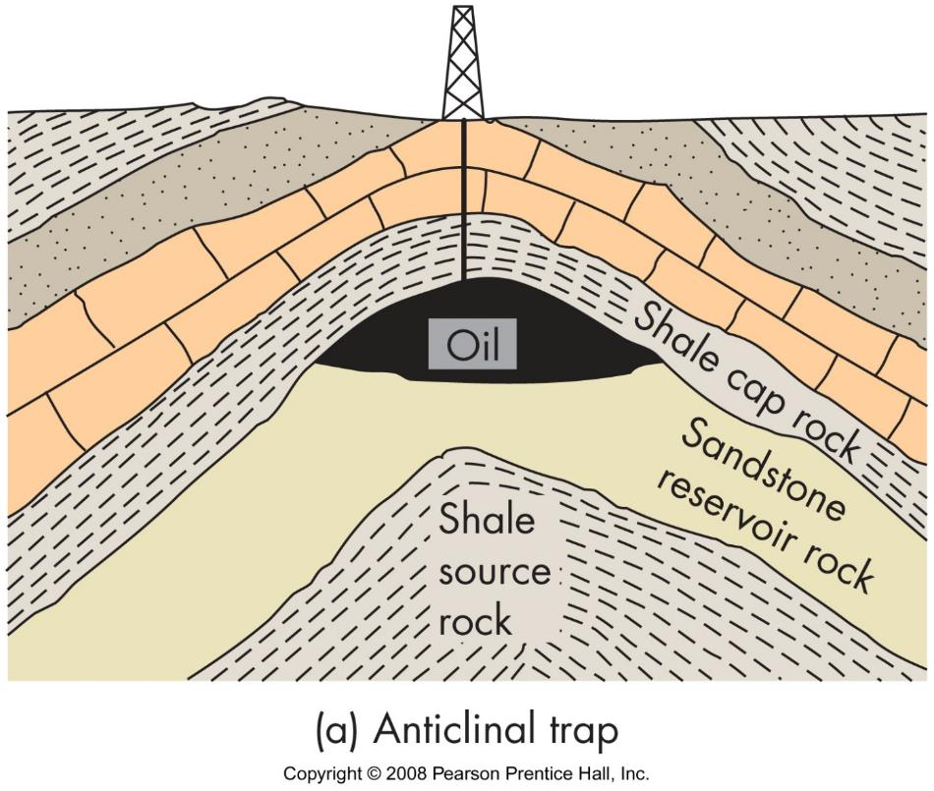
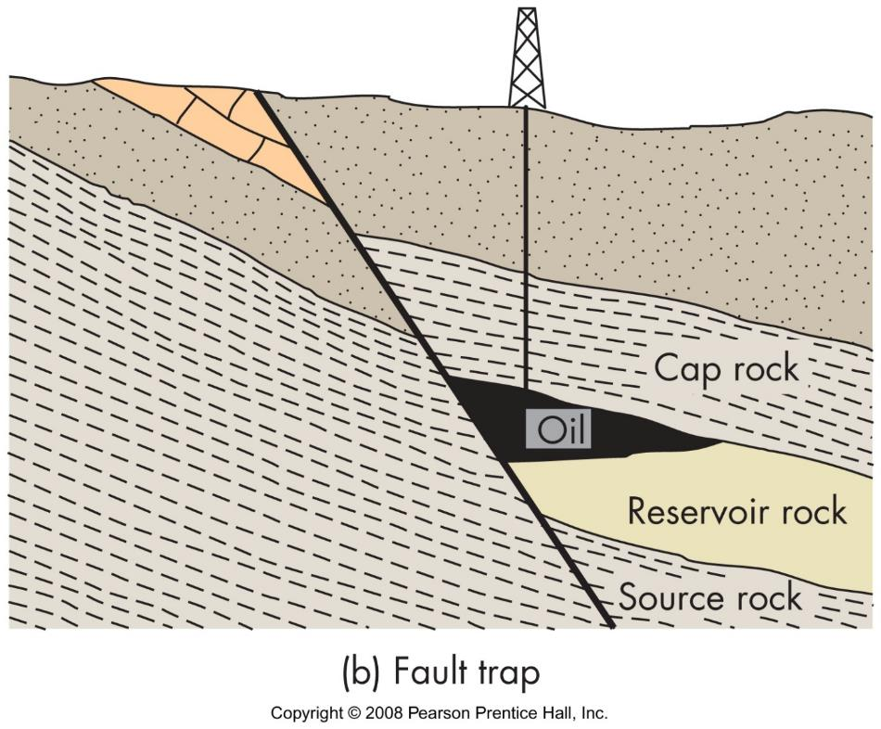
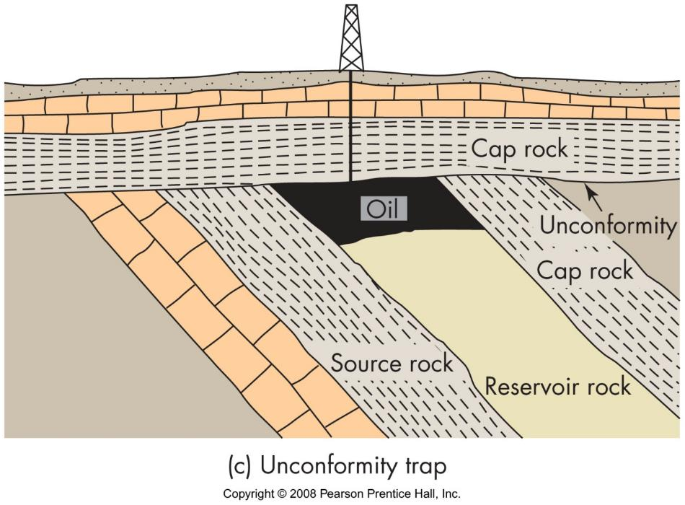
Petroleum and gas fields
source rock
organic-rich oceanic deposits
shale & limestone
reservoir rock
cap rock
trap structure

Slide 10
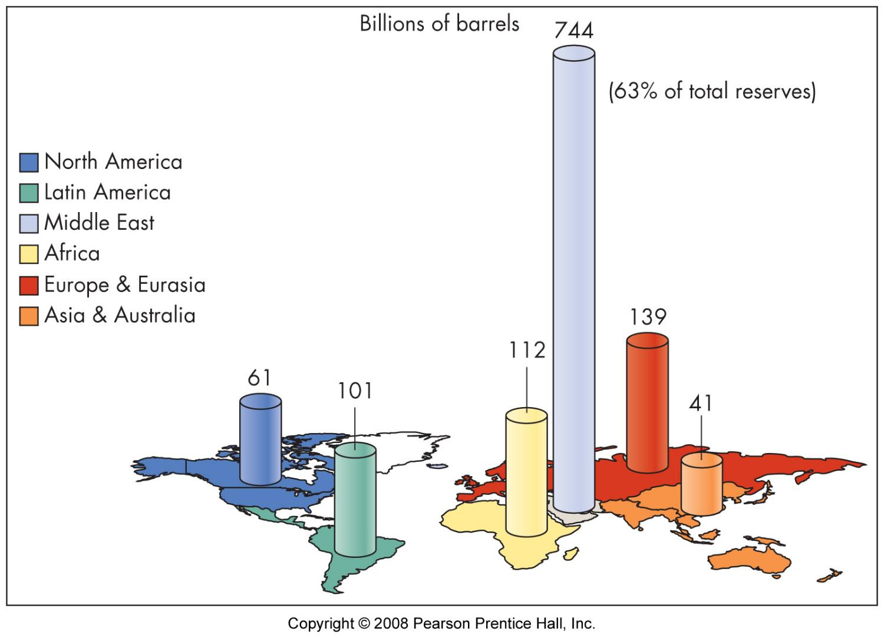

Slide 11
Petroleum and gas recovery
primary
enhanced (secondary)

Slide 12
Other petroleum and gas resources
methane hydrate
oil shale
tar sands

Slide 13
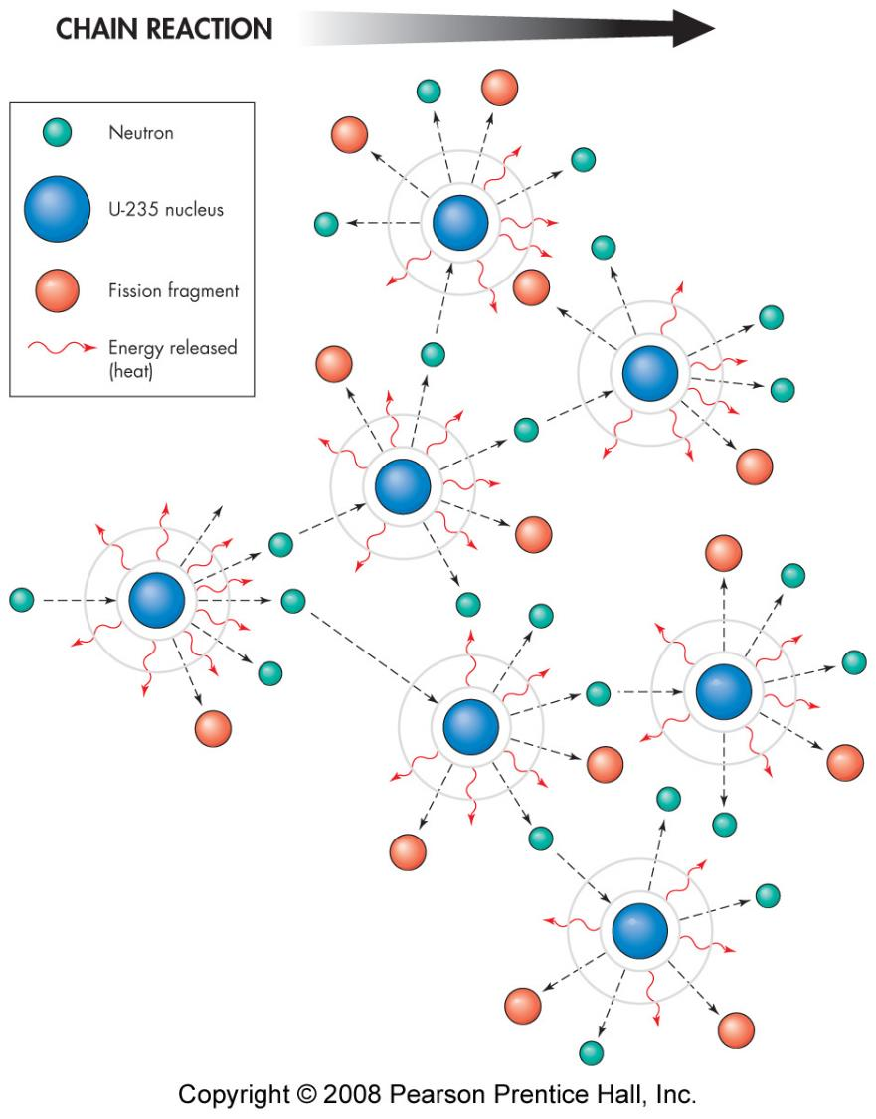
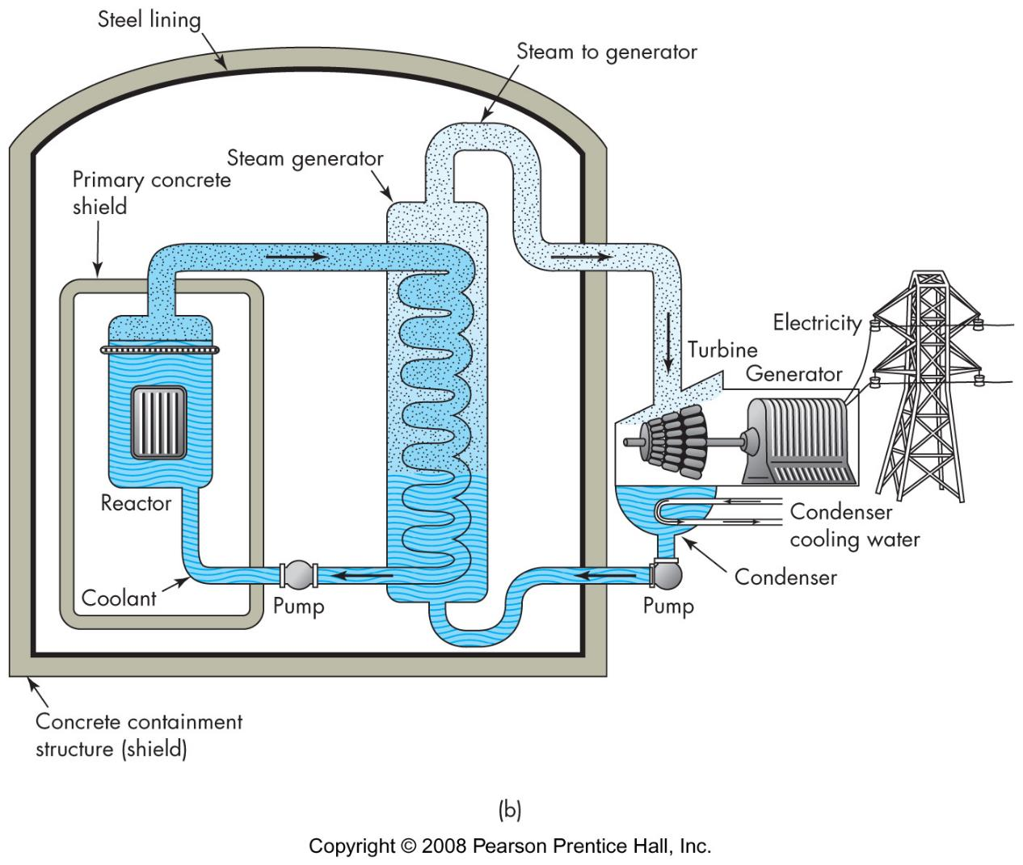
Nuclear fission
Uranium ore
U²³⁸: 99.3%
U²³⁵: 0.7%
must enrich U²³⁵
process - split atomic nulcei
burning reactor
breeder reactor

Slide 14
Fusion
4H ➔ 1He (sun)
benefits
high energy
low waste
problem
hard to contain

Slide 15
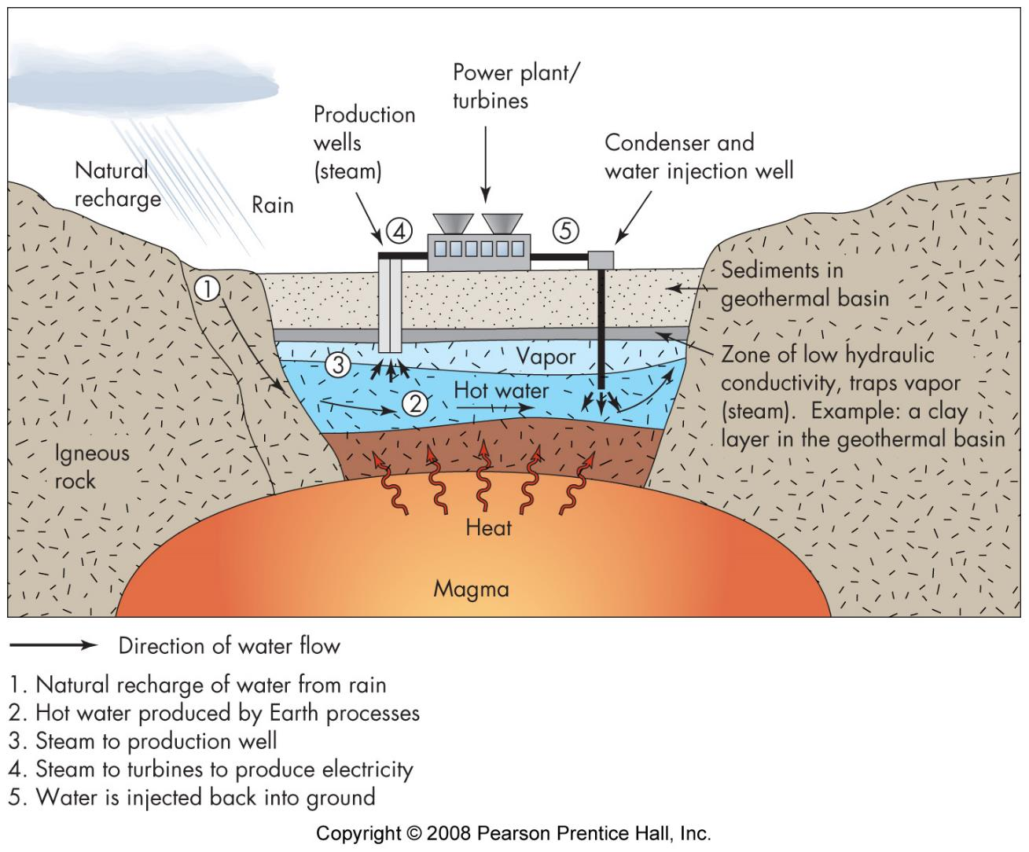
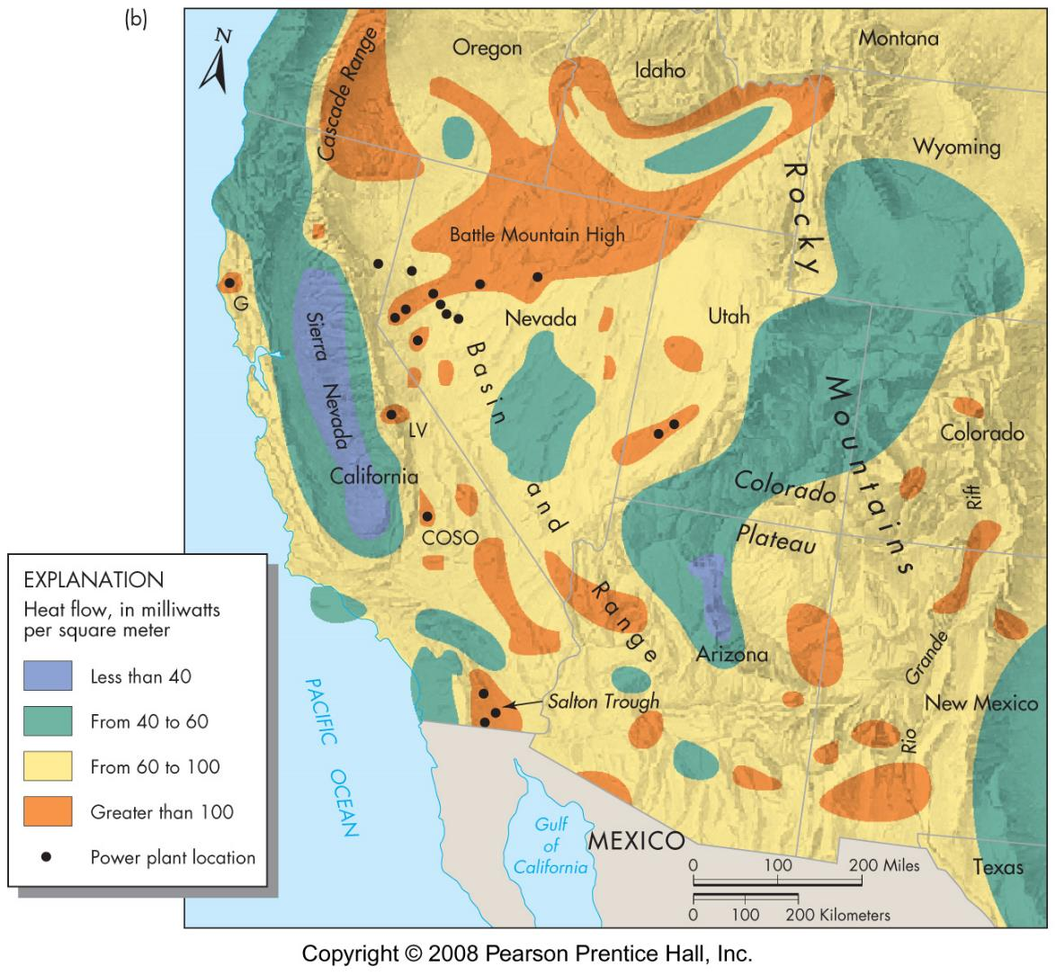
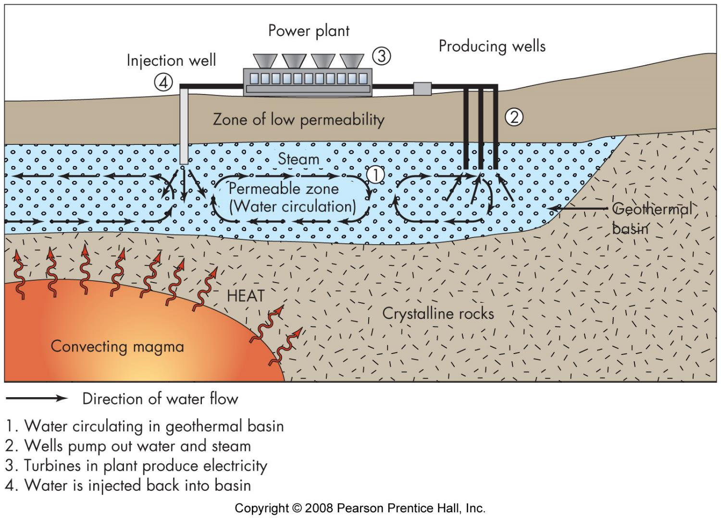
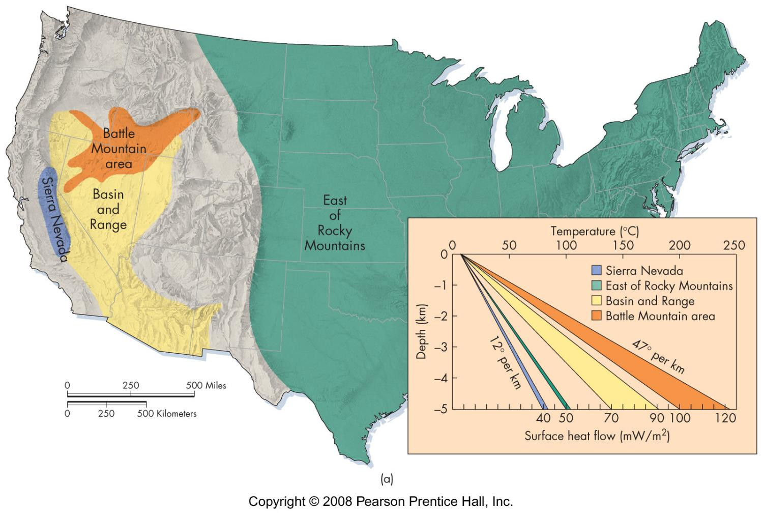
Geothermal
geology
high geothermal gradients
hot springs and geysers
hydrothermal convection systems
environmental impact
may deplete system
may be stinky & noisy

Slide 16
Renewable energy sources
solar
hydro
wind
biomass

Slide 17
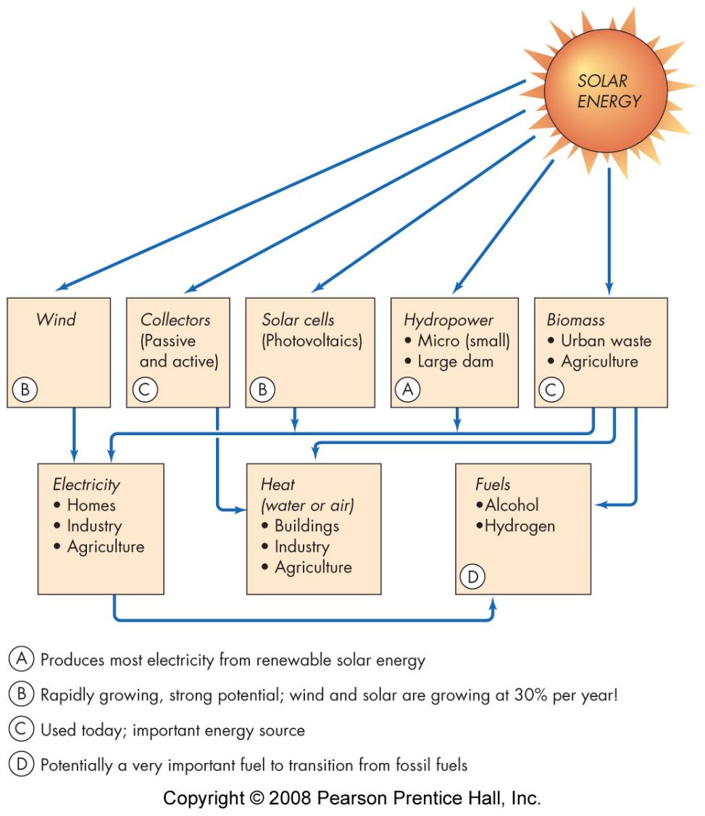
Renewable energy sources
solar
direct heat
electricity generation
turbine
photovoltaic
passive

Slide 18
Renewable energy sources
water power
types
hydroelectric
run-of-river
pump storage
tidal
impact
impede flow
flooding

Slide 19
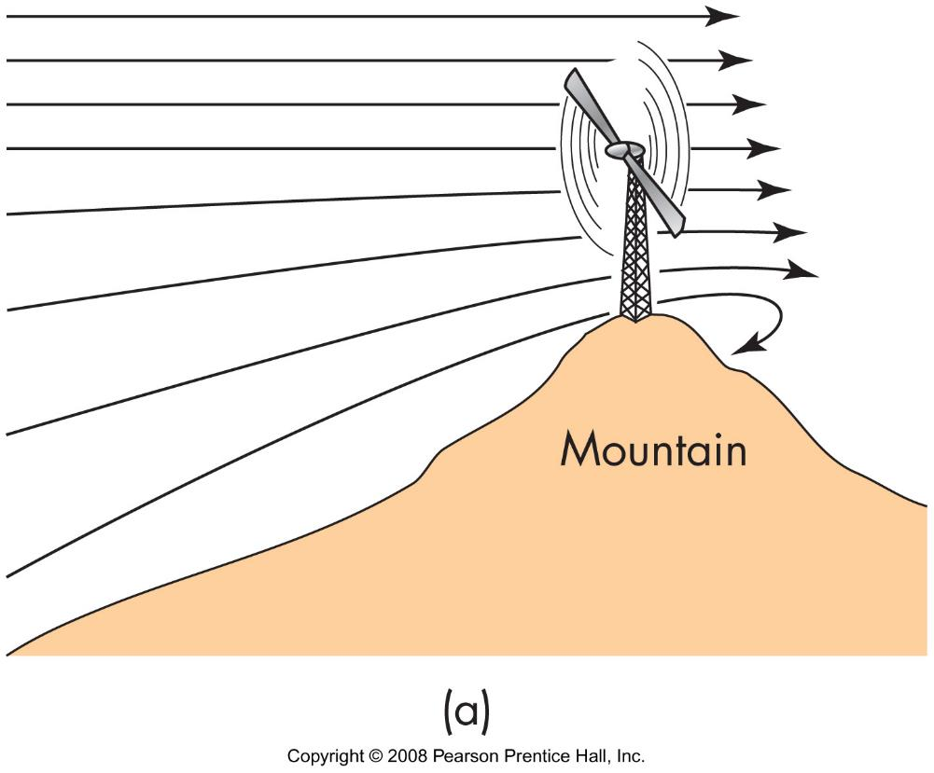
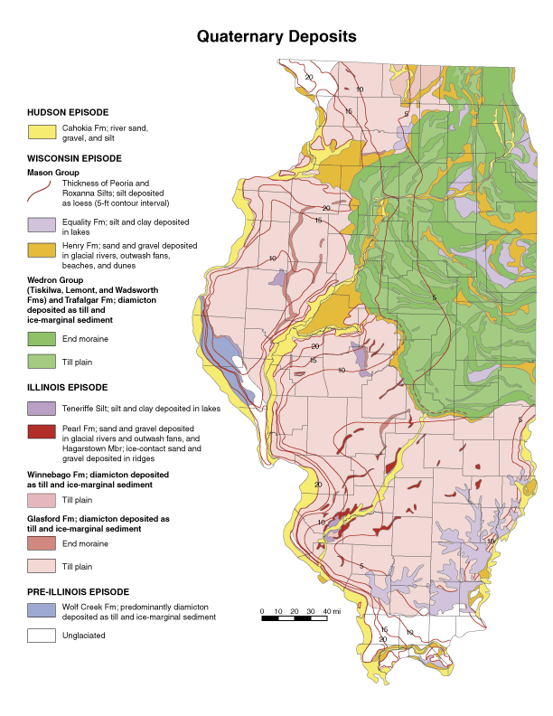
Renewable energy sources
wind power
biomass
trees
dung
ethanol
biodeisel

Slide 20
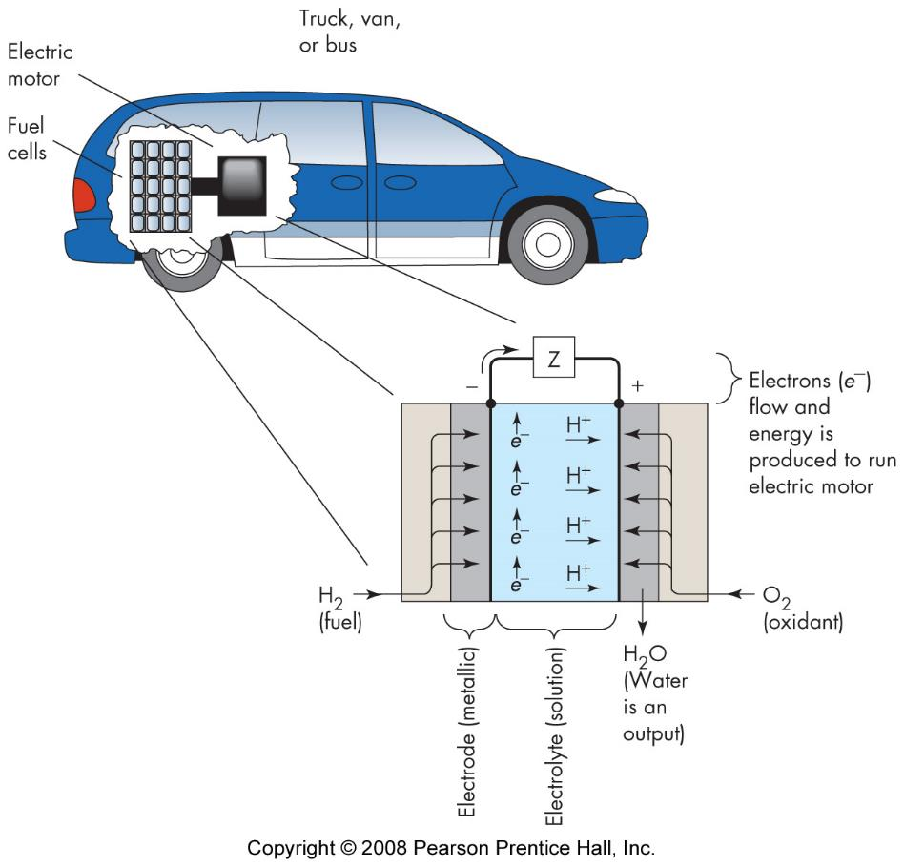
hydrogen fuel cell
“burns” hydrogen to produce water
must use energy to produce hydrogen

Slide 21
reduced energy use
conservation
cogeneration - use of waste heat
efficiency

Slide 22
energy policy
production
consumption
sources

