Slide 1
Impact of Resource Use

Slide 2
Depletion of resource
non-renewable (on human scale)
often occur in small localized bodies
not evenly distributed

Slide 3
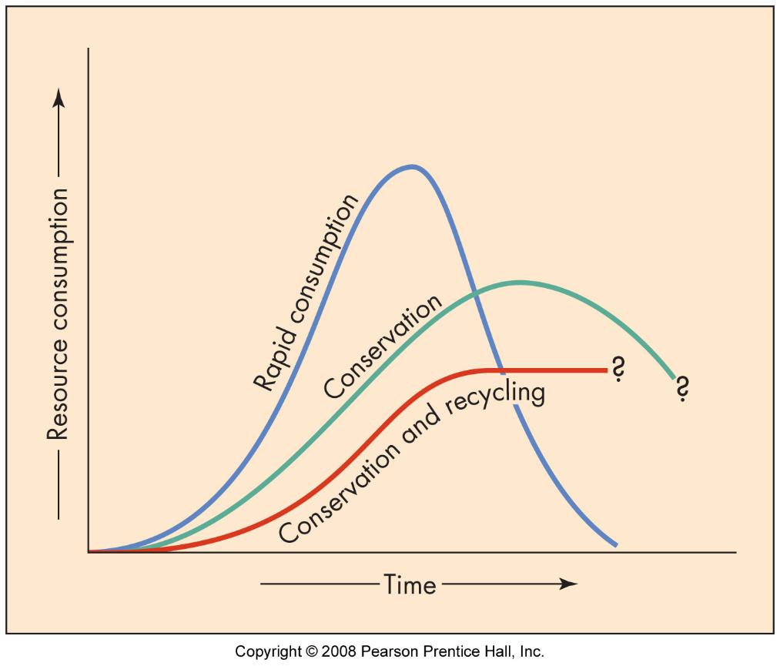
Consumption
rapid
slower
sustainable

Slide 4
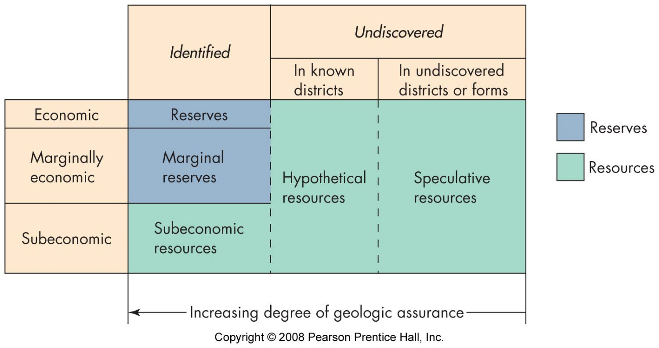
Resources and reserves
potentially useful materials
identified
useable
legally retrievable
economically viable

Slide 5
Environmental impact
exploration - small
development – large

Slide 6
Environmental impact
exploration - small
development – large
  surface disruption

Slide 7
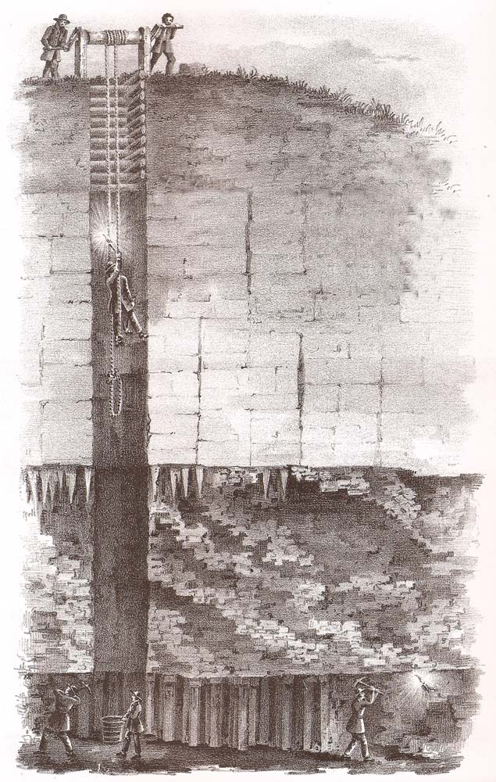
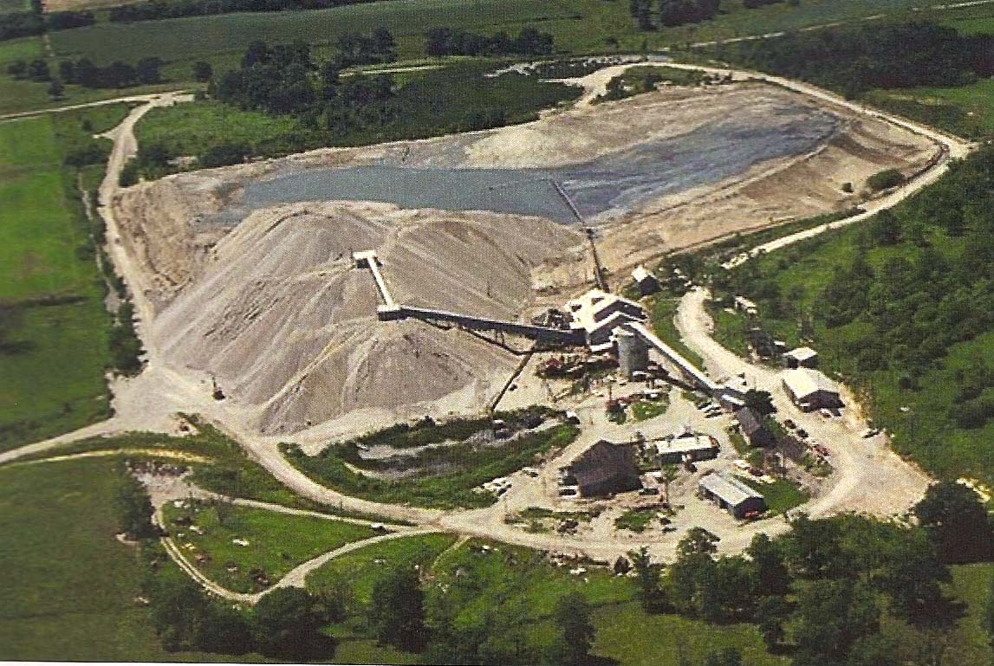
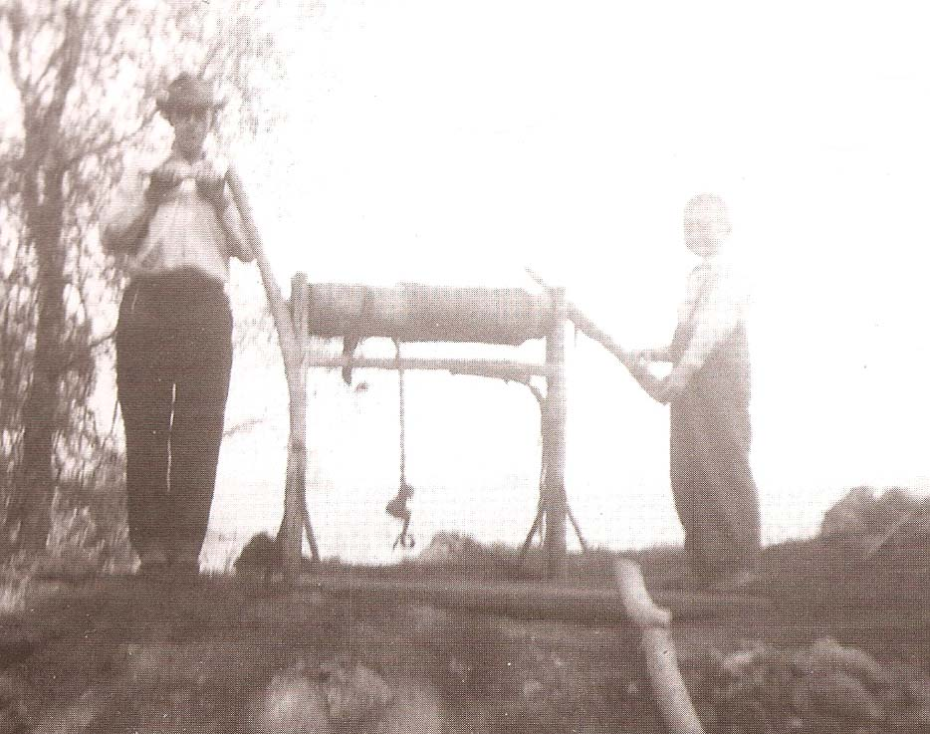
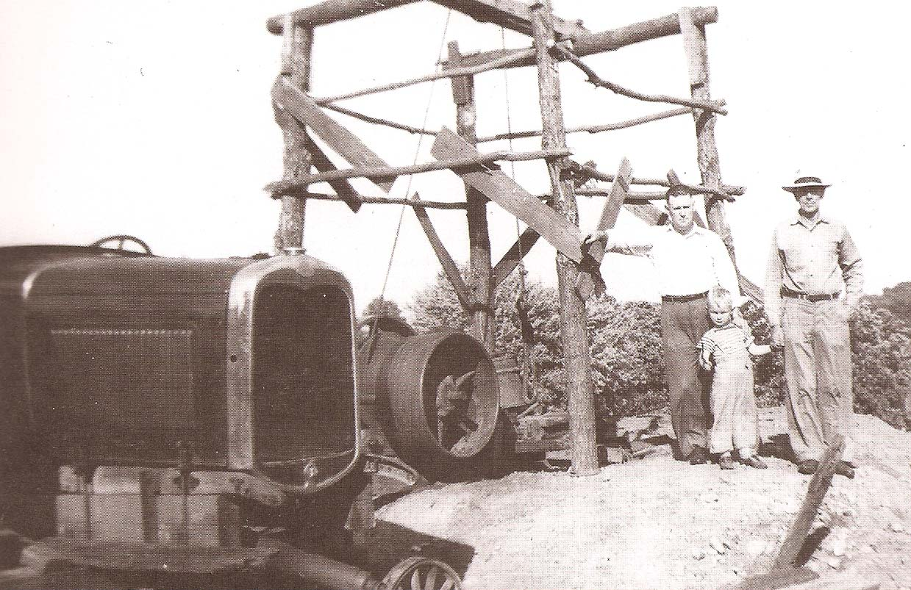
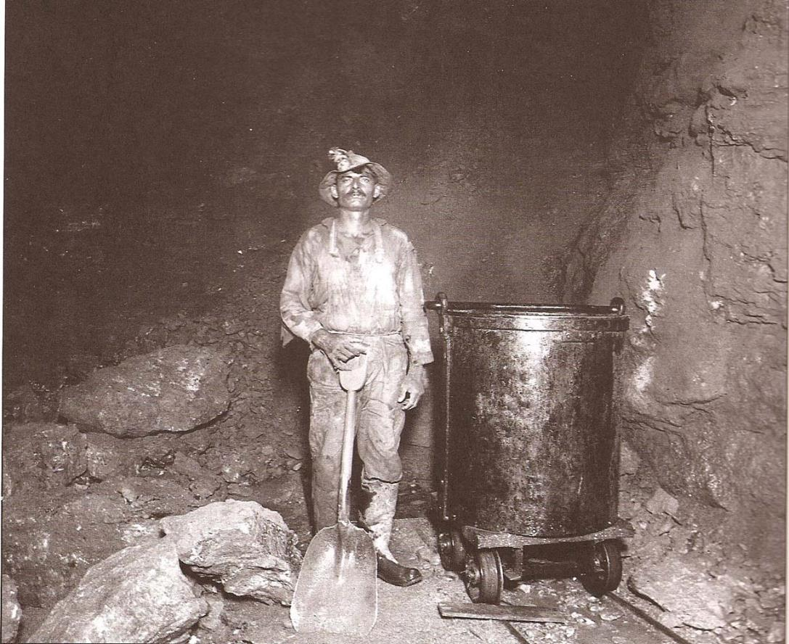
Environmental impact
Shaft mining
  small scale
  large scale

Slide 8
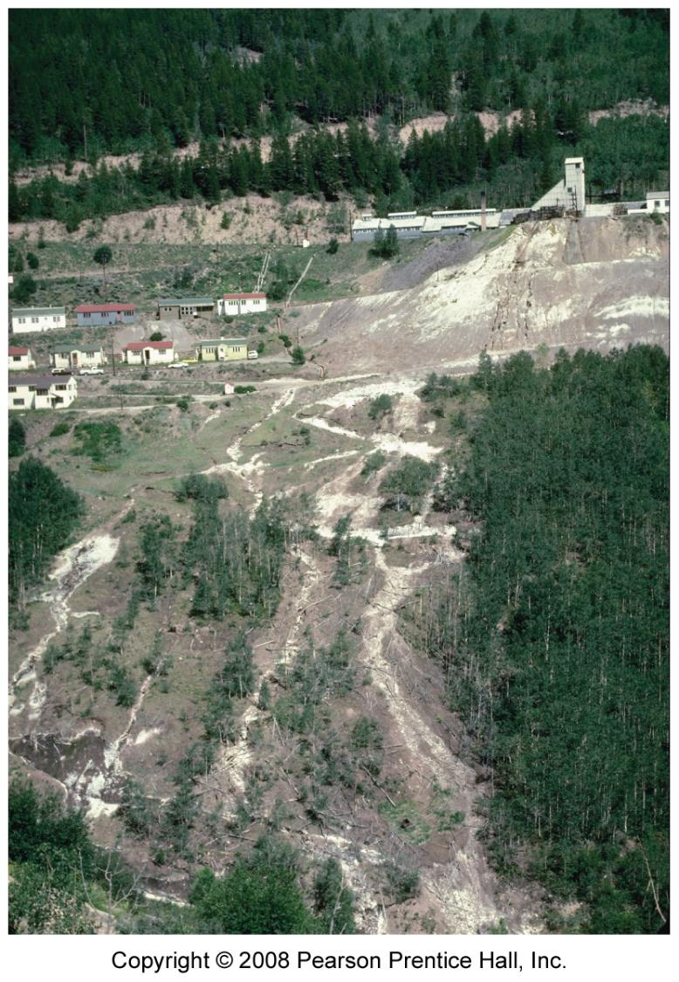
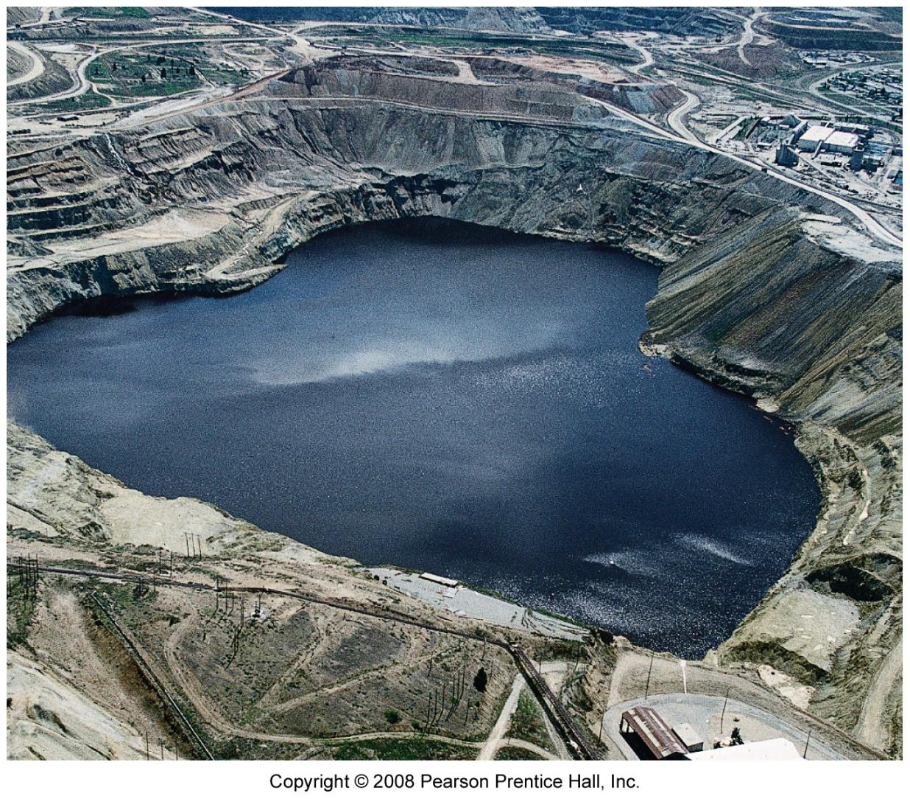
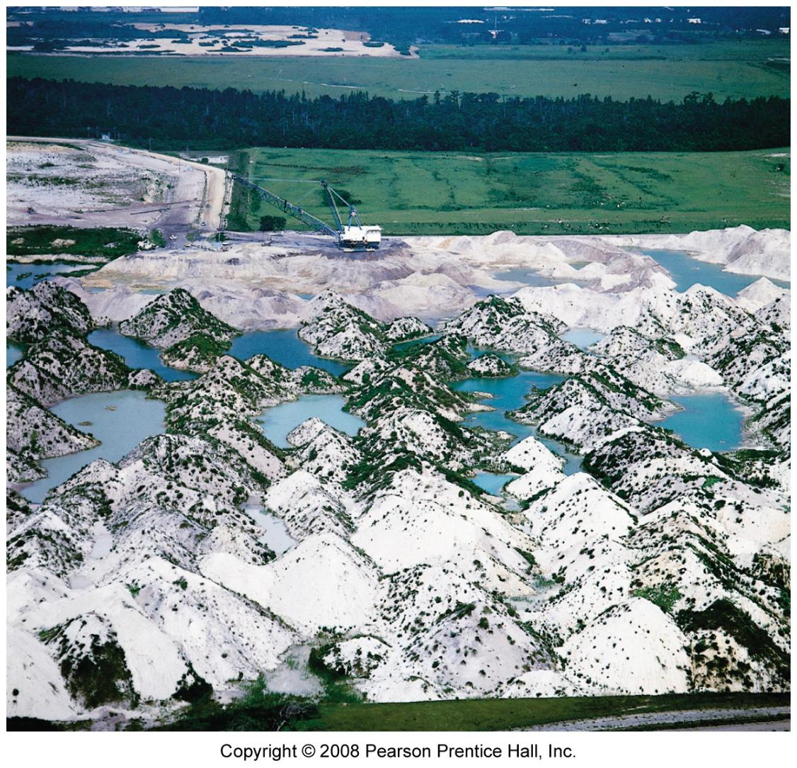
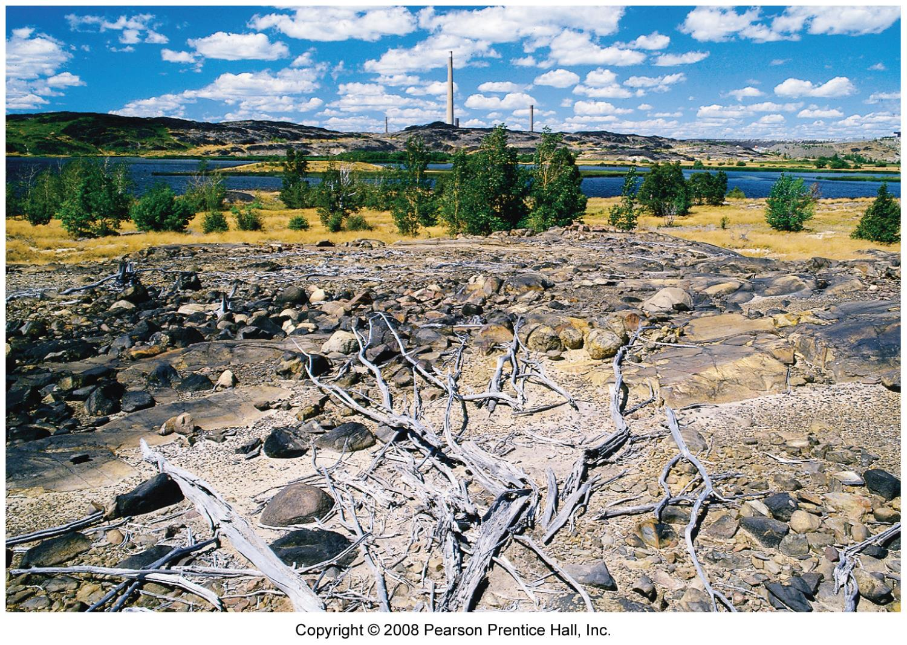
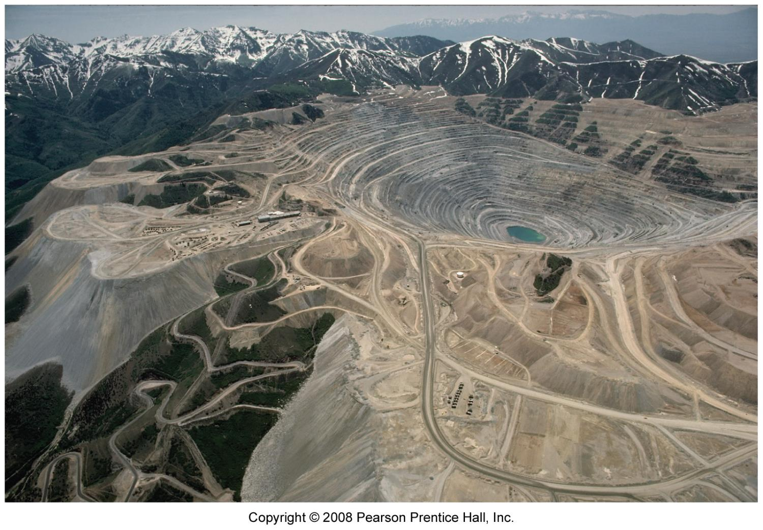
Environmental impact
exploration - small
development – large
  surface disruption
  slag deposits
  water pollution
  air pollution
  social

Slide 9
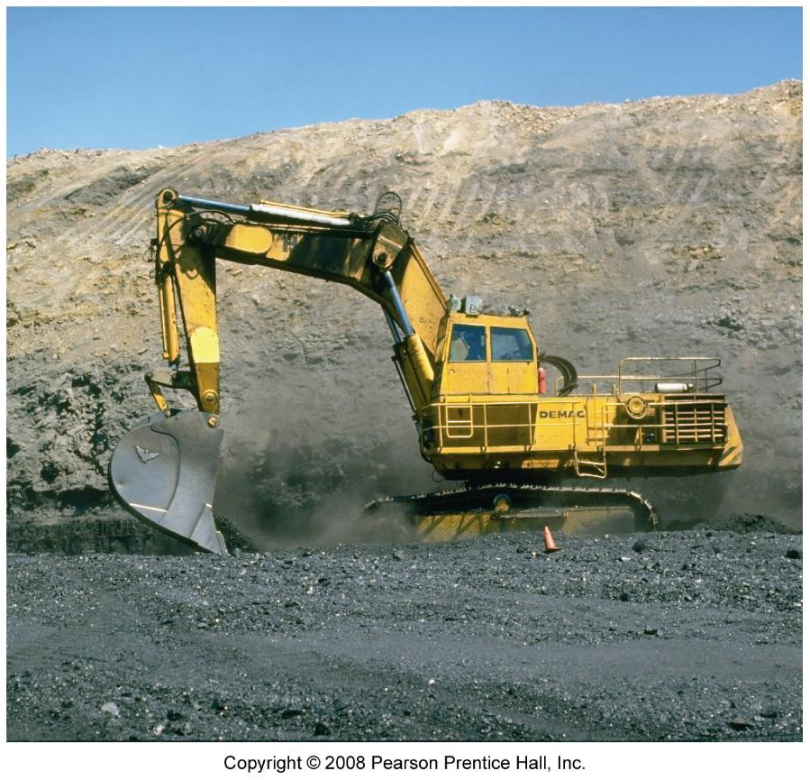
Impact of coal mining
strip mining
  disturbs large areas
  reclamation
  mountain-top removal
underground
  subsidence
  fires

Slide 10
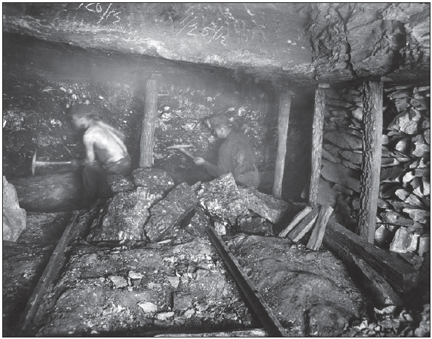
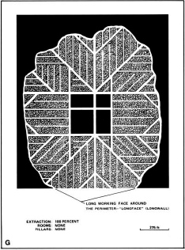
Mining Methods
longwall

Slide 11
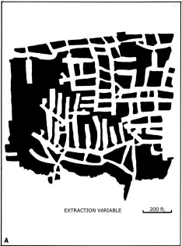
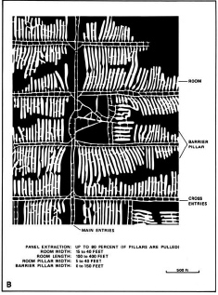
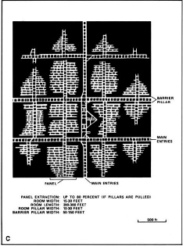
Mining Methods
room & pillar
modified room & pillar
room & pillar panel

Slide 12
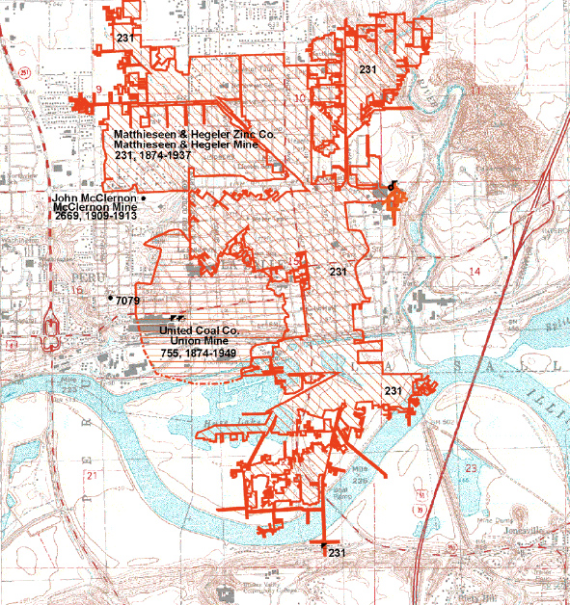
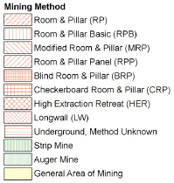
Herrin Coal

Slide 13
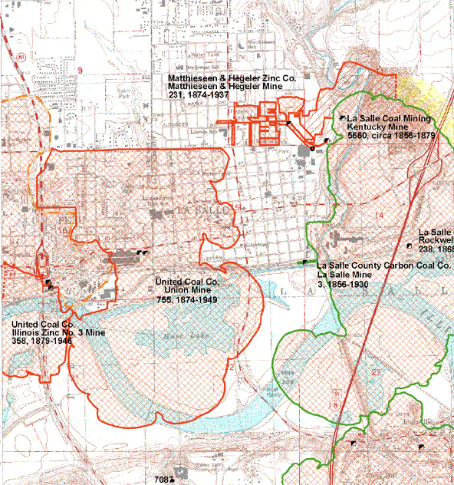
Colchester Coal

Slide 14
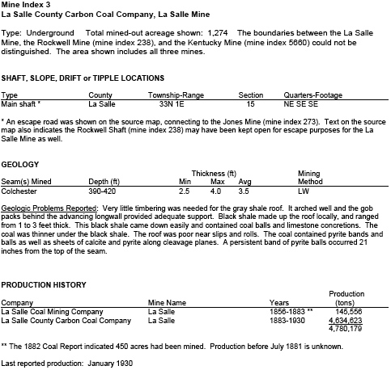

Slide 15
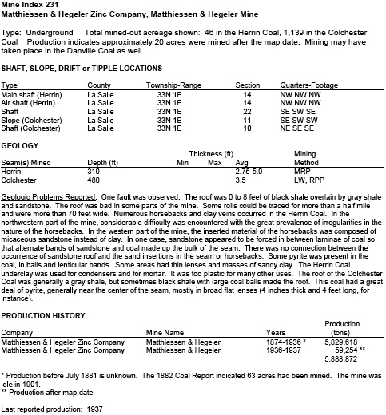

Slide 16
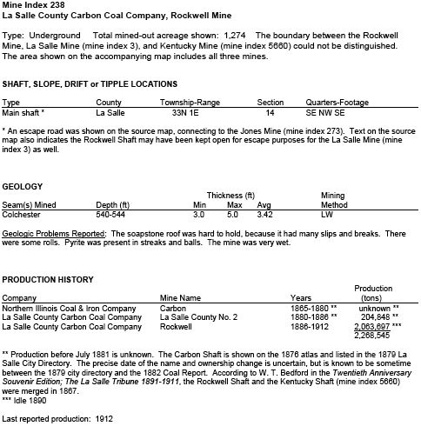

Slide 17
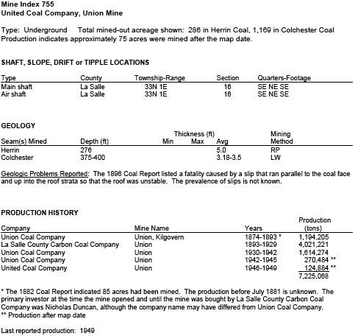

Slide 18
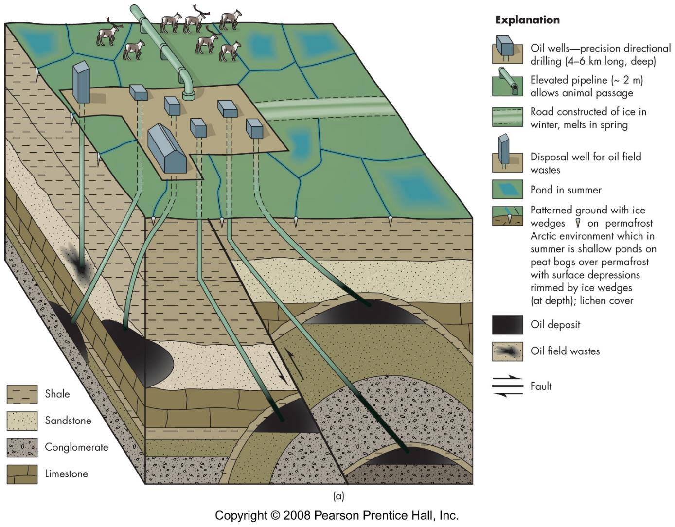
Impact of petroleum and gas exploration and development
roads
drilling
  old - straight down, multiple sites
  new - multi directional, one site
wastewater
spills
refining
energy use

Slide 19
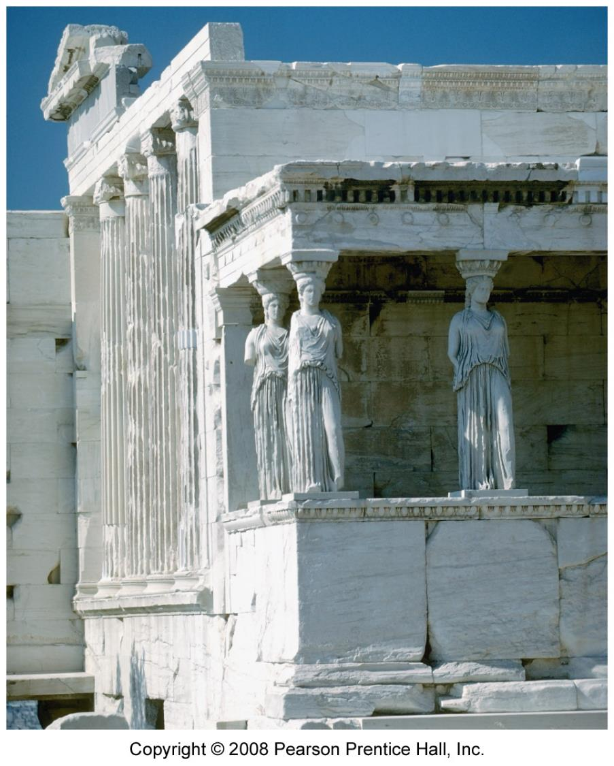
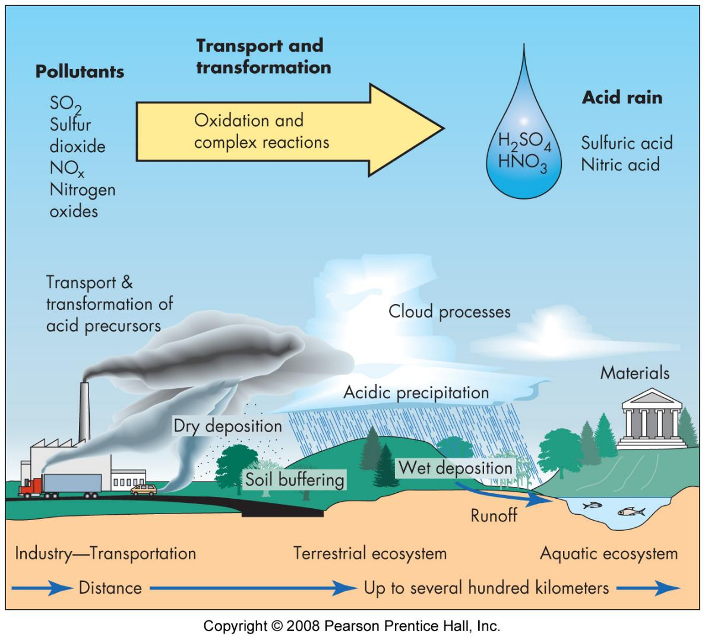
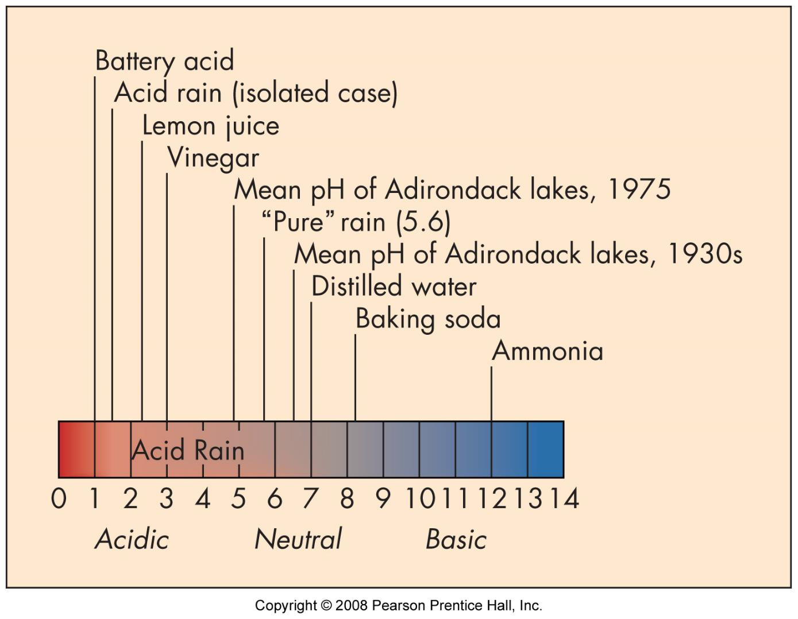
Acid deposition
source
  burning fossil fuels
  SOx & NOx
effect - damage
  vegetation
  water ecosystems
  human structures
solutions
  buffer lakes
  clean emissions
  clean fuel

Slide 20
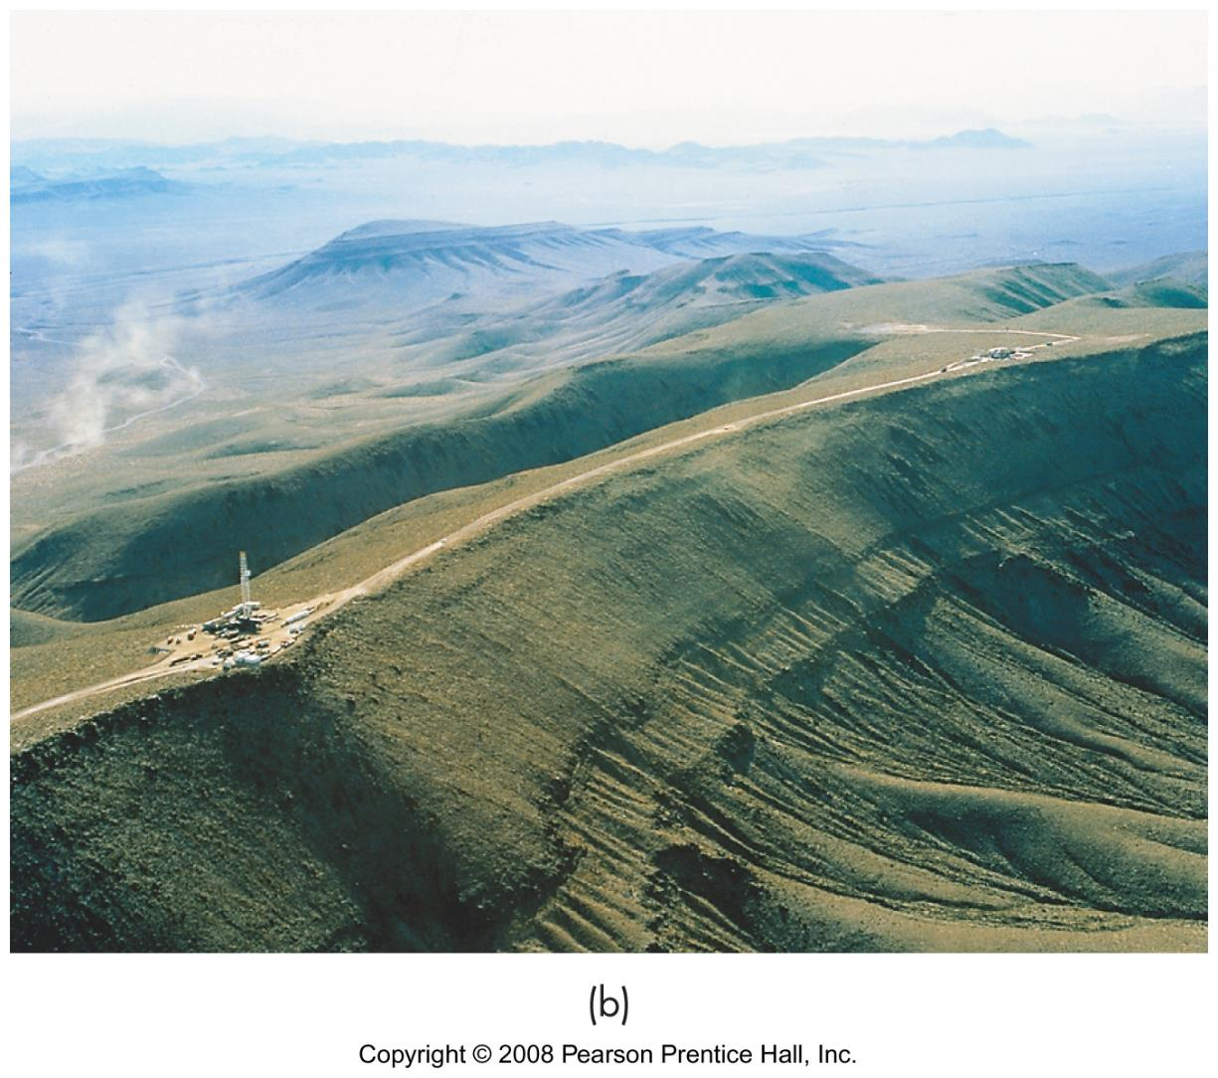
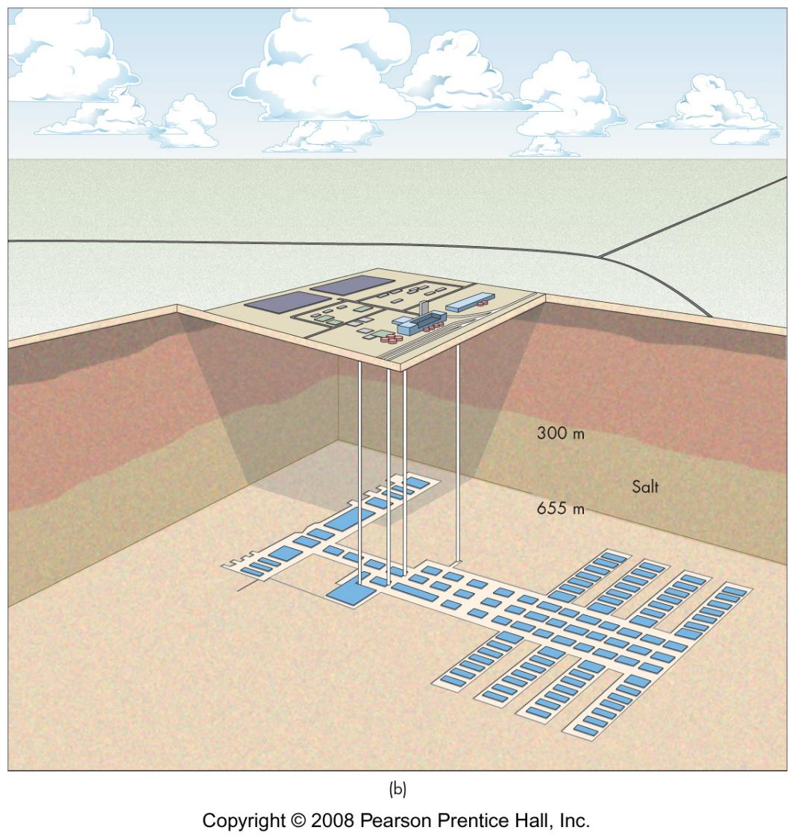
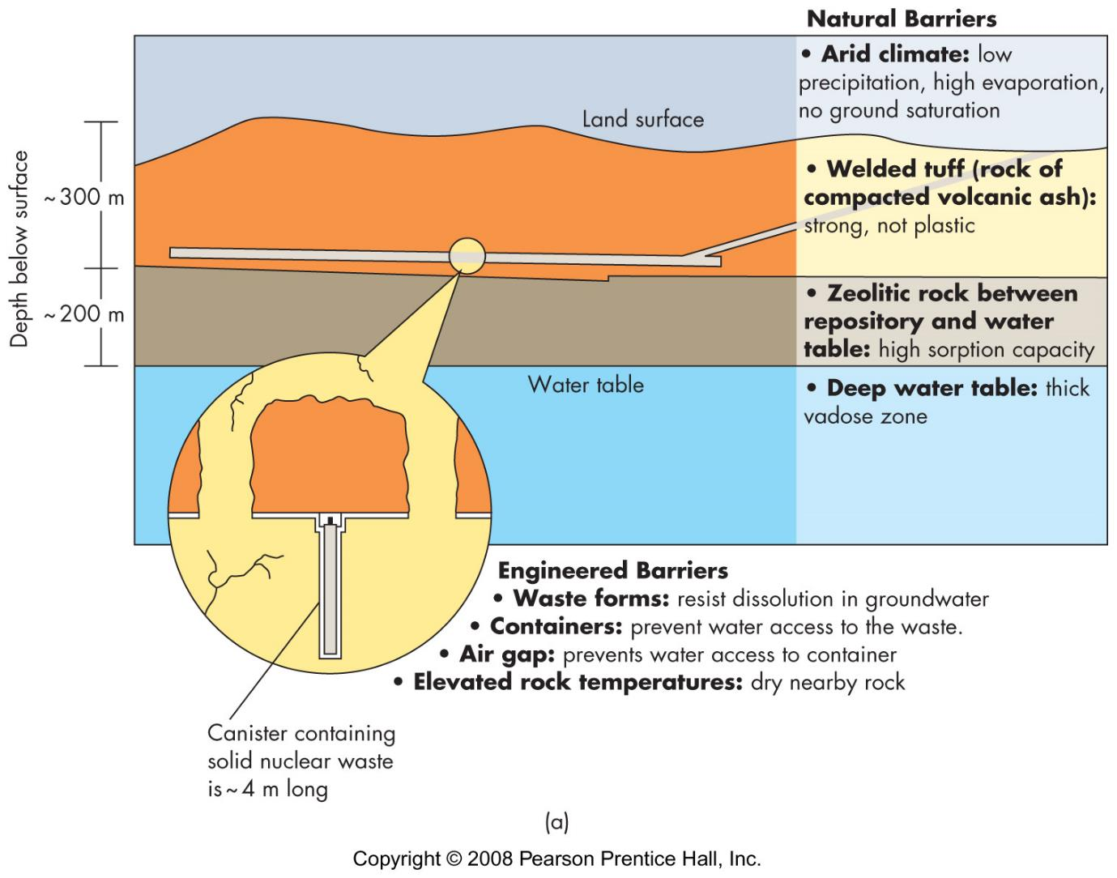
Fission: environmental effects
problems
  highly toxic (some)
  difficult to contain (some)
  long-lived (some)
  bad publicity (bombs)
  could be used by bad people
waste
  low-level: regional disposal
  trans-uranic: WIPP
  high-level: Yucca Mtn

Slide 21
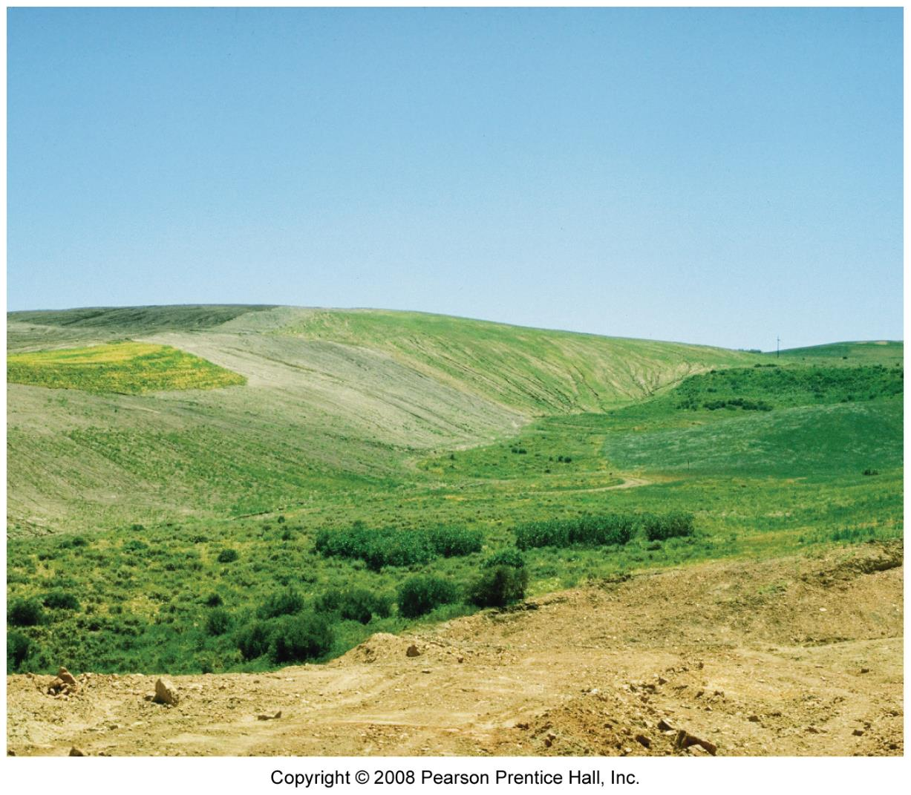
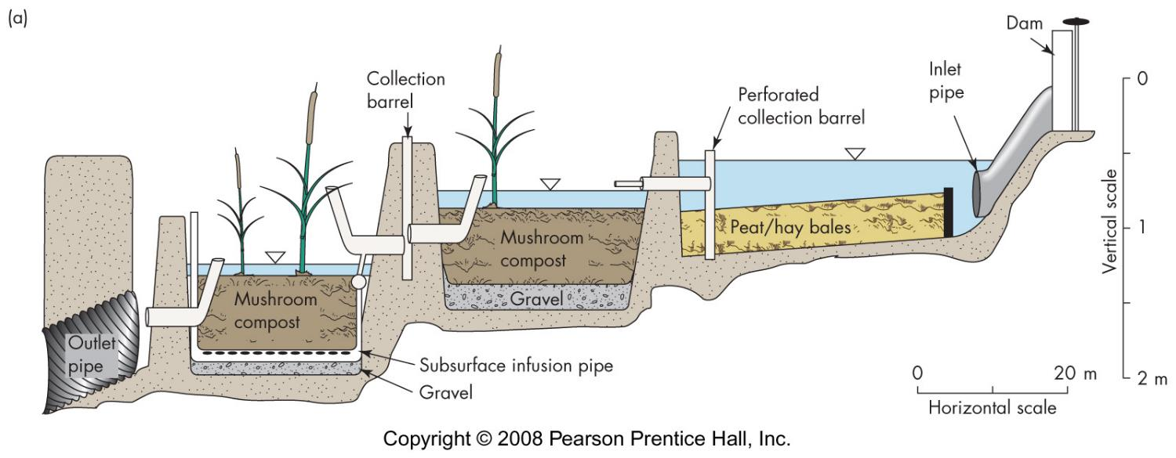
Restoration & Reclamation
regulations
biotechnology
return site to near original state if possible
new use for site

