Slide 1
Chapter 14: Mineral Resources

Slide 2
Characteristics
non-renewable (on human scale)
often occur in small localized bodies
not evenly distributed

Slide 3
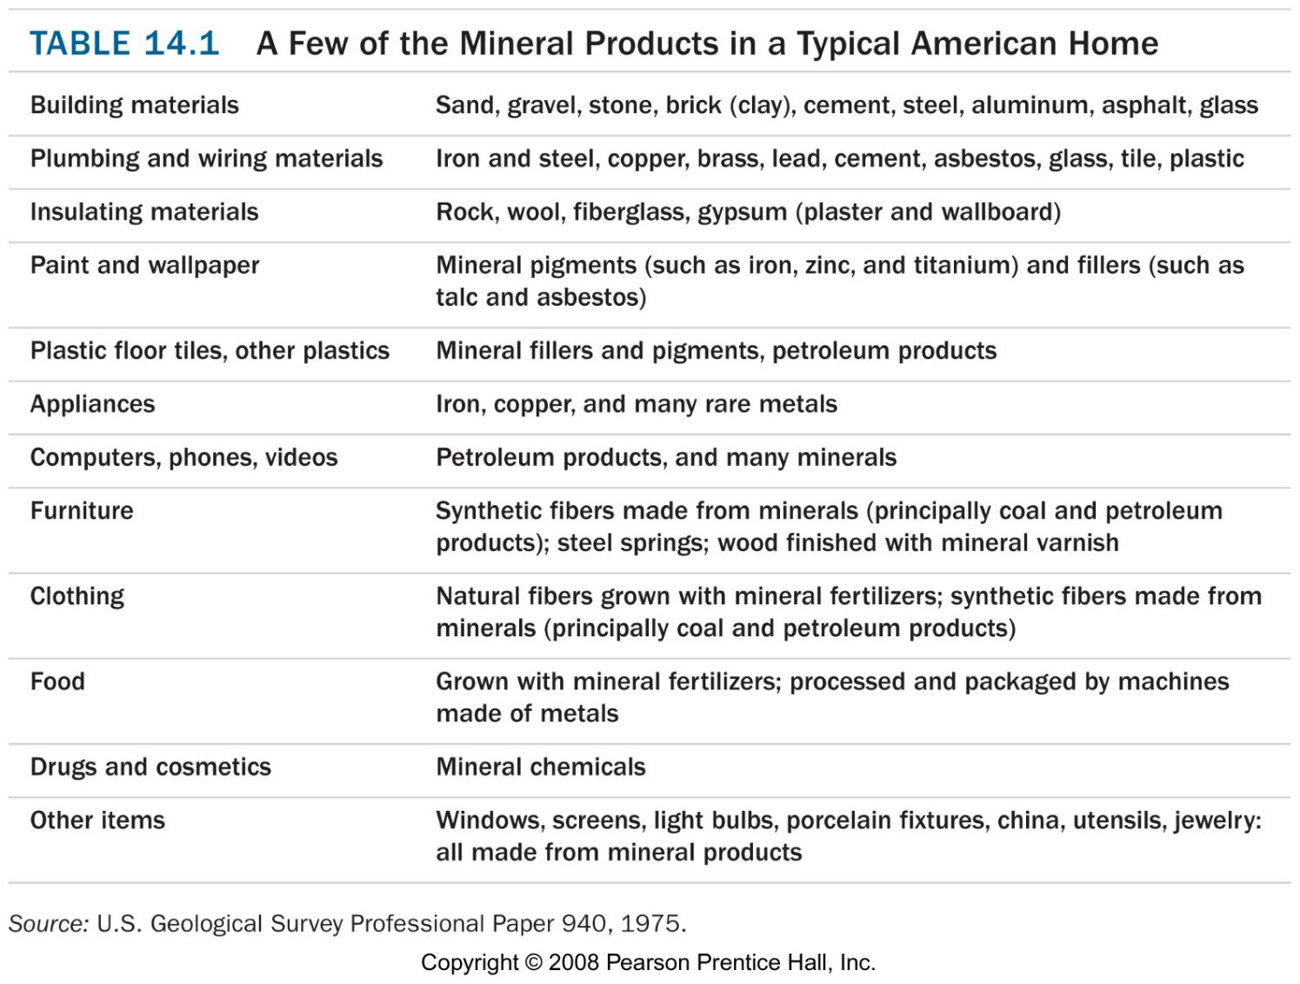
Uses
metal production
building materials
chemical industry
agriculture
necessary for life (ie. NaCl)

Slide 4
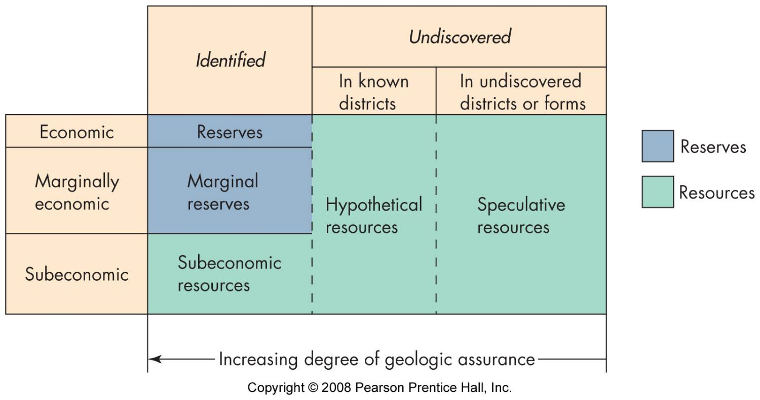
Resources and reserves
potentially useful materials
identified
useable
legally retrievable
economically viable

Slide 5
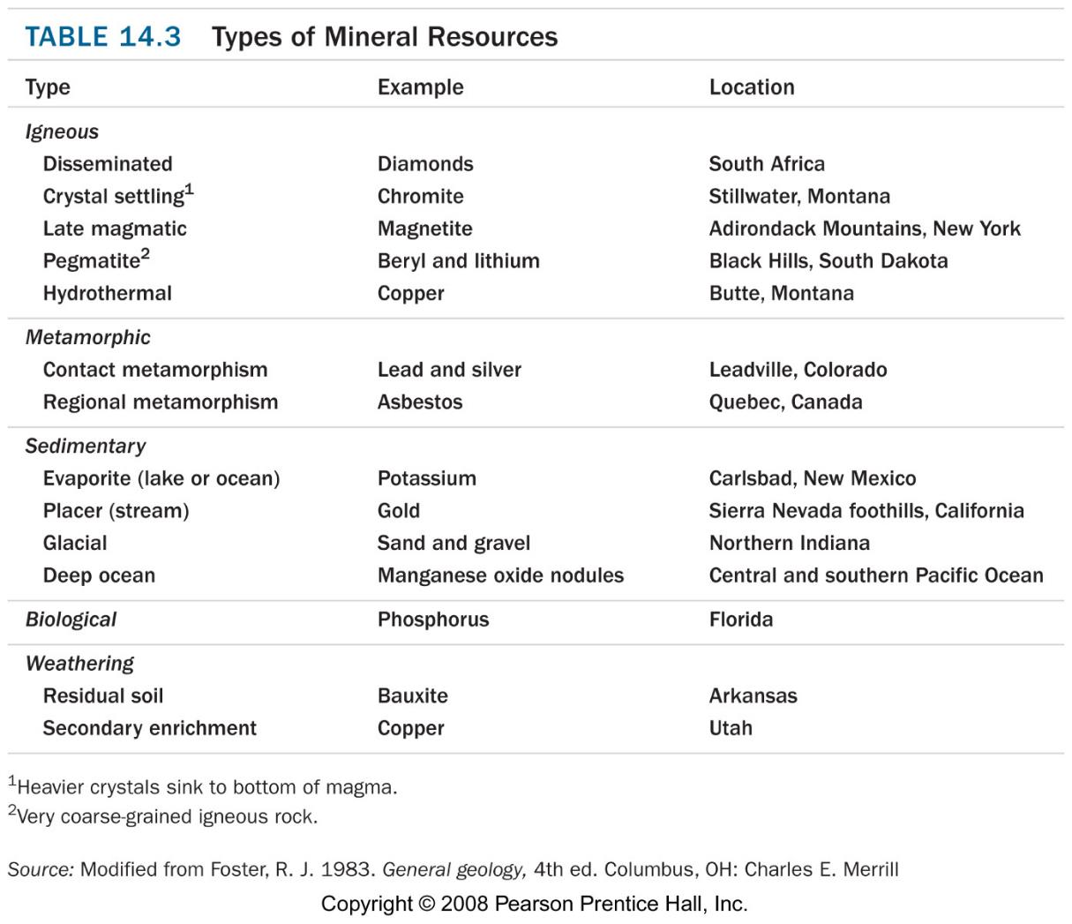
Geology
“whole rock” resource
host rock & ore
  ore = economically useful concentration
geologic processes
  concentrate
  locate

Slide 6
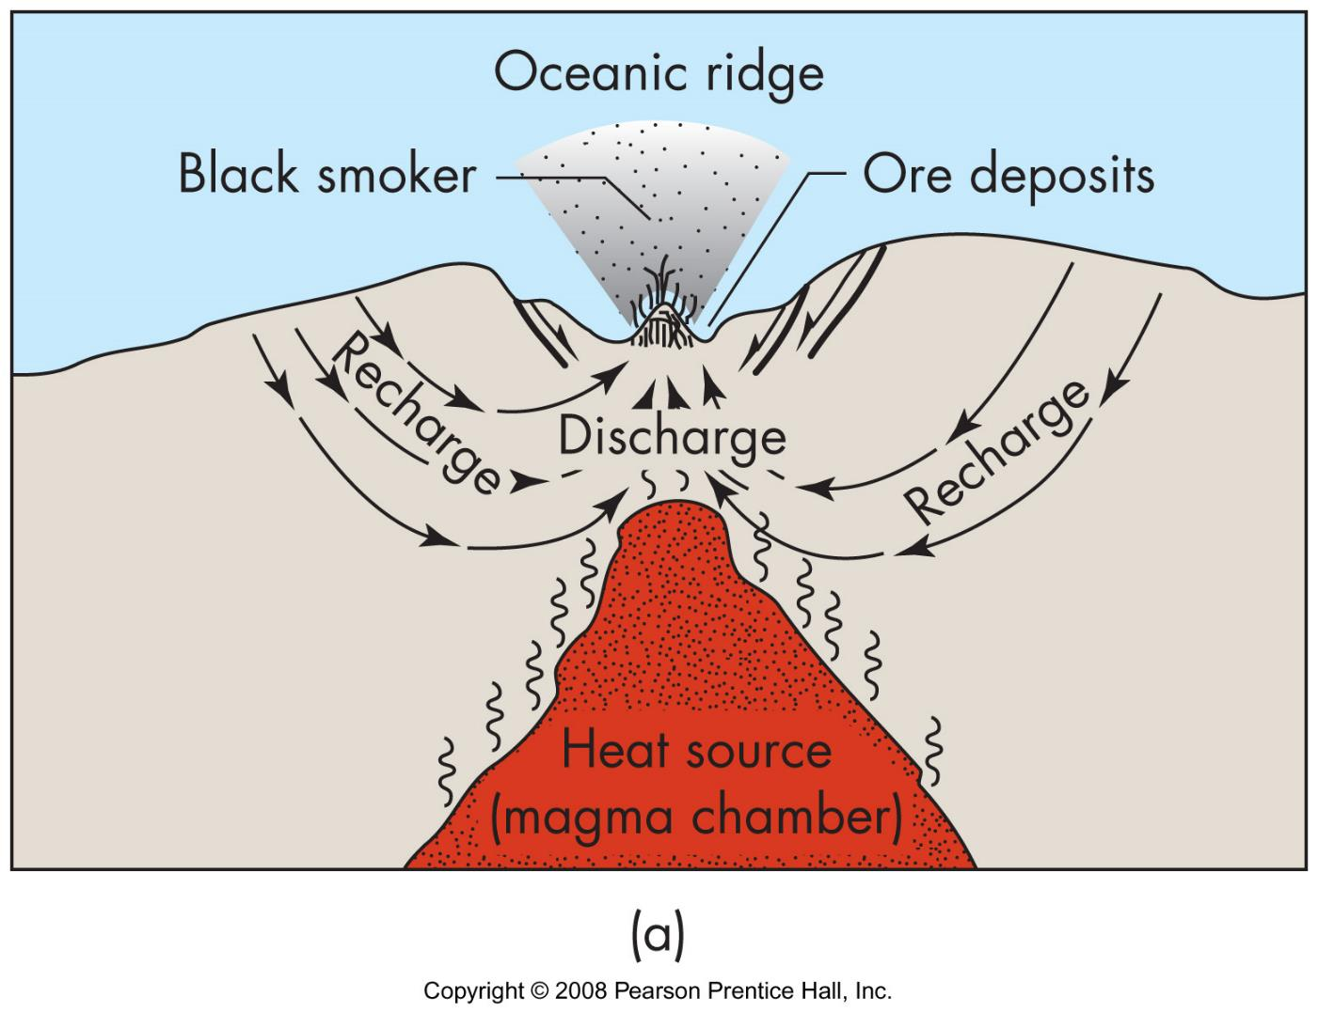
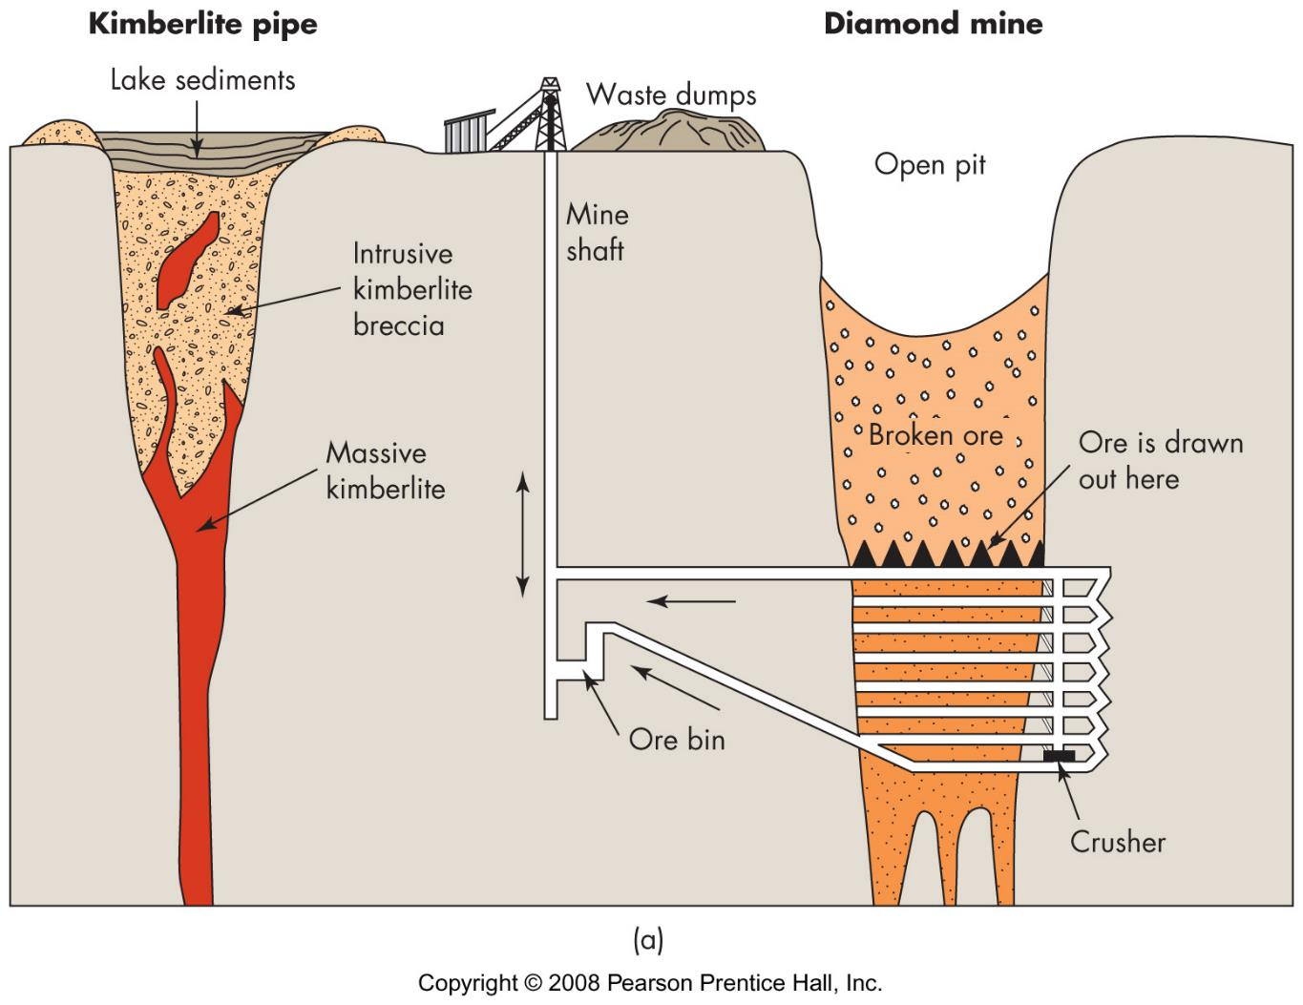
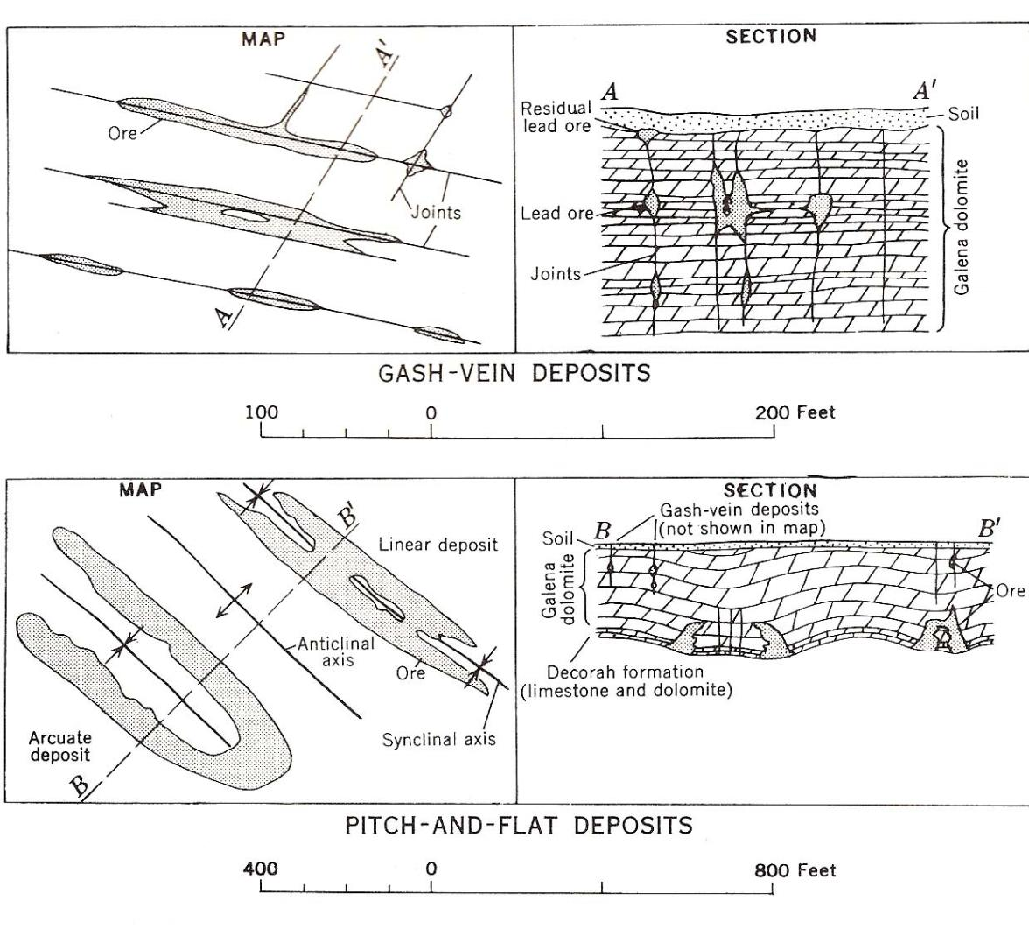
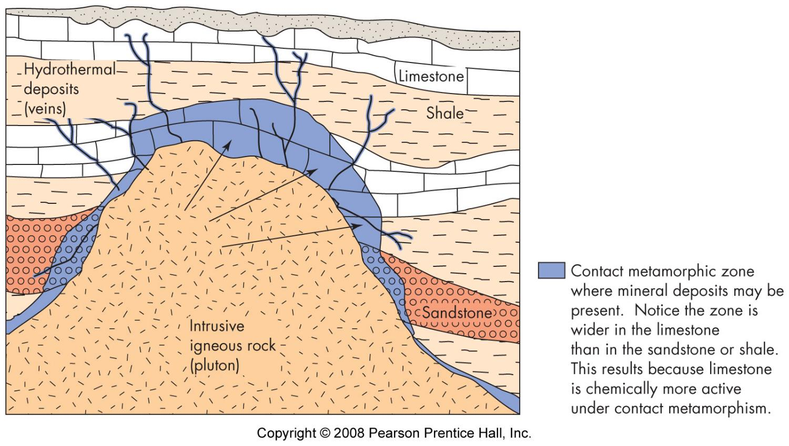
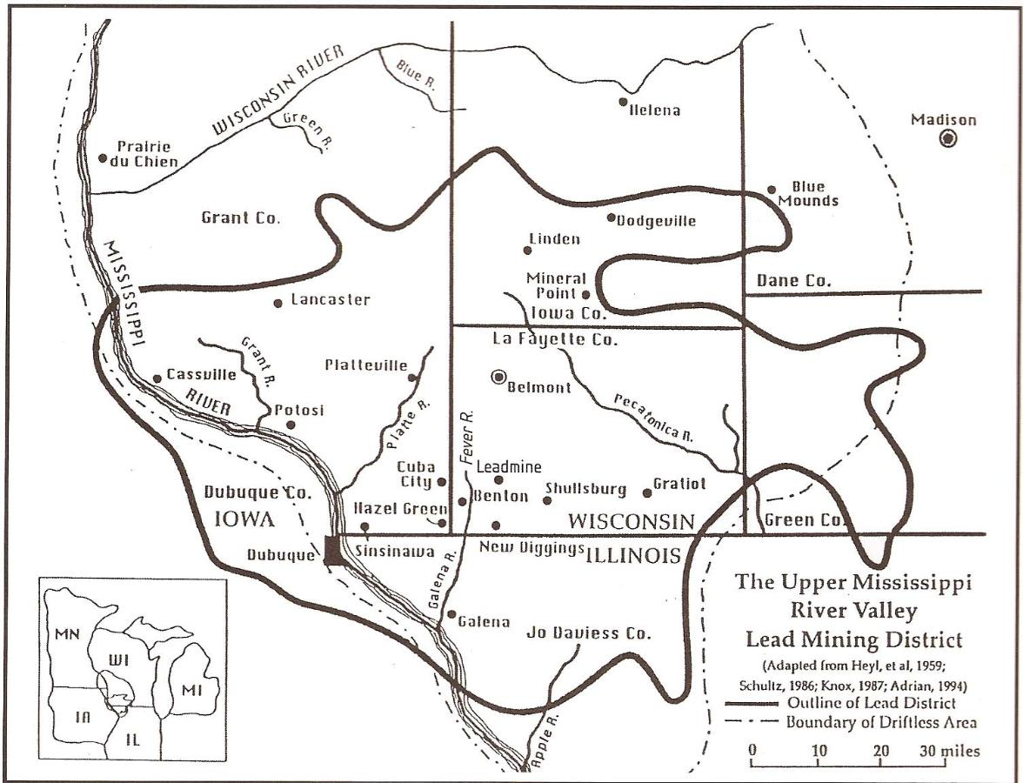
Igneous processes
kimberlite
layered intrusions
pegmatites - late stage solutions
hydrothermal
veins
cavity filling
replacement
mid-ocean ridges

Slide 7
Metamorphism
contact
regional
(hydrothermal)

Slide 8
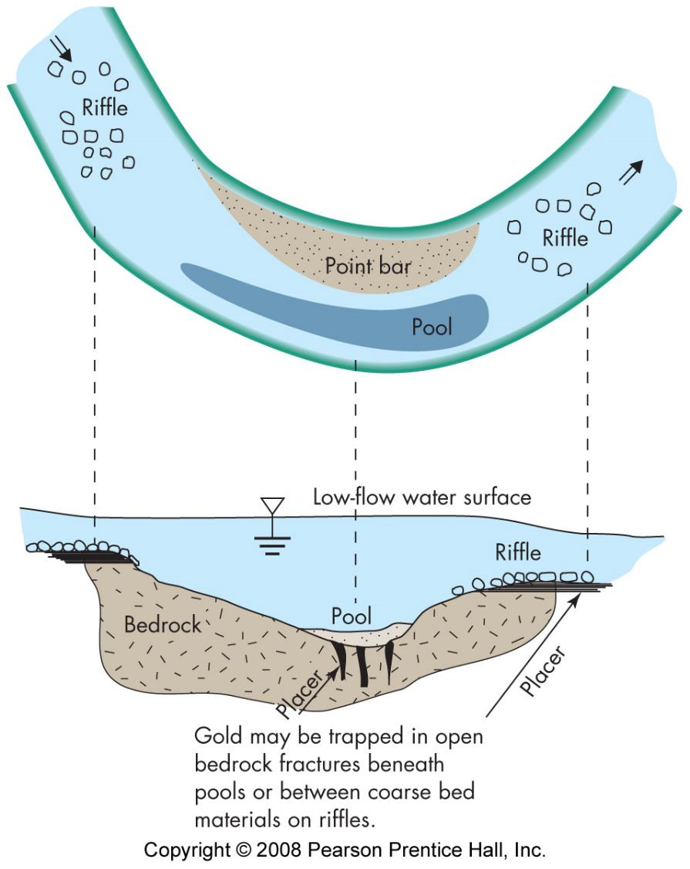
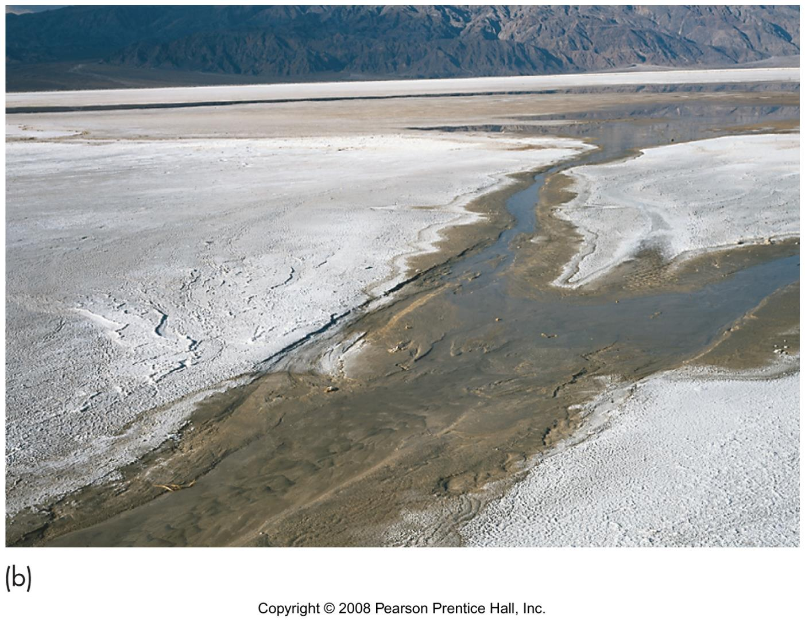
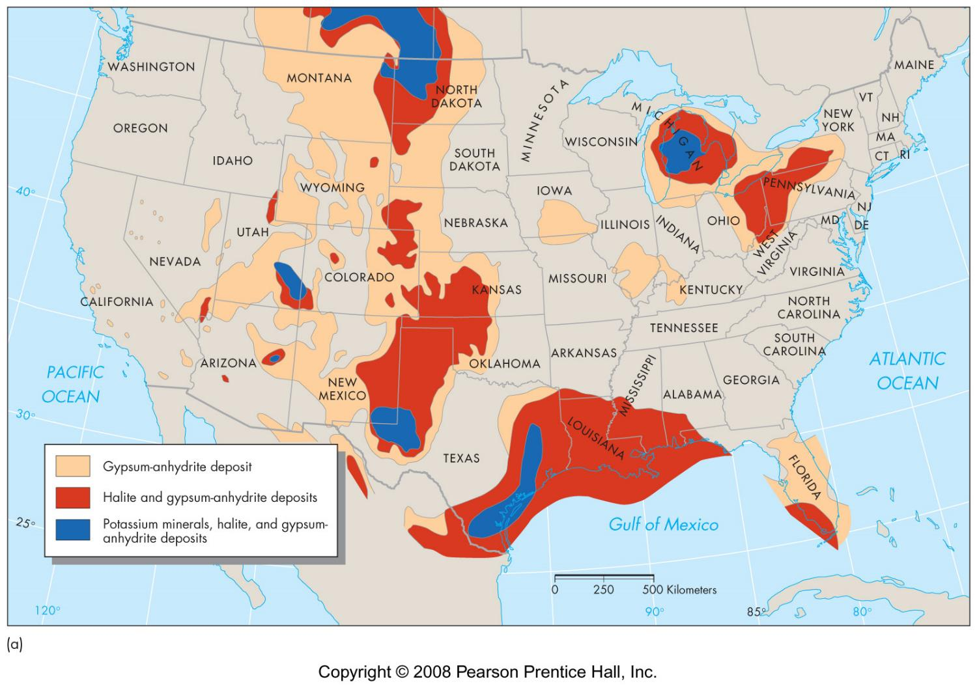
Sedimentary processes
sand and gravel deposits (Lab 17, #4)
ore and mineral deposits
  placers - streams and beaches
  evaporites
    salt domes
    gypsum
    CaCO2
    brines
  banded iron deposits

Slide 9
Biological processes
calcium shells
phosphate
  bones
  guano

Slide 10
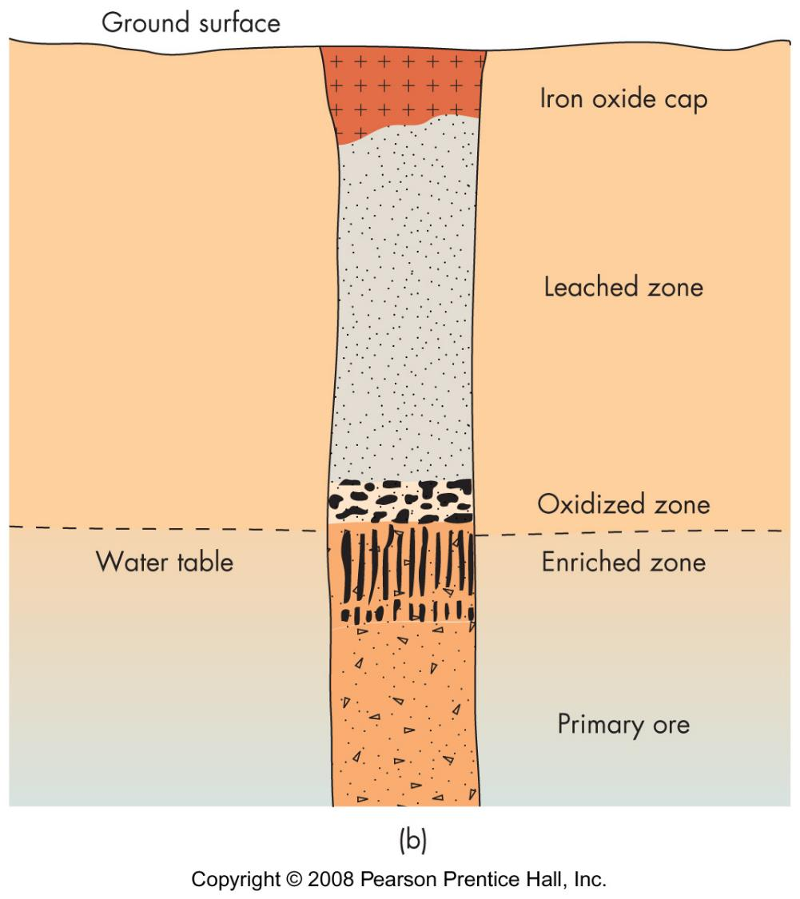
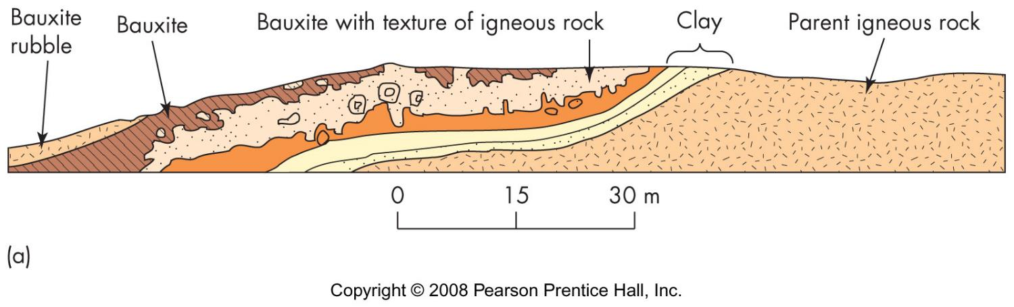
Weathering
residual minerals from rock body
residual ore deposit
secondary enrichment of ore bodies

Slide 11
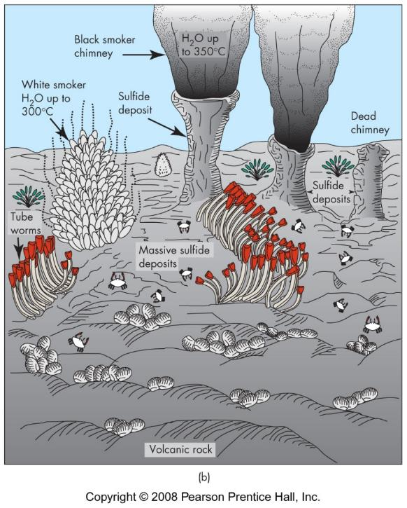
From Sea
Sea water
  salts
  magnesium
Deep ocean floor
  ocean ridges
    black smokers
    sulfides
  manganese oxide nodules
    Mn 24%, Fe 14%, Cu 1%, Ni 1%, Co 25%
    mm to cm in diameter
    1 to 5mm/million yrs

Slide 12
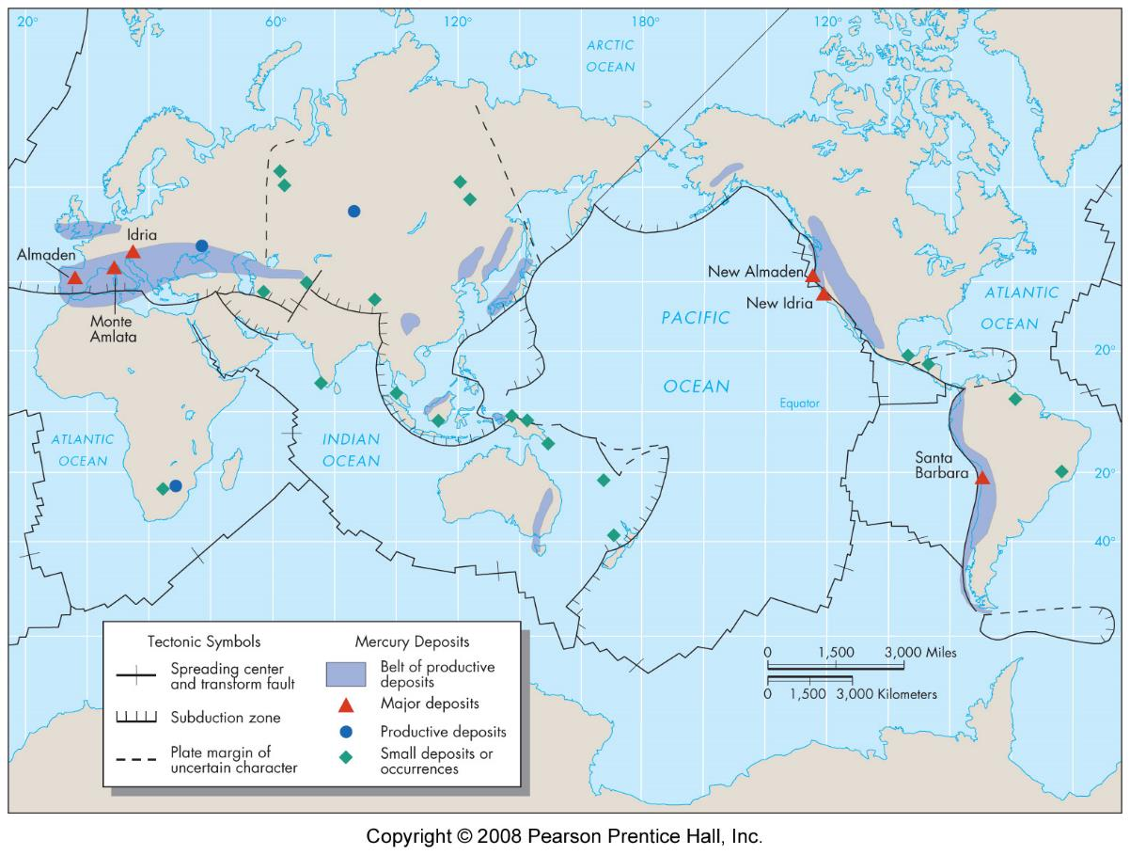
effect of plate tectonics
Impacts rock forming environments
  igneous
  metamorphic
  (sedimentary)
Exposes rocks

Slide 13
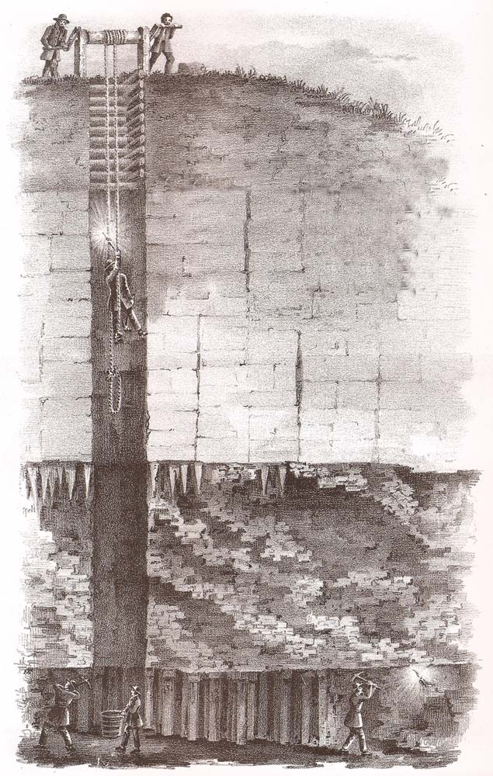
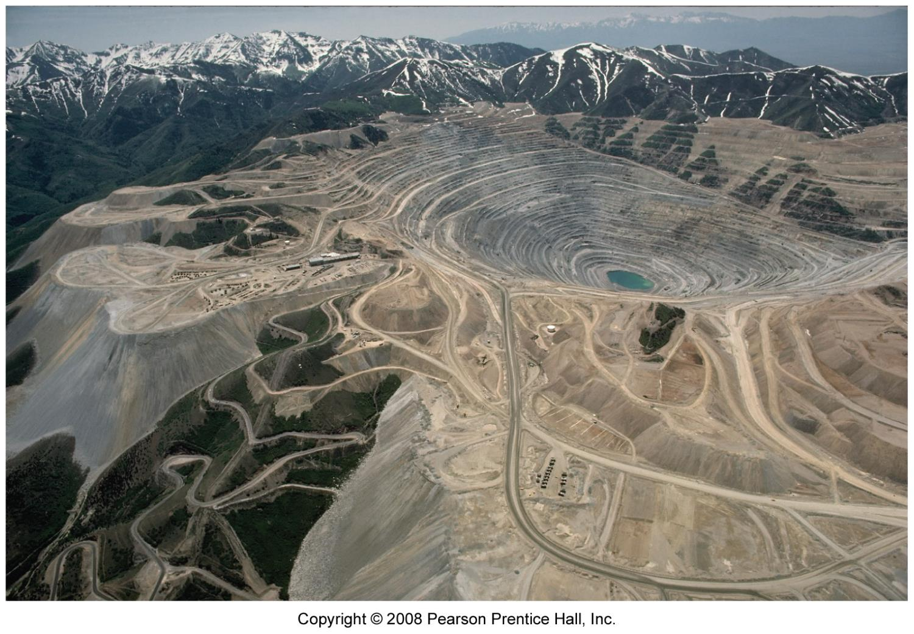
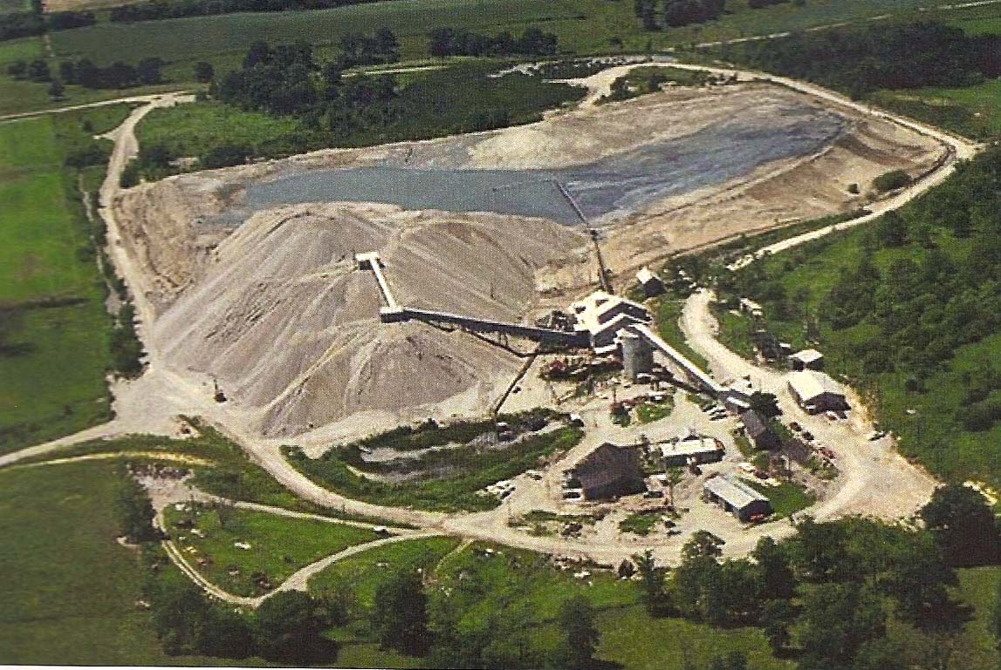
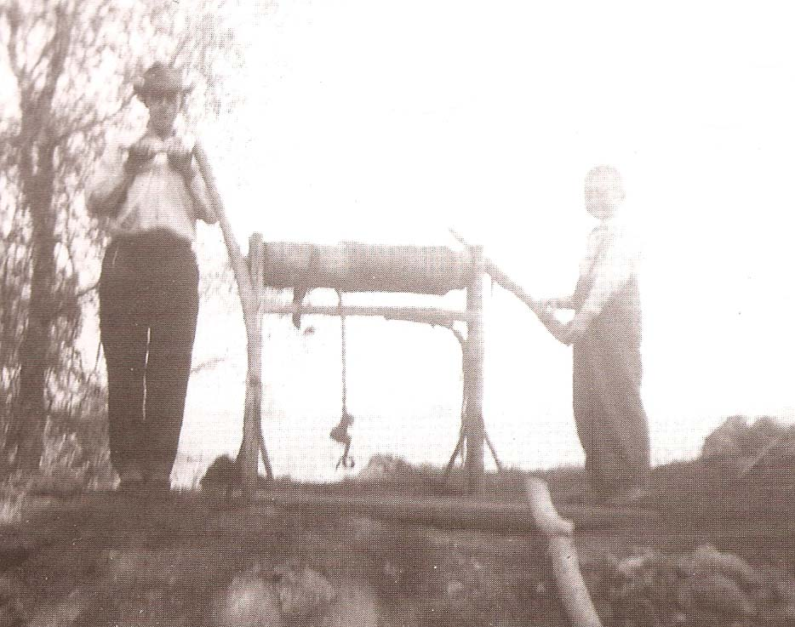
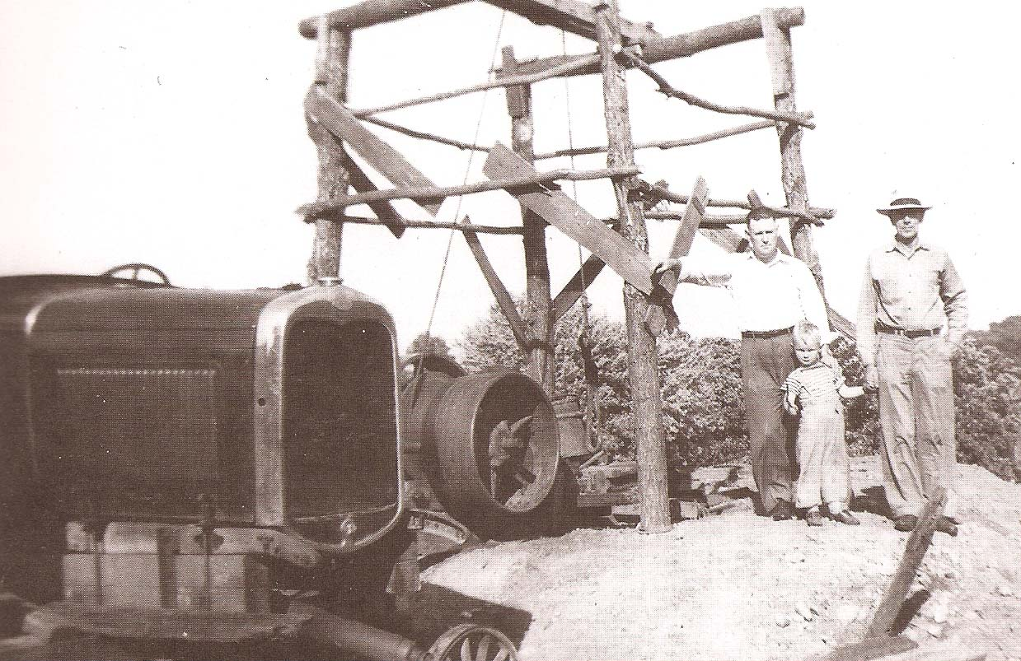
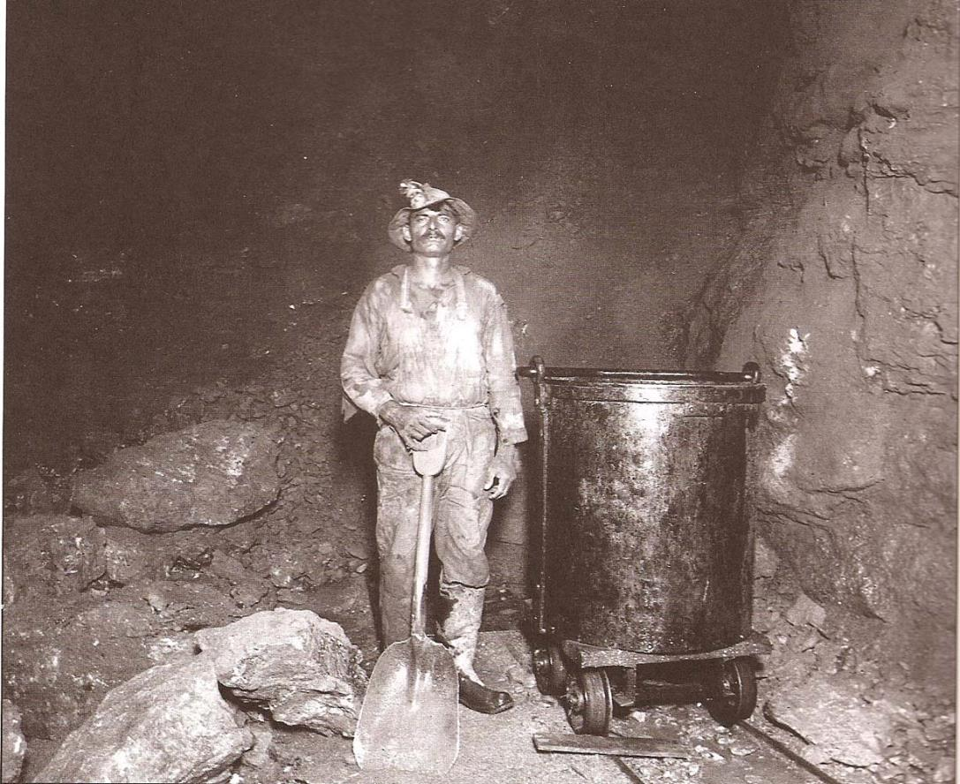
Extraction
Shaft mining
  small scale
  large scale
Surface mining

