Slide 1
Resources

Slide 2
Resources
potentially useful materials
should be
useable
identified
retrievable
economically viable

Slide 3
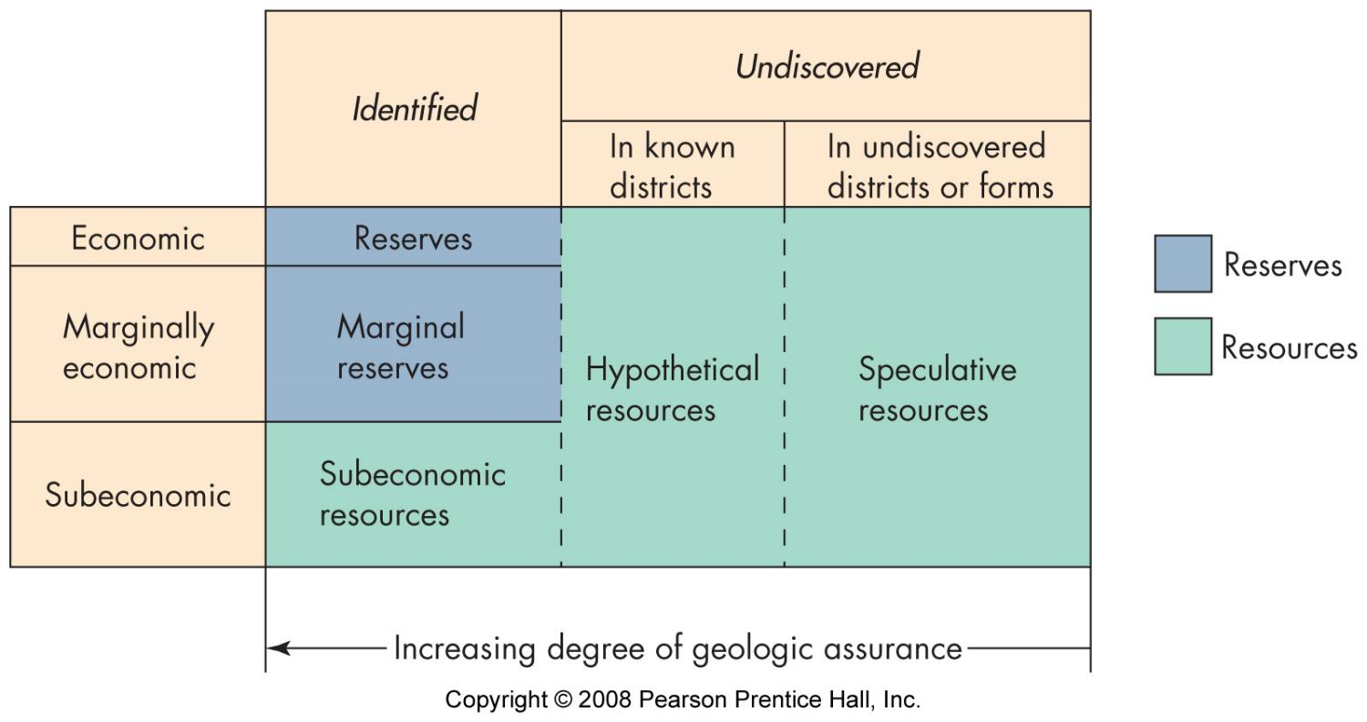
Resources and reserves

Slide 4
Characteristics
renewable/non-renewable
on human scale
“mining” vs renewable use
occurrence
small localized bodies
widespread
distribution

Slide 5
Categories
Water
Rocks and Minerals
Energy
overlap between categories

Slide 6
Uses
necessary for life
energy production
raw materials
food
consumer products
construction
agriculture

Slide 7
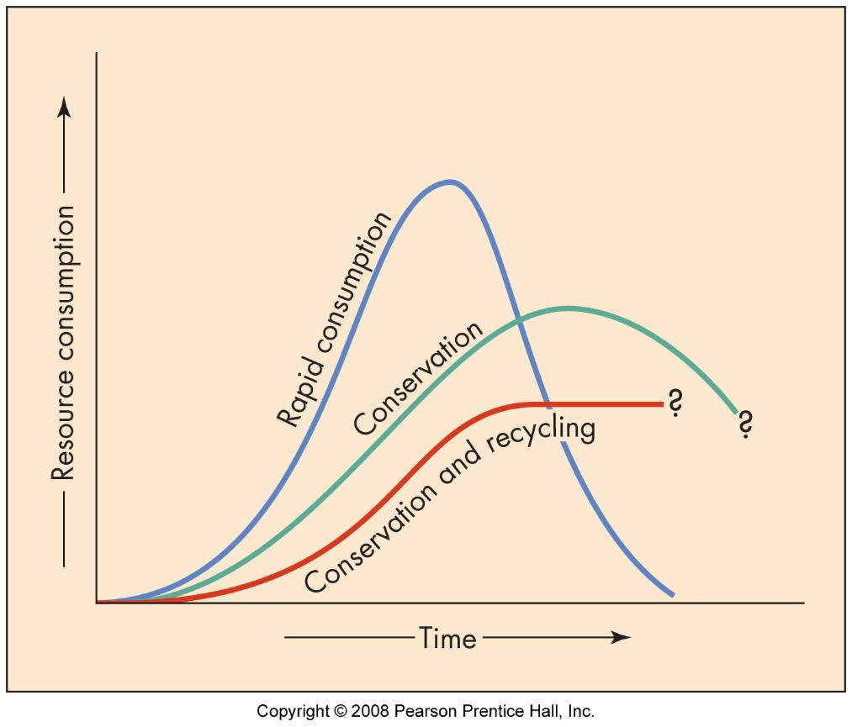
Consumption
rapid
slower
sustainable

Slide 8
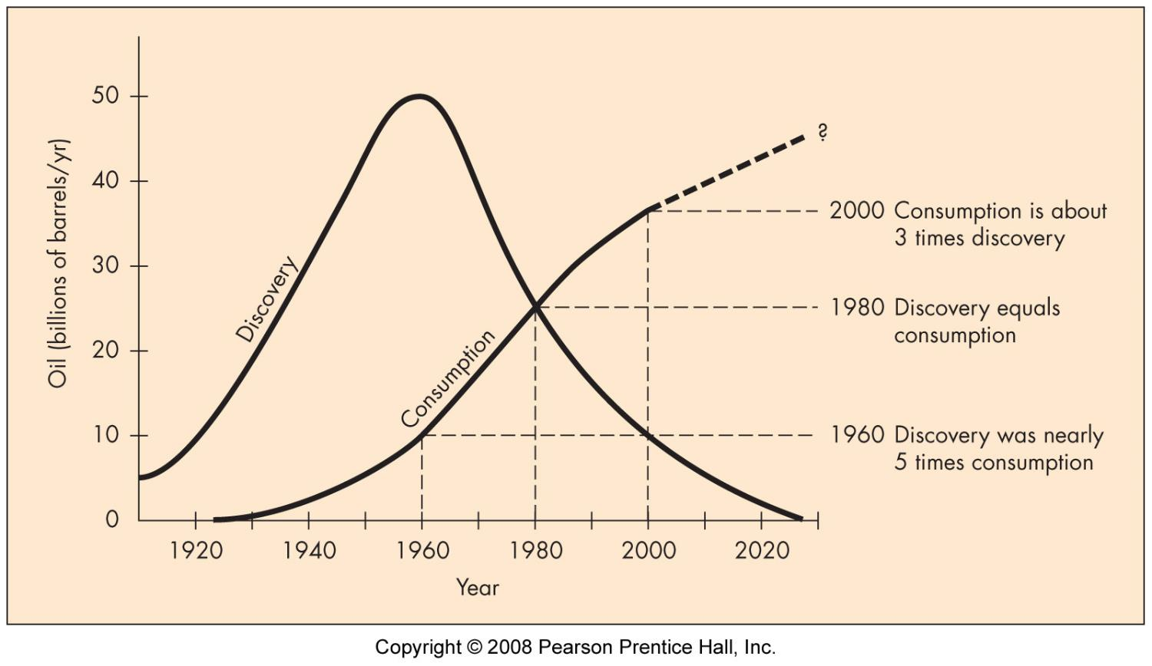
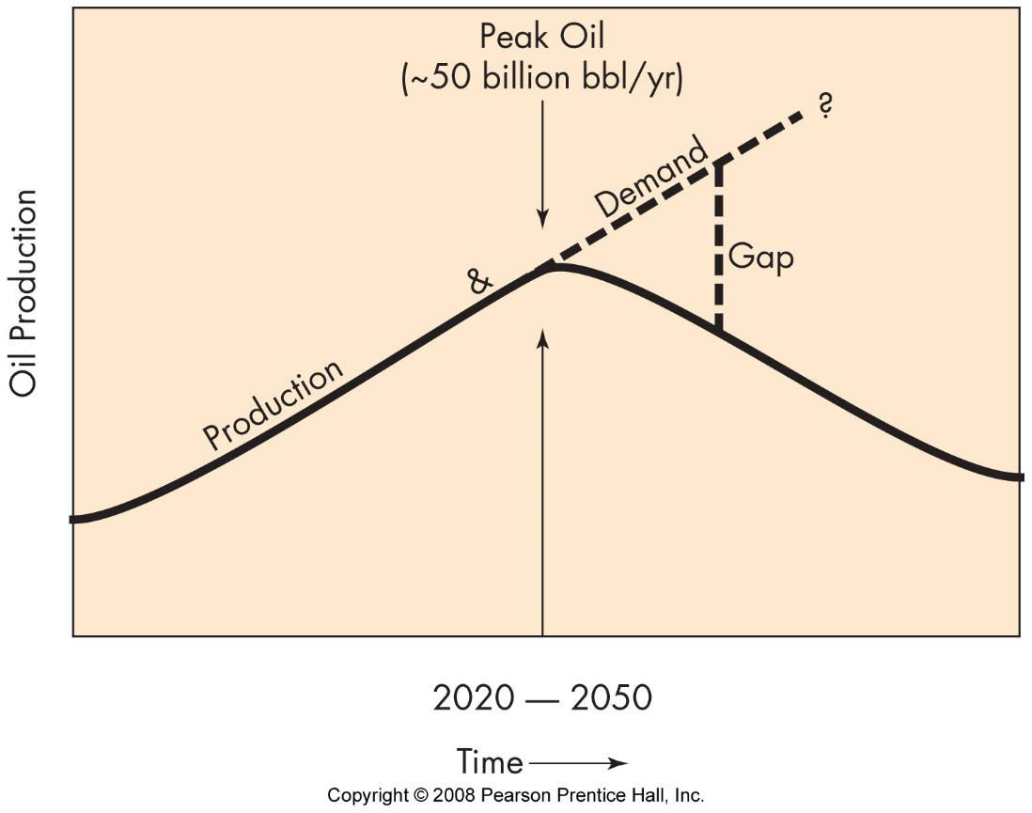
Consumption

Slide 9
Extraction
In-place use
Drilling
Shaft mining
Surface mining

Slide 10
Environmental impact
exploration - small
development – can be large
surface disruption
slag deposits
water pollution
air pollution
social disruption

Slide 11
Restoration & Reclamation
regulations
return site to near original state if possible
new use for site

Slide 12
Approaches to Use
Stewardship
responsible use
future availability
“Relatives not Resources”

