Slide 1
Chapter 12: Water Resources

Slide 2
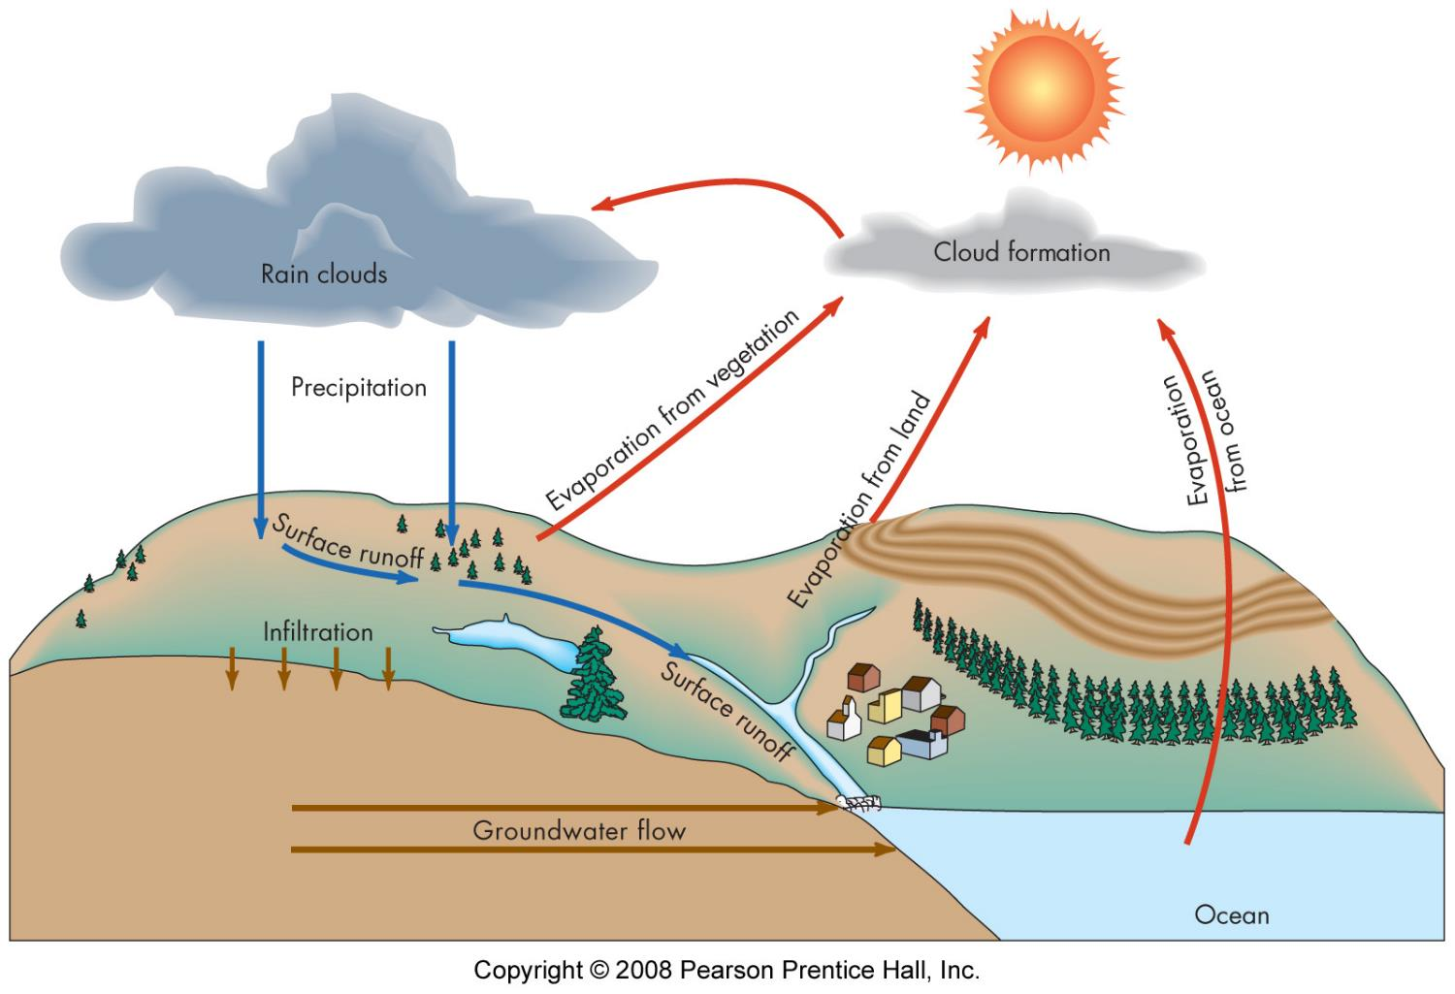
Water cycle

Slide 3
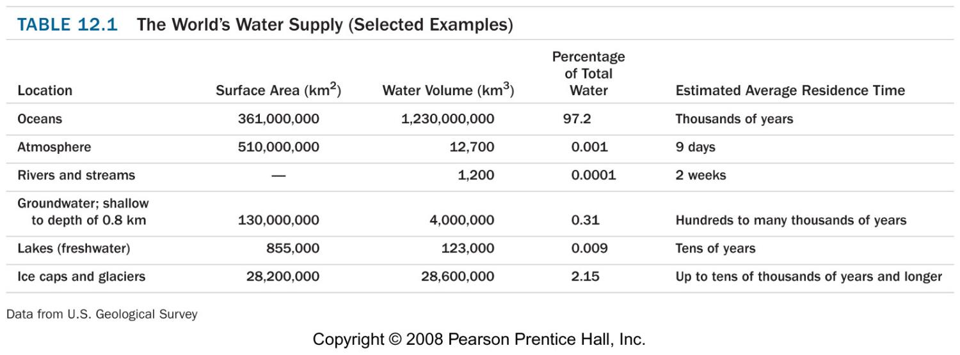
Water cycle

Slide 4
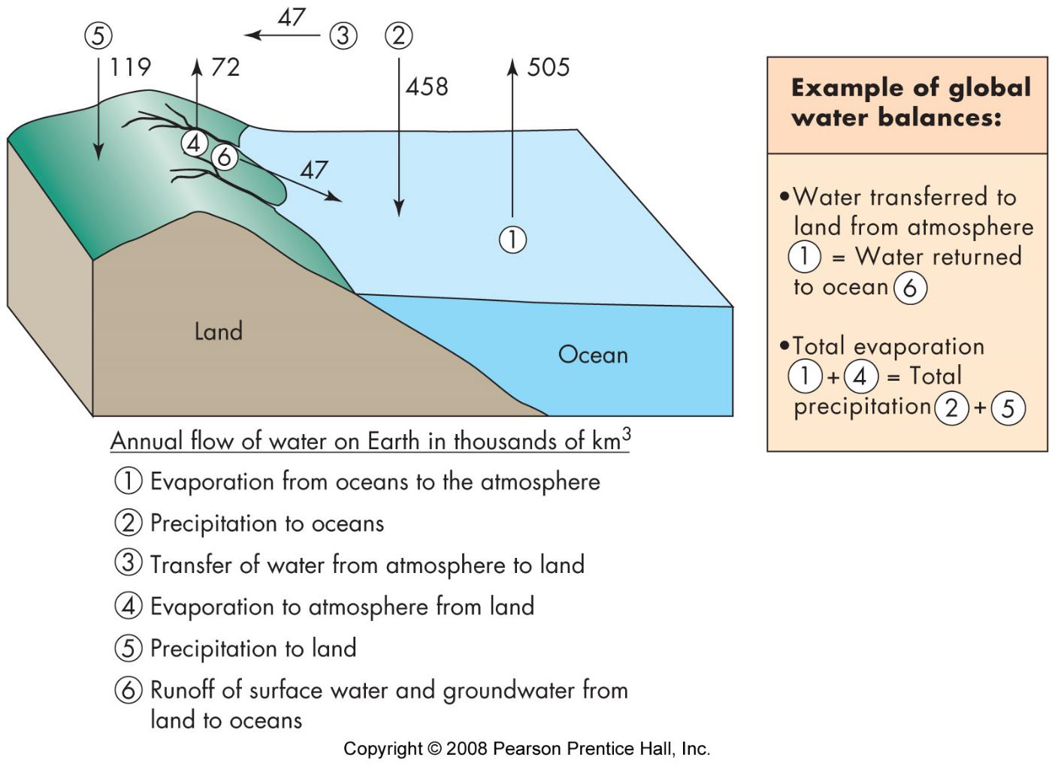
Water cycle

Slide 5
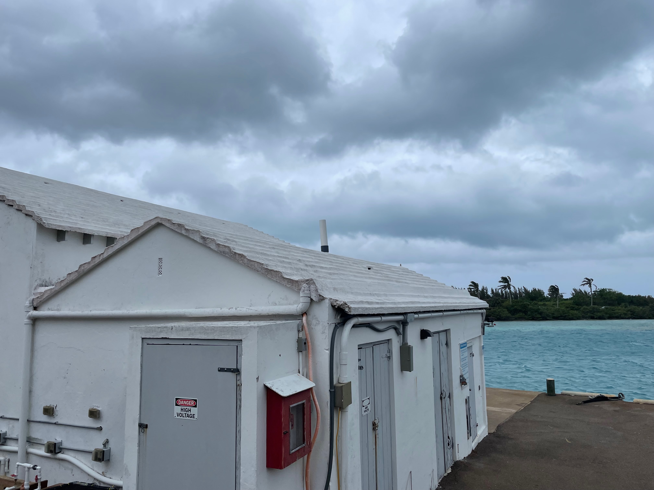
Rainwater

Slide 6
Surface Water
watershed - drainage basin
https://www.epa.gov/waterdata/hows-my-waterway
supply factors
precipitation
geology
basin shape, relief, slope, efficiency
orientation to storms
vegetation
animals
groundwater flow

Slide 7
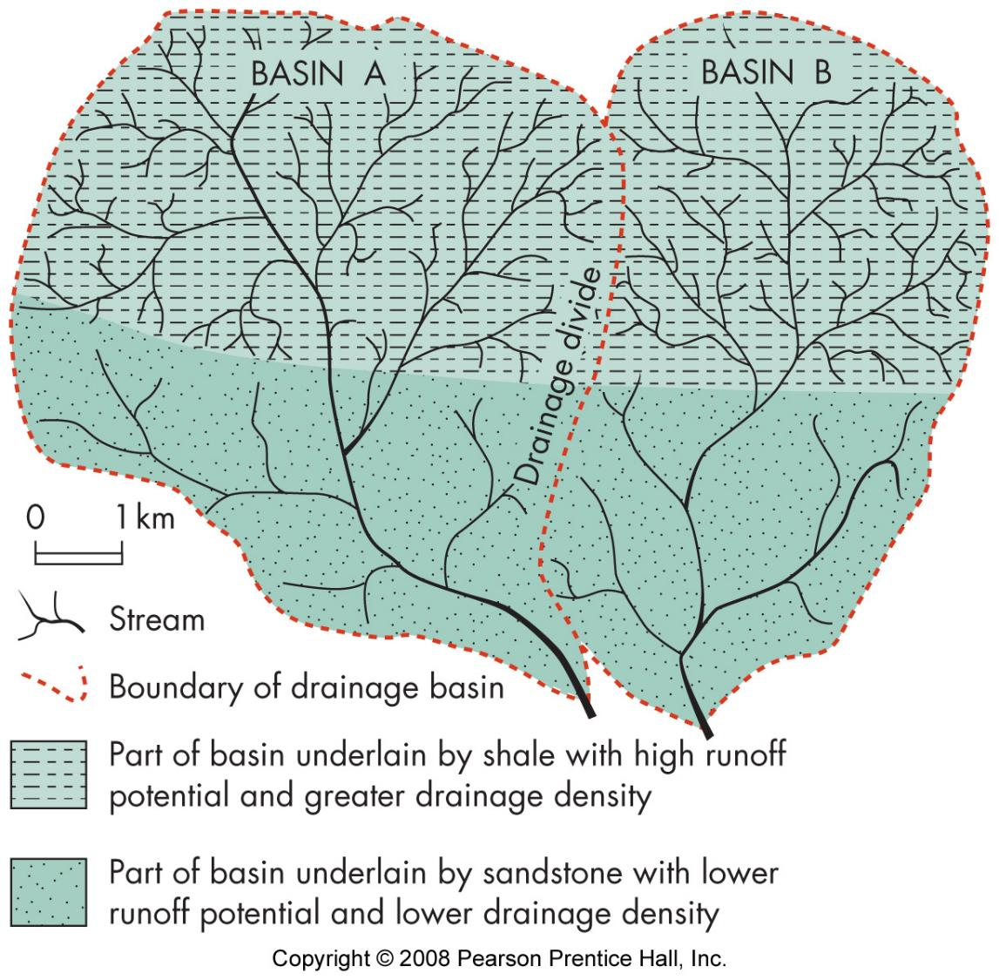
Surface Water

Slide 8
Groundwater recharge
precipitation (ultimate source)
influent (losing) stream or lake

Slide 9
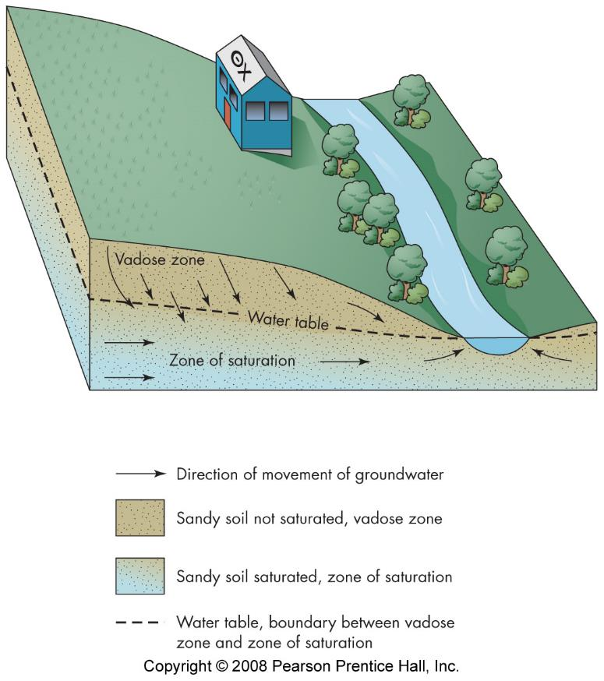
Groundwater distribution
zone of aeration
water table
zone of saturation

Slide 10
Groundwater distribution
zone of aeration
water table
zone of saturation
aquifer
unconfined
confined
perched
artesian
aquitard/aquiclude

Slide 11
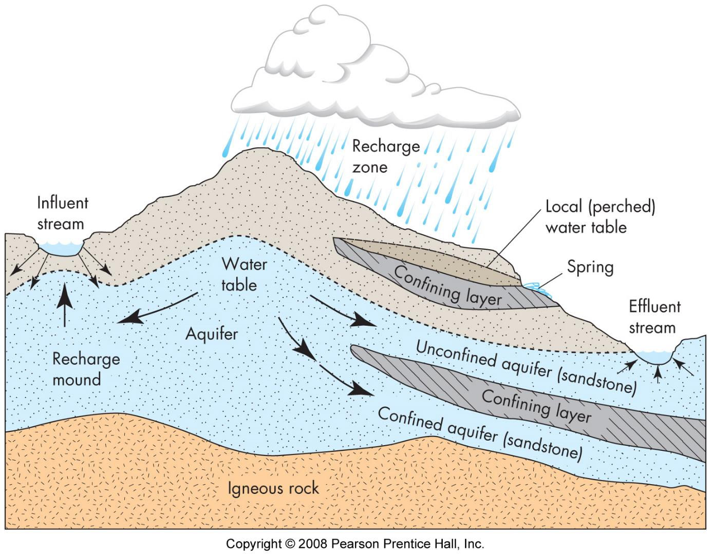

Slide 12
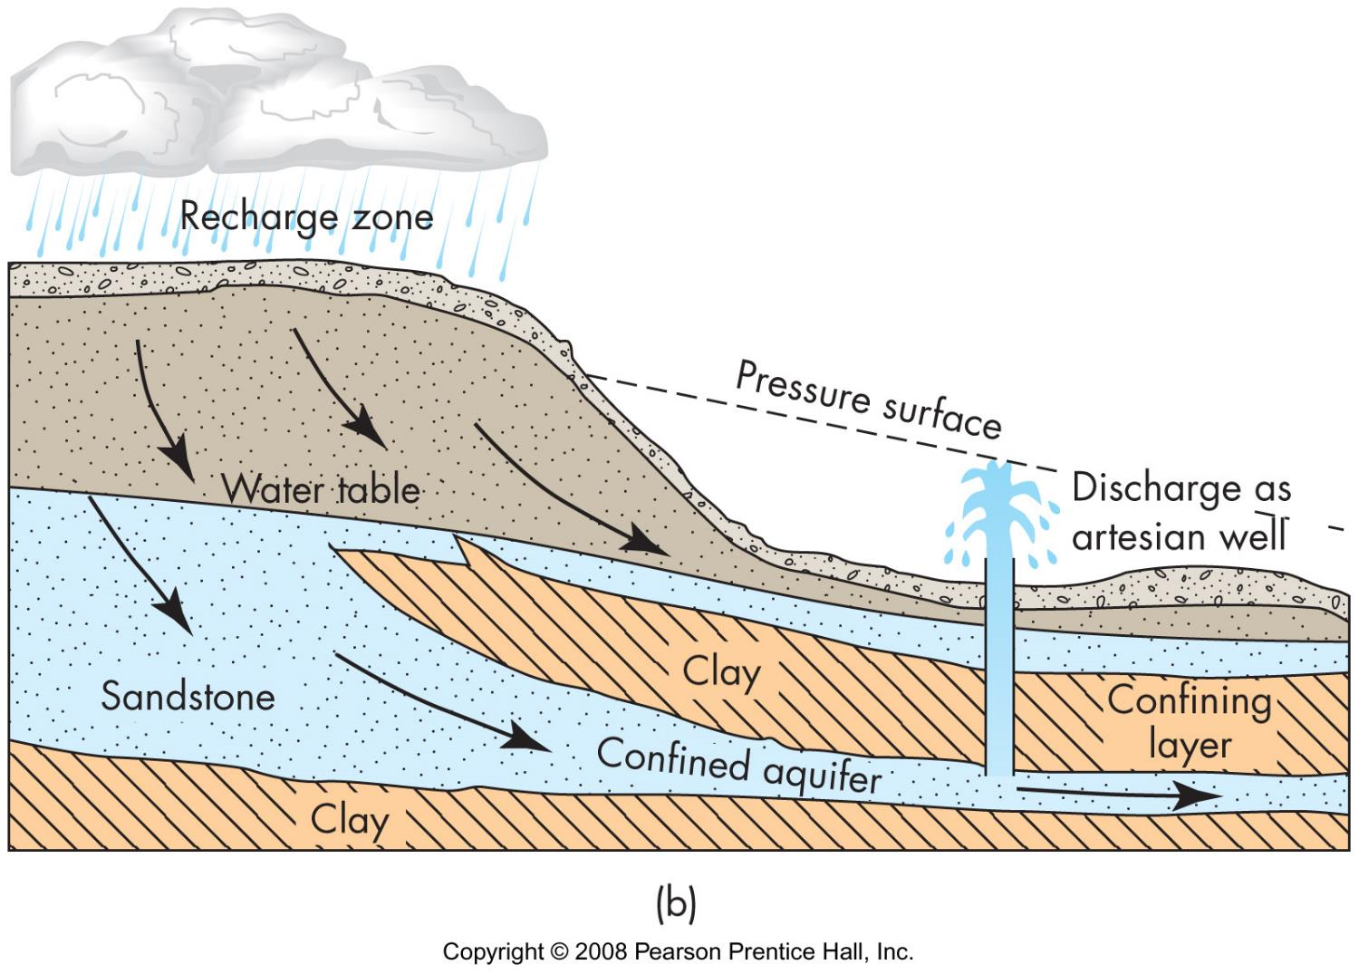

Slide 13
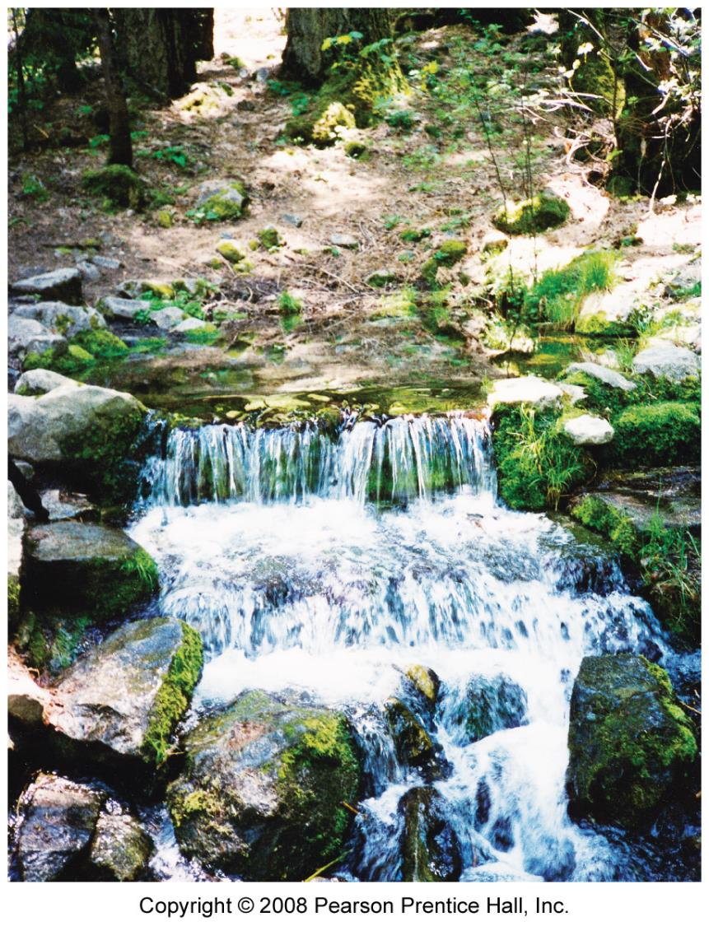
groundwater discharge
effluent stream
gains water
base flow
spring
well

Slide 14
Groundwater Flow
Darcy’s law Q=KiA
Q = discharge (volume/time)
K = hydraulic conductivity
permeability
porosity
i = hydraulic gradient = h/l
h = change in water table elevation
l = distance between wells
A = x-sectional area
rate of flow - cm/day (at best)
V = Ki
residence time
1000s to 10,000s of years

Slide 15
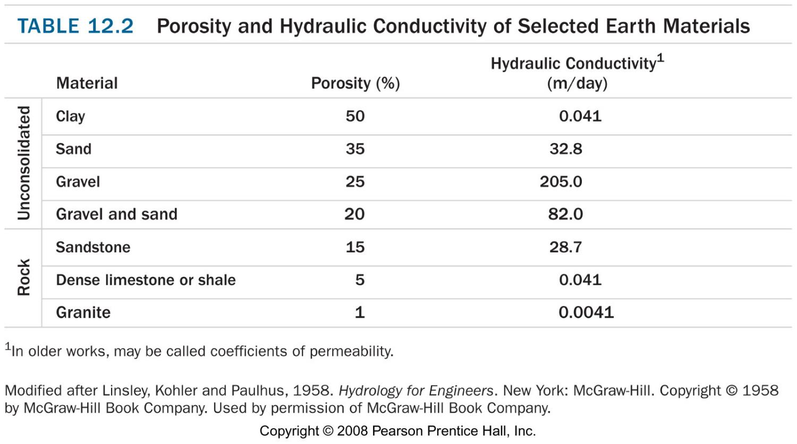
Groundwater Flow
Q = KiA
V = Ki

Slide 16
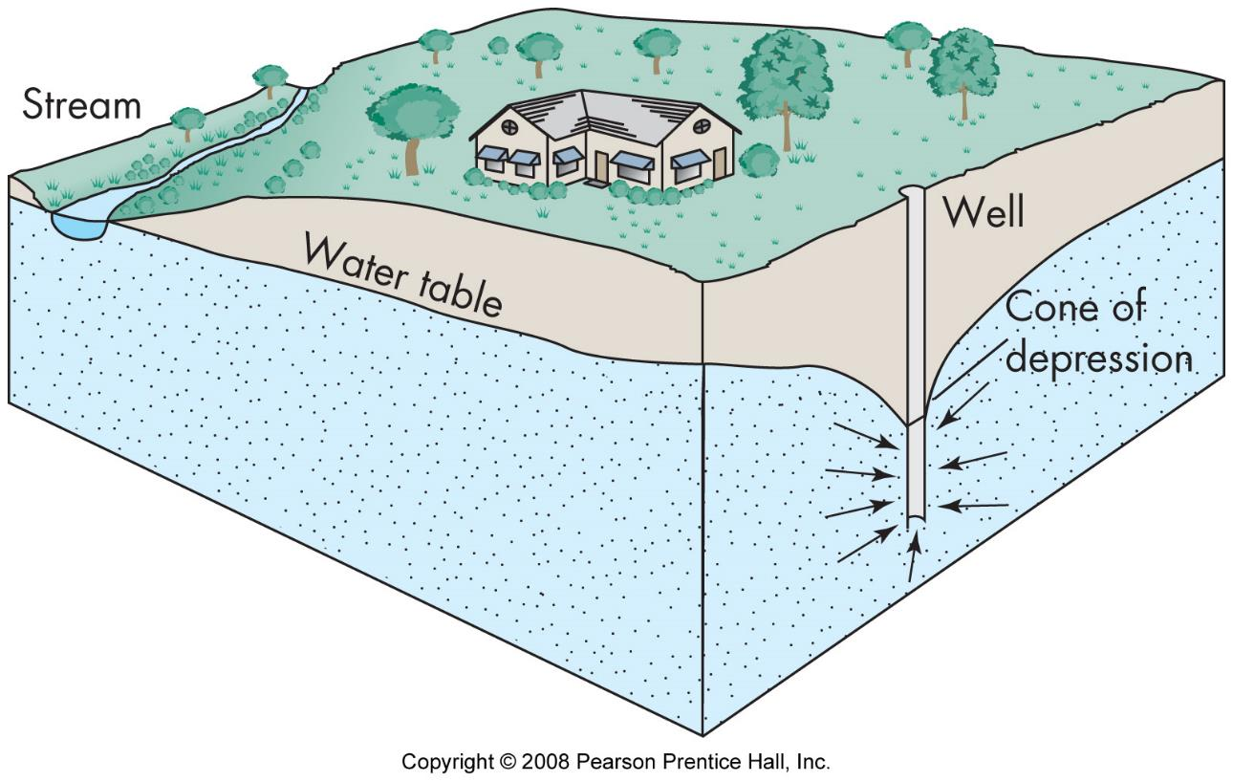
Wells
cone of depression

Slide 17
Wells
cone of depression
artesian wells
yield
sustainable
mining

Slide 18
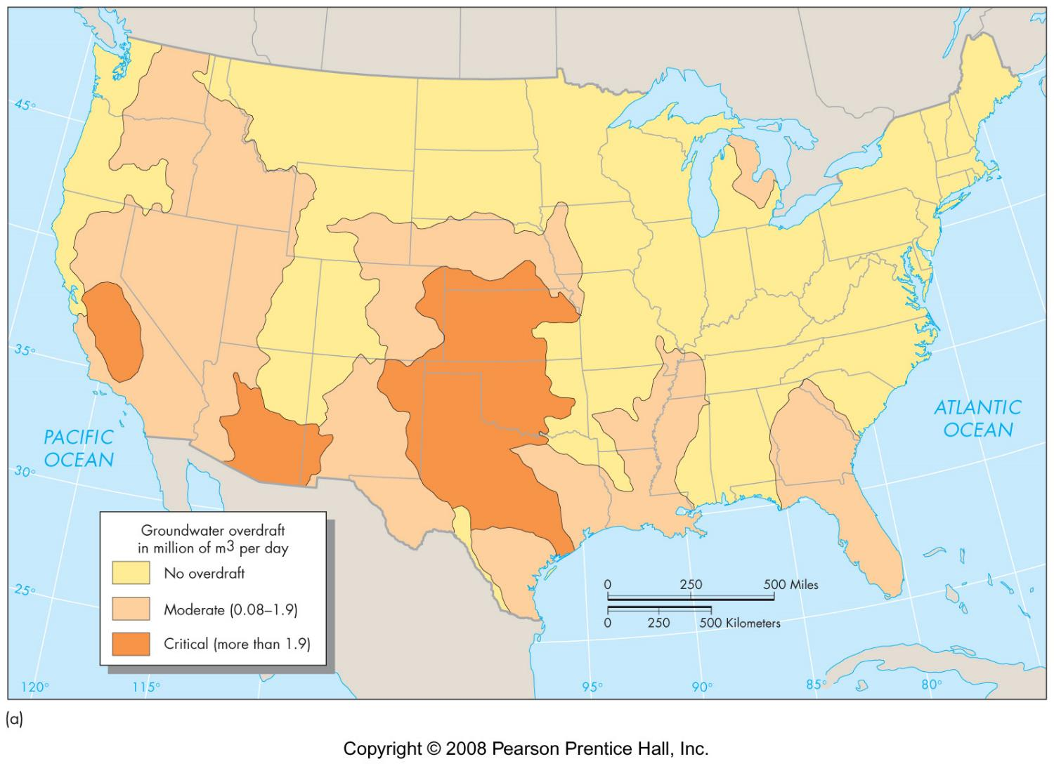
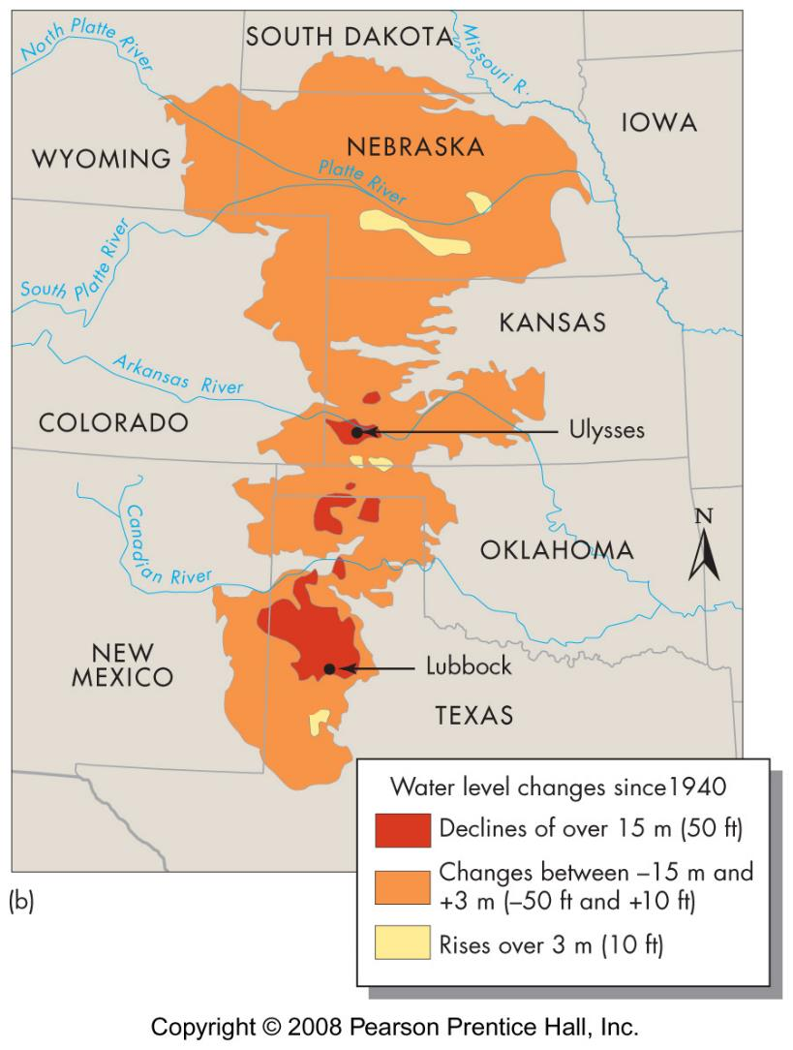

Slide 19
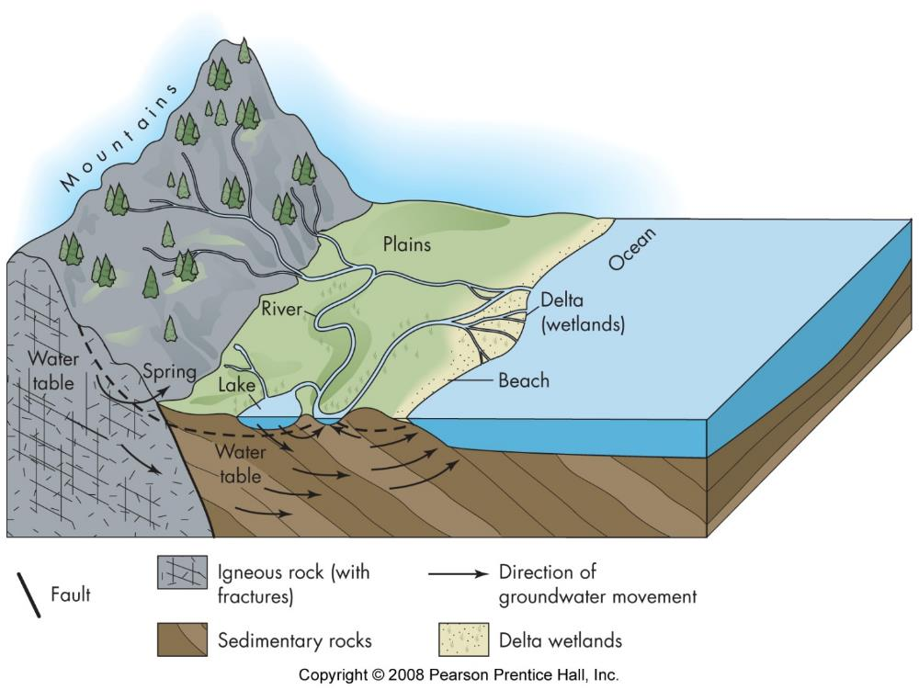
groundwater-surface water interaction
gaining and losing streams
springs

Slide 20
groundwater-surface water interaction
gaining and losing streams
springs
karst
sinkholes
disappearing streams

Slide 21
groundwater-surface water interaction

Slide 22
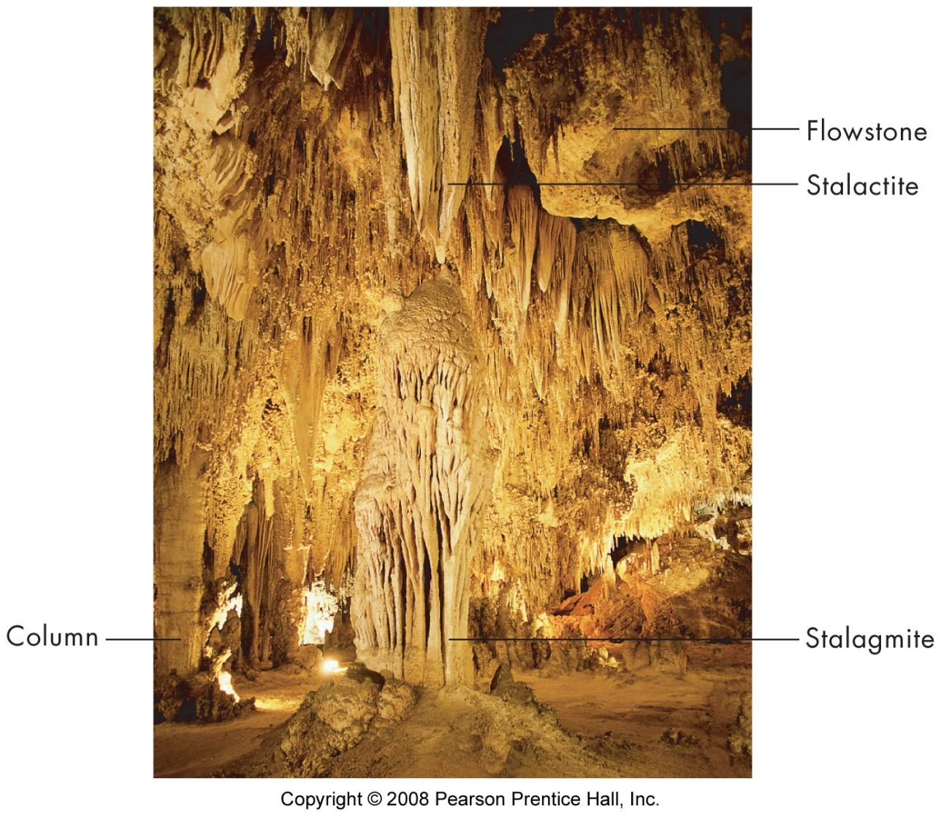

Slide 23
Water supply
Water budget
Input (rain\run on)
output
runoff
withdrawal
subsurface flow
evaporation
transpiration
flood vs drought
https://www.drought.gov

Slide 24
Water Use in the U.S.
Estimated Use of Water in the United States in 2015
https://pubs.er.usgs.gov/publication/cir1441

Slide 25
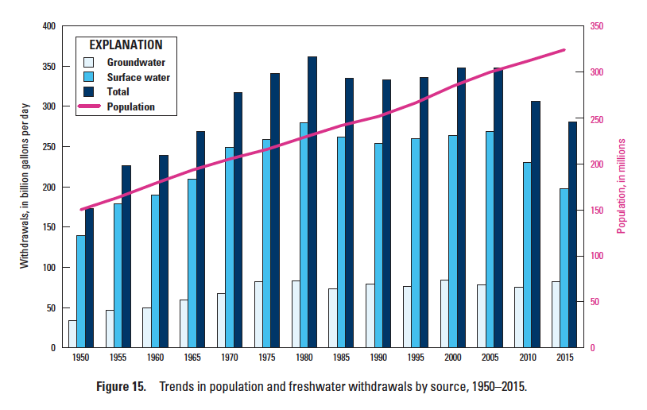
Water Use in the U.S.

Slide 26
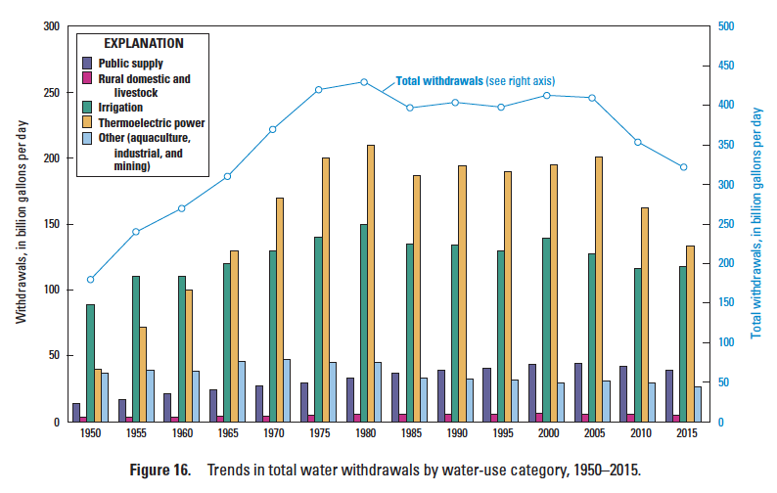
Water Use in the U.S.

Slide 30
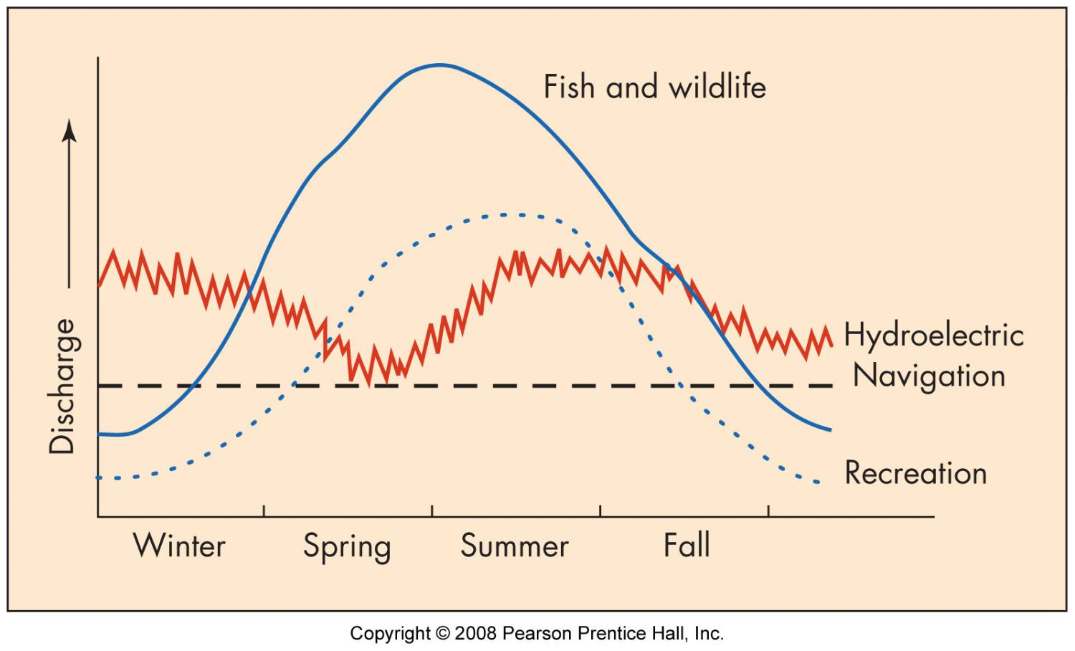
Surface Water Use
in-stream use
navigation
power
habitat
recreation
off-stream
agricultural
residential - (inc. drinking)
industrial & commercial
municipal

Slide 31
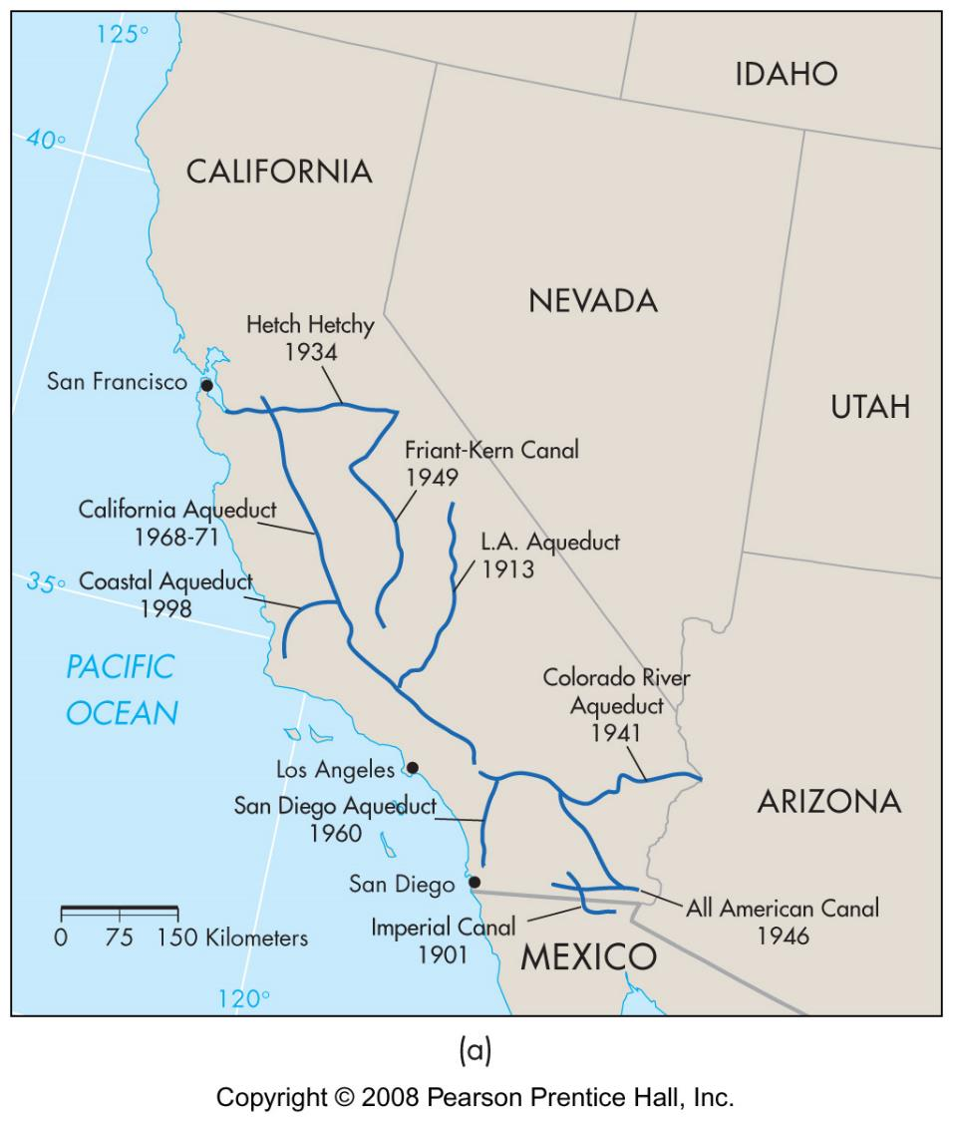
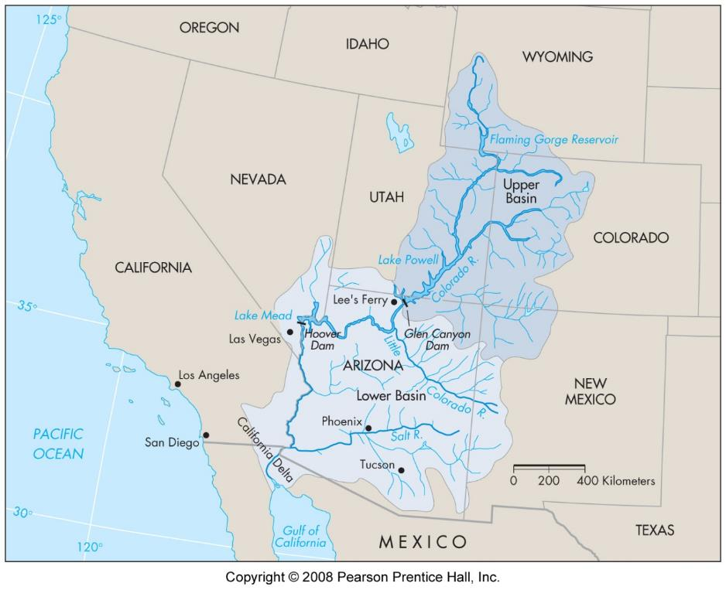
Water management
supply vs demand
volume over time
overdraft
develop supplies
wells
reservoirs
aqueducts
reallocation of use
conservation
increase efficiency
recycling of waste water

Slide 32
Water use issues
out of basin use
consumptive use
sewage
sedimentation

Slide 33
surface water rights
riparian
adjacent landowner
goes with property
east of Miss
prior appropriation
volume per year
separate from other property rights
west of Miss

Slide 34
groundwater rights
absolute ownership (pump at will)
reasonable use
correlative rights
all owners =
safe yield is divided
prior appropriation

