Slide 1
Chapter 18 Geology, Society, and the Future: Selected Examples

Slide 2
Environmental Influences on Health
beneficial vs harmful
dose : response
too much, too little, just right
acute vs chronic response
exposure
natural vs resulting from human activity
ingestion (food, water), inhalation, skin contact

Slide 3
Hazardous Material
dangerous to humans &/or the environment
legal definition
ignitable: flash point below 140$˚$F (60$˚$C)
corrosive (pH <2 or >12.5)
reactive/explosive
toxic
exclusions
include: domestic, radioactive, petroleum

Slide 4
Concepts of Waste Management
dilute and disperse
concentrate and contain
integrated waste management

Slide 5
Integrated Waste Management
Resource recovery
goal: zero waste production
recycle
reuse
Reduce - pay as you throw
Move waste around
Sequential land use (subsequent uses must be limited)
Front end controls
more efficient processes
less packaging

Slide 6
Disposal Methods
Sewer – transfers to treatment facility
Incineration – produces ash and air waste
Composting – recycles organic waste
Landfill – engineered storage site
On-site vs Off-site

Slide 7
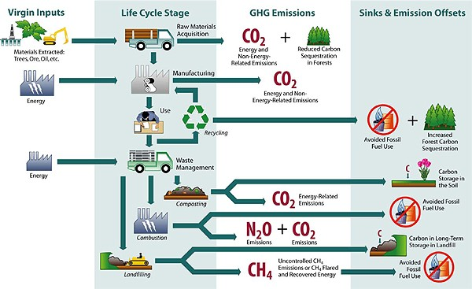

Slide 8
Landfills
Considerations
leachate
methane
rodents & pests
active face - blowing trash
Site selection
local approval
IL PCB - legal requirements
IL EPA - engineering requirements

Slide 9
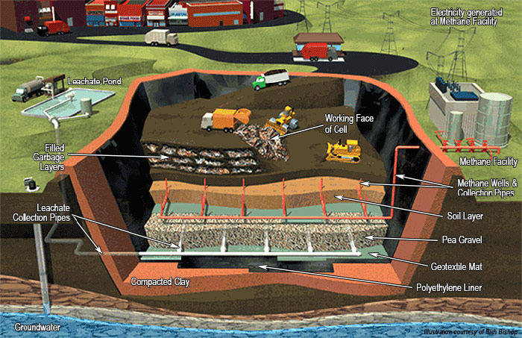
Landfills
Site design
geology
liners
leachate collection and treatment
waste types accepted
monitoring
landfill conditions
migration routes
cells
subsequent monitoring and design

Slide 10
Hazardous Waste Disposal
Waste by-products
Uncontrolled sites - CERCLA
Controlled sites - RCRA
responsible management
cradle to grave
generators
transporters
storage
treatment
disposal

Slide 11
Site Selection and Evaluation Methods
Cost benefits analysis
Physiographic determinism
use map overlays (to show +’s and -’s)
choose best site
use physical, social, aesthetic, etc
Environmental geology mapping
interpretive
may focus on anticipated uses
content based on user
GIS

Slide 12
Site Selection and Evaluation Considerations
Landscape aesthetics - scenic resources
hard to evaluate - subjective
uniqueness - overall scenic
Sequential land use
Multiple land use

Slide 13
Environmental Impact Statement
EIS summary
purpose and need
rigorous comparison of alternatives
description of environment
discussion of consequences
Identification of issues and alternatives
Record of decision
alternatives
which are preferred
rationale
avoidance and/or mitigation required

