Slide 1
Chapter 13: Water Pollution

Slide 2
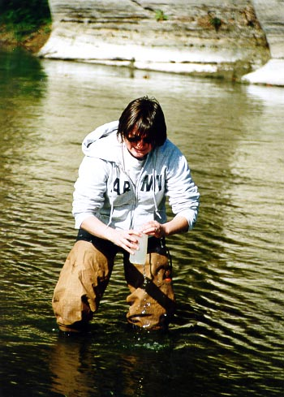
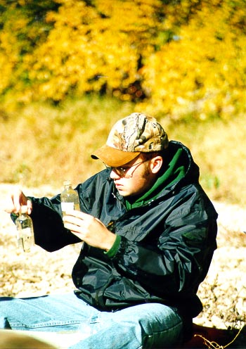

Slide 3
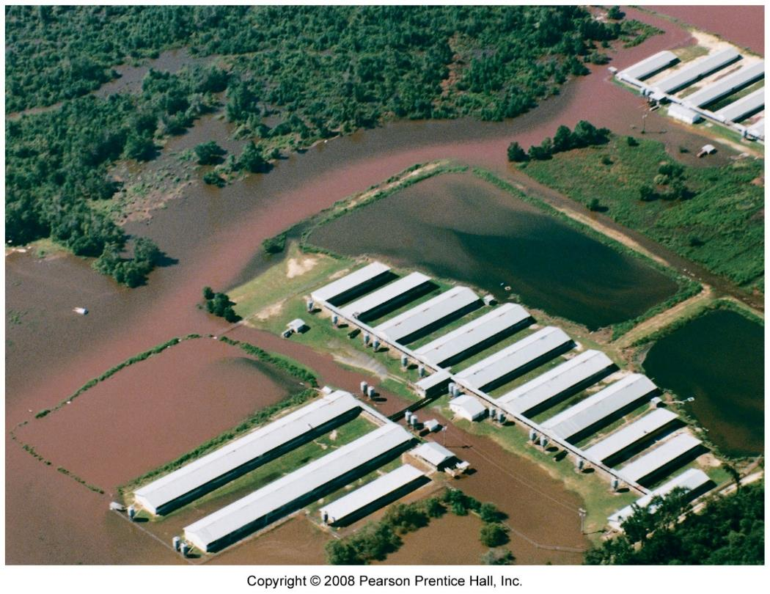
Water pollution
Degradation of water quality
biological
chemical
physical

Slide 4
Pollutants
nutrients
phosphorous
nitrogen (blue baby syndrome)
oil
toxic substances
hazardous chemicals
heavy metals
radioactive material
sediment
thermal

Slide 5
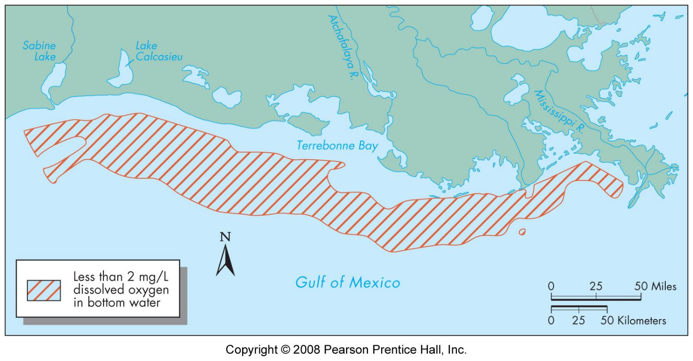
Pollutants
Biochemical oxygen demand
mg/l of O₂ consumed over 5 days at 20°C
agricultural runoff - nutrient
sewage
pathogenic organisms
human disease - cholera and typhoid
Fecal coliform bacteria
threshold 200 cells/100 ml water

Slide 6
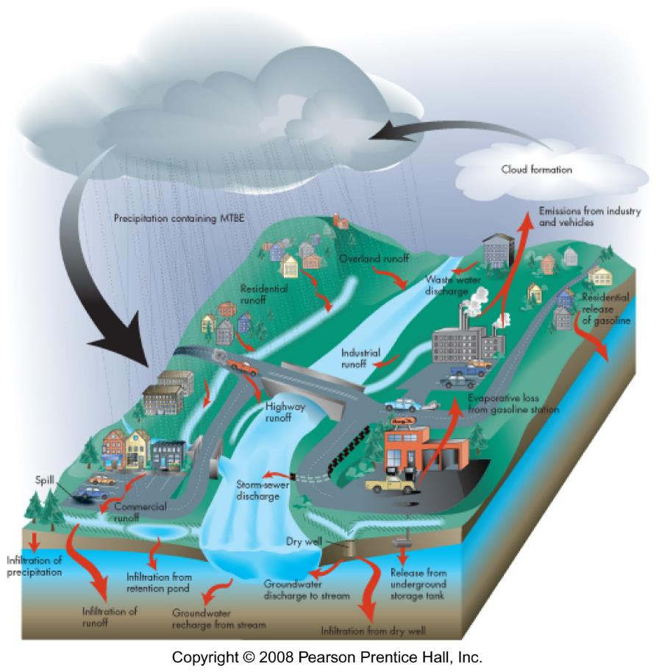
pollutant migration
source
route
target

Slide 7
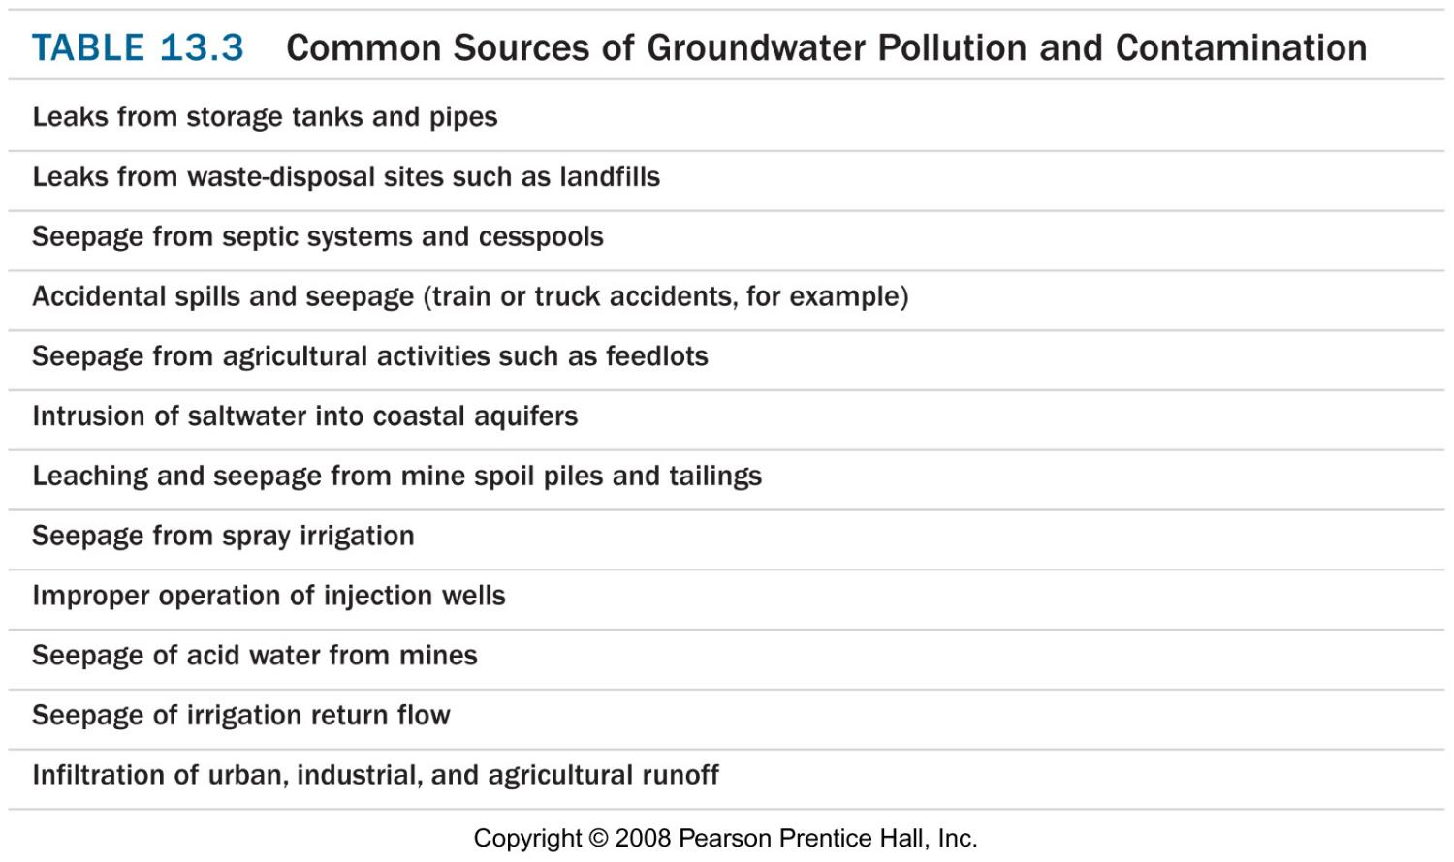
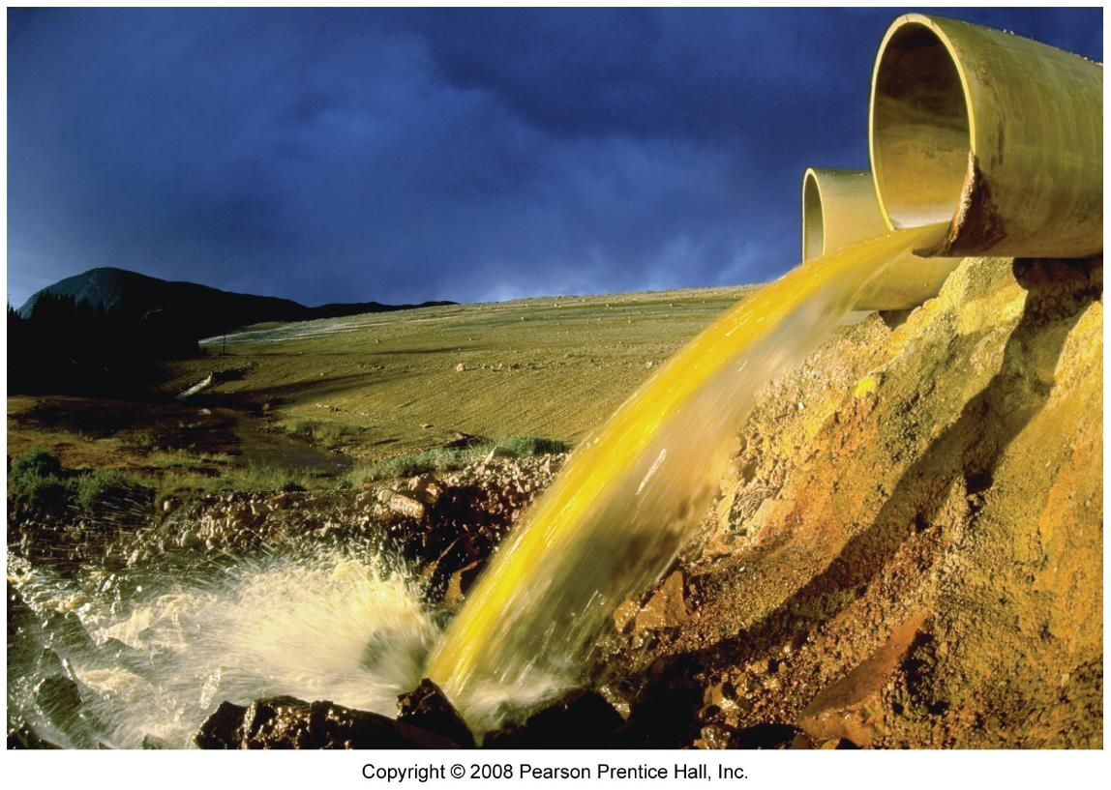
Pollution
source
point
non-point
state
dissolved
not dissolved
sediment borne
release - long term vs single event

Slide 8
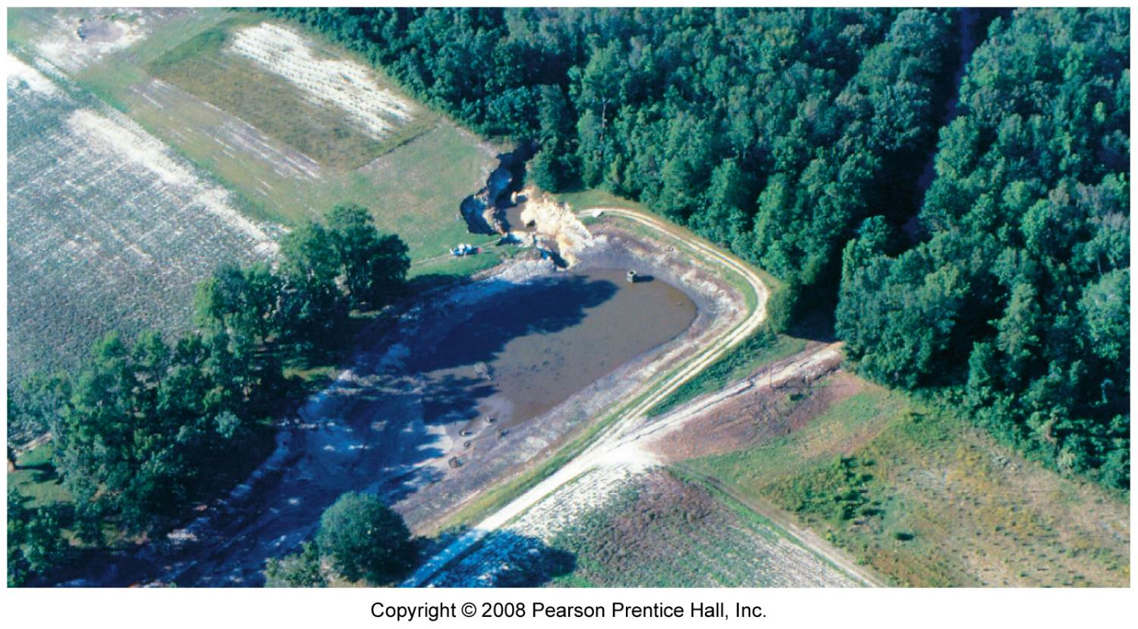
Surface water pollution
routes
direct
washed in
seepage from banks
fate
deposited
diluted
consumed
evaporate

Slide 9
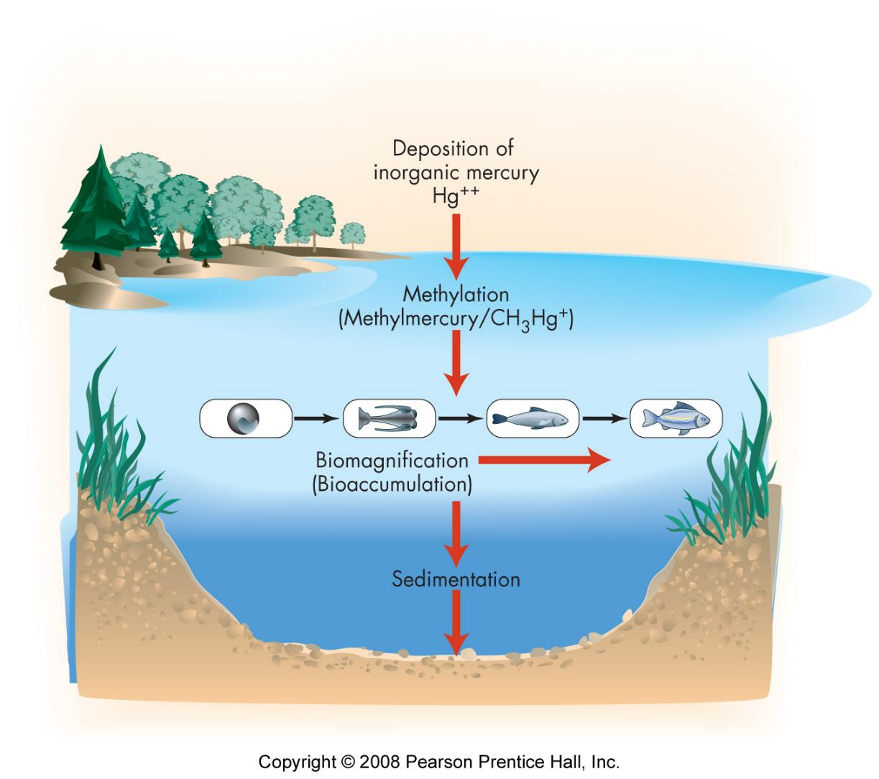
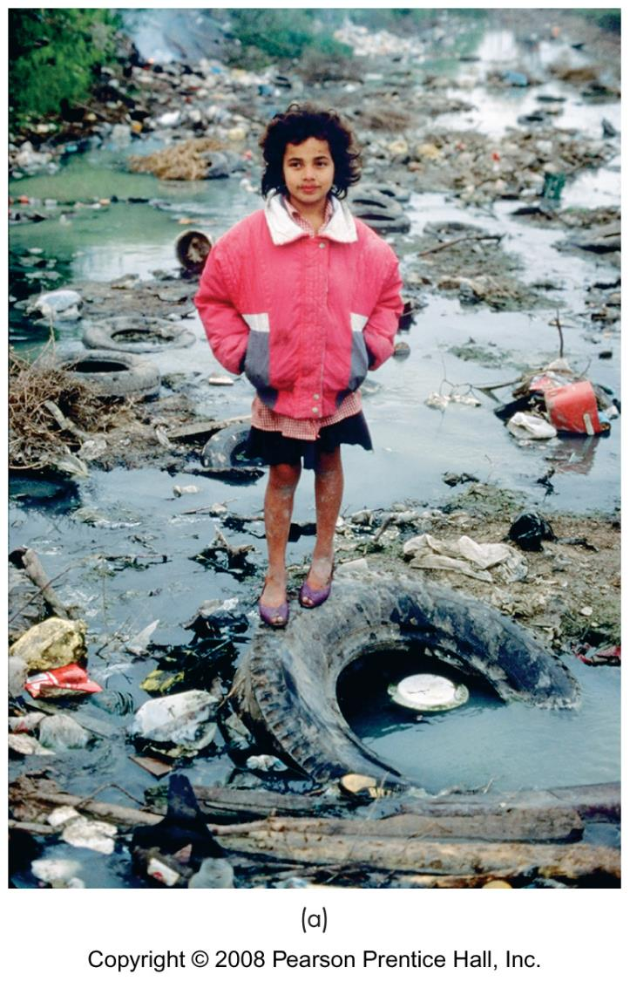
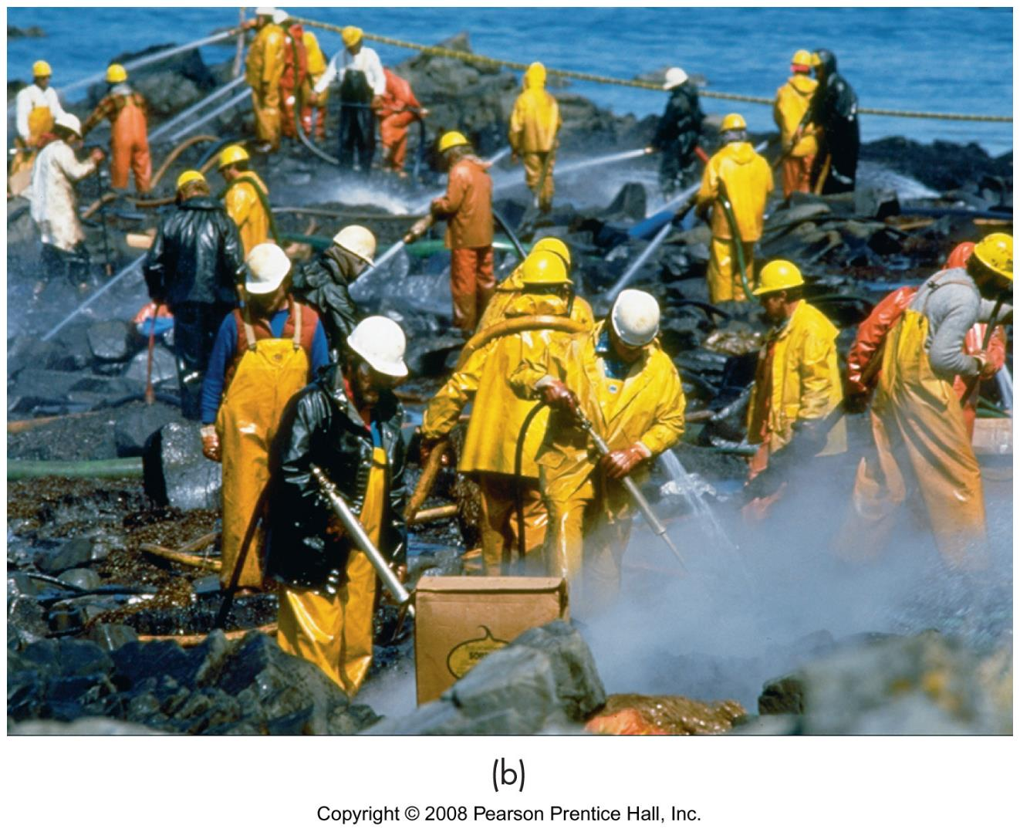
Surface water pollution
effected targets
water supplies
fisheries
ecosystems
remediation
eliminate source
excavate sediment
treat water

Slide 10
Groundwater pollution
route
seepage
leaching
fate
dissolves and disperses
LNAPLS - floats
DNAPLES - sinks
vaporizes
attaches to earth materials

Slide 11
Groundwater pollution
effected targets
wells
surface water
remediation process
site characterization
risk assessment
corrective action

Slide 12
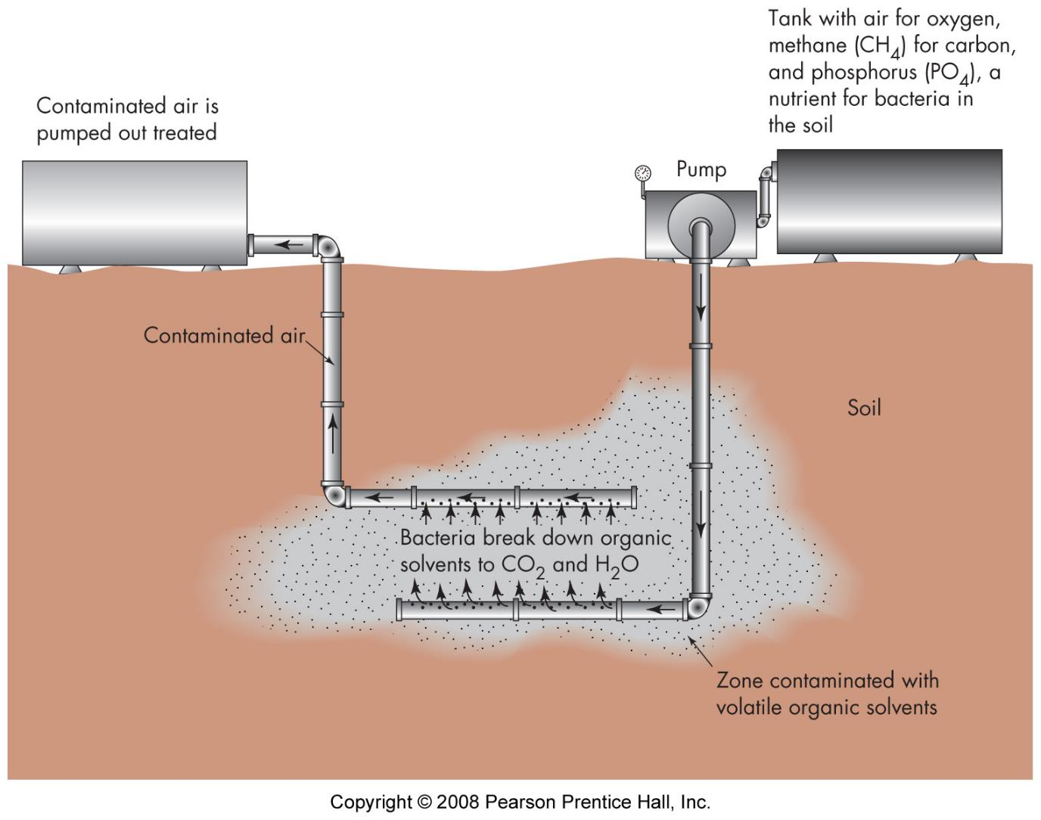
Groundwater pollution: treatment
remove source
clean (impossible?)
GW extraction - smearing wells/trenches
vapor extraction
sparging
bioremediation
treatment beds

Slide 13
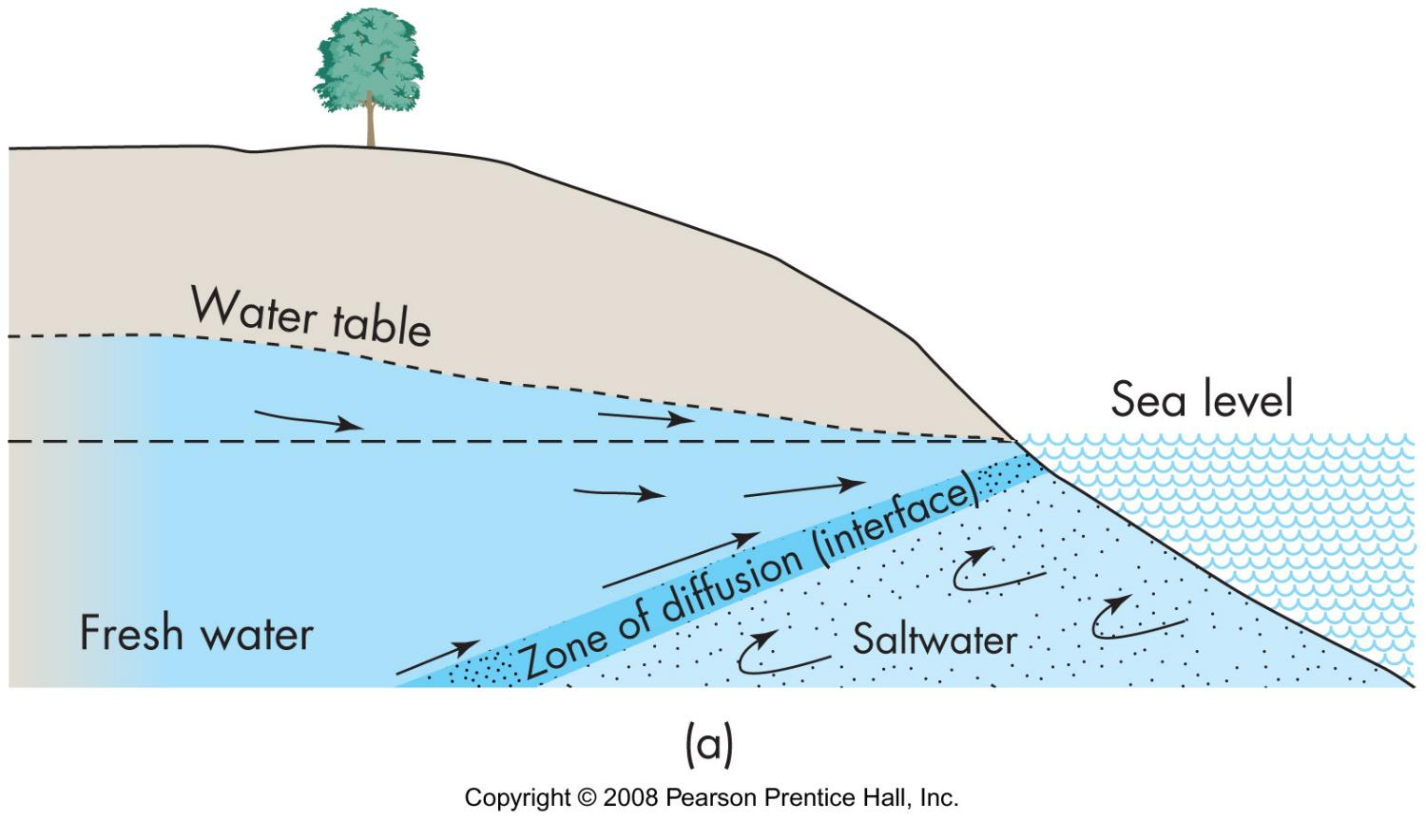
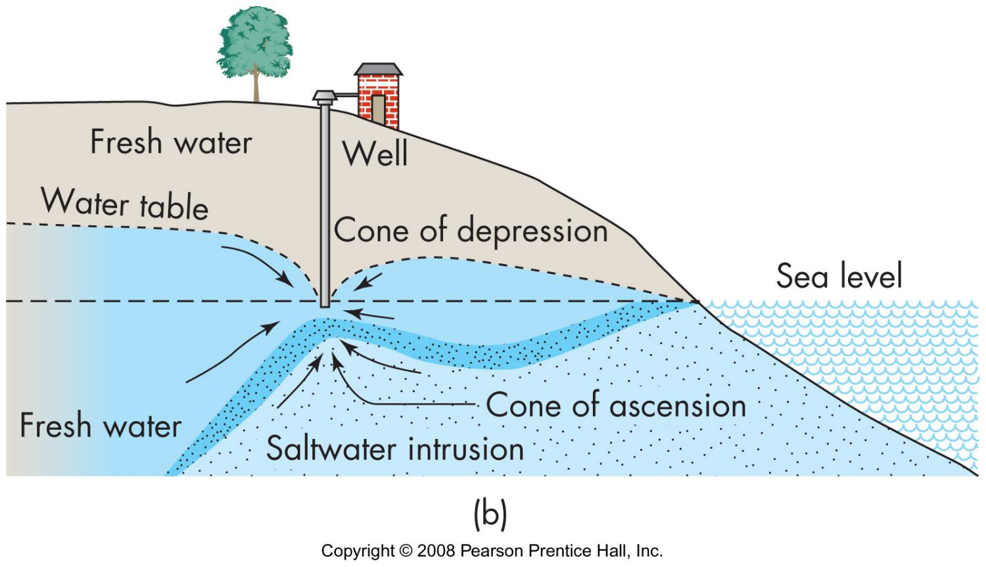
Saltwater intrusion
near coast
fresh water floats on saltwater
rises
drought
withdrawal of fresh water
desalinization (expensive)

Slide 14
water quality standards
set by government
basis
science
economics
ethics
politics

Slide 15
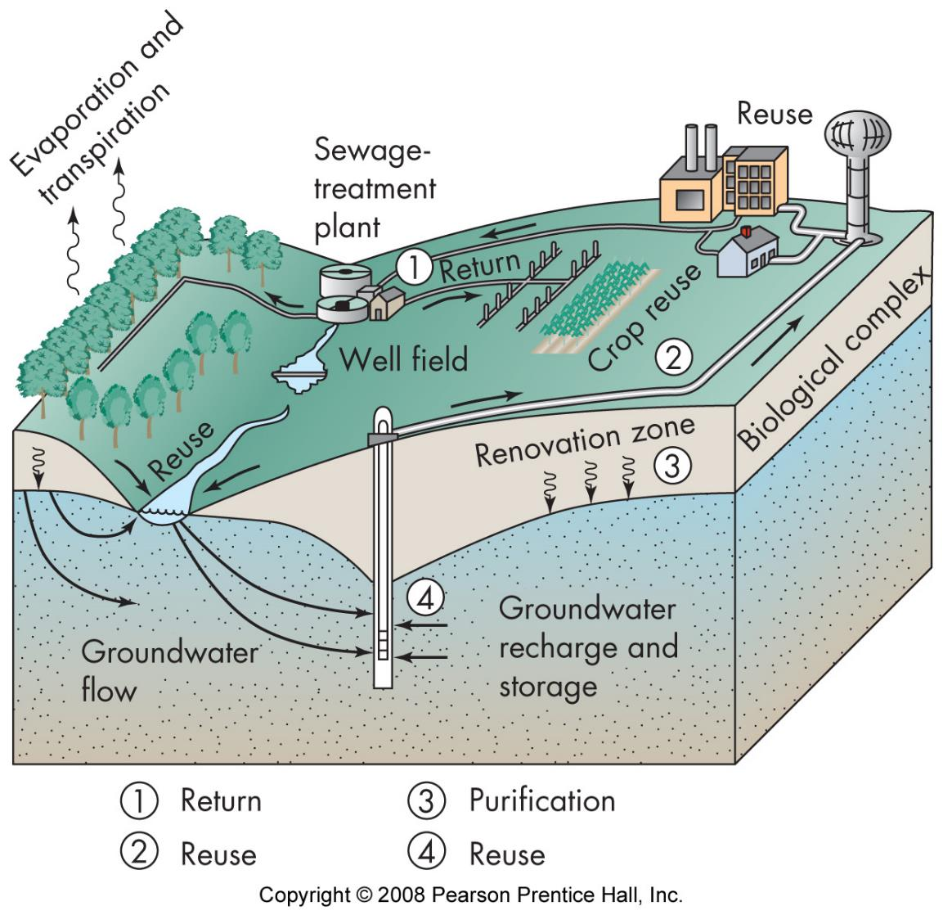
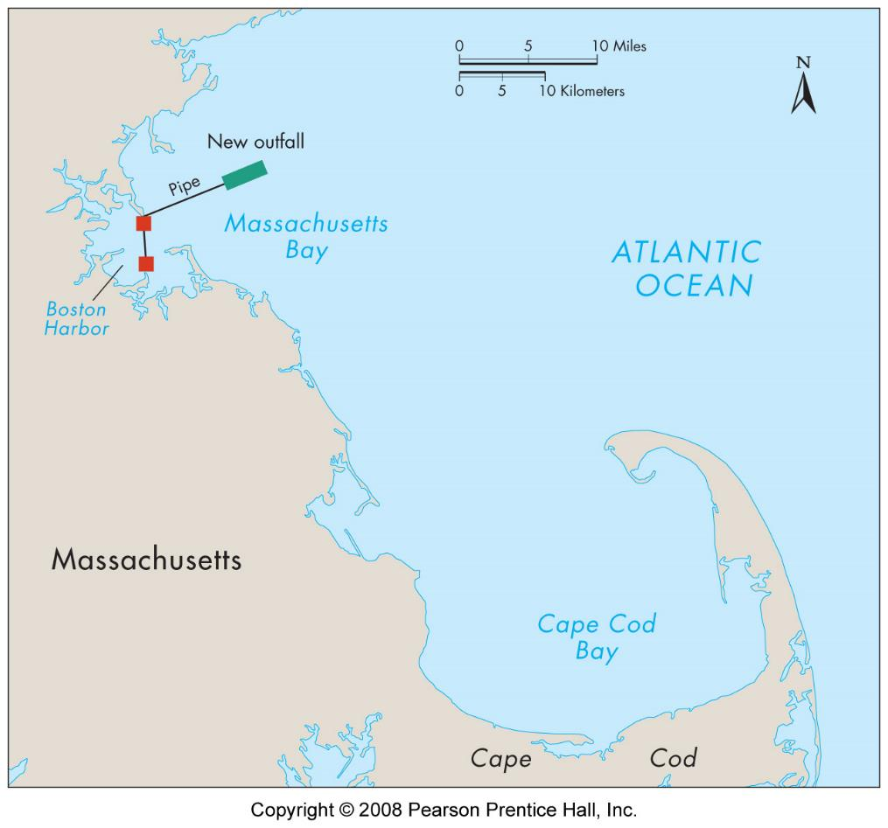
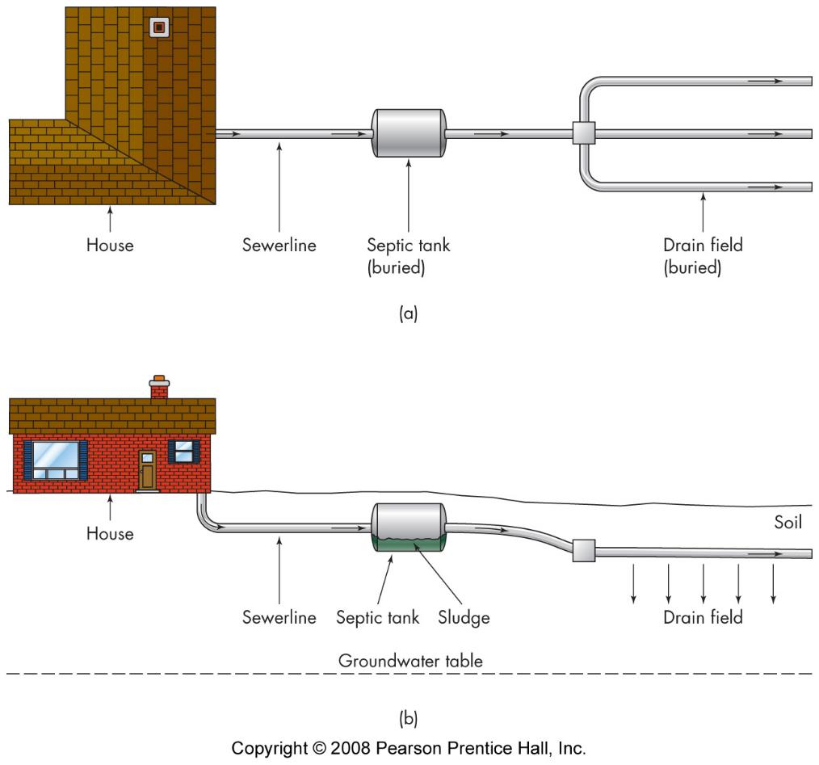
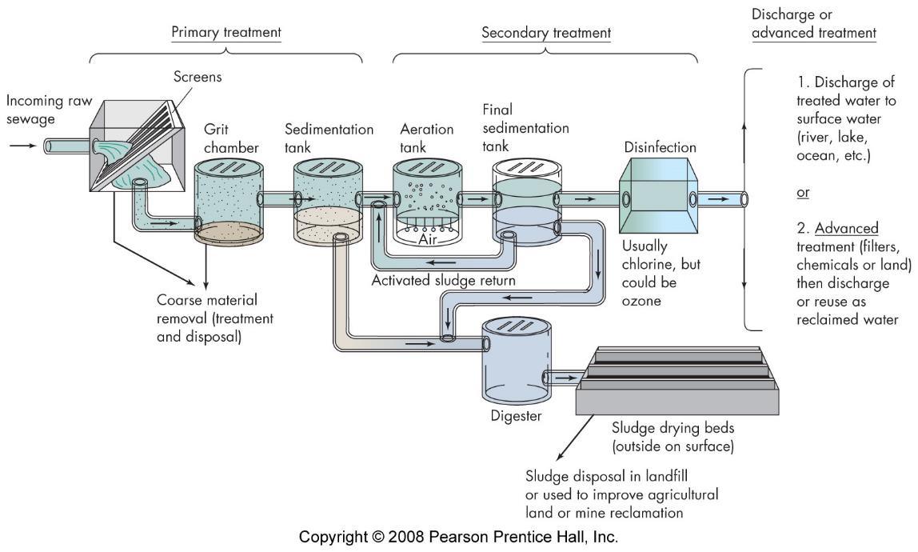
Wastewater treatment
dilute & disperse
large-scale treatment
septic tank
alternatives

